Slide 1
كلية المستقبل الجامعة
قسم الصيدلة
1st course (Blood Physiology)
Introduction
M.sc. Duaa Falah pharmacology and toxicology

Slide 2
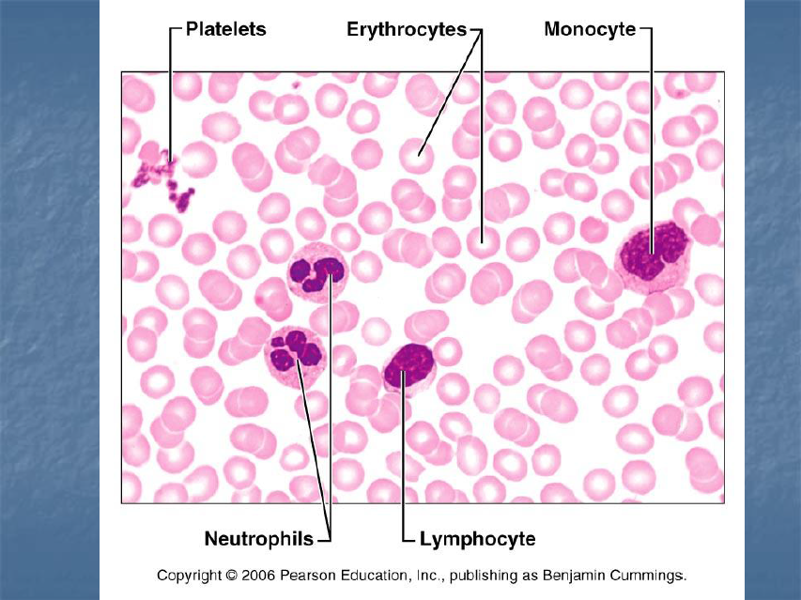

Slide 3
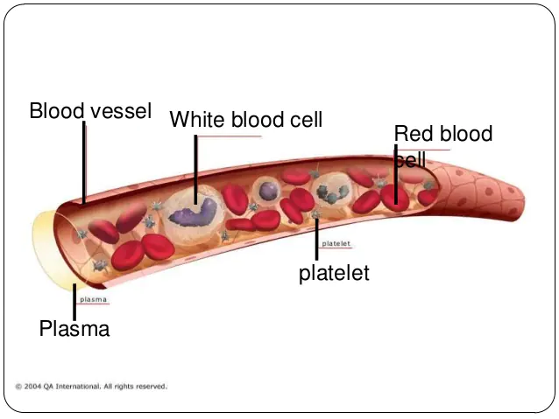

Slide 4
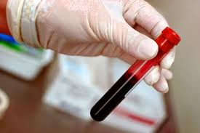
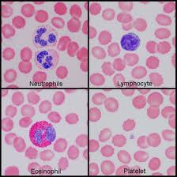
Experiments on the physiology of blood

Slide 8
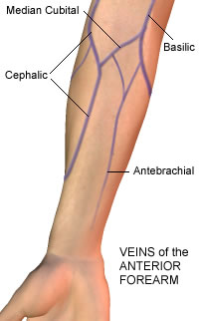
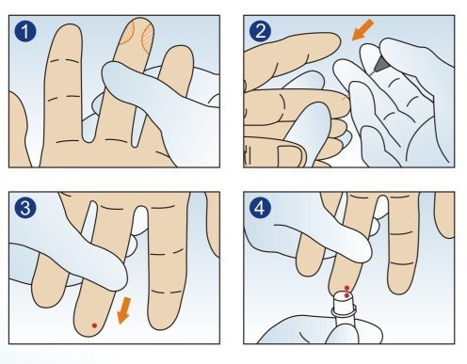
Blood taken either from capillaries or veins
or

Slide 9
Finger prick (blood from capillaries)
Select a site that is warm, pink and free of any cuts, scars or rashes. Avoid skin areas that have evidence of previous punctures.
The recommended site for capillary collection on adults is the palmer surface of the distal (end) segment of the third (middle) or fourth (ring) finger, ideally of the non-dominant hand
Notes:
free of any calluses, burns, cuts, scars, bruises, or rashes.
The site should not be cyanotic (bluish from lack of oxygen), edematous (swollen), or infected
The fifth finger should be avoided*. The side and tip of the finger should be avoided
.
* The distance between the skin surface and the bone in the fifth finger also makes it unsuitable for puncture

Slide 10
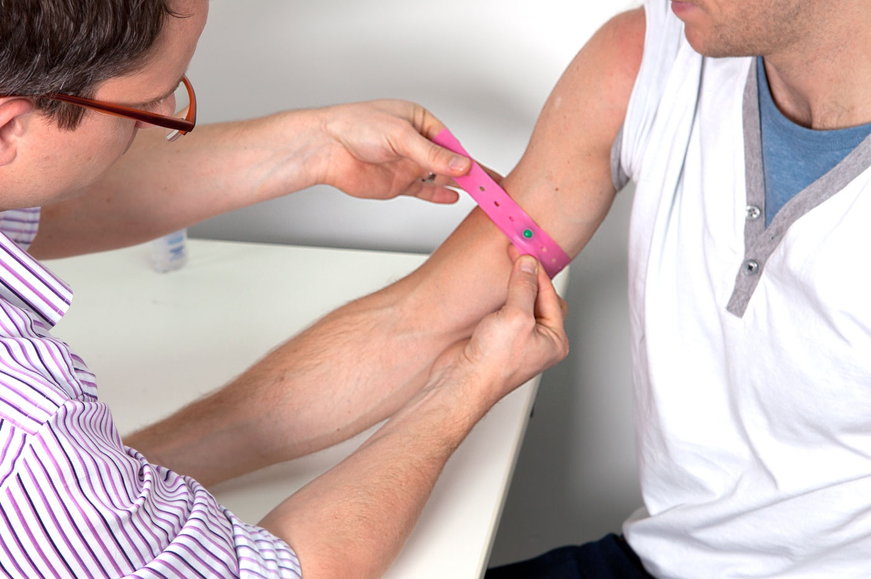
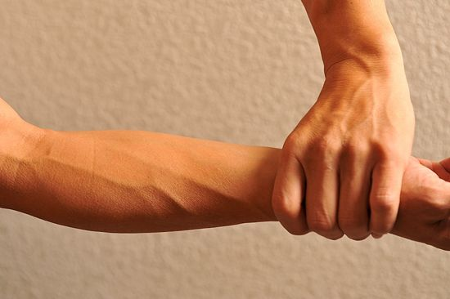
Tourniquet is used before Vein puncture

Slide 11
The compound Microscope

Slide 13
Hemocytometer (Neubauer chamber)

Slide 17
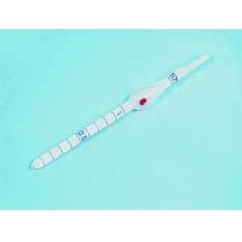
WBC pipette RBC pipette
The Pipettes

Slide 18
RBC pipette

Slide 19
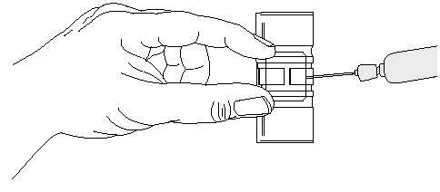

Slide 21
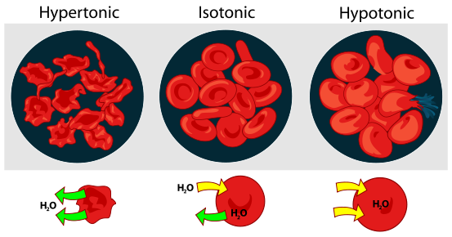
The solution used for dilution must be isotonic, Why?
Notes:
* As commonly used in the medical field, though, isotonic solutions are solutions which have the same concentration of solute as the cells in the human body. A cell placed in an isotonic solution will neither gain nor lose water.
When two aqueous solutions of different concentrations or tonicities are separated by a semi-permeable membrane such as a cell wall, water will migrate from the less concentrated, or hypotonic, side to the more concentrated, or hypertonic, side in an attempt to bring both sides into equilibrium. This process is known as osmosis. The greater the difference in the two solutions' concentrations, the higher the osmotic pressure will be, and the quicker the osmotic transfer will be.

Slide 22
When a solvent passes through a semipermeable membrane from a dilute solution into a more concentrated one, the concentrations become equalized and the phenomenon is known as osmosis.
• The pressure responsible for this phenomenon is termed osmotic pressure and varies with the nature of the solute.

Slide 23
Laboratory precaution
Wear your white coats.
It is better to perform the experiment of blood on your own blood.
Sterilize the tip of your finger with alcohol before pricking.
Clean all instrument after use, before leaving the lab.
It is better to be vaccinated with hepatitis virus vaccine
Wash your hands before leaving the lab.

Slide 24
Commonly used conversion factors for volumes:
1 Liter (L) = 1000 milliliters (ml)
= 1000 cubic centimeters (cc)
1 liter (1000 cc)

Slide 25
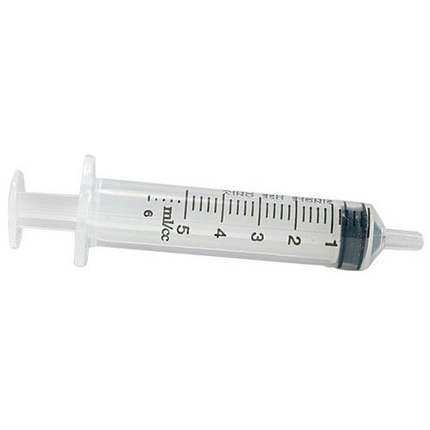
1 milliliter = 1 cubic centimeter (cm 3) ((1 ml = 1 cc
1cc

Slide 26
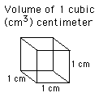
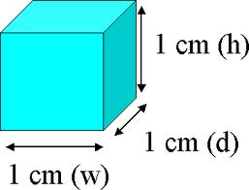
What is cubic centimeter (cc)?
We want the number of blood cells in 1 cubic millimeter (c.mm)
→

Slide 27
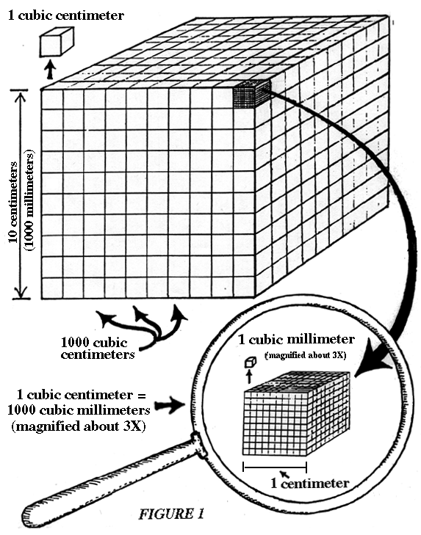
1 cc (1 ml)= 1000 cubic millimeters
(c.mm)
→ 1 c.mm = 1 microliter

Slide 28
Thank you

