Slide 1
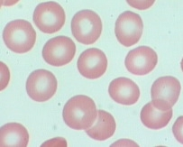
Red Blood Cell Physiology
Dr Rawa Majid Mohammed

Slide 2
Learning Objectives
Morphological Features of RBCs
Functions of the RBCs
Hematological Indices

Slide 3
Red Blood Cells
RBC are also known as erythrocytes or red blood corpuscles as it contains haemoglobin which turns red on binding with oxygen.
It also carries carbon dioxide away from tissues to lungs.
It contains certain antigens on its surface membrane that determine blood groups and makes basis of whole blood transfusion physiology.

Slide 4
Red Blood Cells
Clinical Application :
Since RBC uses glucose constantly from plasma,
whenever blood glucose level is to be tested, the sample is taken in the fluoride vial

Slide 5
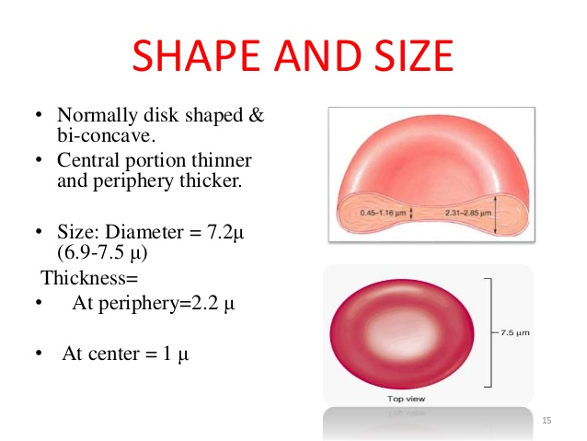
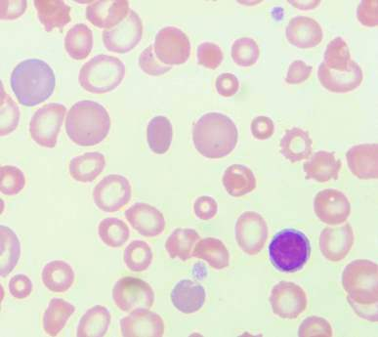
Red Blood Cells- Morphology-Size
RBCs are anucleated discs
RBC count : 4-6 million/mm³,
Life span - 120 days.
Central pallor is seen due to presence of less haemoglobin molecule in the centre.
Size – Diameter: 7-7.8 µm,
Thickness at the periphery-2.2 µm and
Centre - 1 µm

Slide 6
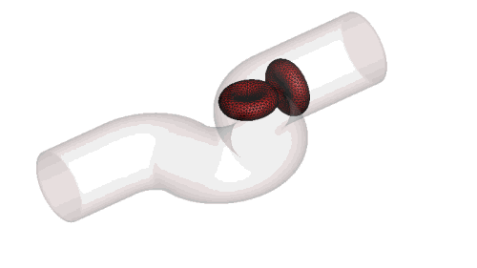
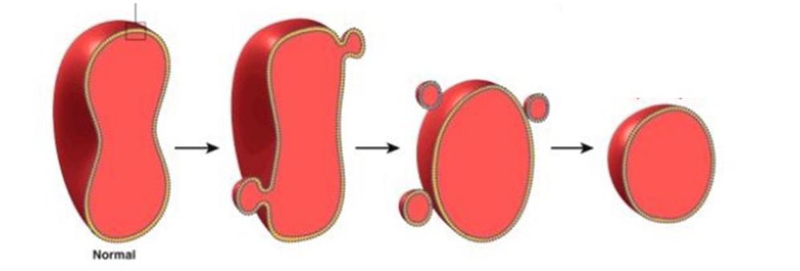
Red Blood Cells- Shape
Shape - Normal biconcave disc
Biconcave shape has many advantages:
1. Flexibility RBCs
2. Greater surface area/volume ratio

Slide 7
Red Blood Cells- Normal values
RBCs Count-4-6 million/mm ³
Hb content-14-16 gm/dl
O₂ carrying Capacity of blood-1 gm Hb binds to 1.34 ml of O₂
PCV=45±2 ml/100 ml of blood

Slide 8
Hematological Indices
Red blood cell indices are blood tests that provide information about the average volume or size (MCV) and hemoglobin content (MCH, MCHC) of red blood cell.

Slide 9
Thank you

