Slide 1
Carbohydrate metabolism & diabetes mellitus
Dr. Shaimaa Munther

Slide 2
General introduction
Carbohydrates are present in food in various forms:
1. simple sugars
- monosaccharides
2. complex chemical units
- disaccharides
- polysaccharides
Processing of carbohydrates in GIT
Ingested carbohydrates → cleaving proces →
→ monosaccharides → absorbtion in stomach,
duodenum and proximal jejunum

Slide 3
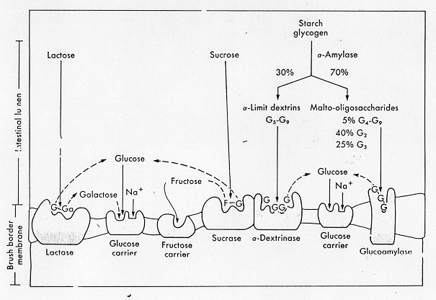
Notes:
Most of our ingested carbohydrates are polymers, such as starch and glycogen.
Salivary amylase and pancreatic amylase are responsible for the digestion of these nonabsorbable polymers to dextrins and disaccharides, which are further hydrolyzed to monosaccharides by maltase, an enzyme released by the intestinal mucosa.
Sucrase and lactase are two other important gut-derived enzymes that hydrolyze sucrose to glucose and fructose and lactose to glucose and galactose.
When disaccharides are converted to monosaccharides, they are absorbed by the gut and transported to the liver by the hepatic portal venous blood supply.

Slide 4
GLUT (Glucose transporter isoform 1-14)
GLUT-1 (Erythrocyte and Brain)
GLUT-2 (Liver, Kidney &
β-cells/ Pancreas)
GLUT-3 (Neurons)
GLUT-4 (Adipose tissue & skeletal muscles)
GLUT-5 (Transports fructose small intestine & testes)

Slide 5
Glucose Metabolism
Glucose is a primary source of energy for humans. The nervous system, including the brain, totally depends on glucose for energy.
Nervous tissue cannot concentrate or store carbohydrates; therefore, it is critical to maintain a steady supply of glucose to the tissue. For this reason, the concentration of glucose in the ECF must be maintained in a narrow range.
When the concentration falls below a certain level, the nervous tissue loses the primary energy source and are incapable of maintaining normal function.

Slide 6
Notes:
Glucose Metabolism
Glucose Metabolic pathways
After glucose enters the cell, it is quickly shunted into one of three possible metabolic pathways, depending on the availability of substrates or the nutritional status of the cell.
The ultimate goal of the cell is
1-to convert glucose to carbon dioxide and water.
2- During this process, the cell obtains the high-energy molecule adenosine triphosphate (ATP) from inorganic phosphate and adenosine diphosphate (ADP).
Note/ The cell requires oxygen for the final steps in the electron transport chain (ETC).
Nicotinamide adenine dinucleotide (NAD) in its reduced form (NADH) will act as an intermediate to couple glucose oxidation to the ETC in the mitochondria where much of the ATP is gained.
The first step for all three pathways requires glucose to be converted to glucose-6-phosphate using the high energy molecule, ATP. This reaction is catalyzed by the enzyme hexokinase (Fig. 13-8).
Glucose metabolic pathways :
1- Hexose monophosphate pathway
2- Hexose monophosphate shunt (HMP shunt)
3- Glucose storage (glycogenesis)

Slide 7
Regulation of Carbohydrate Metabolism
The liver, pancreas, and other endocrine glands are all involved in controlling the blood glucose concentrations within a narrow range.
During a brief fast, glucose is supplied to the ECF from the liver through glycogenolysis.
When the fasting period is longer than 1 day, glucose is synthesized from other sources through gluconeogenesis.

Slide 8
Control of blood glucose is under two major hormones:
Insulin and glucagon, both produced by the pancreas, permitting the body to respond to increased demands for glucose or to survive prolonged fasts. It also permits the conservation of energy as lipids when excess substrates are ingested.
Insulin is the primary hormone responsible for the entry of glucose into the cell of muscle and adipose tissue and increased glucose metabolism.
It is synthesized by the B- cells of islets of Langerhans in the pancreas. When these cells detect an increase in plasma glucose, they release insulin, and is not released when glucose levels are decreased.
It also regulates glucose by increasing glycogenesis, lipogenesis, and glycolysis and inhibiting glycogenolysis.
Note/ Insulin is the only hormone that decreases glucose levels and can be referred to as a hypoglycemic agent

Slide 10
Control of blood glucose is under two major hormones:
Glucagon is the primary hormone responsible for increasing glucose levels
( hyperglycemic hormone )
It is synthesized by the alpha - cells of islets of Langerhans in the pancreas and released during stress and fasting states.
When these cells detect a decrease in body glucose, they release glucagon, & increasing plasma glucose levels by glycogenolysis in the liver and an increase in gluconeogenesis.

Slide 11
Insulin EFFRCTS ON ORGANS
Anabolic in response to hyperglycemia
Liver
Stimulates glycogen synthesis, glycolysis, and fatty acid synthesis
Muscle
Stimulates glycogen synthesis
Adipose
Stimulates lipoprotein lipase resulting in uptake of fatty acids from chylomicrons and VLDL
Stimulates glycolysis for glycerol phosphate synthesis (precurser to triglycerides)

Slide 12
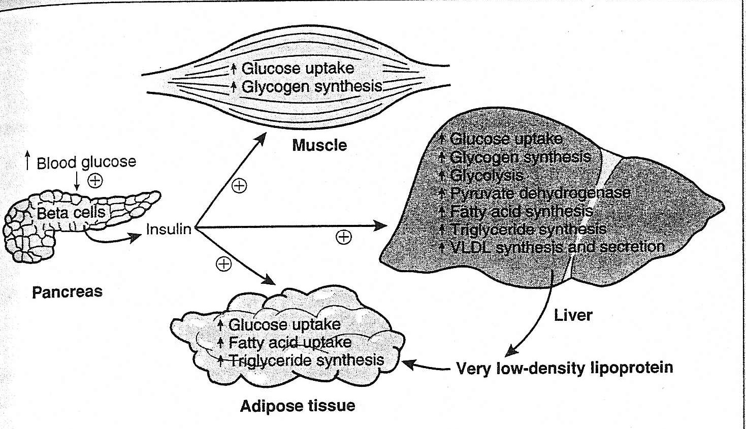
Role in insulin in lowering blood glucose

Slide 13
Glucagon EFFRCTS ON ORGANS
Catabolic, in response to hypoglycemia
Liver
Activates glycogen degradation, & gluconeogenesis
Adipose
Stimulates lipolysis and release of fatty acids

Slide 14
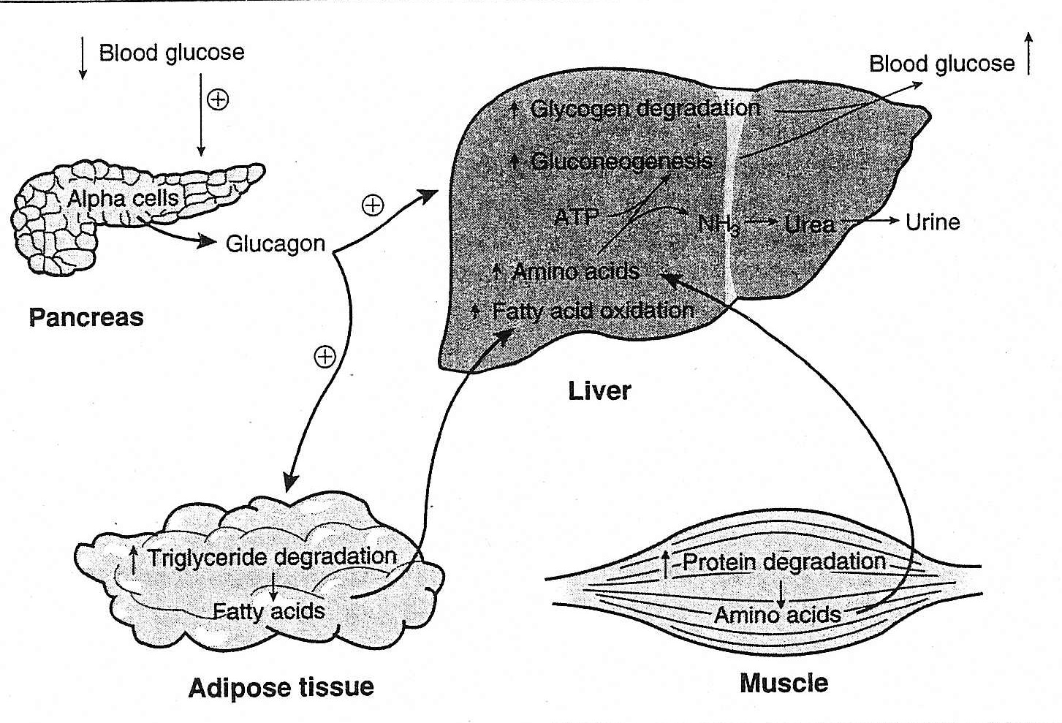
Role of glucagon in increasing blood glucose levels

Slide 15
Other hormones or factors affect blood glucose level
Two hormones produced by the adrenal gland affect carbohydrate metabolism. Epinephrine & Glucocorticoids
Epinephrine is released during times of stress, produced by the adrenal medulla, increases plasma glucose by inhibiting insulin secretion, increasing glycogenolysis, and promoting lipolysis.
Glucocorticoids, primarily cortisol, are released from the adrenal cortex on stimulation by adrenocorticotropic hormone (ACTH).
Cortisol increases plasma glucose by :
Increase gluconeogenesis
Increase intestinal absorption
Decrease glucose entry into cell
Increasing lipolysis.

Slide 16
Other hormones or factors affect blood glucose level
Two anterior pituitary hormones, growth hormone and ACTH, promote increased plasma glucose.
Growth hormone increases plasma glucose by decreasing the entry of glucose into the cells and insulin antagonism.
Its release from the pituitary is stimulated by decreased glucose levels and inhibited by increased glucose.

Slide 17
Other hormones or factors affect blood glucose level
Two other hormones affect glucose levels: thyroxine and somatostatin.
The thyroid gland is stimulated by the production of thyroid-stimulating hormone (TSH) to release thyroxine that increases plasma glucose levels by increasing glycogenolysis, gluconeogenesis, and intestinal absorption of glucose.
Somatostatin, produced by the D cells of the islets of Langerhans of the pancreas, increases plasma glucose levels by the inhibition of insulin, glucagon, growth hormone, and other endocrine hormones.

Slide 18
HYPERGLYCEMIA
Hyperglycemia is an increase in plasma glucose levels.
In healthy patients, during a hyperglycemia state, insulin is secreted by the B cells of the pancreatic islets of Langerhans. Insulin enhances membrane permeability to cells in the liver, muscle, and adipose tissue.
Hyperglycemia, or increase plasma glucose levels, is caused by an imbalance of hormones.

Slide 19
Diabetes Mellitus ( D.M.)
Diabetes mellitus is actually a group of metabolic diseases characterized by hyperglycemia resulting from Defects in insulin secretion, insulin action, or both.
In 1979, the National Diabetes Data Group developed a classification and diagnosis scheme for diabetes mellitus.
This scheme included dividing diabetes into two broad categories:
Type 1, insulin-dependent diabetes mellitus (IDDM);
Type 2, non–insulin-dependent diabetes mellitus (NIDDM).

Slide 20
The International Expert Committee on the Diagnosis and Classification of Diabetes Mellitus, working under the sponsorship of the American Diabetes Association, was given the task of updating the 1979 classification system into:

Slide 21
Type 1 diabetes is characterized by inappropriate hyperglycemia, primarily a result of pancreatic islet B cell destruction and a tendency to ketoacidosis.
Type 2 diabetes, in contrast, includes hyperglycemia cases that result from insulin resistance with an insulin secretory defect.
gestational diabetes mellitus Use of the term impaired glucose tolerance to indicate glucose tolerance values above normal but below diabetes levels for women who develop glucose intolerance during pregnancy.

Slide 22
Type 1 diabetes mellitus
Type 1 constitutes only 10% to 20% of all cases of diabetes and commonly occurs in childhood and adolescence
Upper limit of 110 mg/dL on the fasting plasma glucose is designated as the upper limit of normal blood glucose.
Characteristics of type 1 diabetes include abrupt onset, insulin dependence, and ketosis tendency. This diabetic type is genetically related.

Slide 23
Pathophysiology
Causes :
Different causative factors as it is a result of cellular-mediated autoimmune destruction of the B cells of the pancreas, causing an absolute deficiency of insulin secretion.
One or more of the following markers are found in 85% to 90% of individuals with fasting hyperglycemia: islet cell autoantibodies, insulin autoantibodies, glutamic acid decarboxylase autoantibodies, and tyrosine phosphatase IA-2 and IA-2B autoantibodies.
This disease is usually initiated by an environmental factor or infection (usually a virus) in individuals With a genetic predisposition and causes the immune destruction of the B cells of the pancreas and, therefore, a decreased production of insulin.

Slide 24
Signs and symptoms
Signs and symptoms include :
polydipsia (excessive thirst)
polyphagia (increased food intake)
polyuria (excessive urine production)
Rapid weight loss, hyperventilation, mental confusion, and possible loss of consciousness.
Complications: include:
microvascular problems such as nephropathy , neuropathy, and retinopathy.
Increased heart disease is also found in patients with diabetes.
Notes:
Idiopathic type 1 diabetes is a form of type 1 diabetes that has no known etiology, is strongly inherited, and does not have B cell autoimmunity. Individuals with this form of diabetes have episodic requirements for insulin replacement.

Slide 25
Type 2 diabetes mellitus
Is characterized by hyperglycemia as a result of an individual’s resistance to insulin with an insulin secretory defect.
This resistance results in a relative, not an absolute, insulin deficiency.
Type 2 constitutes the majority of the diabetes cases. Most patients in this type are obese or have an increased percentage of body fat distribution in the abdominal region. This type of diabetes often goes undiagnosed for many years and is associated with a strong genetic predisposition, with patients at increased risk with an increase in age, obesity and lack of physical exercise.'

Slide 26
Type 2 diabetes mellitus
Characteristics usually include adult onset of the disease and milder symptoms than in type 1, with ketoacidosis seldom occurring.
However, these patients are more likely to go into a hyperosmolar coma and are at an increased risk of developing macrovascular and microvascular complications.

Slide 27
Gestational diabetes mellitus (GDM)
Defined as diabetes mellitus that develops during pregnancy
GDM associated with increased incidence of neonatal morbidity, including hypocalcemia, hypoglycemia, perinatal complications associated with maternal hyperglycemia
GDM mothers are at increased risk of developing diabetes (incidence of 60% by 15 years after parturition)
Screening is recommended to be performed between 24 and 28 weeks on all women not previously identified as having glucose intolerance
a. 50 grams oral glucose given in the morning after 8-14 hr fast
b. Measure plasma glucose at 1 hour post dose
c. If abnormal (>140 mg/dl) then OGTT indicated with 100 gram oral
glucose load on different day
Notes:
Gestational diabetes GDM is “any degree of glucose intolerance with onset or first recognition during pregnancy.” Glucosuria can also occur after the renal tubular transporter system for glucose becomes saturated. This happens when the glucose concentration of plasma exceeds roughly 180 mg/dL in an individual with normal renal function and urine output.
As hepatic glucose overproduction continues, the plasma glucose concentration reaches a plateau around 300 to 500 mg/dL (17–28 mmol/L). Provided renal output is maintained, glucose excretion will match the overproduction causing the plateau.
Causes of GDM include metabolic and hormonal changes.
Patients with GDM frequently return to normal postpartum. However, this disease is associated with increased complications and an increased risk for development of diabetes in later years.
Infants born to mothers with diabetes are at increased risk for respiratory distress syndrome, hypocalcemia, and hyperbilirubinemia. Fetal insulin secretion is stimulated in the neonate of a mother with diabetes. However, when the infant is born and the umbilical cord is severed, the infant’s oversupply of glucose is abruptly terminated, causing severe hypoglycemia.

Slide 28
Secondary causes of diabetes mellitus
Secondary causes of diabetes mellitus
1. Associated with another condition or other primary disease:
a. Pancreatic disease
b. Endocrine disease
1. Acromegaly (excess growth hormone)
2. Cushing’s syndrome (excess cortisol)
3. Pheochromocytoma (excess catecholamines)
c. Severe liver disease
d. Drug or chemical induced
2. Characteristics and prognosis depend on the primary disorder

Slide 29
Ketoacidosis & hyperosmolar nonketotic states
Ketoacidosis : The individual with type 1 diabetes has a higher tendency to produce ketones.
Patients with type 2 diabetes seldom generate ketones but instead have a greater tendency to develop hyperosmolar nonketotic states.

Slide 30
Ketoacidosis & hyperosmolar nonketotic states
The difference in glucagon and insulin concentrations in these two groups appears to be responsible for the generation of ketones through increased β-oxidation.
In type 1, there is an absence of insulin with an excess of glucagon. This permits gluconeogenesis and lipolysis to occur.
In type 2, insulin is present, as is (at times) hyperinsulinemia; therefore, glucagon is attenuated.
Fatty acid oxidation is inhibited in type 2. This causes fatty acids to be incorporated into triglycerides for release as very low density lipoproteins (VLDL).

Slide 31
1- Diabetic ketoacidosis (DKA)
Diabetic ketoacidosis (DKA) is a medical emergency.
All metabolic disturbances seen in DKA are the indirect or direct consequences of the lack of insulin
Decreased glucose transport into tissues leads hyperglycaemia, which gives rise to glycosuria.
Increased lipolysis cause overproduction of fatty acids, some of which are converted into ketones, giving ketonaemia, metabolic acidosis and ketonuria.
Notes:
Thus the development of DKA is a series of interlocking vicious circles all of which must be broken to aid the restoration of normal carbohydrate and lipid metabolism.
The most common precipitating factors in the development of DKA are infection, myocardial infarction, trauma or omission of insulin.
urine (if available) should be tested for glucose and ketones,
blood checked for glucose and serum sodium, potassium, chloride, bicarbonate, urea and creatinine.
An arterial blood sample should also be sent for measurement of blood gases.
It is important to highlight a clinically important consequence of laboratory methodology here. The presence of ketone bodies in serum interferes with creatinine measurement; therefore serum creatinine can be falsely elevated in the acute stage. Reliable creatinine values are obtained only after ketonaemia
subsides. For reasons that are not entirely clear, amylase activity in serum is also
increased in diabetic ketoacidosis. Pancreatitis should be considered as a precipitating factor only if there is persistent
abdominal pain. Blood glucose should be monitored hourly at the bedside until less than 15 mmol/L. Thereafter checks may continue 2-hourly. The plasma glucose should be confirmed in the laboratory every 2–4 hours. The frequency of monitoring of blood gases depends on the severity of DKA. In severe cases it should be performed 2-hourly at least for the first 4 hours. The serum potassium level should be checked every 2 hours for the first 6 hours, while urea and electrolytes should be measured at 4-hourly intervals
(Fig 33.3). Two other forms of severe metabolic decompensation may occur in diabetic patients. These are hyperosmolar nonketotic (HONK) coma and lactic acidosis. Table 33.1 shows the principal features of these conditions I comparison with DKA.

Slide 32
1- Diabetic ketoacidosis (DKA)
Glycosuria causes an osmotic diuresis, which leads to the loss of water and electrolytes ( sodium, potassium, calcium, magnesium, phosphate and chloride).
Dehydration, if severe, produces prerenal uraemia and may lead to hypovolaemic shock. The severe metabolic acidosis is partially compensated by an increased ventilation rate (Kussmaul breathing).
Frequent vomiting is also usually present and accentuates the loss of water and electrolytes.
Notes:
Thus the development of DKA is a series of interlocking vicious circles all of which must be broken to aid the restoration of normal carbohydrate and lipid metabolism.
The most common precipitating factors in the development of DKA are infection, myocardial infarction, trauma or omission of insulin.
urine (if available) should be tested for glucose and ketones,
blood checked for glucose and serum sodium, potassium, chloride, bicarbonate, urea and creatinine.
An arterial blood sample should also be sent for measurement of blood gases.
It is important to highlight a clinically important consequence of laboratory methodology here. The presence of ketone bodies in serum interferes with creatinine measurement; therefore serum creatinine can be falsely elevated in the acute stage. Reliable creatinine values are obtained only after ketonaemia
subsides. For reasons that are not entirely clear, amylase activity in serum is also
increased in diabetic ketoacidosis. Pancreatitis should be considered as a precipitating factor only if there is persistent
abdominal pain. Blood glucose should be monitored hourly at the bedside until less than 15 mmol/L. Thereafter checks may continue 2-hourly. The plasma glucose should be confirmed in the laboratory every 2–4 hours. The frequency of monitoring of blood gases depends on the severity of DKA. In severe cases it should be performed 2-hourly at least for the first 4 hours. The serum potassium level should be checked every 2 hours for the first 6 hours, while urea and electrolytes should be measured at 4-hourly intervals
(Fig 33.3). Two other forms of severe metabolic decompensation may occur in diabetic patients. These are hyperosmolar nonketotic (HONK) coma and lactic acidosis. Table 33.1 shows the principal features of these conditions I comparison with DKA.

Slide 33
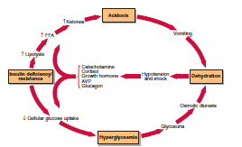

Slide 34
Laboratory investigations
urine (if available) should be tested for glucose and ketones
blood checked for glucose and serum sodium, potassium, chloride, bicarbonate, urea and creatinine.
An arterial blood sample should also be sent for measurement of blood gases.
The serum potassium level should be checked every 2 hours for the first 6 hours, while urea and electrolytes should be measured at 4-hourly intervals
Notes:
(Fig 33.3). Two other forms of severe metabolic decompensation may occur in diabetic patients. These are hyperosmolar nonketotic (HONK) coma and lactic acidosis. Table 33.1 shows the principal features of these conditions I comparison with DKA.

Slide 35
The laboratory findings of a patient with diabetes with ketoacidosis
The laboratory findings of a patient with diabetes with ketoacidosis
1-tend to reflect dehydration
2- Acidosis:
Acetoacetate, β-hydroxybutyrate, and acetone are produced from the oxidation of fatty acids. The two former ketone bodies contribute to the acidosis.
3- Electrolyte disturbances& an ion gap changes
The anion gap in this acidosis can exceed 16 mmol/L.
Serum osmolality is high as a result of hyperglycemia
sodium concentrations tend to be lower due in part to losses (polyuria) and in part to a shift of water from cells because of the hyperglycemia.
Hyperkalemia is almost always present as a result of the displacement of potassium from cells in acidosis. This is somewhat misleading because the patient’s total body potassium is usually decreased.
Bicarbonate and total carbon dioxide are usually decreased due to Kussmaul-Kien respiration (deep respirations).
This is a compensatory mechanism to blow off carbon dioxide and remove hydrogen ions in the process.

Slide 36
Treatment
The management of DKA requires the administration of three agents:
■ Insulin:
Intravenous insulin is most commonly used.
■ Fluids:
Patients with DKA are usually severely fluid depleted and it is essential to expand their ECF with saline to restore their circulation.
■ Potassium:
Despite apparently normal serum potassium levels, all patients with DKA have whole body potassium depletion that may be severe. In most cases, rehydration and insulin therapy will correct the metabolic acidosis, and no further therapy is indicated
Notes:
. However, in the most severe cases when the hydrogen ion concentration is greater than 100 nmol/L, IV sodium bicarbonate may be indicated.

Slide 37
2- Hyperosmolar nonketotic (HONK) coma
Diagnosis
HONK coma occurs mostly in elderly, Type 2 diabetics, and develops relatively slowly over days or weeks.
The term HONK is potentially misleading as DKA also exhibits high serum osmolality, but it remains in common use in clinical practice.
The level of insulin is sufficient to prevent ketosis but does not prevent hyperglycaemia and osmotic diuresis.
Precipitating factors include :
Severe illness, dehydration, glucocorticoids, diuretics, parenteral nutrition, dialysis and surgery.
Extremely high blood glucose levels (above 300 to 500 mg/dL ) accompany severe dehydration resulting in impaired consciousness.

Slide 38
2- Hyperosmolar nonketotic (HONK) coma
More typical of the untreated patient with type 2 diabetes is the nonketotic hyperosmolar state. The individual presenting with this syndrome has an overproduction of glucose; however, there appears to be an imbalance between production and elimination in urine.
Glucose concentrations exceed 300 to 500 mg/dL and severe dehydration is present.
The severe dehydration contributes to the inability to excrete glucose in the urine. Mortality is high with this condition.
Ketones are not observed because the severe hyperosmolar state inhibits the ability of glucagon to stimulate lipolysis.
Notes:
Often, this state is precipitated by heart disease, stroke, or pancreatitis.

Slide 39
The laboratory findings of nonketotic hyperosmolar coma
Plasma glucose values exceeding 1,000 mg/dL
Normal or elevated plasma sodium and potassium, slightly decreased bicarbonate, elevated blood urea nitrogen (BUN) and creatinine, and an elevated osmolality (greater than 320 mOsm/dL).
Note/ The gross elevation in glucose and osmolality, the elevation in BUN, and the absence of ketones distinguish this condition from diabetic ketoacidosis.
Notes:
Other forms of impaired glucose metabolism that do not meet the criteria for diabetes mellitus include impaired fasting glucose and impaired glucose tolerance.

Slide 40
Treatment
Treatment is similar to that of DKA, with the following modifications:
Rehydration should be slower to avoid neurological damage. Dilute (0.45%) saline has been used where the serum sodium level is above 160 mmol/L.
The insulin dose requirements are usually lower than in DKA.
There is also an increased risk of thromboembolism and prophylactic heparin is recommended.
Notes:
Lactic acidosis Diagnosis
Type I lactic acidosis occurs in hypoxic subjects and is due to an excessive production of lactate by peripheral tissues.
Hypoxia is not a feature of type II lactic acidosis, which is probably caused by the impaired metabolism of lactate in the liver.
Both are characterized by an extreme metabolic acidosis ([H+] above 100 nmol/L). There is a high anion gap with low or absent ketones, and high blood lactate concentrations.
Treatment
Large amounts of intravenous sodium bicarbonate may be required to correct the acidosis.
Alternatively the patient may be dialysed against a bicarbonate-containing solution.

Slide 41
3- HYPOGLYCEMIA
Hypoglycemia involves decreased plasma glucose levels and can have many causes—some are transient and relatively insignificant, but others can be life threatening.
The plasma glucose concentration at which glucagon and other glycemic factors are released is between 65 and 70 mg/dL (3.6–3.9 mmol/L); at about 50 to 55 mg/dL (2.8–3.0 mmol/L), observable symptoms of hypoglycemia appear.
The warning signs and symptom of hypoglycemia are all related to the central nervous system.
Notes:
Historically, hypoglycemia was classified as postabsorptive (fasting) and postprandial (reactive) hypoglycemia.
Current approaches suggest classification based on clinical characteristics.
This classification separates patients into those who appear healthy and those who are sick5 (Table 13-8).
Among healthy-appearing patients are those with and without a compensated coexistent disease, This category includes individuals in whom medications may be the cause of hypoglycemia through accidental ingestion by dispensing error. Sick persons may have an illness that predisposes to hypoglycemia or may experience drug and
illness interaction leading to hypoglycemia.

Slide 42
3- HYPOGLYCEMIA
Symptoms of hypoglycemia are increased hunger, sweating, nausea and vomiting, dizziness, nervousness and shaking, blurring of speech and sight, and mental confusion.
Laboratory findings include decreased plasma glucose levels during hypoglycemic episode and extremely elevated insulin levels in patients with pancreatic β-cell tumors (insulinoma).

Slide 43
Diabetic Profile Tests:
Group of tests that are used to diagnose diabetes and to measure the treatment response
These Tests include:
C-peptide, Differentiates between type I and type II.
Blood Glucose
Fasting blood glucose (FBG)
Post prandial glucose (PPG)
OGGT= Oral glucose tolerance test
HbA1c = Glycosylated hemoglobin.
Ketones.
Microalbuminurea.
Insulin.
ICA = islet cell antibodies.

Slide 44
Laboratory methods for the Diagnosis of Diabetes Mellitus
Three methods of diagnosis are suggested:
symptoms of diabetes plus a random plasma glucose level of ≥ 200 mg/dL,
(2) a fasting plasma glucose of ≥126 mg/dL,
(3) an oral glucose tolerance test (OGTT) with a 2-hour post load (75-g glucose load) level ≥ 200 mg/dL, each of which must be confirmed on a subsequent day by any one of the three methods

Slide 45
Laboratory methods for the Diagnosis of Diabetes Mellitus
The preferred test for diagnosing diabetes is measurement of the fasting plasma glucose level.
An intermediate group who did not meet the criteria of diabetes mellitus but who had glucose levels above normal was defined by two methods.
First, those patients with fasting glucose levels ≥ 100 mg/dL but < 126 mg/dL were called the impaired fasting glucose group.
Another set of patients who had 2-hour OGTT levels of ≥ 140 mg/Dl but < 200 mg/dL was defined as having impaired glucose tolerance.
Patients with impaired fasting glucose and/or impaired glucose tolerance are referred to as having “prediabetes, indicating the relatively high risk for the development of diabetes in these patients.

Slide 46
1- Fasting blood sugar (FBG)
Definition: it measures blood glucose after fasting for at least 8 hours
Uses: to diagnose diabetes mellitus when Fasting blood glucose levels significantly elevated (>140mg/dl or > 7.77 mmol/l)
Conformation Tests:
Glucose Tolerance Test
Comprehensive history, physical examination and other tests
Should be done in other diseases that usually diagnosed with elevated plasma glucose levels, such as overactive thyroid gland and pancreatitis.

Slide 47
2- Two hour postprandial blood sugar (2-hour PPT)
Definition:
It measures blood glucose exactly 2 hours after eating a meal.
Sample Preparation:
For a 2-hour postprandial test, the patient should eat a meal exactly 2 hours before the blood sample is taken.
A home blood sugar test is the most common way to check 2-hour postprandial blood sugar levels.
Results should not exceed 140 mg/ dl

Slide 48
3- Random blood sugar (RBS)
Definition:
It measures blood glucose regardless of fasting.
Several random measurements may be taken throughout the day because glucose levels in healthy people do not vary widely throughout the day.
Sample preparation:
No special preparation is required before having a random blood sugar test.
Results should be between 50- 170 mg/ dl

Slide 49
4- Oral glucose tolerance test (OGTT)
Oral glucose tolerance test (OGTT)
Definition: Oral glucose tolerance test is a series of blood glucose measurements that is used to measure the body’s ability to uptake glucose.
This test is commonly used to diagnose diabetes that occurs during pregnancy (gestational diabetes) or in pre diabetic subjects .
Sample preparation: The patient on the test day will be asked to drink a glucose syrup which contained a measured concentration of glucose ( 75g to 100g ) while the pregnant women will take 100g of glucose.
Further, the Blood samples will be collected at timed intervals of 1, 1.5, 2, 2.5 and 3 hours after drinking the glucose. With a urine sample every hour.
This test is recommended when fasting blood glucose test is between 100 mg/dL (5.5 mmol/L) and 126 mg/dL (7.0 mmol/L).
Notes:
GDM is diagnosed by OGTT, when any two of the following four values are met or exceeded:
fasting, > 95 mg/dL;
1 hour, ≥180 mg/dL;
2 hours, ≥155 mg/dL; or 3 hours, ≥140 mg/dL.
This test should be performed in the morning after an overnight fast of between 8 and 14 h after at least 3 days of unrestricted diet (≥150 g carbohydrate per day) and unlimited physical activity.

Slide 50
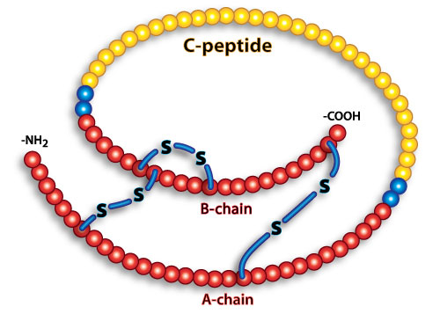
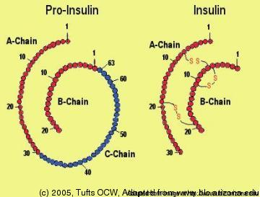
5- C-peptide
C-peptide is metabolically inactive polypeptide chain that is a by-product of normal insulin production by the beta cells in the pancreas. It serves as an important linker between the A- and the B- chains of insulin

Slide 51
5- C-peptide
It is used to monitor beta cells activity and capability over time but it is not used to diagnose diabetes.
C-peptide in Type 1 diabetes:
Definition: autoimmune disorder involves a complete destruction of beta cells with disabilities to produce insulin. This test is ordered for a patient who newly diagnosed with diabetes type-1 to evaluate the residual beta cell function.
The expected result: Low level of insulin and C-peptide will be detected.
C-peptide in type 2 diabetes:
Definition: insulin resistance
This test is ordered for a patient who newly diagnosed with diabetes type-2 to monitor the status of beta cell production of insulin .
The expected value: Normal or high level of C-peptide will be detected.

Slide 52
Glycosylated hemoglobin HbA1c
Definition:
Hemoglobin joins up with glucose to form the chemical called Glycosylated hemoglobin or HbA1c.
Glycosylated hemoglobin is an indicator of how well the blood glucose level has been controlled over a longer period of time, every 2-3 months.
Normal Values:
Glycohemoglobin A1c: 4.5%-5.7% of total hemoglobin
Sample preparation:
-EDTA tube (whole blood) is used.
-Sample is collected in collecting blood tube which has sodium fluoride tube to prevent Glycolysis.
- In separated non-hemolyzd serum, the glucose conc. is generally stable for 8 hours at 25C (or up to 72 hours at 4C).
Notes:
Hemoglobin A stands for Adult type while 8% of this type composed of minor components; A1c, A1b, A1a1, and A1a2. A1c is the one that bind to glucose.

Slide 53
THANK YOU

