Slide 1
Antihypertensive Drugs
Classiﬁcation:
Diuretics
Sympathoplegic agents
Direct vasodilators
Agents that block action of angiotensin
Most anti-HT drugs ↓ BP by ↓ CO &/or ↓ PVR

Slide 2
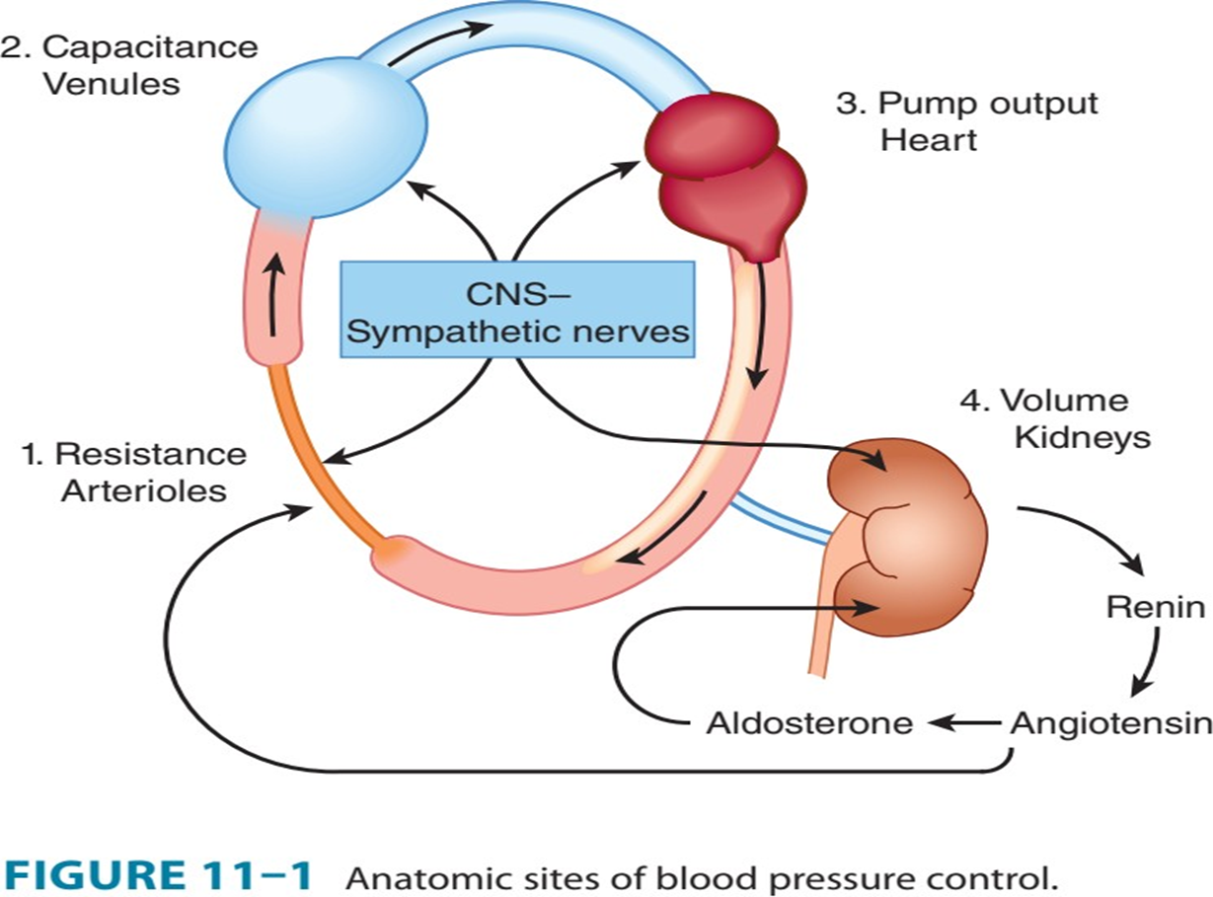
Mechanisms for Controlling Blood Pressure (BP):

Slide 3
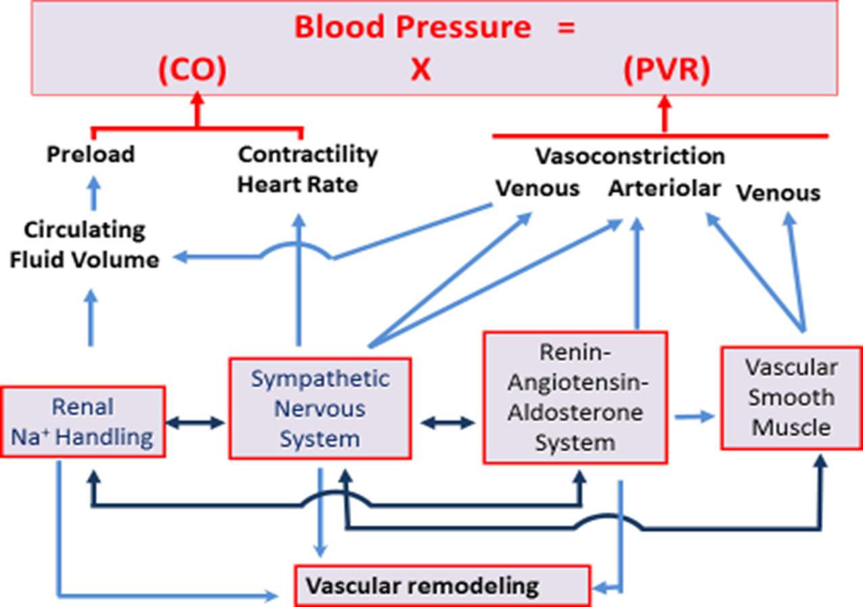

Slide 4
Mild HT can be controlled with a single drug;
Most patients require more than one drug to achieve BP control:
Initiate therapy with a thiazide diuretic.
If BP is inadequately controlled→ 2nd drug (β-blocker) is added.
For patients who still fail to respond→3rd drug (vasodilator) can be added
ACEIs, ARBs, & CCBs can also be used to initiate therapy.

Slide 5
The adverse eﬀects associated with anti-HT may inﬂuence the patient more than the future beneﬁts. e.g., β-blockers-induced sexual dysfunction may→ discontinue therapy.

Slide 6
Thiazides Diuretics
Hydrochlorothiazide, Chlorthalidone, Metolazon Thiazide are used as monotherapy, or in combination with other antihypertensive agents.
They inhibit Na+/Cl− transporter in distal convoluted tubules (DCT)
↓ NaCl reabsorption and ↑ Ca2+ reabsorption
may blunt uric acid secretion leading to gout Long-term use of these drugs may result in hyponatremia and hyperglycemia.

Slide 7
Loop diuretics: Frusemide, Torasemide
Bumetanide
are the most eﬃcacious diuretic agents.
inhibit Na+/K+/2Cl− cotransporter in the thick ascending limb (TAL) of Henle’s loop →
↓ NaCl reabsorption, ↑ Mg2+ excretion & Ca2+
Indications:
1. acute pulmonary edema, HF or cirrhosis
2. as an eﬀective anti-hypertensive agent especially in the presence of renal insuﬃciency.

Slide 8
Potassium-sparing diuretics:
Spironolactone, eplerenone
↓ absorption of Na+ in the collecting ducts
antagonizing the aldosterone eﬀects in collecting tubules→ prevent K+ excretion
Indications:
avoid excessive K+ depletion, particularly in patients on digitalis
hyperaldosteronism evoked by HF, hepatic cirrhosis, or nephrotic syndrome

Slide 9
Sympathoplegic Drugs
↓ sympathetic outflow from vasomotor centers in the brain stem
Clonidine Methyldopa
are rarely used today.

Slide 10
ẞ-Adrenoceptor-Blockers
ẞ1-Selective
Atenolol, Metoprolol
ẞ1 & ẞ2 Non-Selective
Propranolol, Nadolol
ẞ1 & ẞ2 Non-Selective/ α1- Selective
Carvedilol, Labetalol

Slide 11
α 1-Adrenoceptor-Blocking Agents
Prazosin Terazosin Doxazosin
- Seldom used because of their Side Effects profile.

Slide 12
Vasodilators
Hydralazine
Minoxidil
Sodium nitroprusside
Fenoldopam

Slide 13
Calcium-Channel Blockers (CCBs)
Amlodipine Felodipine, Nifedipine
Verapamil
Diltiazem

Slide 14
ACE Inhibitors
Captopril Enalapril Lisinopril Ramipril
↓PVR → vasodilation as a result of the combined effects of:
↓ angiotensin II (the potent vasoconstrictor) &
↑bradykinin (the potent vasodilator)
ACEIs →↓ circulating angiotensin II levels →↓ secretion of aldosterone→ ↓ retention of Na+ & H2O.

Slide 15
Angiotensin Receptor Blockers (ARBs)
Candesartan, Losartan, Valsartan
These drugs are AT1 -receptors blockers.
are alternatives to ACEIs.

Slide 16
Hypertensive Emergency
Sodium Nitroprusside
Labetalol
Fenoldopam
Nicardipine

