Slide 1
Assessment of patients before anaesthesia
By: Dr : Miaad Adnan
FIBMS Anaesthesia
1st lecture/ 3rd stage/ anesthesia technology
2022 - 2023
Dr : Bassim mohammed
MSc anesthesia & intensive care

Slide 2
Purpose of preoperative evaluation ?
1
Doctor-patient relationship
Surgical procedure
Preoperative Preparation
Plan of Anesthetic Technique
Perioperative risk determination.
Coexisting medical conditions
Perioperative risk determination.
Develop a management plan for perioperative anesthetic care
Reduce peri-operative morbidity and mortality
Reduce patient anxiety
Obtain informed consent

Slide 3
The anesthetic plan :
2
Type of anesthesia :
General | Sedation | Neuroaxial or regional or local anesthesia
Airway management | Supplemental oxygen | Technique
Induction | Drugs | Drugs
Maintenance
Muscle relaxation

Slide 4
The anesthetic plan :
3
1 - Preoperative management
History
Physical examination
Evaluation of coexisting disease
Preop lab and diagnostic investigations
Preop medication management
Anesthetic note
Guideline for NPO status

Slide 5
The anesthetic plan :
4
2 - Intraoperative management
Monitoring
Positioning
Fluid management
Special techniques
3 - Postoperative
Pain control
Intensive care
* Postoperative ventilation
* Hemodynamic monitoring

Slide 6
1 . History :
5
History and physical examination are the most important assessors of disease and risk.
General history
History of 1- Coexisting medical illnesses
2- Medications, present therapy
3- Allergies and drug reactions
4- tobacco and alcohol intake
Previous anesthetics, surgeries, deliveries
Family History
Last oral intake

Slide 7
6
1 . History :
Cardiovascular system
Specific enquiries must be made about:
- Angina
incidence
precipitating factors
duration
use of anti-anginal medications, e.g. glyceryl trinitrate (GTN) oral or sublingual )
- Previous myocardial infarction (MI) and subsequent symptoms
- Symptoms indicating heart failure

Slide 8
7
1 . History :
Cardiovascular system
myocardial infarction are at a greater risk of perioperative re-infarction
Elective surgery postponed until at least 6 months after the event
Untreated or poorly controlled hypertension (diastolic consistently > 110 mmHg) may lead to exaggerated cardiovascular responses
- Both hypertension and hypotension can be precipitated which increase the risk of myocardial ischemia

Slide 9
1 . History :
8
Cardiovascular system
- Heart failure will be worsened by the depressant effects impairing the perfusion of vital organs
- Valvular heart disease
* prosthetic valves may be on anticoagulants
need to be stopped or changed prior to surgery
* Antibiotic prophylaxis

Slide 10
1 . History :
9
Active Cardiac Conditions
• Unstable coronary syndromes
- Unstable or severe angina
- Recent MI
• Decompensated HF
• Significant arrhythmias
• Severe valvular disease

Slide 11
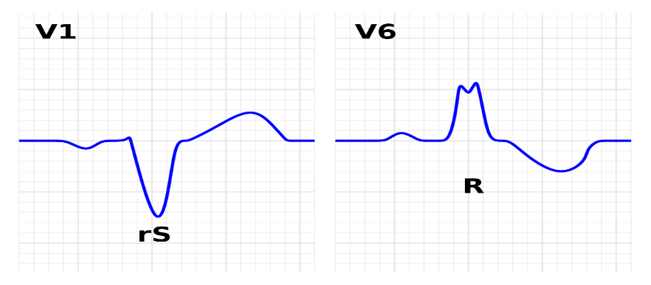
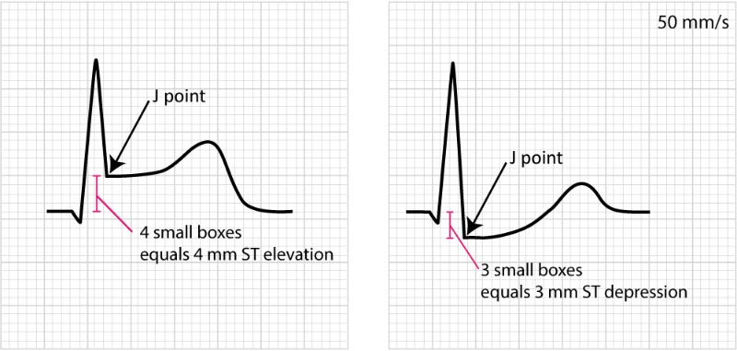
1 . History :
10
Minor Cardiac Predictors
• Advanced age (>70)
• Abnormal ECG
-LV hypertrophy
-LBBB
-ST-T abnormalities
-Rhythm other than sinus
• Uncontrolled systemic hypertension
LBBB. Left bundle branch block

Slide 12
1 . History :
11
Surgical Risk Stratification
High Risk
Vascular (aortic and major vascular)
Intermediate Risk
Intraperitoneal and intrathoracic
, carotid, head and neck, orthopedic, prostate
Low Risk
Endoscopic, superficial procedures,
cataract, breast, ambulatory surgery

Slide 13
1 . History :
13
Respiratory system
Patients with pre-existing lung disease
postoperative chest infections if they are obese or undergoing upper abdominal or thoracic surgery
Chronic obstructive lung disease production of sputum (volume and color)
Dyspnea
Asthma, including precipitating factor
Upper respiratory tract infection
anaesthesia and surgery should be postponed unless it is for a life-threatening condition

Slide 14
1 . History :
15
Family history
All patients should be asked
inherited conditions in the family
history of prolonged apnoea
unexplained death
malignant hyperpyrexia
Surgery postponed

Slide 15
1 . History :
16
SOCIAL HISTORY
Smoking
number of cigarettes
amount of tobacco
Alcohol
induction of liver enzymes
tolerance
Pregnancy
increased risk of regurgitation and aspiration
Elective surgery is best postponed until after delivery.

Slide 16
American Society of Anesthesiology Risk Classification

Slide 17
2 - Physical examination :
18
General History
Physical examination
Evaluation of coexisting disease
Preop lab and diagnostic investigations
Preop medication management

Slide 18
2 - Physical examination :
19
* Vital signs, (CNS, heart, lung,)
* Airway,
* If regional anaesthesia is proposed
- Assessment of the site of block
- Back

Slide 19
2 - Physical examination :
20
vital signs
Blood pressure
Resting pulse
- rate, rhythm
Respiration
- rate, depth, and pattern at rest
Body temperature
Pain score

Slide 20
Airway Assessment
Predictors of difficult intubation
Mallampati classification
ULBT (upper lip bite test)
Inter-incisors gap (IID)
Thyromental distance (TMD)
Forward movement of mandible
Document loose or chipped teeth
Tracheal deviation
Movement of the Neck

Slide 22
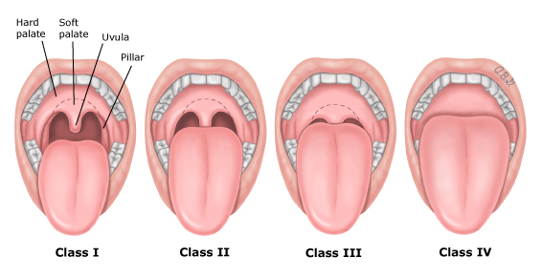
Mallampati test
Class I = visualize the soft palate, uvula, anterior and posterior pillars.
Class II = visualize the soft palate and uvula.
Class III = visualize the soft palate and the base of the uvula.
Class IV = soft palate is not visible at all.

Slide 24
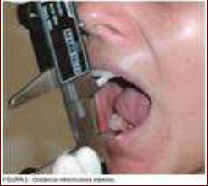
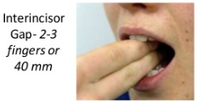
Interincisor distance (IID)
Less than or equal to
4.5 cm is considered
a potentially difficult
intubation.
Generally greater than
2.5 to 3 fingerbreadths
(depending on observers fingers)

Slide 25
Sterno-mental Distance (SMD)
Extended head and neck, mouth closed, distance <12.5cm is a difficult intubation

Slide 27
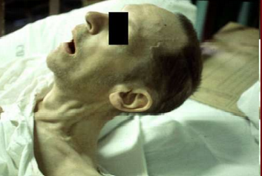
Neck movement

Slide 28
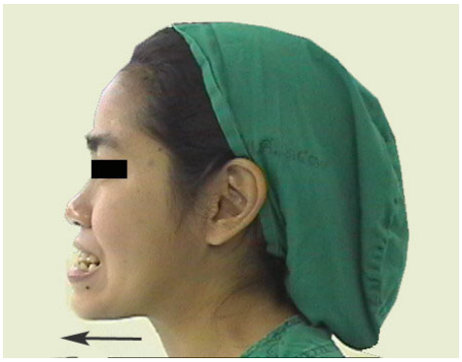
CRANIOFACIAL DEFORMITIES
Temporomandibular joint
protrusion of mandible

Slide 29
Preoperative Laboratory Testing only if indicated from the preoperative history and physical examination.
Blood test
CBC anticipated significant blood loss, suspected hematological disorder (eg.anemia, thalassemia, SCD), or recent chemotherapy.
Complete blood count:-
Red blood cells(RBC), which carry oxygen
White blood cells(WBC), which fight infection
Hemoglobin(Hb), the oxygen-carrying protein in red blood cells
Hematocrit (HCT), the proportion of red blood cells to the fluid component, or plasma, in blood
Platelets (PLT), which help with blood clotting

Slide 30
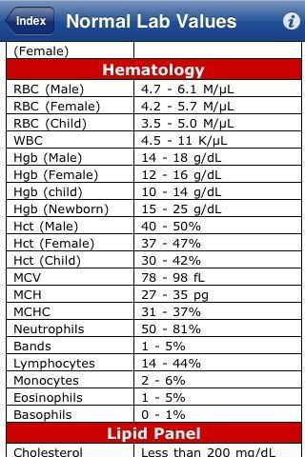

Slide 31
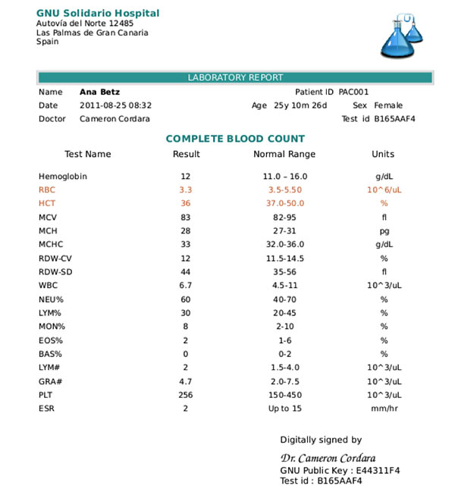

Slide 32
Clotting Screen PT, INR, PTT
indication: any deranged coagulation, such as:
iatrogenic causes (e.g. warfarin),
inherited coagulopathies (e.g haemophilia A/B)
liver impairment.
Surgery with expected blood loss.
9.5-13.5 seconds
0.7-1.2
25 – 35 seconds

Slide 33
Urea & Electrolytes (U&Es) and creatinine
To assess the baseline renal function, which help inform any potential IV fluid management intra- and post-operatively
COMMON ELECTROLYTES INCLUDE:
Chloride (CL) : 95-105 mmol/L
Sodium Na: 135-145 mmol/L
Potassium (K) : 3.5-5 mmol/L
Total calcium: 8.5-10.2 mg/dL
Magnesium: 1.5-2 mEq/L
Glucose: 65-110 mg/dL
Creatinine: 0.8-1.3 mg/dL
Urea: 7-30 mg/dL
Uric acid: 3.5-7.2 mg/dL
Inorganic phosphorous: 2.8-4.5 mg/dL
Ionized calcium: 4.8-5.5 mg/dL

Slide 34
Investigations
ECG age >50 yrs ,history of cardiac disease, hypertension, peripheral vascular disease.
It can indicate any underlying cardiac pathology and provide a baseline if there are post-operative signs of cardiac ischaemia.
An echocardiogram (ECHO) may be considered if the person has:
(1) a heart murmur
(2) cardiac symptom(s)
(3) signs or symptoms of heart failure.
Chest X-rays prior cardiothoracic procedures ,COPD, asthma, recently resolved respiratory tract infection , a change in respiratory symptoms in the past six months, stable cardiac disease, smoking, and extremes of age.

Slide 35
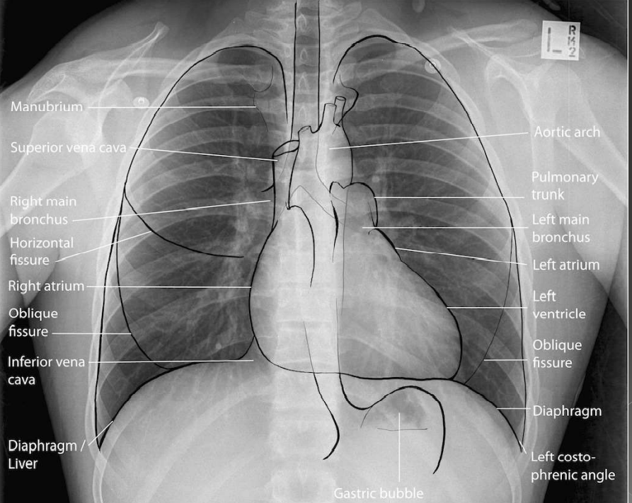

Slide 36
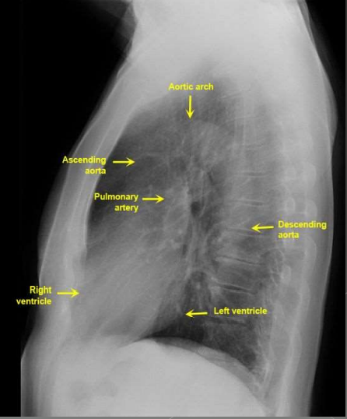

Slide 38
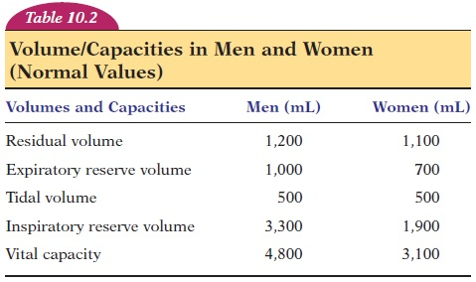
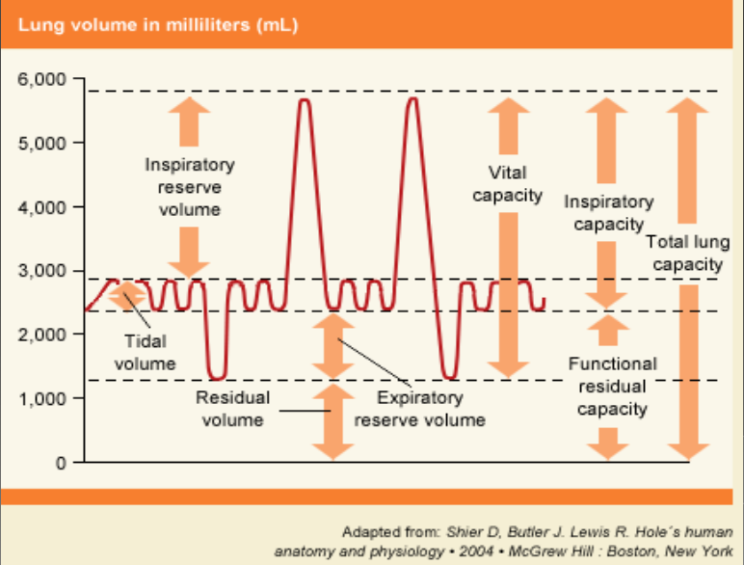
Pulmonary function tests (PFTs) are a group of tests that measure how well your lungs work. This includes how well you’re able to breathe and how effective your lungs are able to bring oxygen to the rest of your body
(VC).
RV
ERV
VT.
IRV.
VC.
Functional residual capacity (FRC). 2300ml
Total lung capacity TLC 5800 ml.

Slide 39
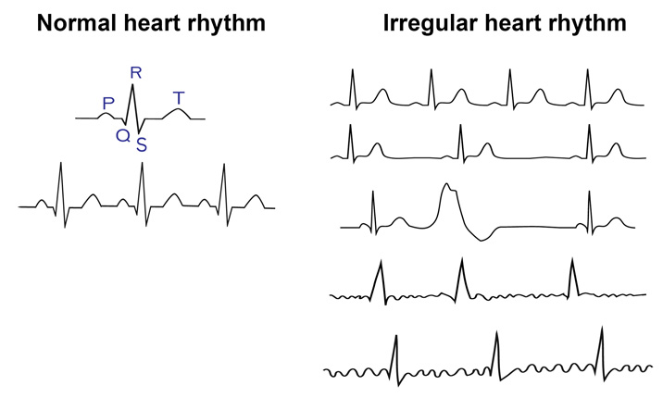
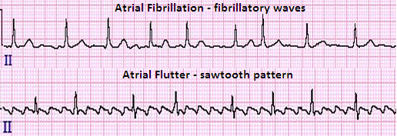
2 - Physical examination :
25
Cardiovascular system
Dysrhythmias
Atrial fibrillation
Heart failure
Heart murmur
Valvular heart disease
Blood pressure is best measured at the end of the examination

Slide 40
2 - Physical examination :
26
Respiratory system
cyanosis
pattern of ventilation
respiratory rate RR
Dyspnoea
Wheeziness
signs of collapse
consolidation and effusion

Slide 41
2 - Physical examination :
27
Nervous system
Chronic disease of the peripheral and central nervous systems
evidence of motor or sensory impairment recorded
dystrophic myotonica
Musculoskeletal
restriction of movement and deformities
reduced muscle mass
peripheral neuropathies
pulmonary involvement
Particular attention to the patient's cervical spine and temporomandibular joints

Slide 42
3-Evaluation of coexisting disease:
29
Cardiovascular disorders :
Hypertension, Ischemic heart disease, Heart failure, Valvular heart disease, Patients with rhythm disturbances, Patient with coronary stents, Patients with pacemakers and ICD devices, Patients with peripheral arterial disease
Pulmonary disorder
Upper respiratory tract infection, Asthma and COPD, Chronic smokers, Restrictive lung diseases,Obstructive sleep apnoea(OSA), Patients scheduled for lung resection

Slide 43
3-Evaluation of coexisting disease:
31
Endocrine system
Diabetes Mellitus, Thyroid disorders, Hypothalamic- pituitary- adrenal disorders, Pheochromocytoma
Diabetes Mellitus
Diabetes : control blood sugar
CVS - HT, myocardial ischemia
CNS - stroke, weakness, autonomic neuropathy peripheral neuropathy
GI – gastro paresis
Stiff joint : cervical spine, TM joint

Slide 44
3-Evaluation of coexisting disease:
33
GIT system
Liver disease
Gastroesophageal reflux symptom increase
risk of pulmonary aspiration
renal system
Surgical stress, anaesthetic agents tend to decrease GFR
* Renal impairment - CKD
- AKI
* Contrast induced nephropathy
* The emphases of the preoperative evaluation of patients with renal insufficiency are on the cardiovascular system, cerebrovascular system, fluid volume, and electrolyte status

Slide 45
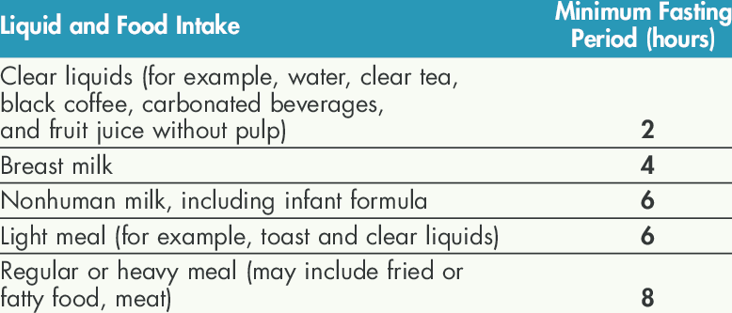
7- NPO :
39

Slide 46
39
you
thank

