Slide 1
Intravenous Anesthetic Agents
Dr : Miaad Adnan
31 / 10 / 2021
FIBMS Anaesthesia

Slide 2
1
Barbiturates
Benzodiazepines
Opioids
Miscellaneous
drugs
Intravenous Anesthetics
Barbiturates
Benzodiazepines
Opioids
Miscellaneous
drugs

Slide 3
Barbiturates (thiopenton or thiopental)
2
Indications :
Induction of anesthesia
Maintenance of anesthesia (but has cumulative effects)
Treatment of status epilepticus
Reduction of intra-cranial pressure (ICP)

Slide 4
Barbiturates (thiopenton or thiopental)
3
Adverse effects:
Hypotension
Respiratory depression
Tissue necrosis (if injected extra-vascular)
Laryngospasm
Bronchospasm (avoid in asthma)
Thrombophlibitis (less common in 2.5% conc.)

Slide 5
Barbiturates (thiopenton or thiopental)
4
Adverse effects:
7 - Allergic reactions 1 in 14000-20000
8 - Intra-arterial injection (lead to sever vasospasm and sever pain it may lead to gangrene of the limb, treatment by keeping the cannula in and inject papeverine 20 mg, heparin and fluid, using 2.5% conc. Is safer)

Slide 6
Barbiturates (thiopenton or thiopental)
5
Contra indications:
Airway obstruction (epiglottis or pharyngeal tumours)
Porphyria
Previous hypersensitivity to this drug

Slide 7
Benzodiazepines (Diazepam, Midazolam)
6
Indications:
Sedation during regional anesthesia
Radiological procedures (children, anxious persons)
Endoscopy
ICU
Supplementation to general anesthesia
Amnesia
Status epilepticus

Slide 8
Benzodiazepines (Diazepam, Midazolam)
7
Adverse effects:
Prolong duration (diazepam)
Painful on injection (diazepam)
Hypotension if used with other agents like opioids
Respiratory depression in over dosage
Contraindications:
Early pregnancy (teratogenic effect)

Slide 9
8
Opioids
Opioids
Agonist
Morphine, Pethidine, Tramadol
Fentanyl & Al, Remi, Su (fentanil)
Agonist-Antagonist
Pentazocine, Nalburphine
Antagonist
Nalaxone

Slide 10
Opioids :
9
Indications :
Provision of analgesia before or after surgery
Induction of anesthesia and maintenance of anesthesia in patients with severe cardiac dysfunction
Inhibition of reflex sympathetic nervous system activity
Provide post operative analgesia by injecting it to the subarachnoid or epidural space

Slide 11
Opioids :
10
Adverse effects :
1 - On cardiovascular system:
Orthostatic hypotension (decreased sympathetic nervous system tone to peripheral veins)
Release of histamine (Morphine)
Bradycardia (Sufentanil)

Slide 12
Opioids :
11
Adverse effects :
2 - On Ventilation :
Increase resting PaCo2
Decrease of responsiveness to the ventilatory stimulation of CO2
Decreased rate of breathing but tidal volume is often increased
Spasm of thoraco-abdominal muscles
Stiff chest syndrome

Slide 13
Opioids :
12
Adverse effects :
2 - On CNS :
Miosis
Stimulation of Dopamine receptors in the chemoreceptor trigger zone which cause nausea and vomiting
Addiction

Slide 14
Opioids :
13
Adverse effects :
3 - On GIT & Urinary Bladder :
Enhancement of bladder sphincter tone which
lead to urine retention
Decrease peristalsis movement of bowel
Increase the tone of the pyloric sphincter which
lead to delayed gastric emptying
Spasm of biliary smooth muscles which leads to pain also spasm of the sphincter of Oddi

Slide 15
Morphine (10, 15mg)
14
Can be Administered by variety of routes
Has active metabolites
Risk of accumulation in patient with renal impairment
Avoid in asthma (histamine release)
Pethidine (100mg)
Shorter acting
Its metabolites has long half life with risk of accumulation in patient with renal impairment, also the metabolites are neurotoxic and result in grand mal seizures
Avoid in patient with history of epilepsy

Slide 16
Tramadol (100mg)
15
Analgesic efficacy around one tenth that of morphine
Avoid in patient with history of epilepsy
Useful for elderly
Useful For Patient-Controlled Analgesia (PCA)
Fentanyl (100μg )
Very potent opioid used primarily for intra-operative analgesia
Useful drug for PCA
Cause respiratory depression

Slide 17
Alfentanil (100μg ) :
16
Ultra short-acting potent opioid used for intra- operative analgesia
Limited use in the post operative period
Cause respiratory depression
Sufentanil :
Is closely related in structure to fentanyl
5-10 times more potent than fentanyl and slightly shorter duration
Remifentanil :
Ultra short acting opioids
The duration of action is short with no residual effects

Slide 18
Opioids :
17
Agonist-Antagonist
Those drugs have limited analgesic properties (ceiling effect) above which increasing doses do not produce additional anesthesia, they usually used for treatment of addiction

Slide 19
Opioids :
18
Antagonist :
Is used as a short acting opioid antagonist because of its short duration of action opioid terminated depression may return when effect of Nalaxone have terminated
Nalaxone may precipitate the sympathetic drive of unrelieved pain (tachycardia, hypertension, arrhythmias-----etc.)

Slide 20
Opioids :
19
Naloxone
Naloxone competes with opioids at the mu, delta, kappa and sigma receptors.
Ampules of 0.02, 0.4 and 1 mg/ml.
Peak effect 1-2 min.
Duration of action 30-60 min.
Used in perioperative surgical patients with excessive sedation or respiratory sedation secondary to opioids.

Slide 21
Opioids :
20
Naloxone
Given in small incremental doses.
High doses of naloxone will result in sudden reversal of analgesic effects leading to abrupt return of pain resulting in hypertension, tachycardia, pulmonary edema, ventricular dysrhythmias and cardiac arrests.
If sedation or respiratory depression recurs, continuous infusion of 3-10 mcg/kg/hour of naloxone is required.

Slide 22
21
Miscellaneous drugs
Propofol
Etomidate
Ketamine hydrochloride

Slide 23
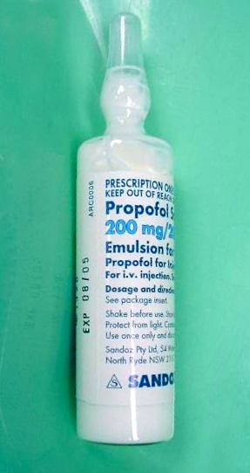
Miscellaneous drugs :
22
1 - Propofol :
Physical and chemical properties
Emulsion consists of :
1% propofol 10mg/ml
10% soyabean oil.
2.25 %glycerol
1.2% purified egg phosphatide.

Slide 24
Miscellaneous drugs :
23
1 - Propofol :
Physical and chemical properties
So Propofol is a highly lipid soluble oil that’s combined with glycerol, egg, and soya bean oil for IV administration.
It’s appearance is similar to that of a 2% milk.
It has a pH of 7 and is supplied in 20 ml ampoules with a concentration of 10 mg/ml.
Neither precipitates histamine release nor triggers malignant hyperthermia.
Has no effects on muscle relaxants.
Associated with low incidence of nausea & vomiting.

Slide 25
Miscellaneous drugs :
24
1 - Propofol :
Effects on Organ systems :
A- Cerebral :
Decreases cerebral blood flow and intracranial pressure.
Propofol has antiemetic, antipruritic, and anticonvulsant properties.
B- Cardiovascular:
Decrease in arterial blood pressure secondary to a drop
in systemic vascular resistance, contractility, and preload.
Hypotension is more pronounced than with thiopental.
Propofol markedly impairs the normal arterial baroreflex response to hypotension.

Slide 26
Miscellaneous drugs :
25
1 - Propofol :
Effects on Organ systems :
C- Respiratory:
Propofol causes profound respiratory depression. Propofol induced depression of upper airway reflexes exceeds that of thiopental.
D- Venous irritation:
Pain on injection is more common than with thiopental esp.
If given in a small vein in the hand.
To solve this problem:
1. small doze of lidocaine with propofol.
2. administering propofol through a fast flowing more proximal IV catheter.

Slide 27
Miscellaneous drugs :
26
2- Ketamine hydrochloride :
A - Indications :
Shocked patient
Pediatric anesthesia
Difficult locations (at accident site, wars)
Analgesia And sedation (wound dressing change)
In ICU
In developing countries (where anesthesia equipment's and trained staff are in short supply)
B - Adverse effects :
Emergence delirium, nightmares and hallucinations
Hypertension and tachycardia
Prolong recovery
Salivation
Increase intra-cranial pressure

Slide 28
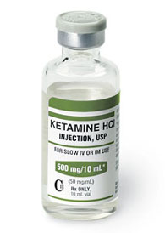
Miscellaneous drugs :
27
2- Ketamine hydrochloride :
It’s a dissociative anesthetic agent.
by dissociative we mean that the patient is unconscious but appears awake and doesn’t feel pain.
It has anesthetic and analgesic effect

Slide 29
Miscellaneous drugs :
28
2- Ketamine hydrochloride :
Physical and chemical properties
chemically related to the psychotropic drug ( e.g. phencyclidine).
Water soluble, and 10x more lipid soluble than thiopental.
pH=3.5 - 5.5

Slide 30
Miscellaneous drugs :
29
2- Ketamine hydrochloride :
METABOLISM
It has a rapid absorption and distribution to the vessel rich groups like THIOPENTAL
Hepatic metabolism is required for elimination
<5% excreted unchanged in urine

Slide 31
Miscellaneous drugs :
30
2- Ketamine hydrochloride :
Mechanism of action
There are 3 theories explains the MOA of ketamine :
1 – N-methyl aspartate receptor theory
NMA receptors may represent a subgroup of the sigma opiate receptors (the PCP site) that blocks spinal pain reflexes
2 – Opiate receptor theory :
Ketamine may have some affinity for opiate receptors but it’s effect can’t be reversed with naloxone.
3- Miscellaneous receptor theory :
It reacts with muscarinic, cholinergic and serotonergic receptors.
Ketamine is a potent analgesic at subanesthetic plasma concentrations.
It has a wide margin of safety ( up to 10x the usual dose )

Slide 32
Miscellaneous drugs :
31
2- Ketamine hydrochloride :
Pharmacodynamics :
1 – CNS :
1. ketamine increases cerebral oxygen consumption, cerebral blood flow, and intracranial pressure
2- generalized increase in the muscle tone and purposful movements.
3- Unpleasant dreams, hallucinations or frank delirium (esp. females & large dose of ketamine).
incidence of delirium in 15-35 year old Pts is approx. 20%

Slide 33
Miscellaneous drugs :
32
2- Ketamine hydrochloride :
Pharmacodynamics :
2 – Respiratory system:
It preserves laryngeal &pharyngeal airway reflexes.
Ketamine is a potent bronchodilator.
FRC → unchanged.
Minute ventilation → unchanged.
Tidal volume → unchanged.
Hypoxic pulmonary vasoconstriction → unchanged.
Ketamine causes increased secretions but this can be limited by anti-cholinergic drugs.

Slide 34
Miscellaneous drugs :
33
2- Ketamine hydrochloride :
Pharmacodynamics :
3 – CVS :
It produces central sympathetic stimulation, which increases:
Arterial blood pressure, heart rate, and cardiac output.
Pulmonary artery pressure.
Coronary blood flow.
Myocardial oxygen uptake.
It may cause myocardial depression if the sympathetic nervous sys is exhausted or blocked.

Slide 35
Miscellaneous drugs :
34
2- Ketamine hydrochloride :
Pharmacodynamics :
4 – GI :
Minimal anorexia, nausea & vomiting.
5 – GU :
Placental transfer does occur, but neonatal depression hasn’t been observed if the dose is limited to < 1 mg/kg
6 - Muscle system :
Generalized increase in skeletal muscle tone.
Increases the effects of muscle relaxants
7 - Endocrine Sys :
Increased sympathetic stimulation → increased blood glucose, increased plasma cortisol.

Slide 36
Miscellaneous drugs :
35
2- Ketamine hydrochloride :
Indications :
Sole anesthetic for diagnosis and surgical procedures
Induction of anesthesia
To supplement regional or local anesthetic techniques
For anesthetic induction in severe asthmatic pts. Or patients with cardiovascular collapse requiring emergency surgery

Slide 37
Miscellaneous drugs :
36
2- Ketamine hydrochloride :
Contraindications :
1- lack of knowledge of the drug
2- lack of resuscitative equipment
3- inability to maintain a patent airways
4- allergy to ketamine
5- history of psychosis
6- cerebral-vascular disease
7- Patients. For whom hypertension is hazardous

Slide 38
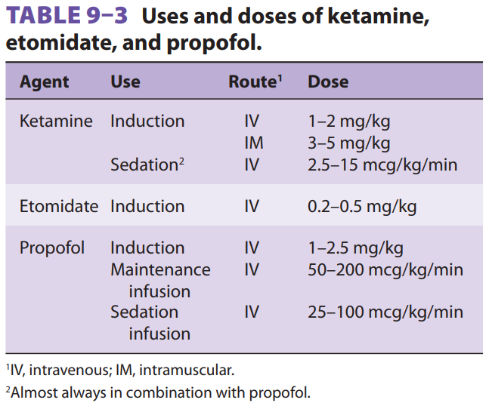
37

Slide 39
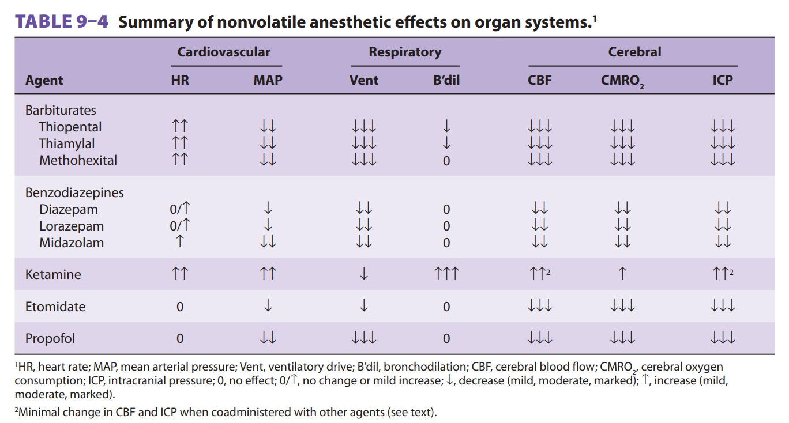
38

Slide 40
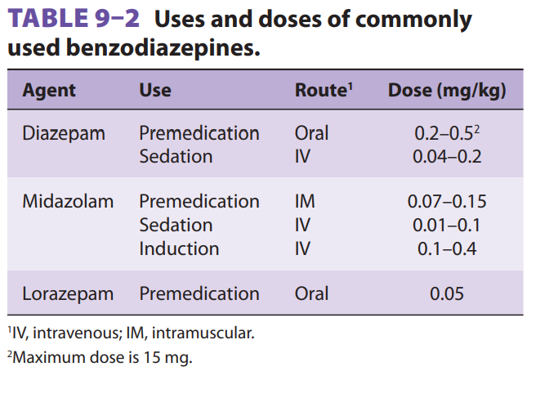
39

Slide 41
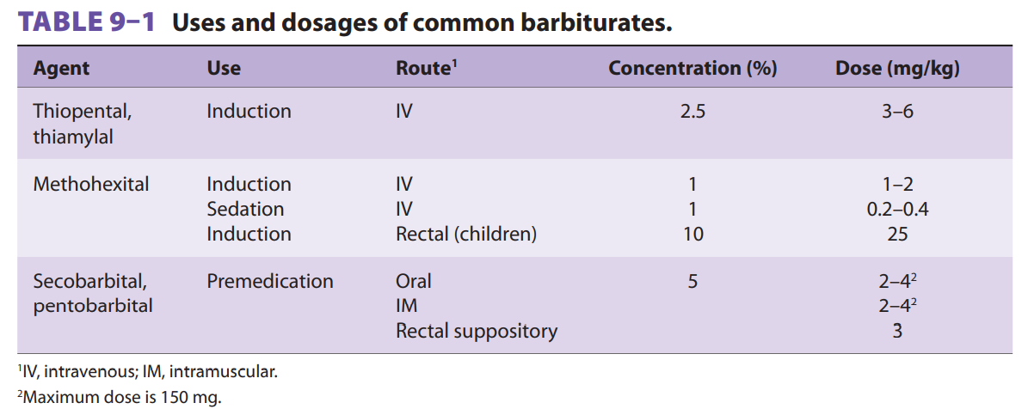
40

Slide 42
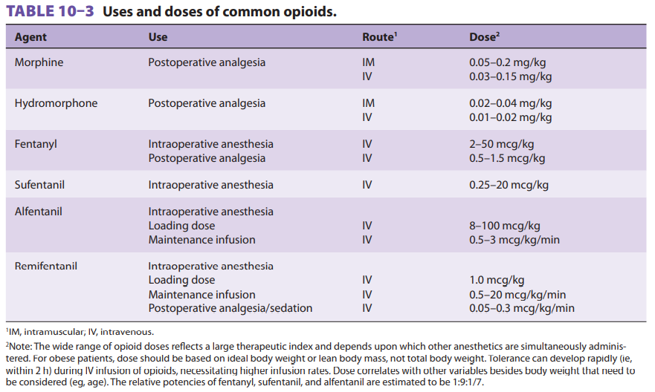
41

Slide 43
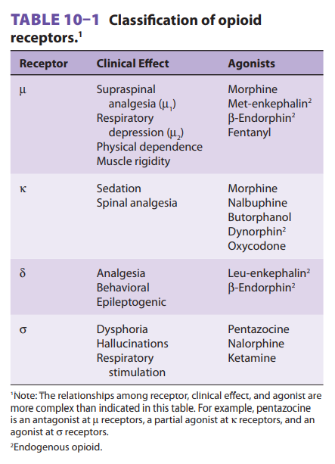
42

Slide 44
Thank You
39
f
End of lecture

