Slide 1
Elevators
Dr.Mohammed Alaraji
B.D.S,F.I.B.M.S

Slide 2
Are (exo-levers), instrument designed to elevate or luxate the teeth or roots from their bony socket in closed or surgical method of extraction to force a tooth or root along the line of withdrawal

Slide 3
Line of withdrawal
Is the path along which the tooth or root will move out of its socket when minimal force is applied to it, and this line is primarily determined by root pattern (long axis of the tooth).

Slide 4
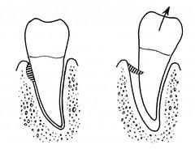

Slide 5
Point of application
Is the site on the root at which force must be applied to effect delivery, it is determined by the line of withdrawal. We have buccal point of application, distal point of application, and mesial point of application.

Slide 6
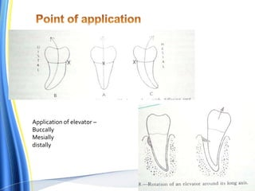

Slide 7
Parts of elevators

Slide 8
All elevators have the following parts:
I-Handle: This may be a continuation of shank or at right angle to it.
II - Shank.
III. Blade: This part engages the crown or root and transmit force to the tooth, bone or both. The working side of the blade is either concave or flat.

Slide 9
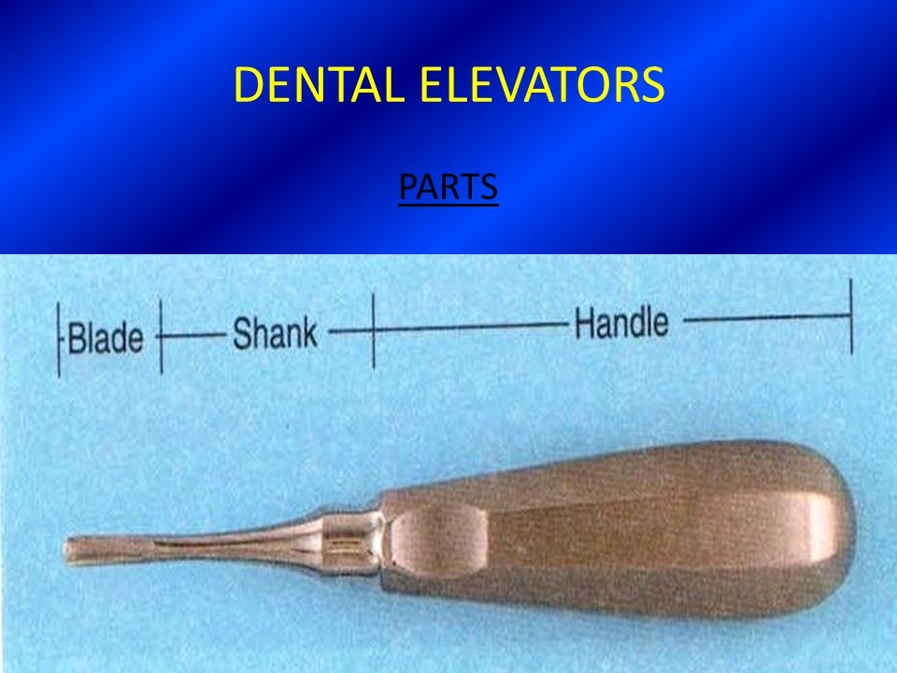

Slide 10
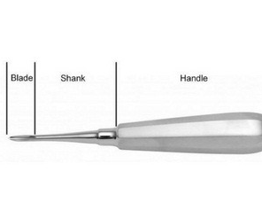

Slide 11
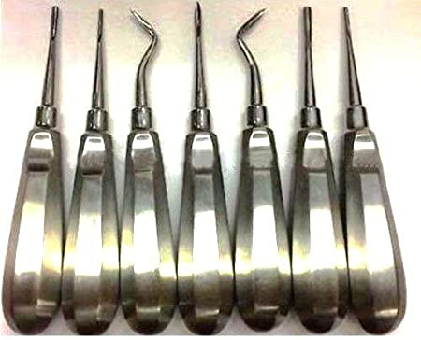

Slide 12
Mechanical principles of uses of elevators
1- Lever principle.
2- Wedge principle.
3- Wheel and axle principle.
4- Combination of these principles.

Slide 13
Lever Principle
This is the most commonly used principle or technique used with Dental elevators. The Lever principle comes with three basic components – Fulcrum, Effort and Load. Elevator is the lever of first order or Class I lever. Fulcrum is positioned between the Effort and Resistance.
When used with Elevators, the handle of the elevator is the Effort while the tip of the blade is the working end applies the load to the tooth where it is engaged in.

Slide 14
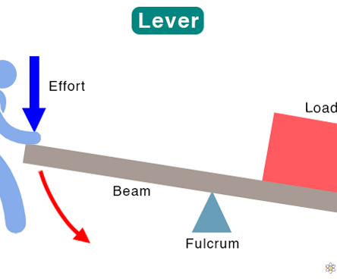

Slide 15
Wedge Principle
A Wedge basically expands, splits and displaces the object that receives the force.
The Wedge (Elevator) is forced or pushed into the space between the root and the bone parallel to the long axis of the root. The force is applied on the base of the plane which turns this resistance into force on the slant side.
Wedge principle is used by positioning a straight elevator tip between the tooth and the alveolar bone and applying slow and constant apical pressure to tear the periodontal ligament attachment from the bone and luxating the root or tooth.
this expands the bony socket leading to separation of the PDL ligament from the bone leading to luxation of the tooth.

Slide 16
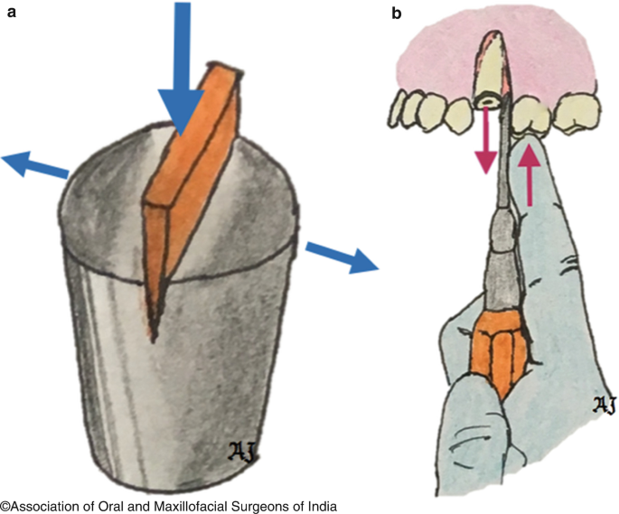
Wedge principle

Slide 17
Wheel and Axle Principle
It is the most aggressive of the three principles, the force is applied to the circumference of the wheel which turns the axle to raise the weight or the tooth. The main use of Wheel and Axle principle is done by Crossbar Elevators which engage into the space between the root and the bone, the handle is at right angle to the shank which is rotated .
If applied in an improper manner, it will lead to fracture of mandible as the amount of force applied is more due to the right angle positioning of the handle to the shank.

Slide 18
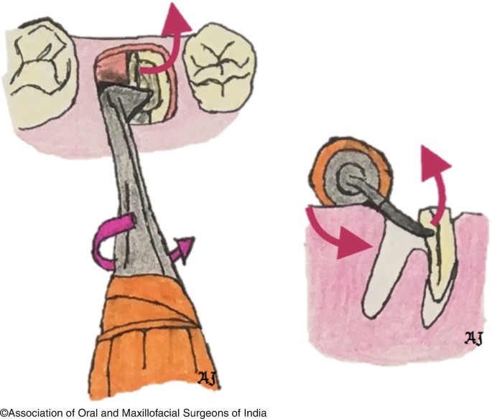
Wheel and axle principle

Slide 19
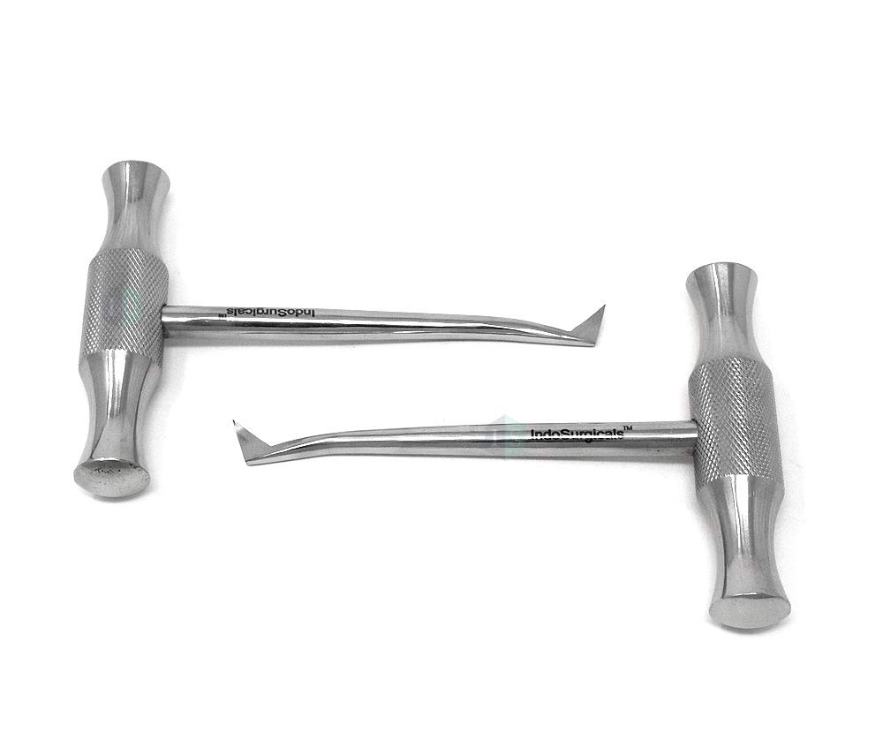
Crossbar elevator

Slide 20
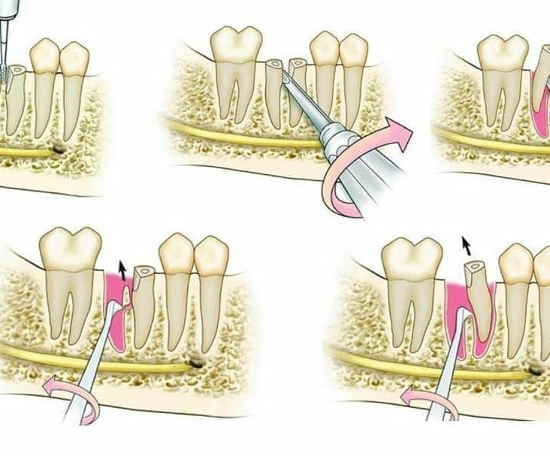

Slide 21
Thank you

