Slide 1
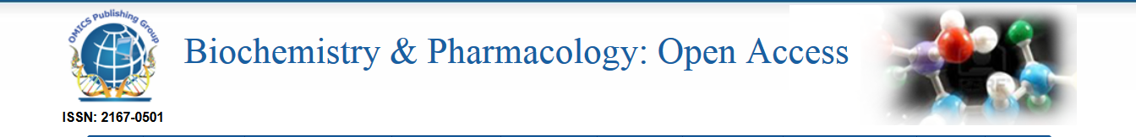
Calcium metabolism and its regulation
Lec 9 and 10

Slide 2
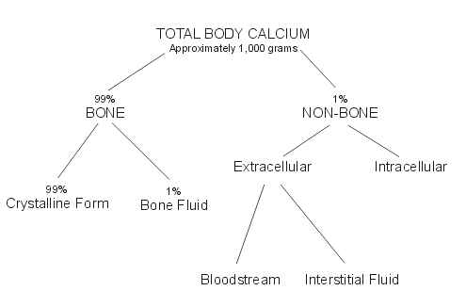
Distribution

Slide 3
Different Forms of Calcium
Most of the calcium in the body exists as the mineral hydroxyapatite, Ca₁₀(PO₄)₆(OH)₂.
Calcium in the plasma:
45% in ionized form (the physiologically active form)
45% bound to proteins (predominantly albumin)
10% complexed with anions (citrate, sulfate, phosphate)
Both total calcium and ionized calcium measurements are available in many laboratories

Slide 4
Body requirements
Age (in years) Calcium Requirement
1 – 3 500mg
4 - 8 800mg
9 - 18 1300mg
19 - 50 1000mg
51+ 1500mg
*Pregnant and lactating women are recommended a daily calcium intake of 1000mg.

Slide 5
source
Calcium is found in milk and dairy products,
Green leafy vegetables,
seafood,
almonds,
blackstrap molasses,
broccoli,
enriched soy and rice milk products, figs,
soybeans and tofu.

Slide 6
Absorption of Ca
Absorption is taking place from the first and second part of duodenum against concentration gradients
Absorption required a carrier protein , helped by Ca-dependent ATPase
Increased absorption-
- calcitriol , active form of Vit-D
- PTH
- acidic pH
- Lys and Arg
Inhibiting absorption -
- phytic acid
- oxalates
- phosphate
- Mg
- caffeine

Slide 7
Biological functions of Calcium
Bone and teeth mineralization
Regulate neuromuscular excitability
Blood coagulation
Secretory processes
Membrane integrity
Plasma membrane transport
Enzyme reactions
Release of hormones and neurotransmitters
Intracellular second messenger

Slide 8
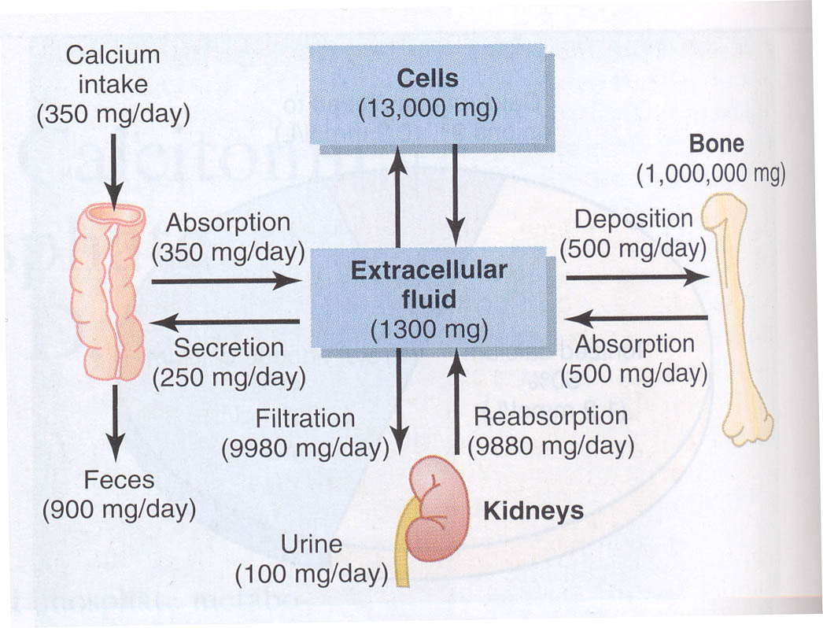
Calcium turnover

Slide 9
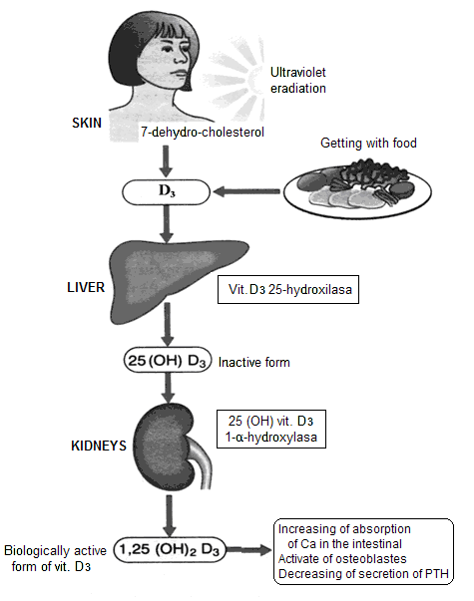
Hormone regulation of calciummetabolism
Vitamin D
Parathyroid hormone (PTH)
Organ-target: bones, kidneys
Function of PTH - increase of Ca concentration in plasma
Mechanisms:
1. Releasing of Са by bones (activation of osteoclasts – resumption of bones)
2. Increase of Са reabsorbing in kidneys
3. Activation of vit. Dз synthesis
and increase of absorption
in the intestine
Calcitonin
Organ-target - bones
Function - decrease of Ca concentration in plasma

Slide 10
Vitamin D3
Dietary cholesterol is converted into 7-dehydrocholesterol and transported to skin
UV sunlight (290-320nm) penetrates the skin to break provitamine ( 7-dehydrocholesterol ) to previtamine and it is then converted to Cholecalciferol by the process of isomerisation
In the liver, cholecalciferol undergoes 25-hydroxylation to yield 25(OH) Vit-D ( calcidiol)
In the kidney , calcidiol undergoes further 1α-hydroxylation to produce 1,25 –dihydroxy Vit-D (Calcitriol). Its production in the kidney is catalyzed by 1α -hydroxylase .
1α -hydroxylase activity is increased by :
Decreased serum Ca2+
Increased PTH level
Decreased serum phosphate
Action of 1,25-dihydroxycholecalcififerol(Calcitriol)
Increases intestinal Ca2+ absorption
Increases intestinal phosphate absorption
Increase renal reabsorption of Ca2+ and phosphate
Increases osteoclast activity
Notes:
Levels of 1,25 OHD do not decrease until defy is severe
D2 - ergocalciferol

Slide 11
Vitamin D3 and Calcium Control
Vitamin D3 (Cholecalciferol)
  Converted to precursor in liver
    Initially stored
    Converted to 25-Hydroxycholecalciferol
    Feedback control limits concentration
  Converted to active form in kidney
    1,25-Dihydroxycholecalciferol
    Under the feedback control of parathyroid hormone (PTH)
The main action of 1,25-(OH)₂-D is to stimulate absorption of Ca²⁺ from the intestine.
1,25-(OH)₂-D induces the production of calcium binding proteins which sequester Ca²⁺, buffer high Ca²⁺ concentrations that arise during initial absorption and allow Ca²⁺ to be absorbed against a high Ca²⁺ gradient

