Slide 1

Al-Mustaqbal University College
Department of Nursing
Medical Terminology
Lecture \3
By:
Dr. Saadya Hadi
Dr. Ali Faris Al- saadi
Notes:
Slide Show Notes
When a serious injury occurs, you have to think and act quickly. Medical assistance may be only minutes away, but sometimes seconds count. What you do in those first few seconds and minutes can make the difference between life and death. Quick, calm, and correct action can make all the difference.
“First aid” is emergency care given to the sick or injured before medical personnel arrive. That’s why a knowledge of first aid and CPR (cardiopulmonary resuscitation) is so important. And that’s why you’re participating in this session today.
The purpose of this session is to provide you with a basic overview of first-aid techniques and priorities. It is not the same as a first-aid and CPR certification course. A certification course is much more detailed and offers you the opportunity to practice first-aid and CPR skills as well as to provide you with hours of classroom training.
We urge you to take a course and get certified. Taking a certification course will give you the full knowledge and confidence you need to use first-aid skills on the job, at home, and elsewhere in your community.
In the meantime, the information in this session can help you better handle medical emergencies when you are the first or only person on the scene.

Slide 2
Objectives:
After studying this lecture, you will be able to:
Define common medical combining forms.
Define common medical prefixes.
Define common medical suffixes.
2
Notes:
Slide Show Notes
Let’s review briefly now with a multiple choice exercise. Choose the best answer, a or b, to complete each statement on the screen.
Third-degree burns are very serious and can even be life threatening. Call 911 immediately if you see signs of third-degree burns.
For a particle in the eye, flush with water until the particle comes out. Never rub the eye. If the particle doesn’t come out, cover the eye and get medical attention.
For inhalation of vapors or gases, get into fresh air right away.
For heatstroke, call 911 immediately if you recognize symptoms
of heatstroke. A person can die from heatstroke.

Slide 3
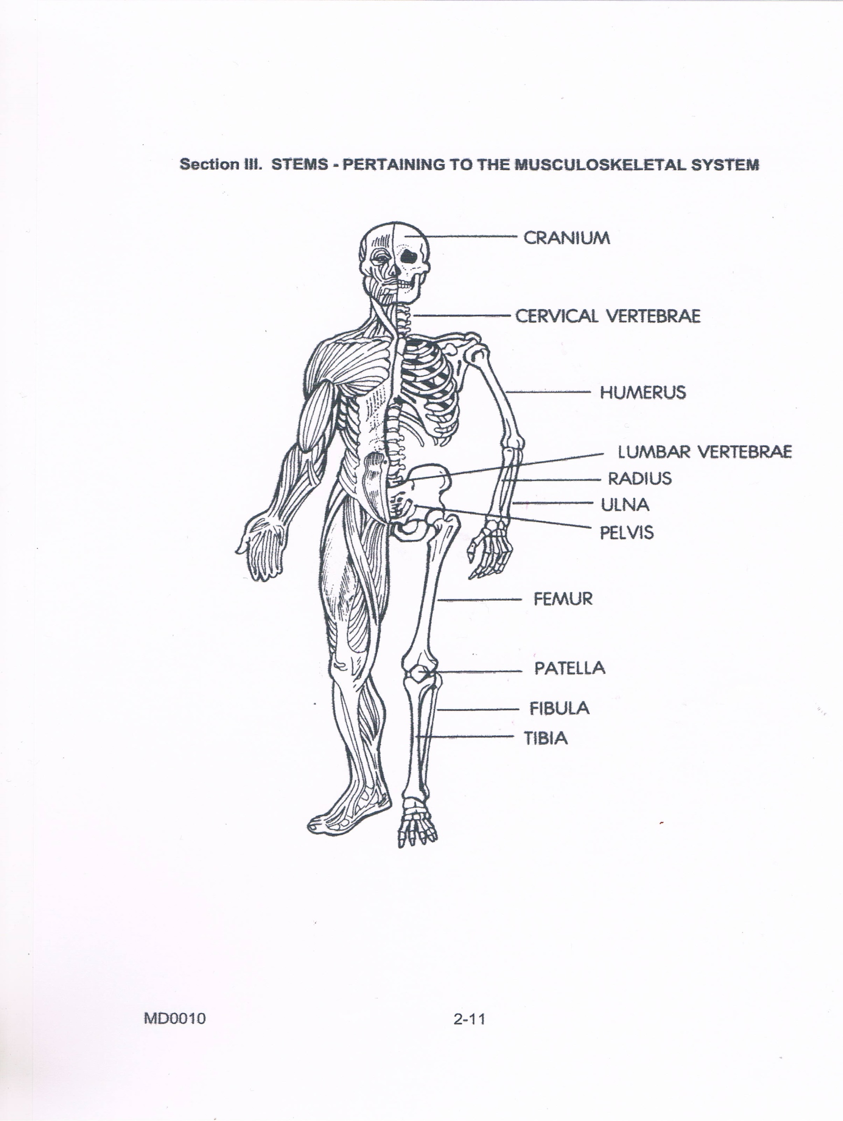
Medical Terminology \Musculoskeletal System

Slide 4
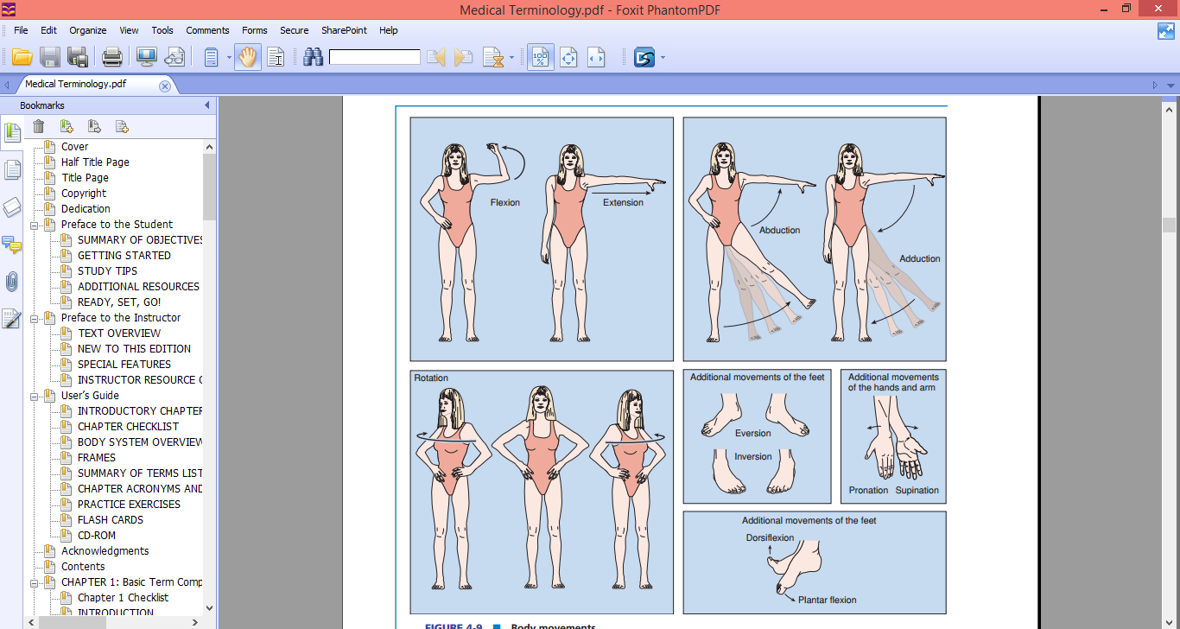
Movement

Slide 5
Movement
Flexion: decrease in the angle of the joint
Extension: increase in the angle of the joint
Abduction: movement of limb away from midline
Adduction: movement of limb towards the midline
Pronation: movement of hand and forearm to bring the palm facing posterior
Supination: movement of hand and forearm to bring the palm facing anterior
Reposition: thumb repositioned back to the anatomic position
Elevation: movement of the scapular superiorly
Depression: movement of the scapular inferiorly
Eversion: movement of the sole of the foot away from the median plane
Inversion: movement of the sole of the foot towards from the median plane
Protrusion: movement of the mandible, lips or tongue anteriorly
Retraction: movement of the mandible, lips or tongue posteriorly.

Slide 6
Word Root and Combining Vowel for Musculoskeletal Terms
Example | Meaning | Comping Frame
Osteitis, Osteomalacia, Osteoporosis | Bone | Osteo
Arthritis, | Joint | Arthro
Chondritis, | Cartilage | Chondro
Myoma, Myositis | Muscle | Myo
Myelitis | Bone Marrow | Myelo
Tendonitis | Tendon | Tendo
Intercostal Space | Rib | Costo
Bursitis | Bursa, “bag”, (shock absorber between tendons and bones) | Burso
Craniotomy | Skull | Crani(o)

Slide 7
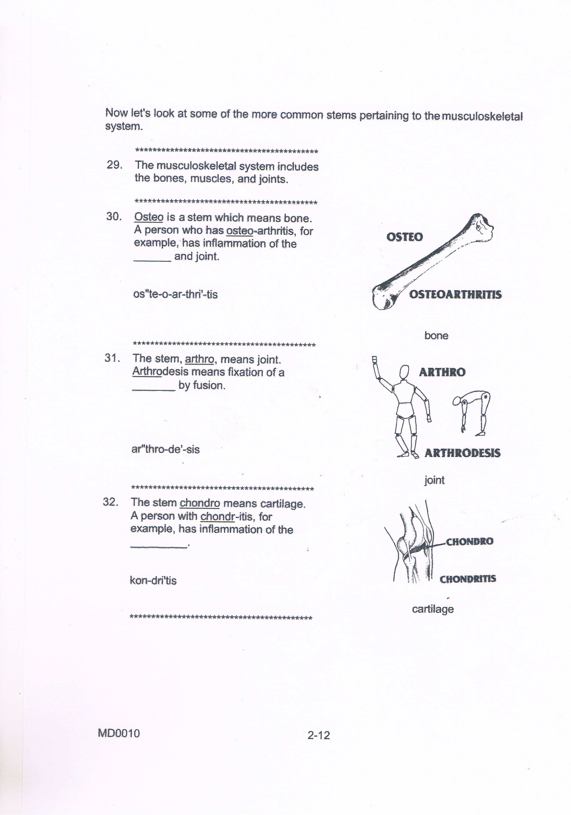
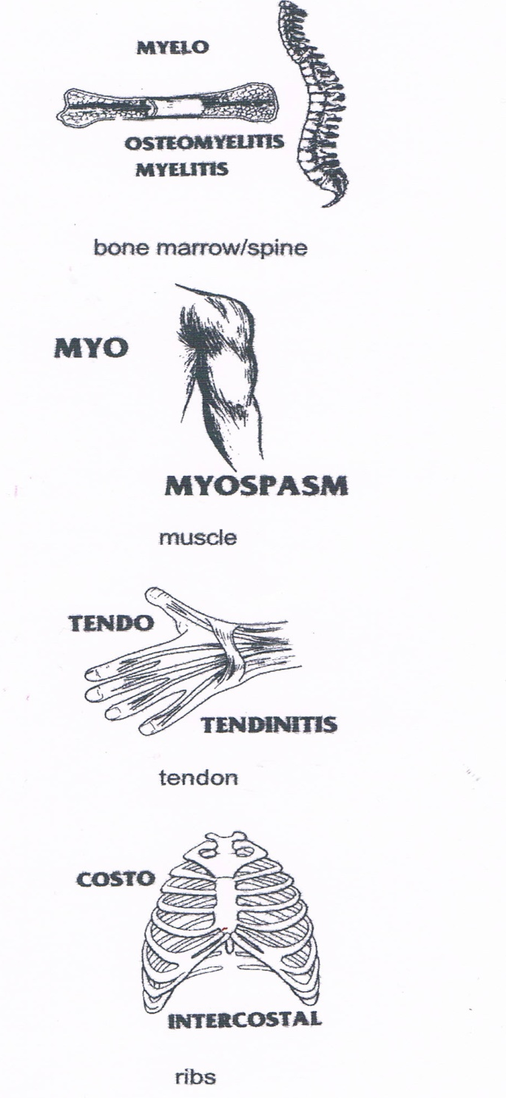
7
Notes:
Slide Show Notes
Let’s review briefly now with a multiple choice exercise. Choose the best answer, a or b, to complete each statement on the screen.
Third-degree burns are very serious and can even be life threatening. Call 911 immediately if you see signs of third-degree burns.
For a particle in the eye, flush with water until the particle comes out. Never rub the eye. If the particle doesn’t come out, cover the eye and get medical attention.
For inhalation of vapors or gases, get into fresh air right away.
For heatstroke, call 911 immediately if you recognize symptoms
of heatstroke. A person can die from heatstroke.

Slide 8
Prefixes for Musculoskeletal Terms
Example | Meaning | Comping Frame
articulate | Joint | Articul-
Osteoma (bone tumor) | bone | Osteo-, oste-
Epiphysis wide ends of a long bone | on or upon | Epi-
Myomalacia | Muscle | Myo-
Diaphysis | meaning through, throughout, or completely, | Dia-
Metaphysis | after" or "beyond | Meta-
Endosteum | Within | Endo-
hypotonia | Decrease | Hypo-

Slide 9
Suffixes for Musculoskeletal Terms
Example | Meaning | Comping Frame
Osteomalacia, chondromalacia | Softening | -malacia
Osteoporosis | Porous | -porosis
Myasthenia gravis | Weakness, loss of strength | -asthenia
Atrophy (shriveling of muscles), hypertrophy (increase in size and strength of muscles) | Development, stimulation, maintenance | -trophy
Myalgia, arthralgia, analgesia (take away pain). | Pain | -algia, algesia
Myelofibrosis | Composed of fibrous tissue | -fibrous
Osteoblast | embryonic state of development. | -blast
Osteocytes | Cell | -cyte

Slide 10
Musculoskeletal System Terms
Definition | Terms
Refer to inflammation of the Bone\ Joint. | Osteoarthritis
Refer to fixation of a joint a by fusion. | Arthrodesis
Refer to involuntary contraction of muscle. | Myospasm
Refer to inflammation of the Cartilage. | Chondritis
Refer to inflammation of the Tendon | Tendonitis
Refer to Muscle weakness | Muscular dystrophy
Synovial refers to the secretion of synovia. | Synovial joint
Atonic refers to lacking normal tone as in a muscle that is flaccid. | Atonic
A fracture is a traumatic injury to the bone | Fracture
Rheumatic refers to rheumatism. | Rheumatoid arthritis
10
Notes:
Slide Show Notes
Let’s review briefly now with a multiple choice exercise. Choose the best answer, a or b, to complete each statement on the screen.
Third-degree burns are very serious and can even be life threatening. Call 911 immediately if you see signs of third-degree burns.
For a particle in the eye, flush with water until the particle comes out. Never rub the eye. If the particle doesn’t come out, cover the eye and get medical attention.
For inhalation of vapors or gases, get into fresh air right away.
For heatstroke, call 911 immediately if you recognize symptoms
of heatstroke. A person can die from heatstroke.

Slide 11

11
Notes:
Slide Show Notes
Let’s review briefly now with a multiple choice exercise. Choose the best answer, a or b, to complete each statement on the screen.
Third-degree burns are very serious and can even be life threatening. Call 911 immediately if you see signs of third-degree burns.
For a particle in the eye, flush with water until the particle comes out. Never rub the eye. If the particle doesn’t come out, cover the eye and get medical attention.
For inhalation of vapors or gases, get into fresh air right away.
For heatstroke, call 911 immediately if you recognize symptoms
of heatstroke. A person can die from heatstroke.

Slide 12
Variety of specialist in Musculoskeletal System
Definition | Terms
A medical specialty that treats disorders involving the musculoskeletal system. | Orthopedics
A physician that specializes in the treatment of the musculoskeletal system. | Orthopedist
A branch of medicine that specializes in the treatment of the musculoskeletal system and operative procedures. | Orthopedic Surgery
A physician that specializes in the musculoskeletal system and performs operative procedures. | Orthopedic Surgeon
12
Notes:
Slide Show Notes
Let’s review briefly now with a multiple choice exercise. Choose the best answer, a or b, to complete each statement on the screen.
Third-degree burns are very serious and can even be life threatening. Call 911 immediately if you see signs of third-degree burns.
For a particle in the eye, flush with water until the particle comes out. Never rub the eye. If the particle doesn’t come out, cover the eye and get medical attention.
For inhalation of vapors or gases, get into fresh air right away.
For heatstroke, call 911 immediately if you recognize symptoms
of heatstroke. A person can die from heatstroke.

Slide 13
Variety of specialist in Musculoskeletal System
Definition | Terms
A physician who specializes in diseases of the bones. | Osteologist
Rehabilitation specialists treating a multitude of medical problems | Physical therapist
A physician who specializes in diseases of the joint. | Arthrologist
Visual examination of the interior of a joint | Arthroscopy
A diagnostic procedure to assess the health of muscles and the nerve cells that control them (motor neurons). | Electromyography (EMG)
Cutting out a small tissue sample of muscle in order to examine it under a microscope. | Muscle biopsy
13
Notes:
Slide Show Notes
Let’s review briefly now with a multiple choice exercise. Choose the best answer, a or b, to complete each statement on the screen.
Third-degree burns are very serious and can even be life threatening. Call 911 immediately if you see signs of third-degree burns.
For a particle in the eye, flush with water until the particle comes out. Never rub the eye. If the particle doesn’t come out, cover the eye and get medical attention.
For inhalation of vapors or gases, get into fresh air right away.
For heatstroke, call 911 immediately if you recognize symptoms
of heatstroke. A person can die from heatstroke.

Slide 14
Any Question?
14
Notes:
Slide Show Notes
Let’s review briefly now with a multiple choice exercise. Choose the best answer, a or b, to complete each statement on the screen.
Third-degree burns are very serious and can even be life threatening. Call 911 immediately if you see signs of third-degree burns.
For a particle in the eye, flush with water until the particle comes out. Never rub the eye. If the particle doesn’t come out, cover the eye and get medical attention.
For inhalation of vapors or gases, get into fresh air right away.
For heatstroke, call 911 immediately if you recognize symptoms
of heatstroke. A person can die from heatstroke.

