Slide 1

Al-Mustaqbal University College
Department of Nursing
Medical Terminology
Lecture \6
By:
Dr. Saadya Hadi
Dr. Ali Faris Al- saadi
Notes:
Slide Show Notes
When a serious injury occurs, you have to think and act quickly. Medical assistance may be only minutes away, but sometimes seconds count. What you do in those first few seconds and minutes can make the difference between life and death. Quick, calm, and correct action can make all the difference.
“First aid” is emergency care given to the sick or injured before medical personnel arrive. That’s why a knowledge of first aid and CPR (cardiopulmonary resuscitation) is so important. And that’s why you’re participating in this session today.
The purpose of this session is to provide you with a basic overview of first-aid techniques and priorities. It is not the same as a first-aid and CPR certification course. A certification course is much more detailed and offers you the opportunity to practice first-aid and CPR skills as well as to provide you with hours of classroom training.
We urge you to take a course and get certified. Taking a certification course will give you the full knowledge and confidence you need to use first-aid skills on the job, at home, and elsewhere in your community.
In the meantime, the information in this session can help you better handle medical emergencies when you are the first or only person on the scene.

Slide 2
Objectives:
After studying this lecture, you will be able to:
Define common medical combining forms.
Define common medical prefixes.
Define common medical suffixes.
2
Notes:
Slide Show Notes
Let’s review briefly now with a multiple choice exercise. Choose the best answer, a or b, to complete each statement on the screen.
Third-degree burns are very serious and can even be life threatening. Call 911 immediately if you see signs of third-degree burns.
For a particle in the eye, flush with water until the particle comes out. Never rub the eye. If the particle doesn’t come out, cover the eye and get medical attention.
For inhalation of vapors or gases, get into fresh air right away.
For heatstroke, call 911 immediately if you recognize symptoms
of heatstroke. A person can die from heatstroke.

Slide 3
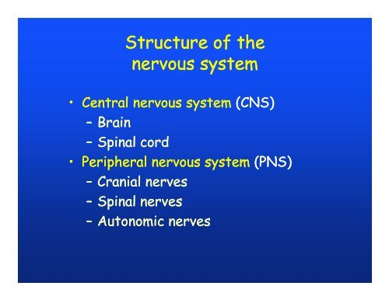
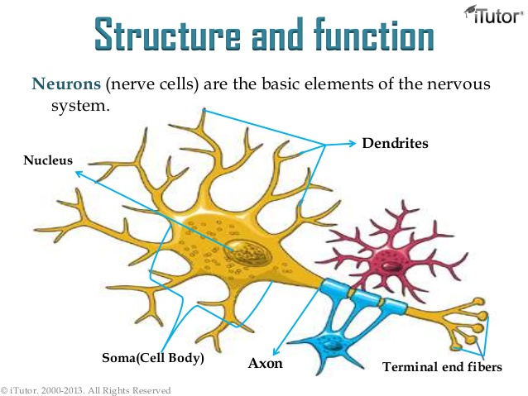
Medical Terminology \The Nervous System

Slide 4
Word Root and Combining Vowel for the Nervous System
Example | Meaning | Combining Frame
Cerebellitis | Cerebellum | Cerebell/o
Cerebroma | Cerebrum | Cerebr/o
Cephalgia (a headache) | Head | Cephal/o
Craniectomy | Skull | Crani/o
Encephalitis (inflammation of the brain) | Brain | Encephal/o
Ganglitis | Ganglion | Gangli/o
Cerebroma | Medulla oblongata | Medul/o
Myelogram (X-ray of the spinal cord) | Spinal cord | Myel/o
Neurologist | Nerve | Neur/o

Slide 5
Example | Meaning | Combining Frame
Spinectomy | Spine | Spin/o
Meningitis (inflammation of the membranes) | Membranes surrounding the brain and spinal cord | Mening/o

Slide 6
Prefixes for the Nervous System
Example | Meaning | Prefixes
Dyslexia (difficulty reading) | Difficult | dys-
Post operation | After | Post-
Pre operation | Before | Pre-
Malfunction | Poor | Mal-

Slide 7
Suffixes for the Nervous System
Example | Meaning | Suffixes
Encephalopathy (disease of the brain) | Disease | -pathy
Aplasia (no development) Hyperplasia (over development) | Development, formation, growth | -plasia
Hemiplegia (paralysis of one side of the body) Quadriplegia (paralysis of all four limbs) | Paralysis | -plegia
cephalomegaly | Largamente | -megaly
Craniotomy | Opening | -otomy
Meningomyelocele (protrusion of membranes and spinal cord) | Hernia | –celes

Slide 8

8
Notes:
Slide Show Notes
Let’s review briefly now with a multiple choice exercise. Choose the best answer, a or b, to complete each statement on the screen.
Third-degree burns are very serious and can even be life threatening. Call 911 immediately if you see signs of third-degree burns.
For a particle in the eye, flush with water until the particle comes out. Never rub the eye. If the particle doesn’t come out, cover the eye and get medical attention.
For inhalation of vapors or gases, get into fresh air right away.
For heatstroke, call 911 immediately if you recognize symptoms
of heatstroke. A person can die from heatstroke.

Slide 9
Specialist in the Nervous System
Definition | Terms
Neurology is a medical specialty that treats conditions related to the nervous system. | Neurology
A neurologist is a person who treats conditions related to the nervous system. | Neurologist
A neurosurgeon is a physician that specializes in the nervous system and operative procedures. | Neurosurgeon
9
Notes:
Slide Show Notes
Let’s review briefly now with a multiple choice exercise. Choose the best answer, a or b, to complete each statement on the screen.
Third-degree burns are very serious and can even be life threatening. Call 911 immediately if you see signs of third-degree burns.
For a particle in the eye, flush with water until the particle comes out. Never rub the eye. If the particle doesn’t come out, cover the eye and get medical attention.
For inhalation of vapors or gases, get into fresh air right away.
For heatstroke, call 911 immediately if you recognize symptoms
of heatstroke. A person can die from heatstroke.

Slide 10
Diagnostic Test of the Nervous System
Definition | Terms
A computed tomography is a technique that uses radiography to produce an image of the cross section of tissue. | Computed Tomography (CT scan)
A computer analyzes this information to show subtle differences in tissue molecular structure producing very high resolution and better differentiation of soft tissue, such as a tumor within the brain. | Magnetic Resonance Imaging (MRI)
A cerebral angiography uses serial x-rays to visualize intra and extra cranial blood vessels. This procedure is used to detect vascular lesions and tumors. | Cerebral Angiography
During this procedure electrical activity of the brain is recorded by scalp electrodes to evaluate seizure disorders, cerebral disease, and brain death. | Electroencephalography (EEG)
10
Notes:
Slide Show Notes
Let’s review briefly now with a multiple choice exercise. Choose the best answer, a or b, to complete each statement on the screen.
Third-degree burns are very serious and can even be life threatening. Call 911 immediately if you see signs of third-degree burns.
For a particle in the eye, flush with water until the particle comes out. Never rub the eye. If the particle doesn’t come out, cover the eye and get medical attention.
For inhalation of vapors or gases, get into fresh air right away.
For heatstroke, call 911 immediately if you recognize symptoms
of heatstroke. A person can die from heatstroke.

Slide 11
Definition | Terms
During a myelography, a contrast medium is injected into the subarachnoid space and an x-ray of the spinal cord and vertebral column is performed. It is used to detect for spinal lesions. | Myelography
For a cerebrospinal fluid analysis, cerebrospinal fluid is aspirated by needle insertion between the l3-l4 or l4- l5 intervertebral spaces. This procedure assesses for different central nervous system diseases. | Cerebrospinal Fluid Analysis (Lumbar puncture)
11
Notes:
Slide Show Notes
Let’s review briefly now with a multiple choice exercise. Choose the best answer, a or b, to complete each statement on the screen.
Third-degree burns are very serious and can even be life threatening. Call 911 immediately if you see signs of third-degree burns.
For a particle in the eye, flush with water until the particle comes out. Never rub the eye. If the particle doesn’t come out, cover the eye and get medical attention.
For inhalation of vapors or gases, get into fresh air right away.
For heatstroke, call 911 immediately if you recognize symptoms
of heatstroke. A person can die from heatstroke.

Slide 12
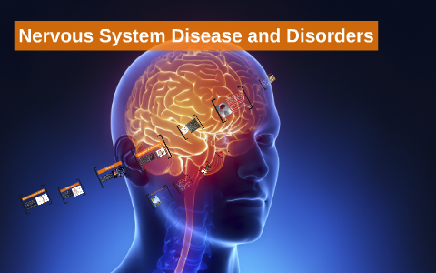
The Nervous System Disorder and Disease
12
Notes:
Slide Show Notes
Let’s review briefly now with a multiple choice exercise. Choose the best answer, a or b, to complete each statement on the screen.
Third-degree burns are very serious and can even be life threatening. Call 911 immediately if you see signs of third-degree burns.
For a particle in the eye, flush with water until the particle comes out. Never rub the eye. If the particle doesn’t come out, cover the eye and get medical attention.
For inhalation of vapors or gases, get into fresh air right away.
For heatstroke, call 911 immediately if you recognize symptoms
of heatstroke. A person can die from heatstroke.

Slide 13
Definition | Terms
Agnosia is the loss of ability to recognize objects. This may be through a visual, auditory, or tactile sensory system. | Agnosia
Aphasia is an inability to express words or form words and to understand language | Aphasia
Apraxia is an inability to perform purposeful acts such as the manipulation of objects on a voluntary basis. | Apraxia
Bell’s Palsy is a condition marked by unilateral weakness or paralysis of the facial muscles on the affected side. | Bell’s Palsy
A brain abscess is a cluster of infectious material within a portion of the brain. | Brain abscess
Brain death is irreversible loss of all brain function even though the heart continues to beat. | Brain death
13
Notes:
Slide Show Notes
Let’s review briefly now with a multiple choice exercise. Choose the best answer, a or b, to complete each statement on the screen.
Third-degree burns are very serious and can even be life threatening. Call 911 immediately if you see signs of third-degree burns.
For a particle in the eye, flush with water until the particle comes out. Never rub the eye. If the particle doesn’t come out, cover the eye and get medical attention.
For inhalation of vapors or gases, get into fresh air right away.
For heatstroke, call 911 immediately if you recognize symptoms
of heatstroke. A person can die from heatstroke.

Slide 14
Definition | Terms
A brain injury is an injury to the skull or brain such as a blow or penetrating object that is severe enough to interfere with normal functioning. | Brain injury
Epilepsy is a neurological disorder characterized by paroxysmal transient disturbances of brain function, resulting in convulsions and loss of consciousness. | Epilepsy
Hemiplegia is paralysis of one side of the body, or part of it, due to injury in the motor area of the brain. | Hemiplegia
Intracranial pressure is pressure exerted by the volume of the intracranial contents within the cranium. | Intracranial pressure (ICP)
Multiple sclerosis is an immune disease that causes the demyelination or destruction of the myelin sheath. | Multiple Sclerosis
14
Notes:
Slide Show Notes
Let’s review briefly now with a multiple choice exercise. Choose the best answer, a or b, to complete each statement on the screen.
Third-degree burns are very serious and can even be life threatening. Call 911 immediately if you see signs of third-degree burns.
For a particle in the eye, flush with water until the particle comes out. Never rub the eye. If the particle doesn’t come out, cover the eye and get medical attention.
For inhalation of vapors or gases, get into fresh air right away.
For heatstroke, call 911 immediately if you recognize symptoms
of heatstroke. A person can die from heatstroke.

Slide 15
Any Question?
15
Notes:
Slide Show Notes
Let’s review briefly now with a multiple choice exercise. Choose the best answer, a or b, to complete each statement on the screen.
Third-degree burns are very serious and can even be life threatening. Call 911 immediately if you see signs of third-degree burns.
For a particle in the eye, flush with water until the particle comes out. Never rub the eye. If the particle doesn’t come out, cover the eye and get medical attention.
For inhalation of vapors or gases, get into fresh air right away.
For heatstroke, call 911 immediately if you recognize symptoms
of heatstroke. A person can die from heatstroke.

