Slide 1

Al-Mustaqbal University College
Department of Nursing
Medical Terminology
Lecture \5
By:
Dr. Saadya Hadi
Dr. Ali Faris Al- saadi
Notes:
Slide Show Notes
When a serious injury occurs, you have to think and act quickly. Medical assistance may be only minutes away, but sometimes seconds count. What you do in those first few seconds and minutes can make the difference between life and death. Quick, calm, and correct action can make all the difference.
“First aid” is emergency care given to the sick or injured before medical personnel arrive. That’s why a knowledge of first aid and CPR (cardiopulmonary resuscitation) is so important. And that’s why you’re participating in this session today.
The purpose of this session is to provide you with a basic overview of first-aid techniques and priorities. It is not the same as a first-aid and CPR certification course. A certification course is much more detailed and offers you the opportunity to practice first-aid and CPR skills as well as to provide you with hours of classroom training.
We urge you to take a course and get certified. Taking a certification course will give you the full knowledge and confidence you need to use first-aid skills on the job, at home, and elsewhere in your community.
In the meantime, the information in this session can help you better handle medical emergencies when you are the first or only person on the scene.

Slide 2
Objectives:
After studying this lecture, you will be able to:
Define common medical combining forms.
Define common medical prefixes.
Define common medical suffixes.
2
Notes:
Slide Show Notes
Let’s review briefly now with a multiple choice exercise. Choose the best answer, a or b, to complete each statement on the screen.
Third-degree burns are very serious and can even be life threatening. Call 911 immediately if you see signs of third-degree burns.
For a particle in the eye, flush with water until the particle comes out. Never rub the eye. If the particle doesn’t come out, cover the eye and get medical attention.
For inhalation of vapors or gases, get into fresh air right away.
For heatstroke, call 911 immediately if you recognize symptoms
of heatstroke. A person can die from heatstroke.

Slide 3
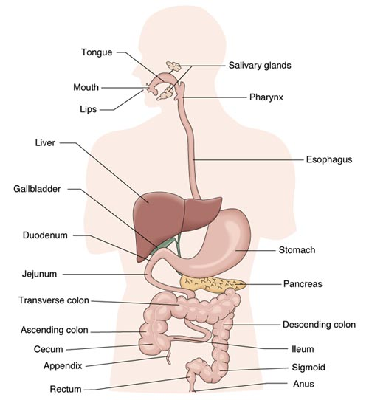
Medical Terminology \The Gastrointestinal System
Structures
Lips (cheil/o)
Mouth (stomat/o
Tongue (gloss/o; lingu/o)
Salivary glands
  Sublingual
  Submandibular
  Parotid
Pharynx
Esophagus
Stomach (gastr/o)
Small intestine
  Duodenum
  Jejunum
  Ileum (hip = ilium)
Large intestine
  Cecum
  Ascending
  Transverse
  Descending
  Sigmoid
Rectum
Anus

Slide 4
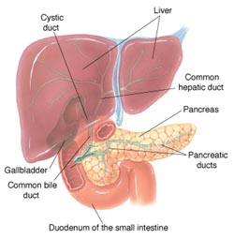
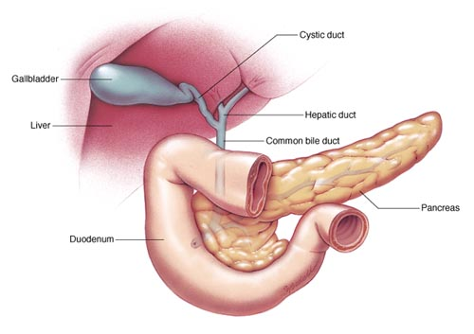
Structures
Liver (hepat/o)
    Hepatic duct
Gallbladder
    Cystic duct
  Cholecyst/o
  Chole = bile
  Cyst = bladder
Common bile duct
Pancreas
    Pancreatic duct

Slide 5
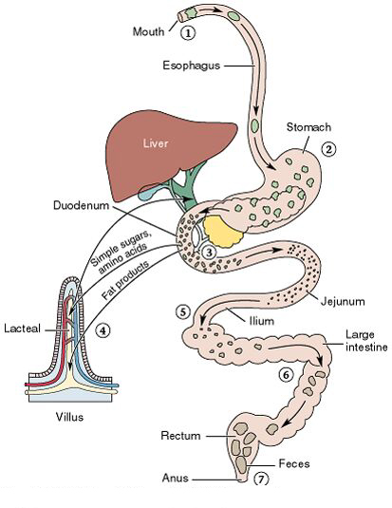
    Functions (physiology)
    All functions aided by “Peristalsis”
    Ingestion
    Digestion
      (pepsis)
    Mechanical
      Mouth
      stomach
    Chemical
      Mouth
      Stomach
      Duodenum
      Pancreas
    Absorption
      Jejunum
      Ileum
    Elimination

Slide 6
Word Root and Combining Vowel for The Gastrointestinal System
Example | Meaning | Combining Frame
Gingivitis | Gums | Gingiv\o
Esophagogastrostomy | esophagus | Esophag(o)
Gastrectomy/ gastrotomy/ gastrostomy | Stomach | Gastr/o
Enteritis | small intestine | Enter/o
Colonoscopy, Colostomy, Colectomy | pertaining to the colon | Colon(o)
Cecostomy | Pertaining to the cecum | Cec(o)
Ileostomy | ileum | Ile(o)
jejunectomy | jejunum | Jejun(o)
proctologist | rectum and anus | Proct/o; rect/o

Slide 7
Example | Meaning | Combining Frame
Hepatectomy | liver | Hepat(o)
Pancreatitis | pancreas | Pancreat(o)
Splenomegaly | spleen | Spleen(o)
Appendicitis | appendix | Appendic(o)
pertaining to a S-shape. | sigmoid colon | Sigmoid(o)
Hematemesis | blood | Hemat(o)
Cholelithiasis | bile | Chol(e)
Cholecystostomy, Cholecystectomy | gallbladder | Cholecyst(o)

Slide 8
Prefixes for Gastrointestinal System
Example | Meaning | Prefixes
Dysphagia, dyspepsia | difficult | dys-
Retroperitoneal, Retro gastric | Behind | Retro-
Endogasotrosopy | refers to inside | Endo-
Epigastric | above | Epi-
Biliary | pertains to bile | Bili-
Hyper gastric | Excessive. | Hyper-
Hypogastric | Decrease | Hypo-
Post operation | After | Post-
Pre operation | Before | Pre-
Malabsorption | Poor | Mal-

Slide 9
Suffixes for Gastrointestinal System
Example | Meaning | Suffixes
Hepatopathy | disease | -pathy
Steatorrhea | discharge | -rrhea
Appendicitis, enteritis | Inflammation | -itis
Hematemesis | Vomiting | -mesis
Splenomegaly | Largament | -megaly
Colostomy | Opening | -otomy
Colectomy | Remove | -ectomy
Bronchostenosis | Narrowing | -stenosis
umbilical hernia, umbilicocele | hernia | –celes
Enterorrhaphy | Suture | -rrhaphy

Slide 10

10
Notes:
Slide Show Notes
Let’s review briefly now with a multiple choice exercise. Choose the best answer, a or b, to complete each statement on the screen.
Third-degree burns are very serious and can even be life threatening. Call 911 immediately if you see signs of third-degree burns.
For a particle in the eye, flush with water until the particle comes out. Never rub the eye. If the particle doesn’t come out, cover the eye and get medical attention.
For inhalation of vapors or gases, get into fresh air right away.
For heatstroke, call 911 immediately if you recognize symptoms
of heatstroke. A person can die from heatstroke.

Slide 11
Specialist in Gastrointestinal System
Definition | Terms
The study of the diseases of the gastrointestinal tract. | Gastroenterology
physician specializing in diseases of the gastrointestinal tract. | Gastroenterologist
11
Notes:
Slide Show Notes
Let’s review briefly now with a multiple choice exercise. Choose the best answer, a or b, to complete each statement on the screen.
Third-degree burns are very serious and can even be life threatening. Call 911 immediately if you see signs of third-degree burns.
For a particle in the eye, flush with water until the particle comes out. Never rub the eye. If the particle doesn’t come out, cover the eye and get medical attention.
For inhalation of vapors or gases, get into fresh air right away.
For heatstroke, call 911 immediately if you recognize symptoms
of heatstroke. A person can die from heatstroke.

Slide 12
Diagnostic Test of the Gastrointestinal System
Definition | Terms
A technique that uses radiographic to produce an image of the cross section of tissue. | Abdominal Computed tomography (CT)
An MRI is a procedure used to produce an image by the creation of a magnetic field to give detailed information about the gastrointestinal system. | Abdominal Magnetic Resonance Imaging (MRI)
Ultrasound is high-frequency sound waves. | Abdominal ultrasound
Administration of a radiopaque barium sulfate liquid to visual defects of the esophagus and surrounding areas. | Barium test
The IV (intravenous) instillation of a radiopaque contrast to visualized and record information about the major bile ducts. | Cholangiography
12
Notes:
Slide Show Notes
Let’s review briefly now with a multiple choice exercise. Choose the best answer, a or b, to complete each statement on the screen.
Third-degree burns are very serious and can even be life threatening. Call 911 immediately if you see signs of third-degree burns.
For a particle in the eye, flush with water until the particle comes out. Never rub the eye. If the particle doesn’t come out, cover the eye and get medical attention.
For inhalation of vapors or gases, get into fresh air right away.
For heatstroke, call 911 immediately if you recognize symptoms
of heatstroke. A person can die from heatstroke.

Slide 13
Definition | Terms
The examination of the organs and cavities of the body with an endoscope. | Endoscopy
An endoscopic test that allows the visualization of the bile ducts and pancreatic ducts. | Endoscopic retrograde cholangiopancreatography (ERCP)
A test used for the visualization of the upper gastrointestinal tract. | Esophagogastroduodenoscopy (EGD)
Test of evaluate the functions of the liver including storage, metabolism, filtration, and excretion. | Liver function test (LFT)
The IV (intravenous) instillation of a radiopaque contrast to visualized and record information about the major bile ducts. | Liver biopsy
13
Notes:
Slide Show Notes
Let’s review briefly now with a multiple choice exercise. Choose the best answer, a or b, to complete each statement on the screen.
Third-degree burns are very serious and can even be life threatening. Call 911 immediately if you see signs of third-degree burns.
For a particle in the eye, flush with water until the particle comes out. Never rub the eye. If the particle doesn’t come out, cover the eye and get medical attention.
For inhalation of vapors or gases, get into fresh air right away.
For heatstroke, call 911 immediately if you recognize symptoms
of heatstroke. A person can die from heatstroke.

Slide 14
Definition | Terms
The inspection of the sigmoid colon and rectum using a sigmoidoscope. | Sigmoidoscopy
An endoscopic test that allows the visualization of the bile ducts and pancreatic ducts. | Endoscopic retrograde cholangiopancreatography (ERCP)
A test used for the visualization of the upper gastrointestinal tract. | Esophagogastroduodenoscopy (EGD)
Test of evaluate the functions of the liver including storage, metabolism, filtration, and excretion. | Liver function test (LFT)
The IV (intravenous) instillation of a radiopaque contrast to visualized and record information about the major bile ducts. | Liver biopsy
14
Notes:
Slide Show Notes
Let’s review briefly now with a multiple choice exercise. Choose the best answer, a or b, to complete each statement on the screen.
Third-degree burns are very serious and can even be life threatening. Call 911 immediately if you see signs of third-degree burns.
For a particle in the eye, flush with water until the particle comes out. Never rub the eye. If the particle doesn’t come out, cover the eye and get medical attention.
For inhalation of vapors or gases, get into fresh air right away.
For heatstroke, call 911 immediately if you recognize symptoms
of heatstroke. A person can die from heatstroke.

Slide 15
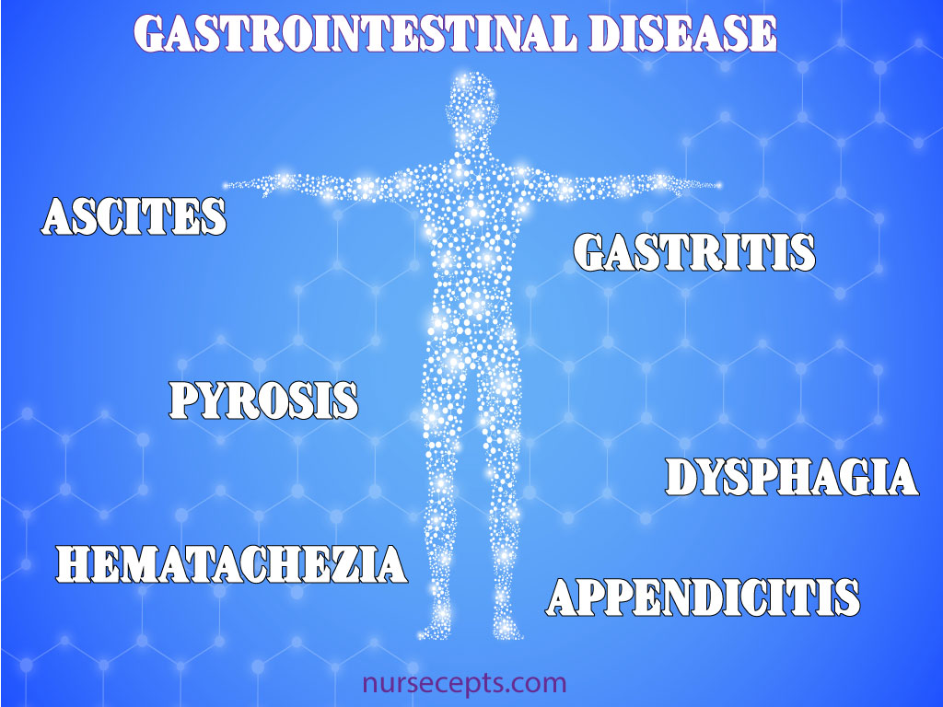
Gastrointestinal System Disorder and Disease
15
Notes:
Slide Show Notes
Let’s review briefly now with a multiple choice exercise. Choose the best answer, a or b, to complete each statement on the screen.
Third-degree burns are very serious and can even be life threatening. Call 911 immediately if you see signs of third-degree burns.
For a particle in the eye, flush with water until the particle comes out. Never rub the eye. If the particle doesn’t come out, cover the eye and get medical attention.
For inhalation of vapors or gases, get into fresh air right away.
For heatstroke, call 911 immediately if you recognize symptoms
of heatstroke. A person can die from heatstroke.

Slide 16
Respiratory System Disease
Definition | Terms
The accumulation of a large amount of fluid in the peritoneal space. | Ascites
Heartburn is a painful burning sensation in the esophagus just below the sternum. | Pyrosis
The passage of bright red blood from the rectum. | Hematochezia
The vomiting of bright red blood. | Hematemesis
Difficulty swallowing. | Dysphagia
A large amount of bilirubin in the blood causing a yellow discoloration of skin, mucus membrane and sclera of the eye. | Jaundice
The distinctive black tarry stool which usually suggests digested blood. | Melena
16
Notes:
Slide Show Notes
Let’s review briefly now with a multiple choice exercise. Choose the best answer, a or b, to complete each statement on the screen.
Third-degree burns are very serious and can even be life threatening. Call 911 immediately if you see signs of third-degree burns.
For a particle in the eye, flush with water until the particle comes out. Never rub the eye. If the particle doesn’t come out, cover the eye and get medical attention.
For inhalation of vapors or gases, get into fresh air right away.
For heatstroke, call 911 immediately if you recognize symptoms
of heatstroke. A person can die from heatstroke.

Slide 17
Definition | Terms
A large amount of fat in the feces that is foul smelling and floats. | Steatorrhea
The presences of gallstones in the gallbladder. | Cholelithiasis
A degenerative disease of the liver. | Cirrhosis
The abnormal enlargement of the liver. | Hepatomegaly
 | peptic ulcer
 | Intestinal obstruction
17
Notes:
Slide Show Notes
Let’s review briefly now with a multiple choice exercise. Choose the best answer, a or b, to complete each statement on the screen.
Third-degree burns are very serious and can even be life threatening. Call 911 immediately if you see signs of third-degree burns.
For a particle in the eye, flush with water until the particle comes out. Never rub the eye. If the particle doesn’t come out, cover the eye and get medical attention.
For inhalation of vapors or gases, get into fresh air right away.
For heatstroke, call 911 immediately if you recognize symptoms
of heatstroke. A person can die from heatstroke.

Slide 18
Any Question?
18
Notes:
Slide Show Notes
Let’s review briefly now with a multiple choice exercise. Choose the best answer, a or b, to complete each statement on the screen.
Third-degree burns are very serious and can even be life threatening. Call 911 immediately if you see signs of third-degree burns.
For a particle in the eye, flush with water until the particle comes out. Never rub the eye. If the particle doesn’t come out, cover the eye and get medical attention.
For inhalation of vapors or gases, get into fresh air right away.
For heatstroke, call 911 immediately if you recognize symptoms
of heatstroke. A person can die from heatstroke.

