Slide 1
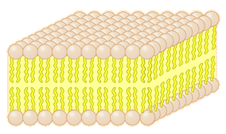
Lab-3-
The Cell Membrane
Homeostasis & Cellular Transport

Slide 2
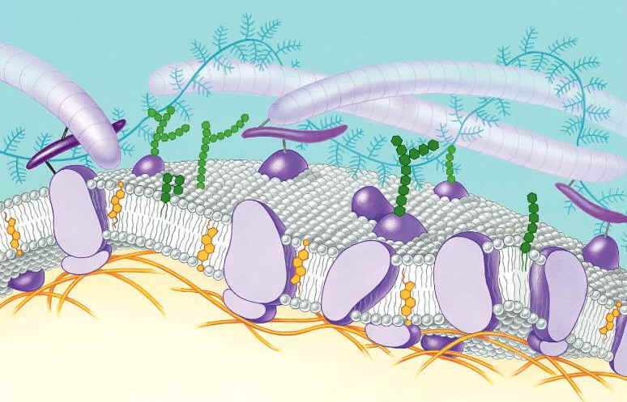
Function of the Cell Membrane:
Cell membrane separates the components of a cell from its environment—surrounds the cell
“Gatekeeper” of the cell—regulates the flow of materials into and out of cell—selectively permeable
Cell membrane helps cells maintain homeostasis—stable internal balance

Slide 3

The Cell Membrane & Homeostasis
The cell membrane is responsible for maintaining homeostasis (home-E-O-Stay-sis) within the cell
Homeostasis is a stable, internal environment
The cell membrane maintains homeostasis through balancing the pH, temperature, glucose (sugar intake), water balance
It does this through active and passive transport
In homeostasis, everything is PERFECT

Slide 4
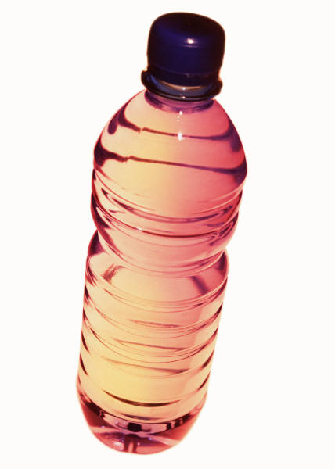
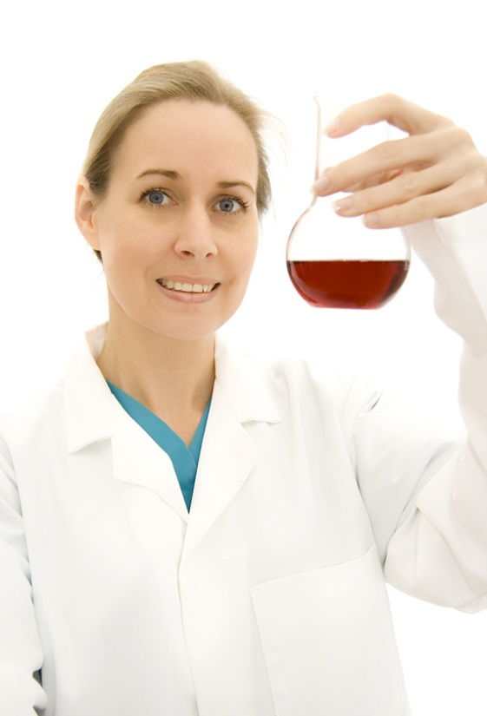
pH and homeostasis
The pH of a solution tells how acidic or basic it is.
pH ranges from a scale to 0-14
Solutions with a pH from 0-6 are acidic
Solutions with a pH of 8-14 are basic
Solutions with a pH of 7 are Neutral.
If a solution’s pH is unbalanced, it is corrected with a BUFFER.

Slide 5
Is it Basic, Acidic, or Neutral?
Orange juice w/ a pH of 2
Gastric juices (stomach juices) w/ a pH of 1
Tap water w/ a pH of 7
Sodium hydroxide w/ a pH of 10
Ammonia w/ a pH of 14
1 (acid)………………6 7(neutral) 8…………………14 (basic)

Slide 6
Cell Membrane aka “The Phospholipid Bilayer”
ALL cells have a cell membrane made of Phosphate, proteins, and lipids
That’s why it’s called the Phospholipid Bilayer
protein channel
Cell Membrane
Layer 1
Layer 2
lipid bilayer
protein pump
All Cells have a cell (plasma membrane):
Prokaryotes (have a cell wall + cell membrane)
Eukaryotes:
  a) Animal Cells ( cell membrane only)
  b) Plant cells (cell membrane + cell wall)

Slide 7
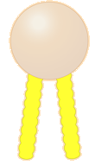
The cell membrane in detail
It’s a double layer (bilayer) of phosphates, and fats (lipids)
A single phospholipid has hydrophilic (water loving) phosphate heads AND hydrophobic (water hating) fatty acid tails
The cell membrane both repels and attracts water through the membrane at the same time
HydroPHILIC head
hydroPHOBIC tails

Slide 8
Passive Transport
A process that does not require energy to move molecules from a HIGH to LOW concentration
Diffusion
Facilitated Diffusion (uses proteins to push particles across)
Osmosis

Slide 9
Diffusion is the movement of small particles across the cell membrane like the cell membrane until homeostasis is reached.
Facilitated diffusion requires the help of carrier and channel proteins
These particles move from an area of high concentration to an area of low concentration.
outside of cell
inside of cell

Slide 10
Diffusion
Examples of diffusion: spraying aerosols, and perfumes.
High concentration (inside of the can)—the molecules are packed tightly together….
To a LOW concentration – when sprayed, the molecules are released to a more free environment
The particles SPREAD OUT
HIGH to LOW concentration

Slide 11
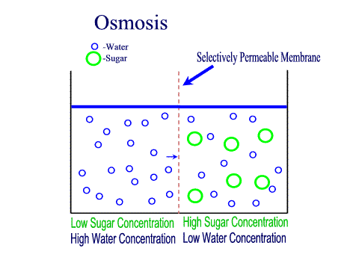
Osmosis is the movement of water through a selectively permeable membrane like the cell membrane
Water moves across the cell membrane from an area of high concentration to an area of low concentration.
Semi-permeable membrane is permeable to water, but not to sugar

Slide 12
Hypertonic Solutions: contain a high concentration of solute relative to another solution (e.g. the cell's cytoplasm). When a cell is placed in a hypertonic solution, the water diffuses out of the cell, causing the cell to shrivel.
Hypotonic Solutions: contain a low concentration of solute relative to another solution (e.g. the cell's cytoplasm). When a cell is placed in a hypotonic solution, the water diffuses into the cell, causing the cell to swell and possibly explode.
Isotonic Solutions: contain the same concentration of solute as another solution (e.g. the cell's cytoplasm). When a cell is placed in an isotonic solution, the water diffuses into and out of the cell at the same rate. The fluid that surrounds the body cells is isotonic.

Slide 13
Osmosis Concentration
Hypertonic: the water or solution OUTSIDE of the cell is saltier than the INSIDE of the cell.
Hyper = “more” ore “above”
This will cause it to shrivel, and shrink
Ex. Pouring salt on a slug will cause it to shrink

Slide 14
Osmosis Concentration
Hypotonic: the water or solution OUTSIDE of the cell
Hypo means “less than” or “below”
A hypotonic solution will cause the cell to take in water, and swell

Slide 15
Osmosis Concentration
Isotonic: the water outside of the cell has an EQUAL amount of salt as the water INSIDE of the cell.
Iso means “equal”
Will cause NO CHANGE in cell size

Slide 16
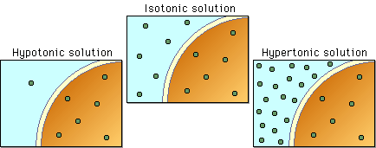

Slide 17
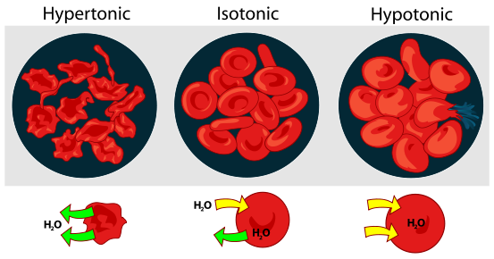
Interactive Red Blood Cell
Click

Slide 18
Types of Active Transport
Active transport uses ENERGY (ATP)
EXOcytosis = how materials EXIT the cell (how the cell uses the bathroom)
ENDOcytosis = how materials ENTER the cell (cell eating/engulfing)
PINOcytosis= how small materials ENTER the cell (cell eating/engulfing)
PHAGOcytosis = how larger materials ENTER the cell (cell eating/engulfing)

Slide 19
Active Transport
Active transport is the movement of molecules from LOW to HIGH concentration.
Energy is required as molecules must be pumped against the concentration gradient.
Proteins that work as pumps are called protein pumps.
Ex: Body cells must pump carbon dioxide out into the surrounding blood vessels to be carried to the lungs for exhale. Blood vessels are high in carbon dioxide compared to the cells, so energy is required to move the carbon dioxide across the cell membrane from LOW to HIGH concentration.
outside of cell
Carbon Dioxide molecules
inside of cell

Slide 20
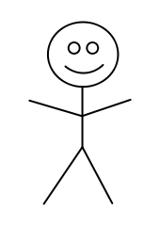
ANALOGY: Passive Transport vs. Active Transport
Active Transport: like going UPHILL
ENERGY NEEDED:
Active Transport
NO ENERGY NEEDED:
Diffusion
Osmosis
Facilitated Diffusion
Passive Transport: Like going DOWNHILL

