Slide 2
Cholesterol
Cholesterol is a fatty substance necessary for the proper functioning of the body, and it binds with lipoproteins, these proteins transport cholesterol to and from cells
in general it is present in the body in two types, the good "HDL" and the bad "LDL" cholesterol.

Slide 3
Cholesterol
The body needs cholesterol to make hormones, vitamin D, and to support the digestive process, the liver manufactures it in sufficient quantities it produces 80% frome cholesterol, but the liver is not the only source of cholesterol , as 20% of blood cholesterol comes from foods such as meat, dairy products, and poultry ..

Slide 5
1-The good Cholesterol (HDL):
which is known as beneficial cholesterol, as these lipoproteins transport cholesterol to the liver to rid the body of it, and it also helps rid the body of excess cholesterol so that it does not collect in the blood vessels.

Slide 6
The importance of HDL
1-remove the LDL frome the blood.
2-decrease the LDL and recycle it by transferring it to the liver,where it is recycled.
3-Good Cholesterol works by repairing the inner walls of blood vessels, so it protects and maintains arteries.

Slide 7
2- The bad Cholesterol (LDL):
This type deposits cholesterol on the walls of the arteries and thus leads to atherosclerosis or myocardial infarction

Slide 9
Triglycerides : are a type of fat (lipid) found in your blood.
When you eat, your body converts any calories it doesn't need to use right away into triglycerides. The triglycerides are stored in fat cells. Later, hormones release triglycerides for energy between meals.
If you regularly eat more calories than you burn, particularly from high-carbohydrate foods, you may have high triglycerides (hypertriglyceridemia).

Slide 10
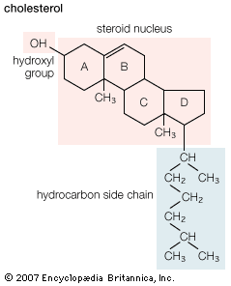
What is the different between cholesterol and T.G ??

Slide 11
best wishes

