Slide 1
Lecture -11 Fungi
Fungus: is a member of a large group of eukaryotic organisms, filamentous, heterotrophs with cell walls made of chitin that includes microorganisms such as yeasts (unicellular) and molds (multicellular), as well as mushrooms. These organisms are classified as a kingdom Fungi.
Why Study Fungi?
Are microorganisms can cause human disease directly or by toxins.
Can affect plants we eat.

Slide 2
Modes of nutrition
All fungi are heterotrophs; غيرية التغذية are not able to ingest their food like animals do, nor can they manufacture their own food the way plants do. Instead, fungi feed by absorption of nutrients from the environment around them. They accomplish this by growing through and within the substrate on which they are feeding. Most fungi are saprophytes, رمية feeding on dead or decaying material.
Fungi=absorptive heterotrophs
Heterotroph (chemo-organotrophs): an organism incapable of synthesizing carbohydrates from inorganic sources; requires preformed organic carbon source for growth.
**The body of a fungus (thallus ) consists largely of filamentous chains of cells called hyphae , some hyphae have septa (septate), some don’t (aseptate ).
يتكون جسم الفطر (ثالوس) إلى حد كبير من سلاسل خيطية من الخلايا تسمى خيوط ، وبعضها بها حاجز (مقسم) ، والبعض الآخر لا (مقسم).

Slide 3
The hyphae secrete digestive enzymes which break down the substrate, making it easier for the fungus to absorb the nutrients which the substrate contains.
Therefore, the natural habitat of almost all fungi is soil or water containing decaying organic matter. لذلك ، فإن الموائل الطبيعية لجميع.
الفطريات تقريبًا هي التربة أو الماء الذي يحتوي على مواد عضوية متحللة
General Properties of Fungi:
1- Fungus is a member of eukaryotic organisms which includes yeasts and Molds.
2- Fungi feed by absorption of nutrients from environment. Hyphae secrets digestive enzymes which breaks down the substrate and makes it easier for fungus to absorb the nutrients
3- Fungi vary widely in size & shape from unicellular microscopic organism to multicellular organism.
4- Spore size, shape & structure are used in the classification & identification of fungi.

Slide 4
5- hyphae and other structures form mycelium.
6- Fungi reproduces sexually and asexually.
7- Fungi are classified based upon hyphae , spore and reproduction.
8- Fungal infections are localized skin infections and systemic infections.
9- Mycoses are diseases caused by fungi.
10- Many are ecologically important saprophytes (consume dead and decaying matter). 5- تشكل الخيوط والتراكيب الأخرى الفطريات. 6- تتكاثر الفطريات عن طريق الاتصال الجنسي واللا جنسي. 7- تصنف الفطريات على أساس الخيوط والجراثيم والتكاثر. 8- الالتهابات الفطرية هي التهابات الجلد الموضعية والتهابات جهازية. 9- الامراض الفطرية هي أمراض تسببها الفطريات. 10- العديد من الفطريات
بيئيًا(تستهلك المواد الميتة والمتحللة). المهمة الرخامية
Basic Structures الهياكل الأساسية
Hypha: fundamental tube-like structural units of fungi
a- Septate: divided by cross walls.
b- Aseptate: lacking cross walls.
: وحدات هيكلية أساسية تشبه الأنبوب من الفطريات أ- مقسمة: Hypha
المتقاطعة مقسمة بجدران متقاطعة. ب- غير مقسمة: يفتقر إلى الجدران.

Slide 5
Mycelium : a mass of hyphae forming the vegative portion of the Fungus a - Aerial - growing or existing in the air b - Vegetative - absorbs nutrients c - Fertile - bears conidia or spores for reproduction.
الفطريات: كتلة من الخيوط تشكل الجزء النباتي من الفطريات أ- هوائي - ينمو أو موجود في الهواء
- ب- نباتي - يمتص العناصر الغذائية ج- تكاثري تحمل كونيديا أو ابواغ للتكاثر.
Spores
Sporulation & Spores - Fusion of nuclear material.

Slide 6
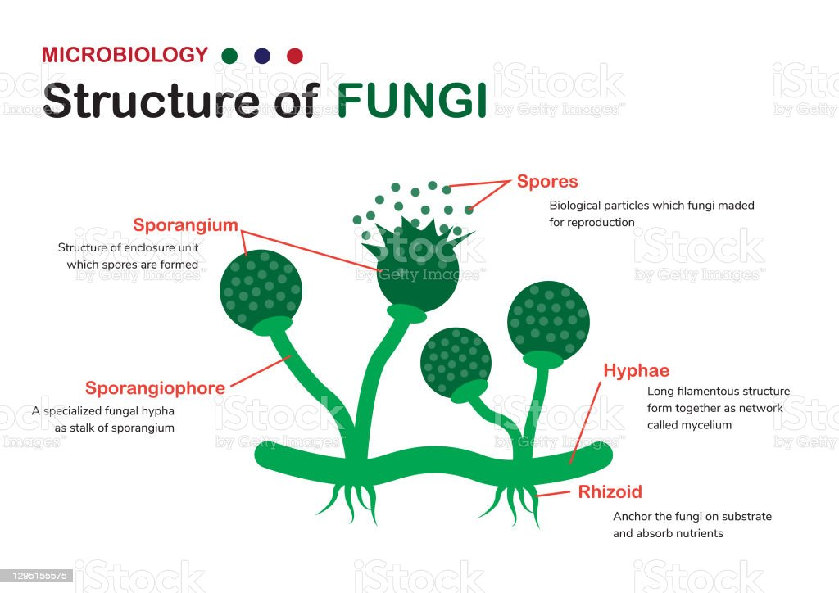

Slide 7
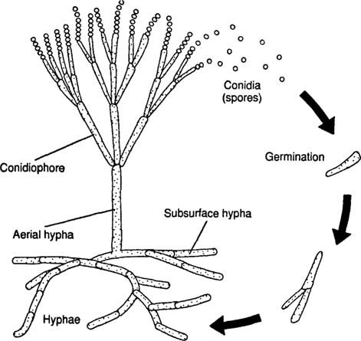

Slide 8
Fungi Reproduction
1 - Sexual Reproduction
2 - Asexual Reproduction
It occurs by the following methods.
1 - Fragmentation In this process, the mycelium breaks into two or
more similar fragments. Each fragment grows into a new
mycelium.
2 - Budding The parent cell produces one or more projections called
buds, which later develop necessary structures and detach to grow
into new individuals. Budding is common in unicellular forms like
yeast.
3 - Fission In this process, the parent cell splits into two equal
halves, each of which develop into a new individual. Fission is also
common in yeast.

Slide 9
SPORES
Asexual spores
-Arthrospore
-Blastospore
-Chlamydospore
-Conidia
* Microconidia
* Macroconidia
Sexual spores
-sexual reproduction is NOT common in fungi.
  Ascospore
  Basidiospore
  Zygospore

Slide 10
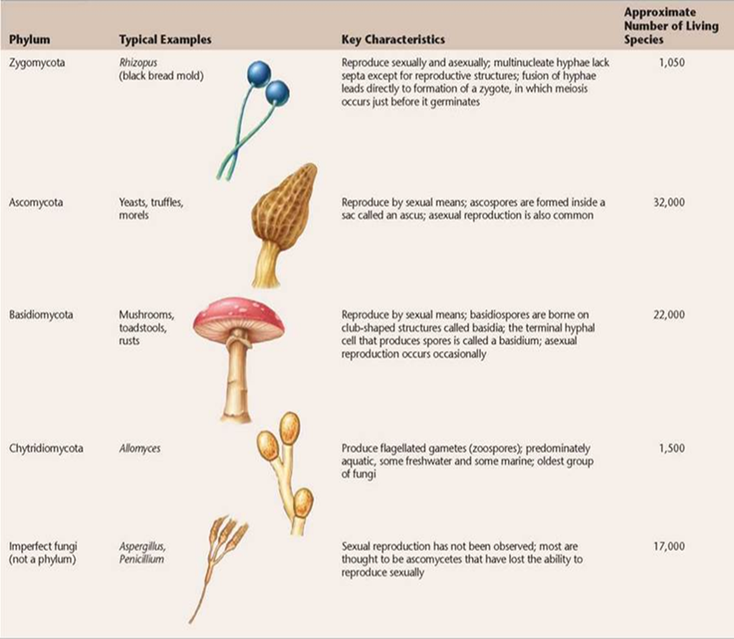

Slide 11
Fungi form two key mutualistic symbiotic associations:
تشكل الفطريات نوعين من العلاقات التكافلية الرئيسية:
1- Lichens: الأشنات A lichen is a mutualistic symbiotic association between a fungus and a photosynthetic algae or cyanobacterium.
2- Mycorrhizae: الفطريات Mycorrhizae are mutualistic symbiotic associations between fungi and the roots of plants.
Classification of fungi
Depending on Morphology
1 - Yeasts
- Unicellular fungi, nonfilamentous, typically oval or spherical cells. Reproduce by mitosis:
- Yeasts are facultative anaerobes, which allows them to grow in a variety of environments. When oxygen is available, they carry out aerobic respiration, when oxygen is not available, they ferment carbohydrates to produce ethanol and carbon dioxide.

Slide 12
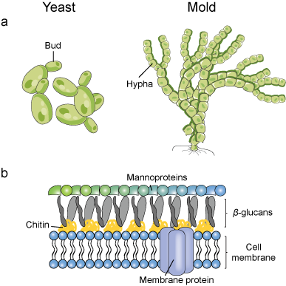
2 - Molds
The molds form large multicellular aggregates of long branching filaments, called hyphae. There are vegetative hyphae and reproductive hyphae. Spores are borne on the reproductive hyphae. Spore size, shape and structure are used in the classification and identification of fungi.

Slide 13
3 - Yeast like fungi
Grow partly as yeasts and partly as elongated cells resembling hyphae which are called pseudo hyphae . e.g. Candida albicans
4 - Dimorphic fungi
Most fungi causing systemic infections are dimorphic:
Dimorphism in pathogenic fungi typically depends on
temperature:
At 37ºC: Yeast form.
At 25ºC: Mold form.

Slide 14
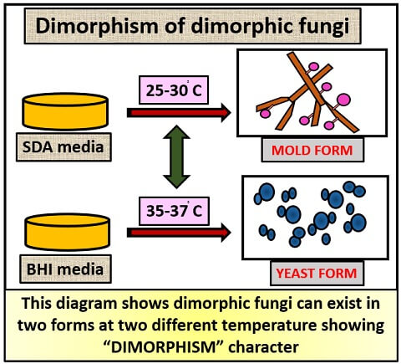
Dimorphism in nonpathogenic fungi may depend on other factors: Carbon dioxide concentration.

