Slide 1
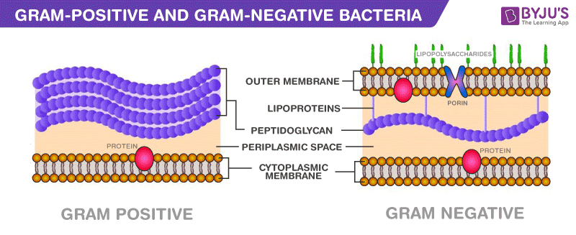
Difference between Gram-Positive and Gram-Negative Bacteria

Slide 2
Gram Positive | Gram Negative
Gram-Positive bacteria | Gram-Negative bacteria
Cell Wall
A single-layered, smooth cell wall | A double-layered, wavy cell-wall
Cell Wall thickness
The thickness of the cell wall is 20 to 80 nanometres | The thickness of the cell wall is 8 to 10 nanometres
Peptidoglycan Layer
It is a thick layer/ also can be multilayered | It is a thin layer/ often single-layered.
Teichoic acids
Presence of teichoic acids | Absence of teichoic acids
Outer membrane
The outer membrane is absent | The outer membrane is present (mostly)
Porins
Absent | Occurs in Outer Membrane
Mesosome
It is more prominent. | It is less prominent.

Slide 3
Gram Positive\ | Gram Negative
Morphology
Cocci or spore-forming rods | Non-spore forming rods.
Flagella Structure
Two rings in basal body | Four rings in basal body
Lipid content
Very low | 20 to 30%
Lipopolysaccharide
Absent | Present
Toxin Produced
Exotoxins | Endotoxins or Exotoxins
Resistance to Antibiotic
More susceptible | More resistant
Examples
Staphylococcus, Streptococcus, etc. | Escherichia, Salmonella, etc.

Slide 4
Gram Staining
These bacteria retain the crystal violet colour even after they are washed with acetone or alcohol and appear as purple-coloured when examined under the microscope after gram staining. | These bacteria do not retain the stain colour even after they are washed with acetone or alcohol and appear as pink-coloured when examined under the microscope after gram staining.

Slide 5
Gram-negative bacteria are more resistant against antibodies because their cell wall is impenetrable.
Gram-positive bacteria constitute a cell wall, which is mainly composed of multiple layers of peptidoglycan that forms a rigid and thick structure. Its cell wall additionally has teichoic acids and phosphate. The teichoic acids present in the gram-positive bacteria are of two types – the lipoteichoic acid and the teichoic wall acid. The cell wall is known as murein.
In gram-negative bacteria, the cell wall is made up of an outer membrane and less layers of peptidoglycan. The outer membrane is composed of lipoproteins, phospholipids, and LPS. The peptidoglycan stays intact to lipoproteins of the outer membrane that is located in the fluid-like periplasm between the plasma membrane and the outer membrane. The periplasm is contained with proteins and degrading enzymes which assist in transporting molecules.
The cell walls of the gram-negative bacteria, unlike the gram-positive, lacks the teichoic acid. Due to the presence of porins, the outer membrane is permeable to nutrition, water, food, iron, etc.

Slide 6
Gram Staining
This technique was proposed by Christian Gram to distinguish the two types of bacteria based on the difference in their cell wall structures. The gram-positive bacteria retain the crystal violet dye, which is because of their thick layer of peptidoglycan in the cell wall.
This process distinguishes bacteria by identifying peptidoglycan that is found in the cell wall of the gram-positive bacteria. A very small layer of peptidoglycan is dissolved in gram-negative bacteria when alcohol is added.
Difference between Gram-Positive and Gram-Negative Bacteria – Key Points
The cell wall of gram-positive bacteria is composed of thick layers peptidoglycan.
The cell wall of gram-negative bacteria is composed of thin layers of peptidoglycan.
In the gram staining procedure, gram-positive cells retain the purple coloured stain.
In the gram staining procedure, gram-negative cells do not retain the purple coloured stain.
Gram-positive bacteria produce exotoxins.
Gram-negative bacteria produce endotoxins.

Slide 7
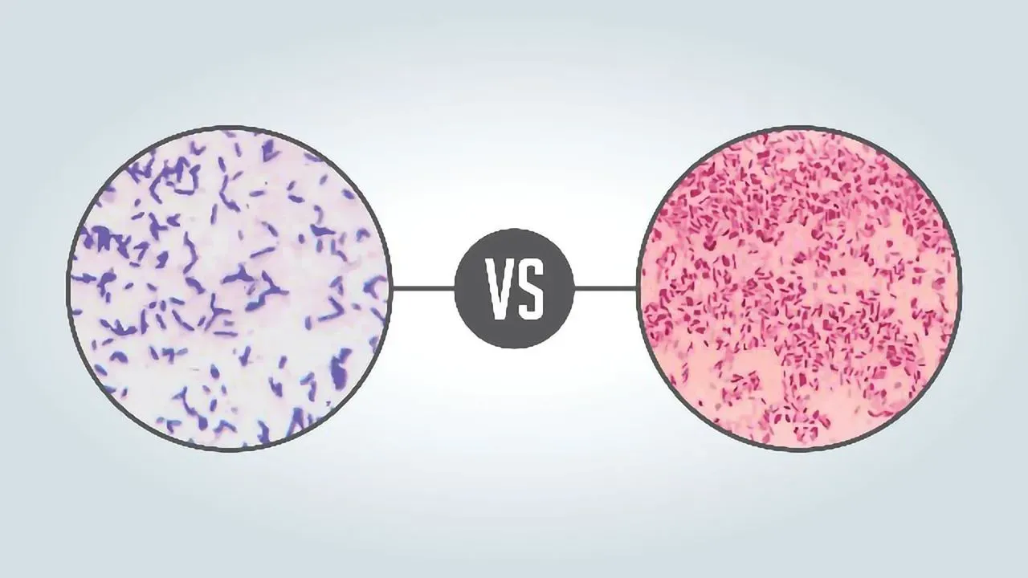
What infections are caused by gram-positive bacteria?
Gram-positive bacteria usually cause Urinary Tract Infections. These are caused commonly in people who are more prone to urinary tract infections or are elderly or pregnant.
Which infections are caused by gram-negative bacteria?
The gram-negative bacteria cause various infections in humans such as indigestion, food poisoning, pneumonia, meningitis and other bacterial infections in the blood cells, bloodstream, wound infections, etc. The infections are caused by Acinetobacter, Pseudomonas aeruginosa and E.coli.

Slide 8
Gram positive bacteria | Gram negative bacteria
Distinctive purple appearance after gram staining | Pale reddish color after gram staining
Bacteria include all staphylococci, all streptococci and some listeria species | Bacteria include enterococci, salmonella species and pseudomonas species
Thick peptidoglycan layer | Thin peptidoglycan layer
No outer lipid membrane | Outer lipid membrane present
No O-specific side chains present | O-specific side chains present
Teichoic and lipoteichoic acids present | Teichoic and lipoteichoic acids not present

Slide 9
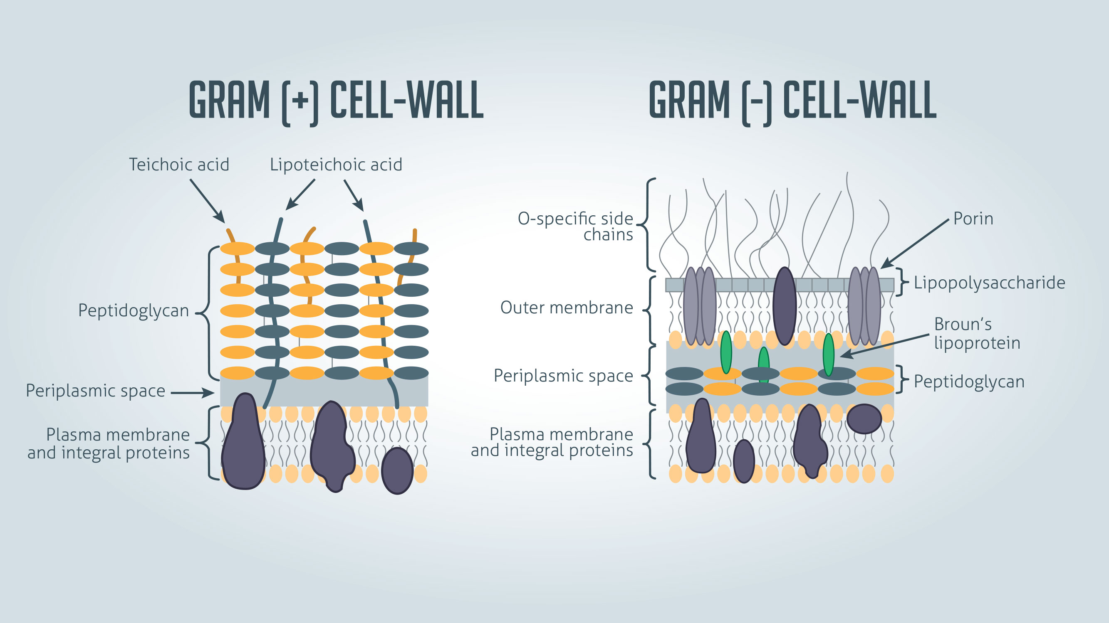

Slide 10
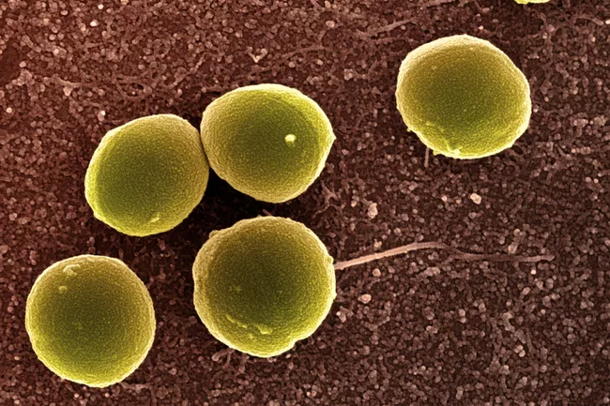
Some Gram positive bacteria have an additional component, mycolic acid, in their cell walls. Mycolic acids produce a waxy outer layer that provides additional protection for mycobacteria, such as Mycobacterium tuberculosis. Gram positive bacteria with mycolic acid are also called acid-fast bacteria because they require a special staining method, known as acid-fast staining, for microscope observation.
Pathogenic Gram positive bacteria cause disease by the secretion of toxic proteins known as exotoxins. Exotoxins are synthesized within the prokaryotic cell and released into the exterior of the cell. They are specific to certain bacterial strains and can cause serious damage to body organs and tissues. Some Gram negative bacteria also produce exotoxins.
Gram positive cocci

Slide 11
Gram Negative Bacteria
Like Gram positive bacteria, the Gram negative bacterial cell wall is composed of peptidoglycan. However, the peptidoglycan is a single thin layer compared to the thick layers in Gram positive cells. This thin layer does not retain the initial crystal violet dye but picks up the pink color of the counterstain during Gram staining. The cell wall structure of Gram negative bacteria is more complex than that of Gram positive bacteria. Located between the plasma membrane and the thin peptidoglycan layer is a gel-like matrix called periplasmic space. Unlike in Gram positive bacteria, Gram negative bacteria have an outer membrane layer that is external to the peptidoglycan cell wall. Membrane proteins, murein lipoproteins, attach the outer membrane to the cell wall.
Another unique characteristic of Gram negative bacteria is the presence of lipopolysaccharide (LPS) molecules on the outer membrane.
LPS is a large glycolipid complex that protects bacteria from harmful substances in their environment. It is also a bacterial toxin (endotoxin) that can cause inflammation and septic shock in humans if it enters the blood.
There are three components of the LPS: Lipid A, a core polysaccharide, and an O antigen. The lipid A component attaches the LPS to the outer membrane. Attached to the lipid A is the core polyssaccharide. It is located between the lipid A component and the O antigen. The O antigen component is attached to the core polyssaccharide and differs between bacterial species. It can be used to identify specific strains of harmful bacteria.
Gram negative cocci refer to Gram negative bacteria that are spherically shaped. Bacteria of the genus Neisseria are examples of Gram negative cocci that cause disease in humans. Neisseria meningitidis is diplococcus, meaning that its spherical cells remain in pairs after cell division. Neisseria meningitidis causes bacterial meningitis and can also cause septicemia and shock

Slide 12
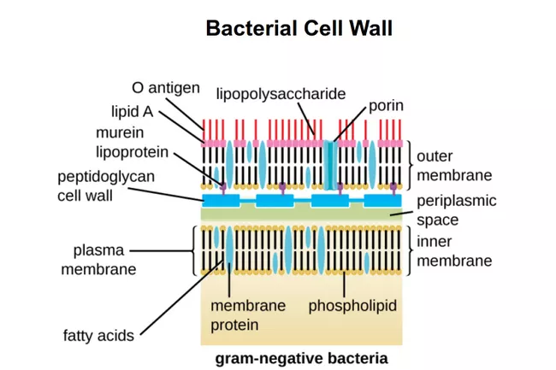

Slide 13
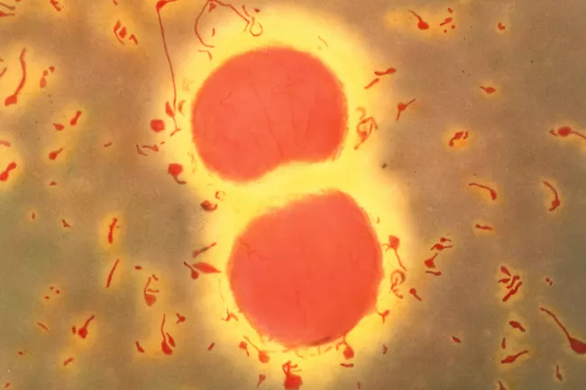
Neisseria meningitidis are spherical, Gram negative bacteria which cause meningitis in humans. The bacteria are typically seen in pairs, each one concave on the side facing its partner.
Another diplococcus bacterium, N. gonorrhoeae, is the pathogen responsible for the sexually transmitted disease gonorrhea. Moraxella catarrhalis is a Gram negative diplococcus that causes ear infections in children, upper respiratory system infections, endocarditis, and meningitis
Gram negative coccobacillus bacteria have bacterial shapes that are in between spherical and rod shaped. Bacteria of the genus Haemophilus and Acinetobacter are coccobacilli that cause serious infections. Haemophilus influenzae can cause meningitis, sinus infections, and pneumonia. Acinetobacter species cause pneumonia and wound infections.

Slide 14
Key Points: Gram Positive vs. Gram Negative Bacteria
Most bacteria can be broadly classified as Gram positive or Gram negative.
Gram positive bacteria have cell walls composed of thick layers of peptidoglycan.
Gram positive cells stain purple when subjected to a Gram stain procedure.
Gram negative bacteria have cell walls with a thin layer of peptidoglycan. The cell wall also includes an outer membrane with lipopolysaccharide (LPS) molecules attached.
Gram negative bacteria stain pink when subjected to a Gram stain procedure.
While both Gram positive and Gram negative bacteria produce exotoxins, only Gram negative bacteria produce endotoxins.

Slide 15
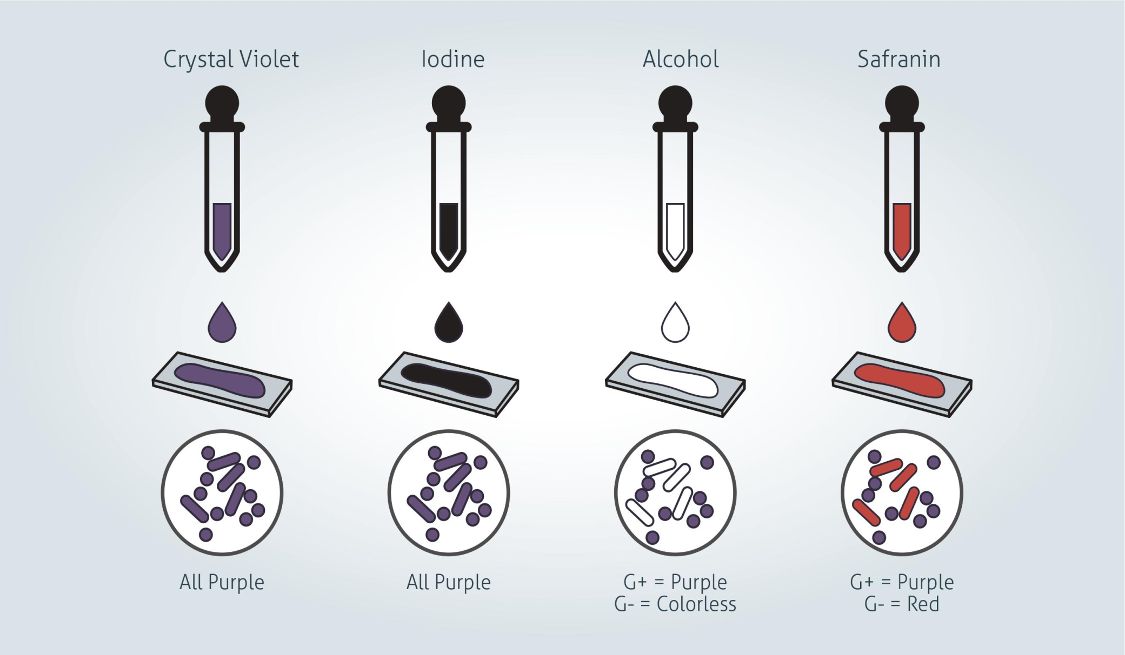
Gram positive vs Gram negative stain

Slide 16
Gram stain procedure - Preparing a sample
1. Label a clean glass microscope slide with your sample identification. Ensure you use a pencil as many inks are removed by the reagents used in the staining procedure.
2. If preparing your slide from a liquid bacterial culture:
Dab a small drop culture onto the slide using a sterile loop. Gently smear the droplet in a circular motion into an area of approximately 1 cm diameter. For very dense cultures it may be necessary to pre-dilute your culture to ensure individual bacterial cells can be seen under a microscope following staining.
If the source material is from a bacterial plate:
Resuspend a loop of colony material in sterile phosphate buffered saline (PBS) and then proceed as for a liquid culture.
3. Once the smear has air dried, pass the smeared slide through a flame two or three times.
This kills the microbes in the smear and fixes the sample to the slide, be careful not to overheat the sample however as this can distort cellular morphology.

Slide 17
Gram stain procedure - Gram staining a sample
1. Gently flood the smear with crystal violet and leave for 1 minute. Tilt the slide slightly and gently rinse with tap water or distilled water.
Crystal violet is a water-soluble dye which enters the peptidoglycan layer in the bacterial cell wall.
2. Gently flood the smear with Gram’s iodine and leave for 1 minute. Tilt the slide slightly and gently rinse with tap water or distilled water. The smear will now appear purple.
Gram's iodine solution (iodine and potassium iodide) is added to form a complex with the crystal violet, which is much larger and is insoluble in water.
3. Decolorize the smear using 95% ethyl alcohol or acetone. Tilt the slide slightly and apply the alcohol drop by drop until the alcohol runs almost clear (5-10 seconds). Immediately rinse with water to avoid over-decolorizing.
Decolorizer dehydrates the peptidoglycan layer, shrinking and tightening it. In Gram positive bacteria, the large crystal violet-iodine complexes are then unable to penetrate and escape the thick peptidoglycan layer, resulting in purple stained cells. However, in Gram negative bacteria, the outer membrane is degraded, the thin peptidoglycan layer is unable to retain the crystal violet-iodine complexes and the color is lost.
4. Gently flood with safranin counterstain and leave for 45 seconds. Tilt the slide slightly and gently rinse with tap water or distilled water.
Safranin is weakly water soluble and will stain bacterial cells a light red, enabling visualization of Gram negative cells without interfering with the observation of the purple of the Gram positive cells.
5. Blot the slide dry on filter paper then view the smear using a light-microscope under oil-immersion.

Slide 18
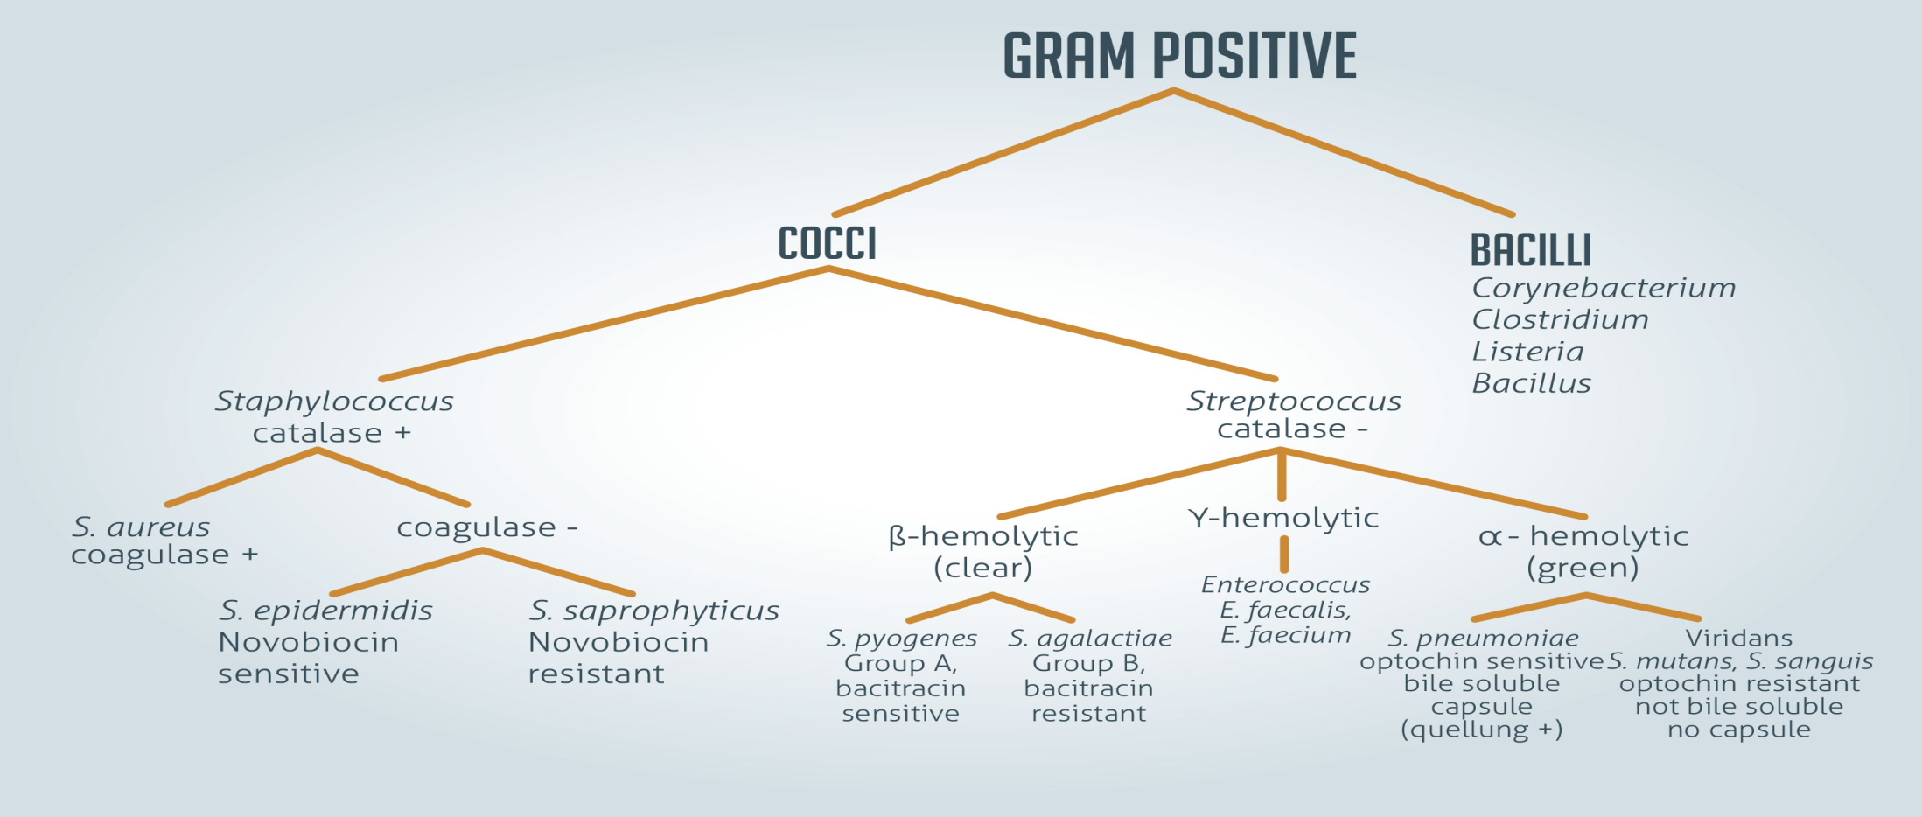
Gram positive vs Gram negative color
Gram positive bacteria
Gram positive bacteria have a distinctive purple appearance when observed under a light microscope following Gram staining. This is due to retention of the purple crystal violet stain in the thick peptidoglycan layer of the cell wall. Examples of Gram positive bacteria include all staphylococci, all streptococci and some listeria species.

Slide 19
Gram negative bacteria
Gram negative bacteria appear a pale reddish color when observed under a light microscope following Gram staining. This is because the structure of their cell wall is unable to retain the crystal violet stain so are colored only by the safranin counterstain. Examples of Gram negative bacteria include enterococci, salmonella species and pseudomonas species.
Gram staining cannot be used reliably to assess bacterial phylogenetic relationships. The single membrane of Gram positive species is thought to be the ancestral state. Historically it had been thought that the second membrane found on Gram negative bacteria evolved just once and so all Gram negative species were more closely related to one another than they were to Gram positive species. However, genetic analysis has since shown this not to be the case and it is likely to have evolved multiple times in different lineages - a product of convergent evolution.

Slide 20
Gram Positive vs Gram Negative Bacteria (31 Major Differences)
S.N. | Character | Gram-Positive Bacteria | Gram-Negative Bacteria
1. | Gram Reaction | Retain crystal violet dye and stain blue or purple on Gram’s staining. | Accept safranin after decolorization and stain pink or red on Gram’s staining.
2. | Cell wall thickness | Thick (20-80 nm) | Thin (8-10 nm)
3. | Peptidoglycan Layer | Thick (multilayered) | Thin (single-layered)
4. | Rigidity and Elasticity | Rigid and less elastic | Less rigid and more elastic
5. | Outer Membrane | Absent | Present
6. | Variety of amino acid in cell wall | Few | Several
7. | Aromatic and Sulfur-containing amino acid in cell wall | Absent | Present
8. | Periplasmic Space | Absent | Present
9. | Teichoic Acids | Mostly present | Absent
10. | Porins | Absent | Present

Slide 21
11. | Lipopolysaccharide (LPS) Content | Virtually None | High
12. | Lipid and Lipoprotein Content | Low (acid-fast bacteria have lipids linked to peptidoglycan) | High (because of the presence of outer membrane
13. | Ratio of RNA:DNA | 8:1 | Almost 1
14. | Mesosomes | Quite Prominent | Less Prominent
15. | Flagellar Structure | 2 rings in basal body | 4 rings in basal body
16. | Magnetosomes | Usually absent. | Sometimes present.
17. | Morphology | Usually cocci or spore-forming rods (exception: Lactobacillus and Corynebacterium) | Usually non-spore-forming rods (Exception: Neisseria)
18. | Endospore formation | Some produce endospores during unfavorable conditions. | Usually not found to produce endospores.
19. | Toxin Produced | Exotoxins | Endotoxins or Exotoxins
20. | Pathogens | Few pathogenic bacteria belong to the Gram-positive group. | Most pathogens are Gram-negative.

Slide 22
21. | Nutritional Requirements | Relatively Complex | Relatively Simple
22. | Resistance to Physical Disruption | High | Low
23. | Cell Wall Disruption by Lysozyme | High | Low (requires pretreatment to destabilize outer membrane)
24. | Susceptibility to Penicillin and Sulfonamide | High | Low
25. | Susceptibility to Streptomycin, Chloramphenicol, and Tetracycline | Low | High
26. | Inhibition by Basic Dyes | High | Low
27. | Susceptibility to Anionic Detergents | High | Low
28. | Resistance to Sodium Azide | High | Low
29. | Resistance to Drying | High | Low
30. | Rendering | They can render Gram -ve by increasing acidity | They can render Gram +ve by increasing alkalinity
31. | Examples | Staphylococcus Streptococcus Bacillus Clostridium Enterococcus Listeria | Escherichia Salmonella Klebsiella Proteus Helicobacter Pseudomonas

Slide 23
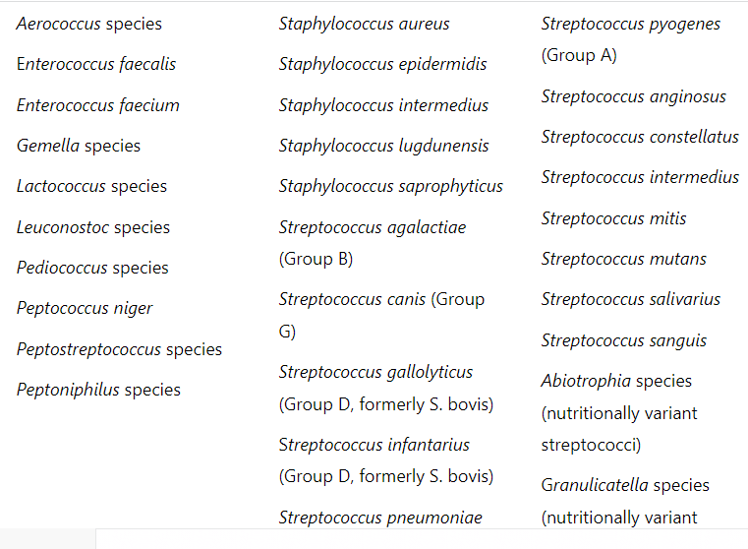
Examples of Gram-positive cocci bacteria

Slide 24
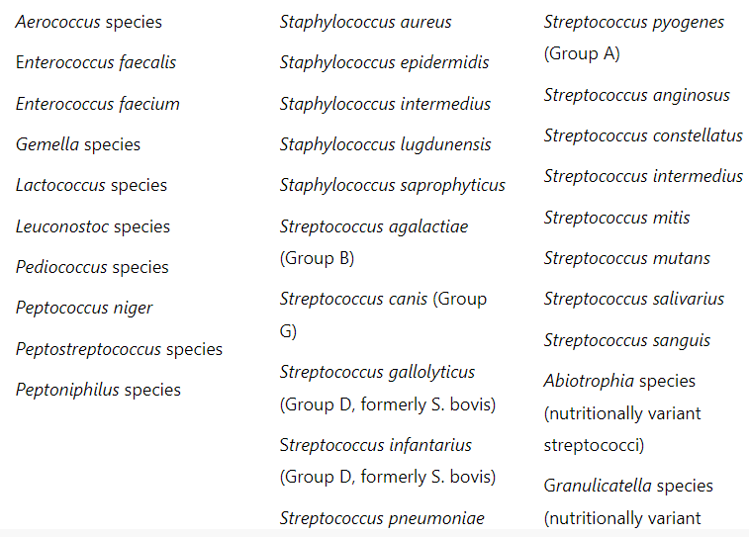
Examples of Gram-positive bacilli bacteria

Slide 25
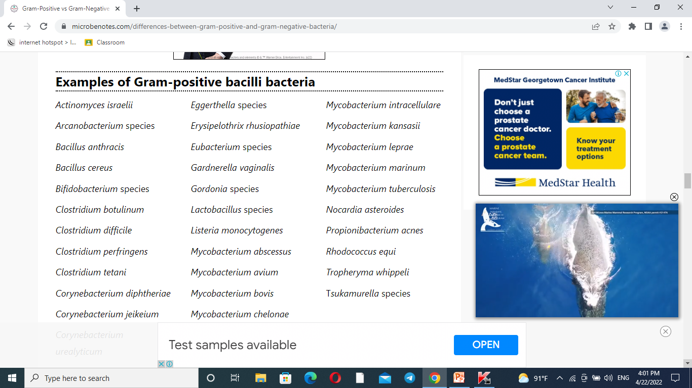

Slide 26
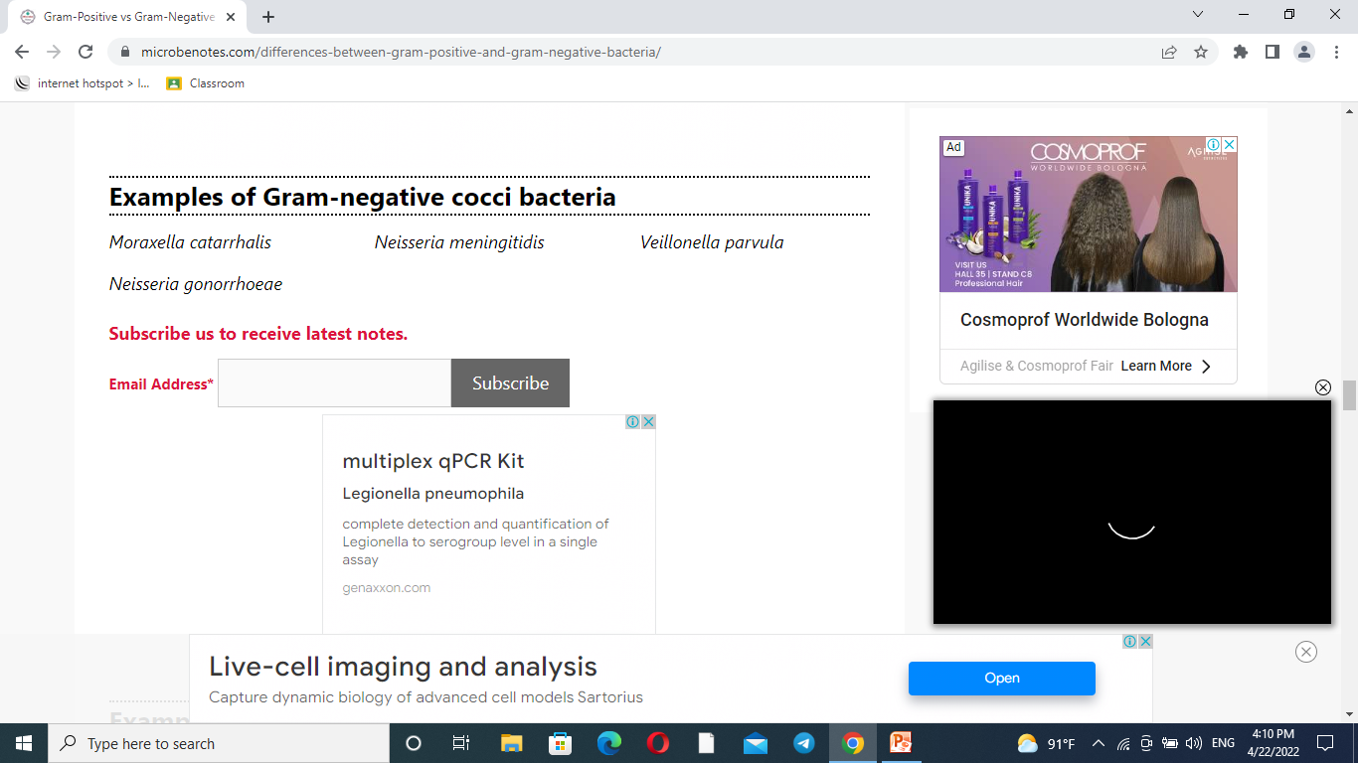

Slide 27
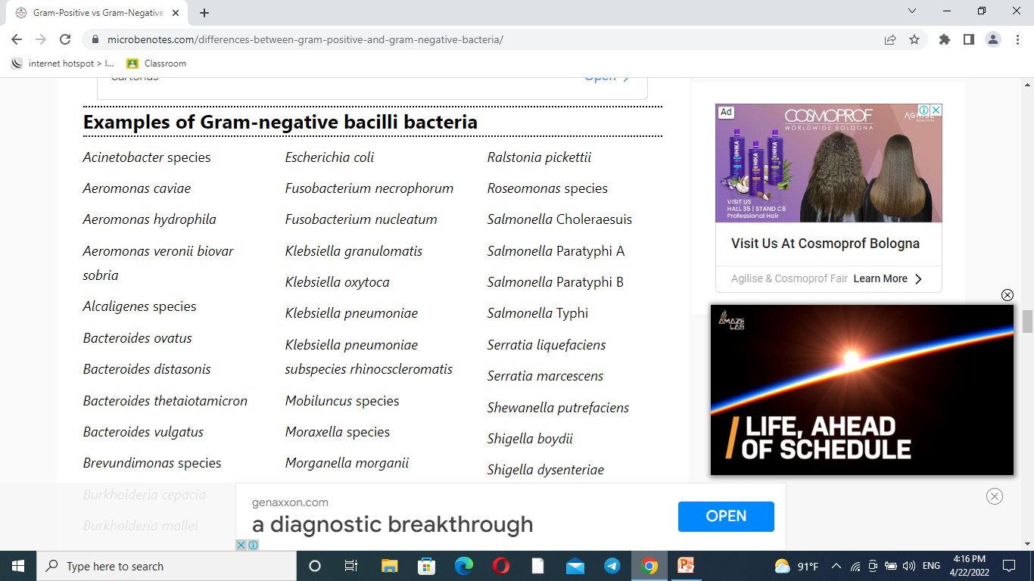

Slide 28


Slide 29
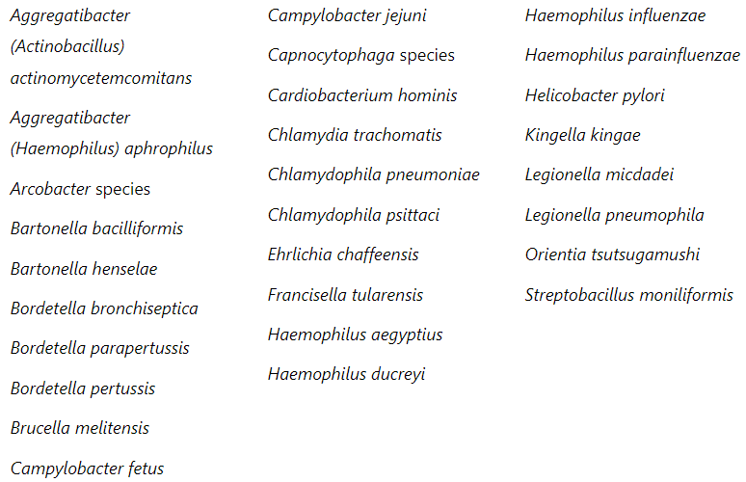
Examples of Gram-negative bacilli and coccobacilli bacteria

Slide 30
Difference Between Endotoxins And Exotoxins
Character | Endotoxins | Exotoxins
Definition | Endotoxins are the lipopolysaccharide-protein complexes, produced at the time of cell death. | Exotoxins are polypeptide proteins excreted by few species of bacteria.
Location | It is a part of the cells and located on chromosomal genes. | It is released from the cells and located on extrachromosomal genes (e.g. plasmids).
Toxicity | Endotoxin is moderate toxic. | Exotoxin is highly toxic.
Source | It is produced after the disintegration of the gram-negative bacteria. | It is produced in the living gram-positive bacteria and certin gram-negative bacteria.
Molecular Weight | The molecular weight is 50-1000 KDa (kilodelton). | The molecular weight is 10 KDa (kilodelton).
Heat sensitive | It is heat stable and active at 250° C or even at 1000° C. | Its is heat imbalanced and destroyed beyond 60-80° C.
Boiling | It does not get denatured on boiling. | It gets denatured on boiling.
Toxic Conversion | It is not possible in endotoxins. | It is possible in exotoxins.

Slide 31
Detected | It is detected in LAL (limulus amebocyte lysate test. | It is detected in various tests like precipitation, neutraliation etc.
Diseases | Meningococcemia, sepsis by gram negative rods etc. | Botulism, Diphtheria, Tetanus.
Enzymatic Activity | The enzymatic activities are always high. | Their is no enzymatic activity.
Effects | Endotoxins general symptoms are fever, diarrhea, vomiting etc. | Exotoxins symptoms are either cytotoxin, enterotoxin or neurotoxin with defined action on cells or tissues.
Neutralization | It cannot be neutralized by antibodies. | it can be neutralized by antibodies.
Vaccines | No effective vaccines are available for endotoxin | Effective vaccines are available for exotoxins.

Slide 32
Immunogenicity | Endotoxins are weakly immunogenic. | Exotoxins are highly immunogenic.
Potency | A large amount of toxin is required to cause a disease. | A single toxin molecule is enough to cause a disease.
Examples | Toxins produced by E.coli, Shigella, Vibrio cholera, Salmonella Typhi. | Toxins produced by Staphylococcus aureus, Streptococcus pyogenes, Bacillus anthracis, Bacillus cereus.

