Slide 1

Al-Mustaqbal University College
Department of Nursing
Medical Terminology
Lecture \8
Notes:
Slide Show Notes
When a serious injury occurs, you have to think and act quickly. Medical assistance may be only minutes away, but sometimes seconds count. What you do in those first few seconds and minutes can make the difference between life and death. Quick, calm, and correct action can make all the difference.
“First aid” is emergency care given to the sick or injured before medical personnel arrive. That’s why a knowledge of first aid and CPR (cardiopulmonary resuscitation) is so important. And that’s why you’re participating in this session today.
The purpose of this session is to provide you with a basic overview of first-aid techniques and priorities. It is not the same as a first-aid and CPR certification course. A certification course is much more detailed and offers you the opportunity to practice first-aid and CPR skills as well as to provide you with hours of classroom training.
We urge you to take a course and get certified. Taking a certification course will give you the full knowledge and confidence you need to use first-aid skills on the job, at home, and elsewhere in your community.
In the meantime, the information in this session can help you better handle medical emergencies when you are the first or only person on the scene.

Slide 2
Objectives:
After studying this lecture, you will be able to:
Define common medical combining forms.
Define common medical prefixes.
Define common medical suffixes.
2
Notes:
Slide Show Notes
Let’s review briefly now with a multiple choice exercise. Choose the best answer, a or b, to complete each statement on the screen.
Third-degree burns are very serious and can even be life threatening. Call 911 immediately if you see signs of third-degree burns.
For a particle in the eye, flush with water until the particle comes out. Never rub the eye. If the particle doesn’t come out, cover the eye and get medical attention.
For inhalation of vapors or gases, get into fresh air right away.
For heatstroke, call 911 immediately if you recognize symptoms
of heatstroke. A person can die from heatstroke.

Slide 3
The Structure and Functions of the Integumentary System
The integumentary system protects the body against pathogens, regulates body temperature, provides sensory input and synthesizes vitamin D. The components of the integumentary system consist of the skin, hair, and nails. Below is a list of structures and functions of the integumentary system.

Slide 4
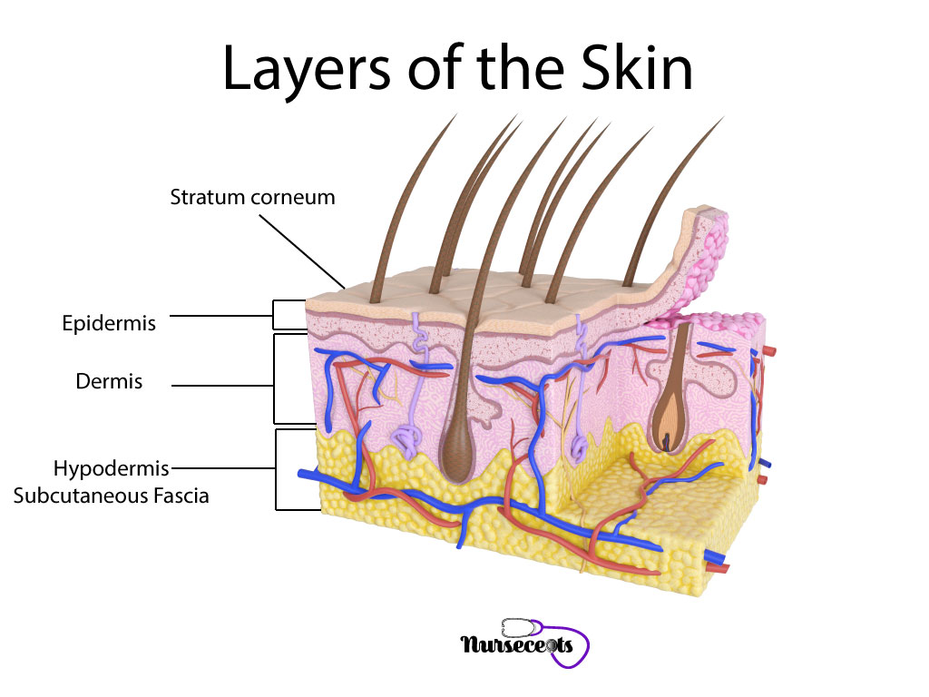

Slide 5
Word Root and Combining Vowel for Integumentary System
Example | Meaning | Combining Frame
Dermatitis | Skin | Drem\o, Cutane(o)
Melanocytes | Melanin | Melan\o
Cyanosis | Blue | Cyan(o)
Melanoma | Cancer | Carcin(o)
Onychectomy | Nail | Onych(o), Ungu(o)
Trichomoniasis. | Hair | Trich(o)
Seborrhea | Sebum | Seb\o

Slide 6
Prefixes and Suffixes for Integumentary System
Example | Meaning | Prefixes
Epidermis | Above | Epi-
Hypopigmentation | Decrease | Hypo-
Hyperpigmentation | Increase | Hyper-
Melanomegaly | Enlargement | -megaly
Onychectomy | Remove | -ectomy
Onychitis | Inflammation | -itis
Melanoma | Tumor | -oma

Slide 7

7
Notes:
Slide Show Notes
Let’s review briefly now with a multiple choice exercise. Choose the best answer, a or b, to complete each statement on the screen.
Third-degree burns are very serious and can even be life threatening. Call 911 immediately if you see signs of third-degree burns.
For a particle in the eye, flush with water until the particle comes out. Never rub the eye. If the particle doesn’t come out, cover the eye and get medical attention.
For inhalation of vapors or gases, get into fresh air right away.
For heatstroke, call 911 immediately if you recognize symptoms
of heatstroke. A person can die from heatstroke.

Slide 8
Specialist in Integumentary System
Definition | Terms
A division of medicine that diagnoses and treat conditions of the skin, hair, and nails. | Dermatology
A physician specializing in the treatment of the skin and accessory structures. | Dermatologist
A branch of medicine that treats conditions of the integumentary system | Plastic Surgery
A physician that repairs, improves and reconstructs damaged body structures. | Plastic Surgeon
8
Notes:
Slide Show Notes
Let’s review briefly now with a multiple choice exercise. Choose the best answer, a or b, to complete each statement on the screen.
Third-degree burns are very serious and can even be life threatening. Call 911 immediately if you see signs of third-degree burns.
For a particle in the eye, flush with water until the particle comes out. Never rub the eye. If the particle doesn’t come out, cover the eye and get medical attention.
For inhalation of vapors or gases, get into fresh air right away.
For heatstroke, call 911 immediately if you recognize symptoms
of heatstroke. A person can die from heatstroke.

Slide 9
Definition | Terms
Acne is a disorder of the sebaceous glands and hair follicles in which pimples, cysts that are infected or abscesses occur. | Acne
Alopecia is the lack of hair due to conditions such as normal aging, skin disorders, anticancer medications, or endocrine disorders. | Alopecia
Dermatitis is inflammation of the skin. | Dermatitis
An ulcer is a crater in the skin as a result of necrosis. An ulcer can be shallow or deep and can be accompanied by an infection or inflammation. | Ulcer
9
Notes:
Slide Show Notes
Let’s review briefly now with a multiple choice exercise. Choose the best answer, a or b, to complete each statement on the screen.
Third-degree burns are very serious and can even be life threatening. Call 911 immediately if you see signs of third-degree burns.
For a particle in the eye, flush with water until the particle comes out. Never rub the eye. If the particle doesn’t come out, cover the eye and get medical attention.
For inhalation of vapors or gases, get into fresh air right away.
For heatstroke, call 911 immediately if you recognize symptoms
of heatstroke. A person can die from heatstroke.

Slide 10
Any Question?
10
Notes:
Slide Show Notes
Let’s review briefly now with a multiple choice exercise. Choose the best answer, a or b, to complete each statement on the screen.
Third-degree burns are very serious and can even be life threatening. Call 911 immediately if you see signs of third-degree burns.
For a particle in the eye, flush with water until the particle comes out. Never rub the eye. If the particle doesn’t come out, cover the eye and get medical attention.
For inhalation of vapors or gases, get into fresh air right away.
For heatstroke, call 911 immediately if you recognize symptoms
of heatstroke. A person can die from heatstroke.

