Slide 1

Al- Mustaqbal University College جامعة المستقبل الاهلية
First stage. مرحلة الاولى
Department of Optometry(Optics) قسم التقنيات البصرية
Head and neck anatomy
Lec. 3
Anatomical Terminology
Dr. Marrwan Hisham Mohamed

Slide 2

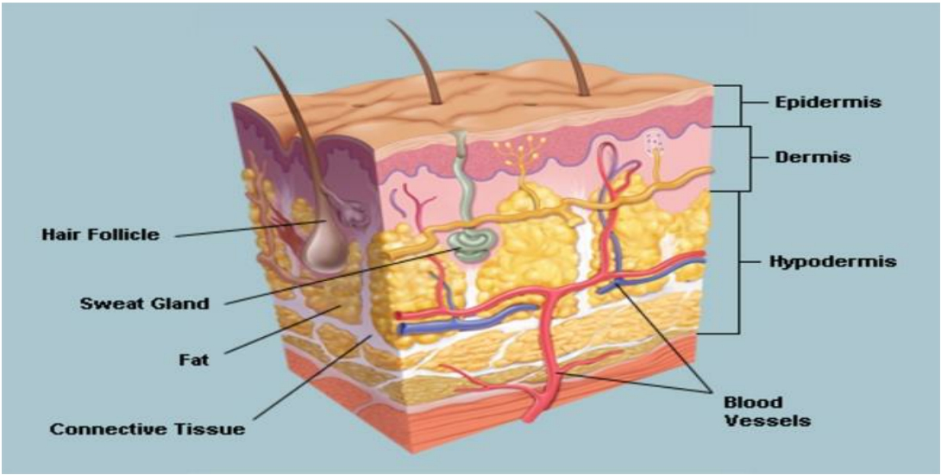
Anatomy of Skin

Slide 3
Skin
The skin is a vital organ that covers the entire outside of the body, forming a protective barrier against pathogens and injuries from the environment. The skin is the body's largest organ; covering the entire outside of the body, it
is about 2 mm thick and weighs approximately six
pounds.

Slide 4
• It shields the body against heat, light, injury, and infection.
• The skin also helps regulate body temperature.
• sensory information from the environment.
• stores water, fat, and vitamin D.
• plays a role in the immune system protecting us from disease.
Functions of skin

Slide 5
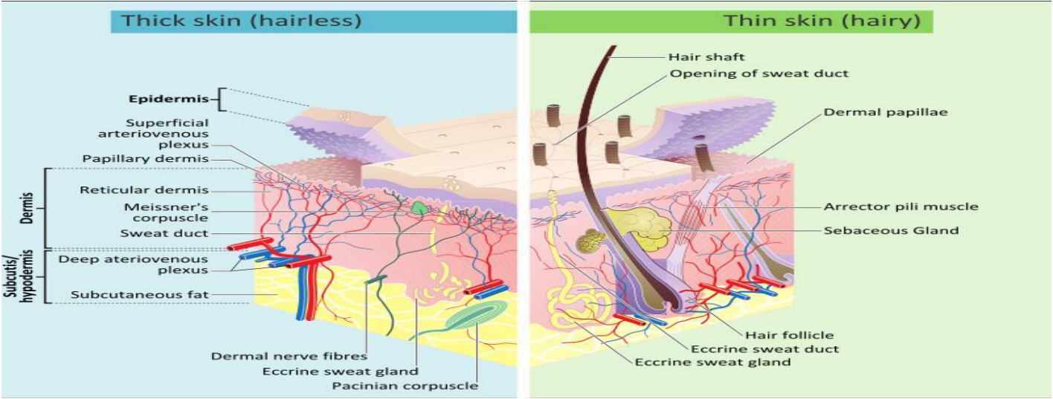
Types of skin
1- Thin (hairy): which is more prevalent on the body.
2- Thick and hairless: which is found on parts of the body that are used heavily and endure a large amount of friction, like the palms of the hands or the soles of the feet.

Slide 6
Basically, the skin is comprised of two layers that cover a third fatty layer. These three layers differ in function, thickness, and strength:
• EPIDERMIS
The outer layer is called the epidermis; it is a tough protective layer that contains the melanin-producing melanocytes.
• DERMIS
The second layer (located under the epidermis) is called the dermis; it contains nerve endings, sweat glands, oil glands, and hair follicles.
• HYPODERMIS
Under these two skin layers is a fatty layer of subcutaneous tissue, known as the subcutis or hypodermis.
Layers of skin

Slide 7
EPIDERMIS
• The Stratum Corneum
The stratum corneum is the outermost layer of the epidermis, and is made up of 10 to 30 thin layers of continually shedding, dead keratinocytes.
• The Stratum Granulosum & the Stratum Lucidum
As these cells move further towards the surface of the skin, they get bigger and flatter and adhere together, and then eventually become dehydrated and die.
• Stratum spinosum: also known squamous cell layer.
This layer contains cells called Keratinocytes produce keratin, a tough, protective protein that makes up the majority of the structure of the skin, hair, and nails.
• The Stratum germinativum : also known The basal cell layer.
This layer contains cells called melanocytes. Melanocytes produce the skin coloring or pigment known as melanin.

Slide 8
DERMIS
• The Papillary Layer
• The upper, papillary layer, contains a thin arrangement of collagen fibers. The papillary layer supplies nutrients to select layers of the epidermis and regulates temperature.
• The Reticular Layer
The lower, reticular layer, is thicker and made of thick collagen fibers that are arranged in parallel to the surface of the skin. The reticular layer is denser than the papillary dermis, and it strengthens the skin, providing structure and elasticity. It also supports other components of the skin, such as hair follicles, sweat glands, and sebaceous glands.

Slide 9
HYPODERMIS
This layer also known as the Subcutis or subcutaneous layer:
is the innermost layer of the skin, and consists of a network of fat and collagen cells, and functions as both an insulator, conserving the body's heat, and as a shock-absorber, protecting the inner organs. It also stores fat as an energy reserve for the body. The blood vessels, nerves, lymph vessels, and hair follicles also cross
through this layer. The thickness of the subcutis layer varies
throughout the body and from person to person.

Slide 10
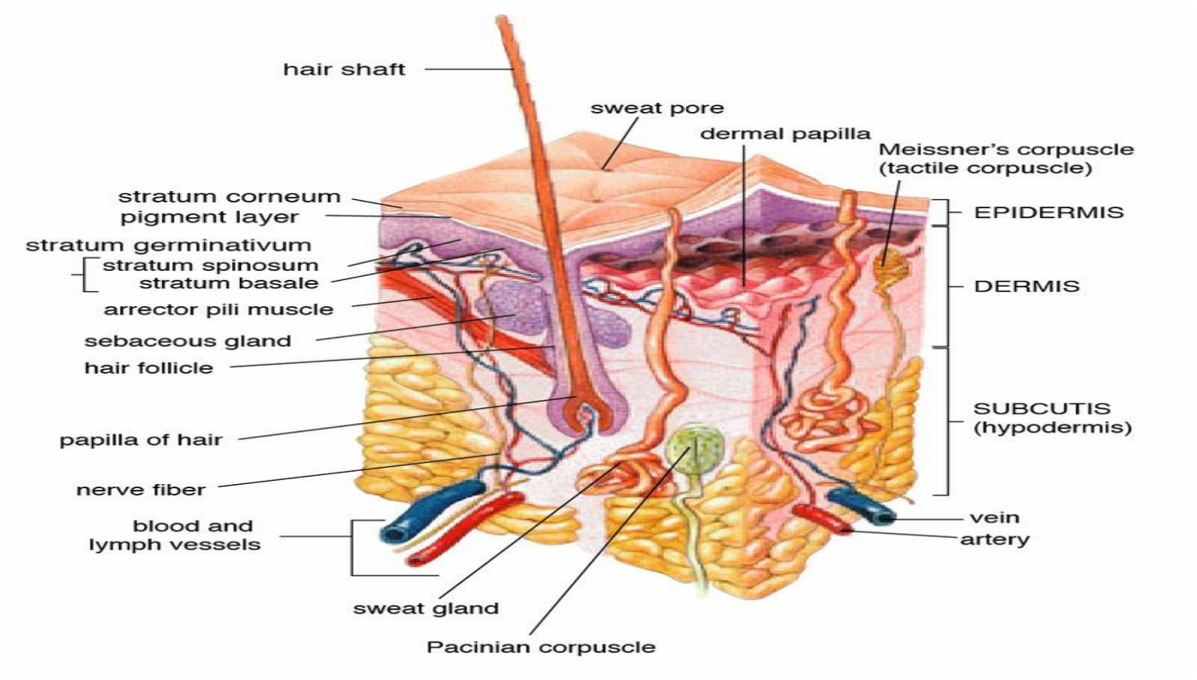

Slide 11
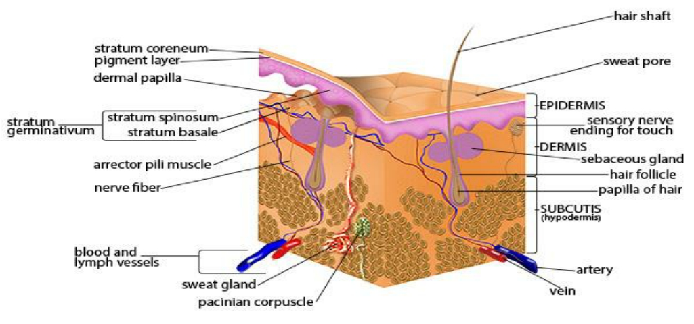
The skin contains many specialized cells and structures
• Basket Cells
• Blood Vessels
• Hair Erector Muscle (Arrector Pili Muscle)
• Hair Follicle
• Hair Shaft
• Langerhans Cells
• Melanocyte
• Merkel Cells
• Pacinian Corpuscle
• Sebaceous Gland
• Sensory Nerves
• Sweat Gland

Slide 12
Thank
you

