Slide 1



Electronic
Professor Ehssan Al-Bermany
PhD
1st semester
© Department of Physics, University of Babylon, 2019.

Slide 2
Chapter One: Semiconductor Material
Lecture 1
© Prof E. Al-Bermany, Department of Physics, University of Babylon.

Slide 3
Electronics
Electronics is the branch of physics that deals with:
the emission and effects of electrons
the use of electronic devices, i.e.,
Science of the motion of charges in a gas, vacuum or semiconductor.
An electronic building blocks packaged in a discrete form with two or more connecting leads or metallic pads.
Components are connected together to create an electronic circuit with a particular function, e.g.: an amplifier radio receiver or oscillator. Active components are sometimes called devices.
Composed of subsystems or electronic circuits, which may include amplifiers signal sources, power supplies etc…, e.g.: Laptop, DVD players, iPod, mobile phonex, PDA (Personal Digital Assistant).
© Prof E. Al-Bermany, Department of Physics, University of Babylon.

Slide 4
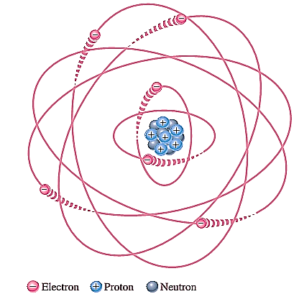


  Atomic structure
All matters on earth made of atoms (made up of elements or combination of elements); all atoms consist of electrons, protons and neutrons except normal hydrogen, which does not have a neutron.
An atom is the smallest particle of an element that retains the characteristics of that element.
According to Bohr, atoms have a planetary orbits structure that consists of a central nucleus, surround by orbiting electrons (Figure 1). Nucleus contains protons and neutrons, similar to the way planets orbit the sun in our solar system.
Each type of atom has a certain number of electrons and protons that distinguishes it from atoms of other elements.
Each electron has its own orbit that corresponds to different energy levels.
In an atom, orbits are grouped into energy bands known as shells. Each shell has a fixed maximum number of electrons at allowed energy levels. The maximum number of electrons
that can exist in each shell can be calculated as,
Ne=2n2 where n is the number of the shell.
Figure (1)
© Prof E. Al-Bermany, Department of Physics, University of Babylon.

Slide 5
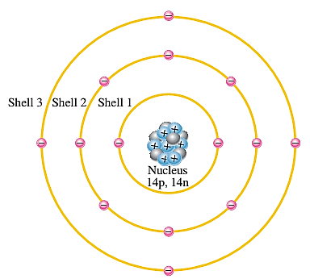
Electrons that are in orbits farther from the nucleus have higher energy and are less tightly bound to the atom than those closer to the nucleus.
Electrons with the highest energy exist in the outermost shell of an atom and are relatively loosely bound to the atom.
This outermost shell is known as the valence shell and electrons in this shell are called valence electrons.
Valence electrons contribute to chemical reactions and bonding within the structure of a material and determine its electrical properties.
Maximum number of valence electron is 8.
An atom is stable if it has 8 valence electrons.
The number of valence electrons determines the ability of material to conduct current.
Figure 2: Illustration of the Bohr model of the silicon atom.
© Prof E. Al-Bermany, Department of Physics, University of Babylon.

Slide 6
  Materials Classification (Insulators, Conductors, and Semiconductor)
  In terms of their electrical properties, materials can be classified into three groups: conductors, semiconductors, and insulators.
  Insulators: An insulator is a material that does not conduct electrical current under normal conditions.
  Valence electrons are tightly bound to the atoms; therefore, there are very few free electrons in an insulator.
  Energy gap in an insulator is very wide (≥ 6 eV). Valence electron requires a large electric field to gain enough energy to jump into conduction band.
  Examples of insulators are rubber, plastics, glass, mica, and quartz.

Slide 7
Conductors: A conductor is a material that easily conducts electrical current. Most metals are good conductors.
The best conductors are (with one valence electron) e.g.: copper (Cu), silver (Ag), gold (Au), and aluminum (Al), which are characterized by atoms with only one valence electron very loosely bound to the atom.
In a conductor, the valence band and the conductor band overlaps
(≤ 0.01 eV). Only a little energy or voltage is needed for the electron to jump into conduction band.
Semiconductors: A semiconductor is a material that is between conductors and insulators in its ability to conduct electrical current. A semiconductor in its pure (intrinsic) state is neither a good conductor nor a good insulator. Single-element semiconductors are silicon (Si), germanium (Ge), antimony (Sb), arsenic (As), astatine (At), boron (B), polonium (Po) and tellurium (Te), these semiconductor characterized by atoms with four valence electrons. Compound semiconductors such as gallium arsenide, indium phosphide, gallium nitride, silicon carbide and silicon germanium are also commonly used. Silicon is the most commonly used semiconductor.
© Prof E. Al-Bermany, Department of Physics, University of Babylon.

Slide 8
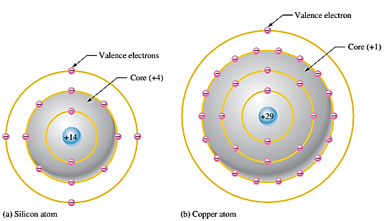
Silicon is a semiconductor and Copper is a conductor. Bohr diagrams of the silicon atom and the Copper atom are shown in following Figure 3.
A Silicon atom has 4 electrons in its valence ring. This makes it a semiconductor.
A Copper atom has only 1 electron in its valence ring. This makes it good conductor.
Figure 3: Diagrams of the silicon and copper atoms.
© Department of Physics, University of Babylon, 2019.

Slide 9
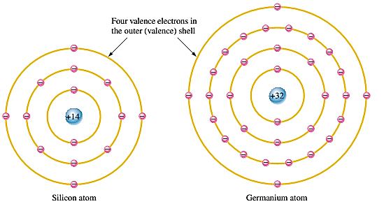
    Silicon and Germanium
The atomic structures of silicon and germanium are compared in Figure 4,
Both silicon and germanium have the characteristic four valence electrons.
The valence electrons in germanium are in the fourth shell while those in silicon are in the third shell, closer to the nucleus.
This means that the germanium valence electrons are at higher energy levels than those in silicon.
Therefore, require a smaller amount of additional energy to escape from the atom. This property makes germanium more unstable at high temperatures and results in excessive reverse current. This is why silicon is a more widely used semiconductive material.
Figure 4
© Prof E. Al-Bermany, Department of Physics, University of Babylon.

Slide 10
    Energy Gap
Energy in an electron is of two types – kinetic (energy of motion) and potential (energy of position).
Each material has its own set of permissible energy levels for the electrons in its atomic structure.
Energy level in an atom is measured in electron volt (eV) = 1.602× 10-19 J
Electrons that orbits within an energy level will have similar amount of energy. When an electron acquires sufficient additional energy, it can leave the valence shell and become a free electron and exists in the condition band.
The energy difference between the valence and conduction band is called the energy gap. Energy gap: the amount of energy that a valence electron must have to jump into the conduction band.
Figure 5 shows energy diagrams for insulators, semiconductors and conductors. The gap for insulators can be crossed only when breakdown conditions occur. In semiconductors, the band gap is smaller, allowing an electron in the valence band to jump into the conduction band if it absorbs a photon. The band gap depends on the semiconductor material. In conductors, the conduction band and valence band overlap, so there is no gap. This means that electrons in the valence band move freely into the conduction band, so there are always electrons available as free electrons.
© Prof E. Al-Bermany, Department of Physics, University of Babylon.

Slide 11
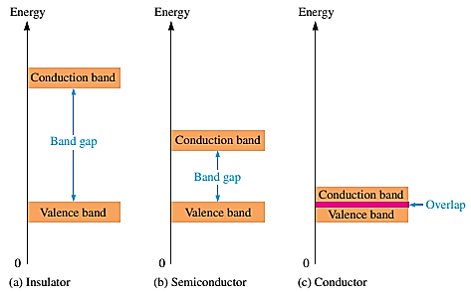
Figure 5: Energy diagrams for insulators, semiconductors, and conductors.
© Prof E. Al-Bermany, Department of Physics, University of Babylon.

Slide 12
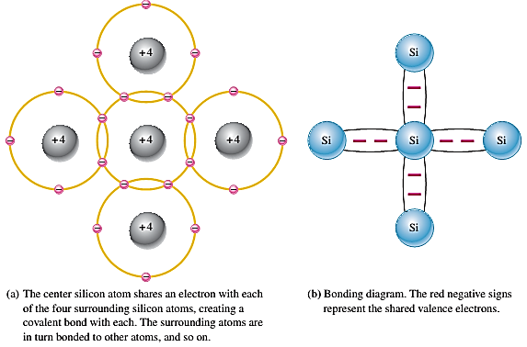
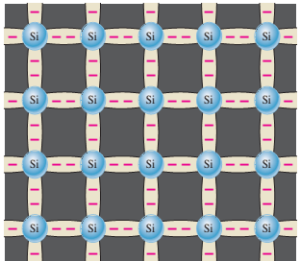
    Covalent Bonds
Figure 6 shows how each silicon atom positions itself with four adjacent silicon atoms to form a silicon crystal. A silicon (Si) atom with its four valence electrons shares an electron with each of its four neighbors. This creates eight shared valence electrons for each atom and produces a state of chemical stability. Also, this sharing of valence electrons produces the covalent bonds that hold the atoms together. Covalent bonding in an intrinsic silicon crystal is shown in Figure 6c. An intrinsic crystal is one that has no impurities. Covalent bonding for germanium is similar because it also has four valence electrons.
Figure 6: Illustration of covalent bonds in silicon.
© Prof E. Al-Bermany, Department of Physics, University of Babylon.

Slide 13
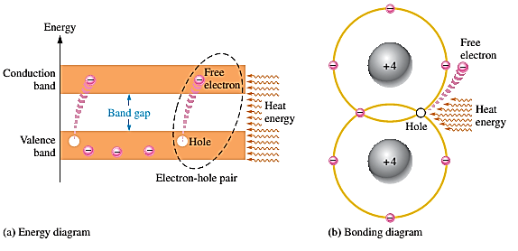
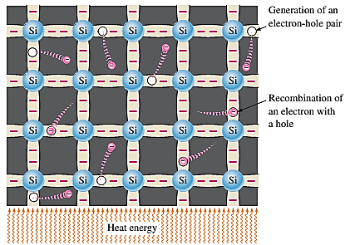
    Conduction Electrons and Holes
When an intrinsic silicon crystal gains sufficient heat (thermal energy), some valence electrons could break their covalent bonds to jump the gap into conduction band, becoming free electrons. Free electrons are also called conduction electrons, (negative charge). This is illustrated in Figure 7.
The vacancy in the valence band is called a hole (positive charge). For every electron raised to the conduction band there is 1 hole in the valence band creating–electron-hole pair. There is an equal number of holes in the valence band created when these electrons jump into the conduction band, this is illustrated in Figure 8. When a conduction-band electron loses energy and falls back into a hole, this is called recombination.
Figure 7: Creation of electron-hole
pairs in a silicon crystal.
Figure 8: Free electrons are being generated continuously while some recombine with holes.
© Prof E. Al-Bermany, Department of Physics, University of Babylon.

Slide 14
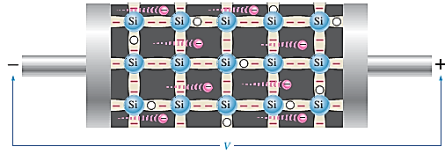
    Electron and Hole Current
In conduction band, when a voltage is applied across a piece of intrinsic silicon, as shown in Figure 9, the thermally generated free electrons in the conduction band, are now easily attracted toward the positive end. This movement of free electrons is one type of current in a semiconductive material and is called electron current.
Figure 8:
© Prof E. Al-Bermany, Department of Physics, University of Babylon.

Slide 15
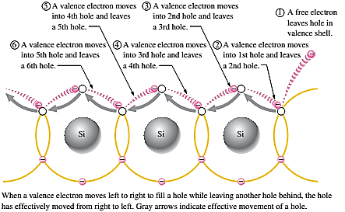
In valance band, in valance band holes generated due to free electrons. Electrons in the valance band are although still attached with atom and not free to move,
However they can move into nearby hole with a little change in energy, thus leaving another hole where it came from.
Effectively the hole has moved from one place to another in the crystal structure, as illustrated in Figure 9. Although current in the valence band is produced by valence electrons, it is called hole current to distinguish it from electron current in the conduction band.
Figure 9
© Prof E. Al-Bermany, Department of Physics, University of Babylon.

Slide 16
    Doping
Since semiconductors are generally poor conductors,
Their conductivity can be increased by the controlled addition of impurities to the intrinsic (pure) semiconductive material.
This process, called doping, increases the number of current carriers (electrons or holes).
Two types of semiconductor material that are subjected to doping process, which are N-type and P-type.
Two types of elements used doping: Trivalent element – with 3 valence electrons and Pentavalent element – with 5 valence electrons.
© Prof E. Al-Bermany, Department of Physics, University of Babylon.

Slide 17
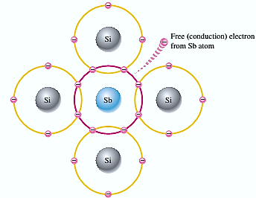
    N-type semiconductors
In order for our silicon crystal to conduct electricity, we need to introduce an impurity atom such as Arsenic (As), phosphorus (P), bismuth (Bi), or Antimony (Sb) into the crystalline structure making it extrinsic (impurities are added).
These atoms have five outer electrons in their outermost covalent bond to share with other atoms and are commonly called "Pentavalent" impurities. This allows four of the five electrons to bond with its neighbouring silicon atoms leaving one "free electron" to move about when an electrical voltage is applied (electron flow). As each impurity atom "donates" one electron, pentavalent atoms are generally known as "donors". In n-type material electrons are majority carrier and holes the minority carrier.
Figure 10: An antimony (Sb) impurity
atom is shown in the center.
The extra electron from the Sb
atom becomes a free electron.
© Prof E. Al-Bermany, Department of Physics, University of Babylon.

Slide 18
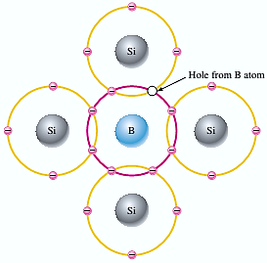
    P-type semiconductors
Trivalent (with 3 valence electrons) impurity atoms are added – Aluminum (Al), boron (B), indium (In), gallium (Ga), trivalent also known as a acceptor atom since they accept electrons.
When a trivalent atom is added to an intrinsic, it will readily accept free electron, as a result –becomes p-type extrinsic semiconductor. Each trivalent atom forms covalent bond with 4 adjacent Si atom.
Since 4 electrons are needed to form a covalent bond causes an existence of hole in the covalent bonding. It also causes a lack of valence electrons in the B atoms. In p-type material holes are majority carrier and electron the minority carrier
Figure 11: Trivalent impurity atom
in a silicon crystal structure. A boron
(B) impurity atom is shown in the center.
© Prof E. Al-Bermany, Department of Physics, University of Babylon.

