Slide 1
Gastroduodenal Disorders
Peptic Ulcer Disease
Lecture #3
First semester
Al-Mustaqbal University College
Nursing Department
2nd Class
Adult Nursing
:by
lecturer
Professor Dr. Fakhria Jaber

Slide 2
Peptic Ulcer Disease
A peptic ulcer is a lesion in the mucosa of the lower esophagus, stomach, pylorus or duodenum.
The stomach is divided on the basis of the physiologic function into two main portions:
1) The proximal two third, the fundic gland area, acts as a receptacle for ingested food and secrete acid and pepsine.
2) The distal third, the pyloric gland area, mixes and propels food into the duodenum and produces the hormone gastrein.
"Peptic" lesions may occur in the esophagus (esophagitis), stomach, (gastritis), or duodenum (duodenities).

Slide 3
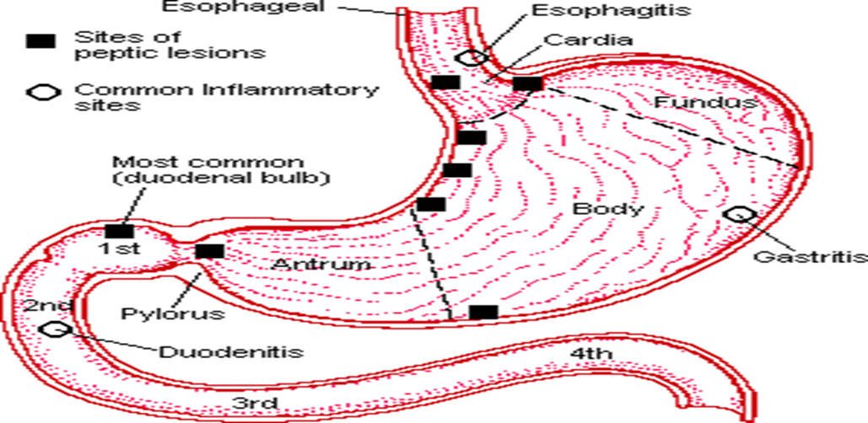
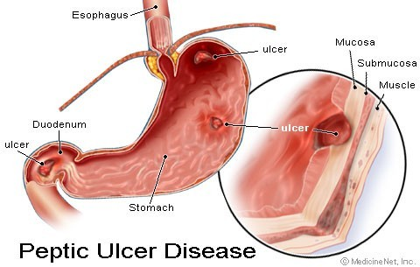
Note peptic ulcer sites and common inflammatory sites in the previous Fig.

Slide 4
Pathophysiology/Etiology
Helicobacter pylori infection—exact mechanism is unclear.
Non steroidal anti-inflammatory drug (NSAID)–induced ulcers.
  The risk of gastric ulcers is much greater than duodenal ulcers.
  Aspirin is the most ulcerogenic NSAID.
Hyper secretion of acid:
  Believed to be caused by an overactive vagus nerve, which stimulates the release of gastrin.
  Methylxanthines (tea, coffee, cola, and chocolate) and smoking may also increase gastric acidity
  Found in disorders such as Zollinger-Ellison syndrome tumors of the pancreas which increases secretion of gastrin(multiple peptic ulcers).
Genetic predisposition and stress appear to be controversial factors.

Slide 5
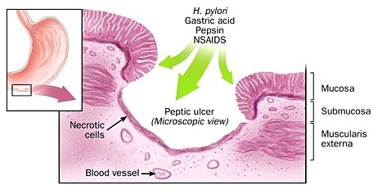

Slide 6
Clinical Manifestations
 | Gastric ulcers | Duodenal ulcers
Lesion. | Superficial; smooth margins; round, oval or cone shaped. | Penetrating
Location of lesion. | Antrum. Also in body and fundus of the stomach. | First 1-2 cm of duodenum.
Clinical Manifestations | Pain occurring in the high left epigastric area radiating to the back & upper abdomen | Pain located to the right of the midline epigastric region radiating to the back
 | Described as dull, aching, and gnawing | Describes as burning , cramping, pressure like pain across midepigastrium & upper abdomen
 | Pain is worse with food | Pain may increase when the stomach is empty, approximately 1½ to 3 hours after eating.

Slide 7
Clinical Manifestations | Not relieved with antacids as well as with duodenal | Patients may report relief from pain after eating or taking antacids
 | Some clients have constant pain or no clear pattern of discomfort | Pain may awaken person at night, periodic and episodic
 | Weight loss | Weight gain if food relieves the pain
 | Black or tarry stools from bleeding

Slide 8
Diagnostic Evaluation
  Upper GI series usually outlines ulcer or area of inflammation.
  Fiberoptic panendoscopy (esophagogastroduodenoscopy)—visualization of duodenal mucosa; identifies inflammatory changes, ulcers, lesions, bleeding sites, and malignancy.
  Cytologic brushings and biopsies may be performed to obtained samples.
  Serial stool specimens to detect occult blood
  Gastric secretory studies (gastric acid secretion test and the serum gastric level test)—elevated in Zollinger-Ellison syndrome
  Serum test for H. pylori antibodies may be positive.

Slide 9
Management
A. Specific Pharmacotherapy
H2 receptor antagonists, such as cimetidine (Tagamet), ranitidine (Zantac), famotidine (Pepcid)—inhibit action of histamine on the H2 receptors of the parietal cells, thus reducing gastric acid output and concentration.
Antisecretory or proton pump inhibitor drug omeprazole (Prilosec)—inhibits the production of hydrochloric acid in the stomach. Heals ulcers quickly (in 4 to 8 weeks).
Cytoprotective drug sucralfate (Carafate)—adheres to and protects the ulcer surface by forming a protective barrier against acid, bile, pepsin.
Acid-neutralizing agents (antacids)—provide additional relief of symptoms. Not used alone as treatment.

Slide 10
Antisecretory and cytoprotective drug misoprostol (Cytotec)—prostoglandin analogue inhibits hydrochloric acid production in the stomach.
Antidiarrheal agent bismuth subsalicylate (Pepto-Bismol)—has antibacterial action against H. pylori and enhances mucosal protection through bicarbonate and prostaglandin production.
Antibiotics such as tetracycline and metronidazole (Flagyl) used with bismuth as “triple therapy” to eradicate H. pylori.
For NSAID ulcers—discontinue NSAID and treat as mentioned above. If NSAID is restarted, administer with misoprostol.

Slide 11
B. Dietary Measures
Well-balanced diet, high fiber content, meals at regular intervals ( 6 meals a day).
Avoid caffeine, colas, and alcohol.
Avoid smoking—decreases healing rate and increases recurrence.
C. Surgery Indicated in emergency situations for uncontrolled bleeding or bleeding that developed despite chronic drug maintenance therapy.

Slide 12
Vagotomy: (cutting of vagus nerve) To eliminate the stimulus that triggers gastric acid secretion by the gastric cells; can choose to cut all or portions
Subtotal gastrectomy
  The resected portion includes a small cuff of the duodenum, pylorus, and from two thirds to three quarters of the stomach.
  The duodenum or side of the jejunum is anastomosed to the remaining portion of the stomach.
Total gastrectomy esophagus is anastomosed to jejunum
Complications
GI hemorrhage
Ulcer perforation
Gastric outlet obstruction

Slide 13
Nursing Assessment
Determine location, character, radiation of pain, factors aggravating or relieving pain, how long it lasts, when it occurs.
Ask about eating patterns, regularity, types of food, eating circumstances.
Take a social history of alcohol consumption and smoking.
Ask about medications (especially aspirin, anti-inflammatory drugs, or steroids).
Determine if GI bleeding has been experienced.
Take vital signs, including lying, standing, and sitting blood pressures and pulses, to determine if orthostasis is present due to bleeding.

Slide 14
Nursing Diagnoses
  Fluid Volume Deficit related to hemorrhage
  Pain related to epigastric distress secondary to hypersecretion of acid, mucosal erosion, or perforation
  Diarrhea related to GI bleeding or antacid therapy
  Altered Nutrition, Less Than Body Requirements, related to the disease process
  Knowledge Deficit related to physical, dietary, and pharmacologic treatment of disease.

Slide 15
Nursing Interventions
A. Avoiding Fluid Volume Deficit
Monitor intake and output continuously to determine fluid volume status.
Observe stools for occult blood.
Monitor hemoglobin and hematocrit and electrolytes.
Administer prescribed IV fluids and blood replacement, as prescribed.
Insert an NG tube as prescribed and monitor the tube drainage for signs of visible and occult blood.
Administer medications through the NG tube to neutralize acidity, as prescribed.
Prepare patient for saline lavage, as ordered.
Observe the patient for an increase in pulse and a decrease in blood pressure (signs of shock).

Slide 16
B. Achieving Pain Relief
Encourage bed rest to reduce physical activity and to separate patient from usual environment if pain continues.
Provide small, frequent meals to prevent gastric distention if not NPO.
Teach the patient that caffeine, alcoholic beverages, and nicotine may increase gastric acidity and promote erosion of the gastric mucosa.
Advise the patient about the irritating effects on the gastric mucosa of certain drugs, such as aspirin, NSAIDs, and certain antibiotics.
Administer prescribed medication

Slide 17
Decreasing Diarrhea
Monitor patient’s elimination patterns to determine effects of medications.
Monitor vital signs and watch for signs of hypovolemia. Persistent diarrhea may be a sign of bleeding.
Restrict foods and fluids that promote diarrhea: raw vegetables, fruits, whole grain cereals, carbonated drinks.
Administer antidiarrheal medication as prescribed.
Watch for signs of impaired skin integrity (erythema, soreness) around anus to promote comfort and decrease risk of infection.

Slide 18
D. Achieving Adequate Nutrition
Eliminate foods that cause pain or distress; otherwise, the diet is usually not restricted.
Provide small, frequent feedings on time. This will decrease distention and the release of gastrin. Frequent feedings also help neutralize gastric secretions and dilute stomach contents. However, eating small, frequent meals or snacks can lead to acid rebound, which occurs 2 to 4 hours after eating.
Advise the patient to avoid coffee and other caffeinated beverages as well as carbonated drinks; these may increase acid.
Advise the patient to avoid extremely hot or cold food or fluids, to chew thoroughly, and to eat in a leisurely fashion for better digestion.
Administer parenteral nutrition if bleeding is prolonged and patient is emaciated, as ordered.

