Slide 1
Literature review
Mahdi Al-Anawy

Slide 2
-Research almost never conduct a study in intellectual vacuum
- The researcher reviews resources related to a particular topic before entering in the study.

Slide 3
What is a Literature Review
A literature review is survey of research article books and other information resources related to your study.

Slide 4
Purposes of Literature Review to identify
1) information exists and other people working in your research field.
2) gaps in literature.
3) major research works, methodology & techniques.
4) Main ideas, conclusions and theories.
5) Relationship between previous studies and theories

Slide 5
How Write Literature Review
1) Define the research topic
2) Identify information sources.
3) Discuss finding and conclusion with others
4) Identify relationship between works and the literature

Slide 6
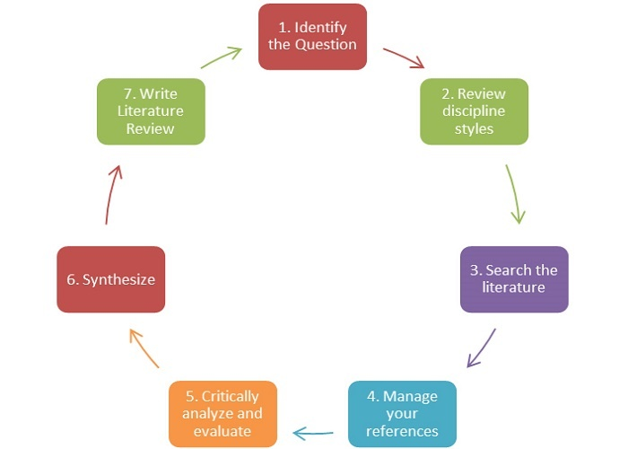
Write Literature Review

Slide 7
Literature Review Resources
1) Books.
2) Journals
3) Conference papers
4) Magazines and newspapers
5) Research reports
6) Theses
7) Electronic databases

Slide 8
Steps for Writing a Literature Review
1) Planning
2) Reading and research
3) Analyzing
4) Drafting
5) Revising

