Slide 1
Adaptive Immunity
Acquired or adaptive immunity: It is the resistance of individuals to environmental and foreign bodies exposes during life. It is also called specific immunity.

Slide 2
Features of adaptive immunity:
Adaptive immunity is characterized by the following:
1. Antigenic specificity: (highly specific).
2. Diversity : ( each antigen there is specific T-cell and B-cell for it).
3. It has immunologic memory: (When there infection for the second some of specific
cells will be saved as memory cells, and when the body exposed to the same infection
the memory cell will activated immediately and get rid of the infection.
4. It can differentiate between self and non-self.
5. It comes later in life: and mediated by the lymphocytes and their products
mainly.
6. It is acquired. This means there is a need of stimulation by foreign body to be activated
and present.
7. Can be active or passive.

Slide 3
Components of adaptive immunity
It has the following components:
1. Anatomical components.
2. Cellular components.
3. Humoral components.
4. Receptors of adaptive immunity.

Slide 4
Anatomical components of the adaptive immunity:
The main anatomical components is the lymphoid organs which are divided into primary and secondary lymphoid organs:
A . The primary lymphoid organs consist of:
1. The Thymus.( the site of T-cells differentiation).
2. The Bone marrow ( the site of blood cells production and B-cells
differentiation).
3. The Bursa of Fabricius: The site of B-cell differentiation in poultry.
Function of the primary lymphoid organs:
- The differentiation, proliferation, and maturation of stem cells into immunocompetent cells in primary lymphoid organs take place.
- The central tolerance takes place.

Slide 5
Anatomical component of adaptive immunity
B. The secondary lymphoid organs:
1. The lymph nodes.
2. The spleen.
3. The peyer’s patches.
4. The mucosa associated lymphoid tissue.
5. The tonsils.
6. The appendix.
Functions:
In these organs the lymphocytes will be stored and also the immunological reaction between foreign bodies and lymphocytes takes place.
The antigens are effectively exposed to the mature lymphocytes.
Initiation of the adaptive immune response takes place.
Peripheral tolerance takes place.

Slide 6
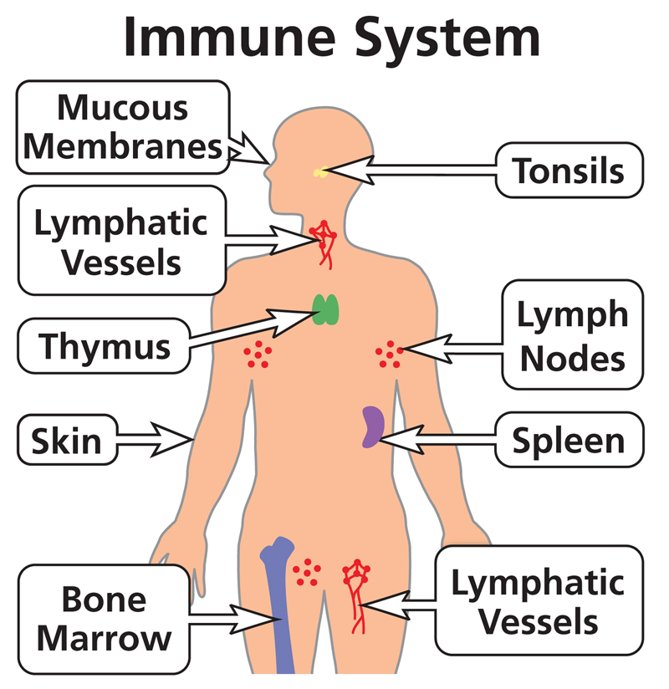
Immune system 3

Slide 7
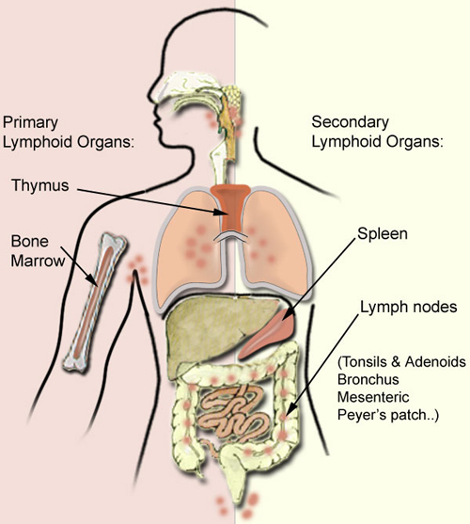
Primary and secondary lymphoid organs

Slide 8
The cellular components of the adaptive immunity:
It includes all types of white blood cells and as following:
1. The monocytes and their derivatives.
2. The granulocytes: which are:
- The neutrophils.
- The eosinophils.
- The basophils.
- The mast cells.
3. The lymphocytes: which are
- T-lymphocytes.
- B-lymphocytes.
- Natural killers.

Slide 9
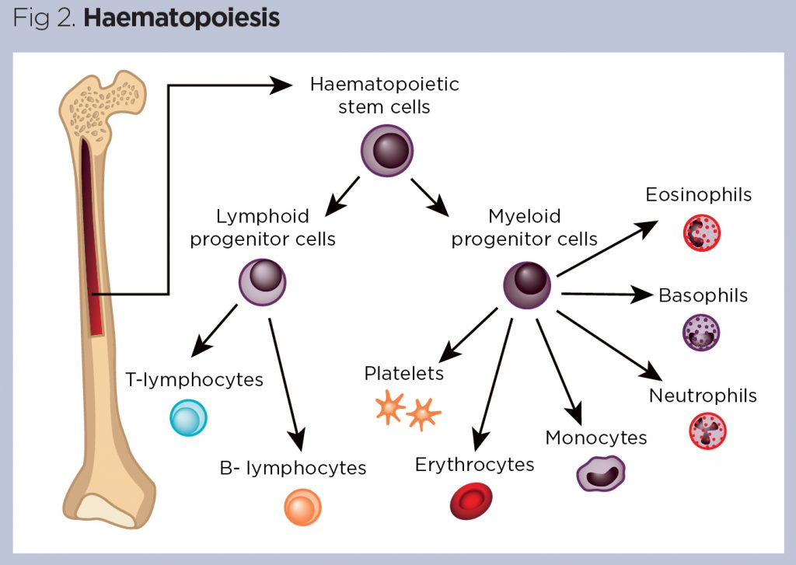
Cells of the immune system

Slide 10
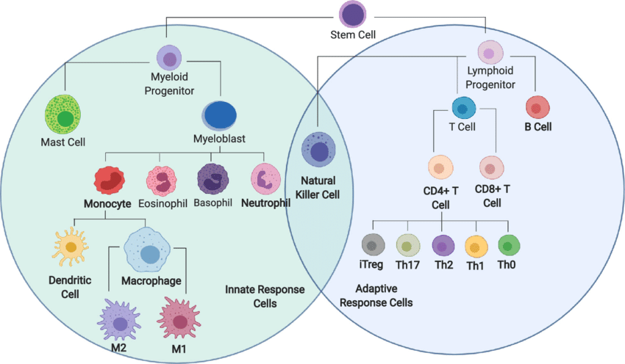

Slide 11
Cellular component of the adaptive immunity:
Many types of cells participate in the adative defense mechanism specifically:
The types of cells are:.
A.-Monocytes and their derivatives which are:
1. Monocytes in blood.
2. Dendritic cells in skin, surrounding tissues, and lymph nodes.
3. Kupfer cells in the liver.
4. Alveolar macrophages in the lung.
5 Microglial cells in the brain.
6. Osteoclast in bones
7. Synovial A cells in joints.
8. Mesengial phagocytes in kidneys.
9. Langerhan’s cells in skin.
10.. Macrophages in the peripheral tissues.

Slide 12
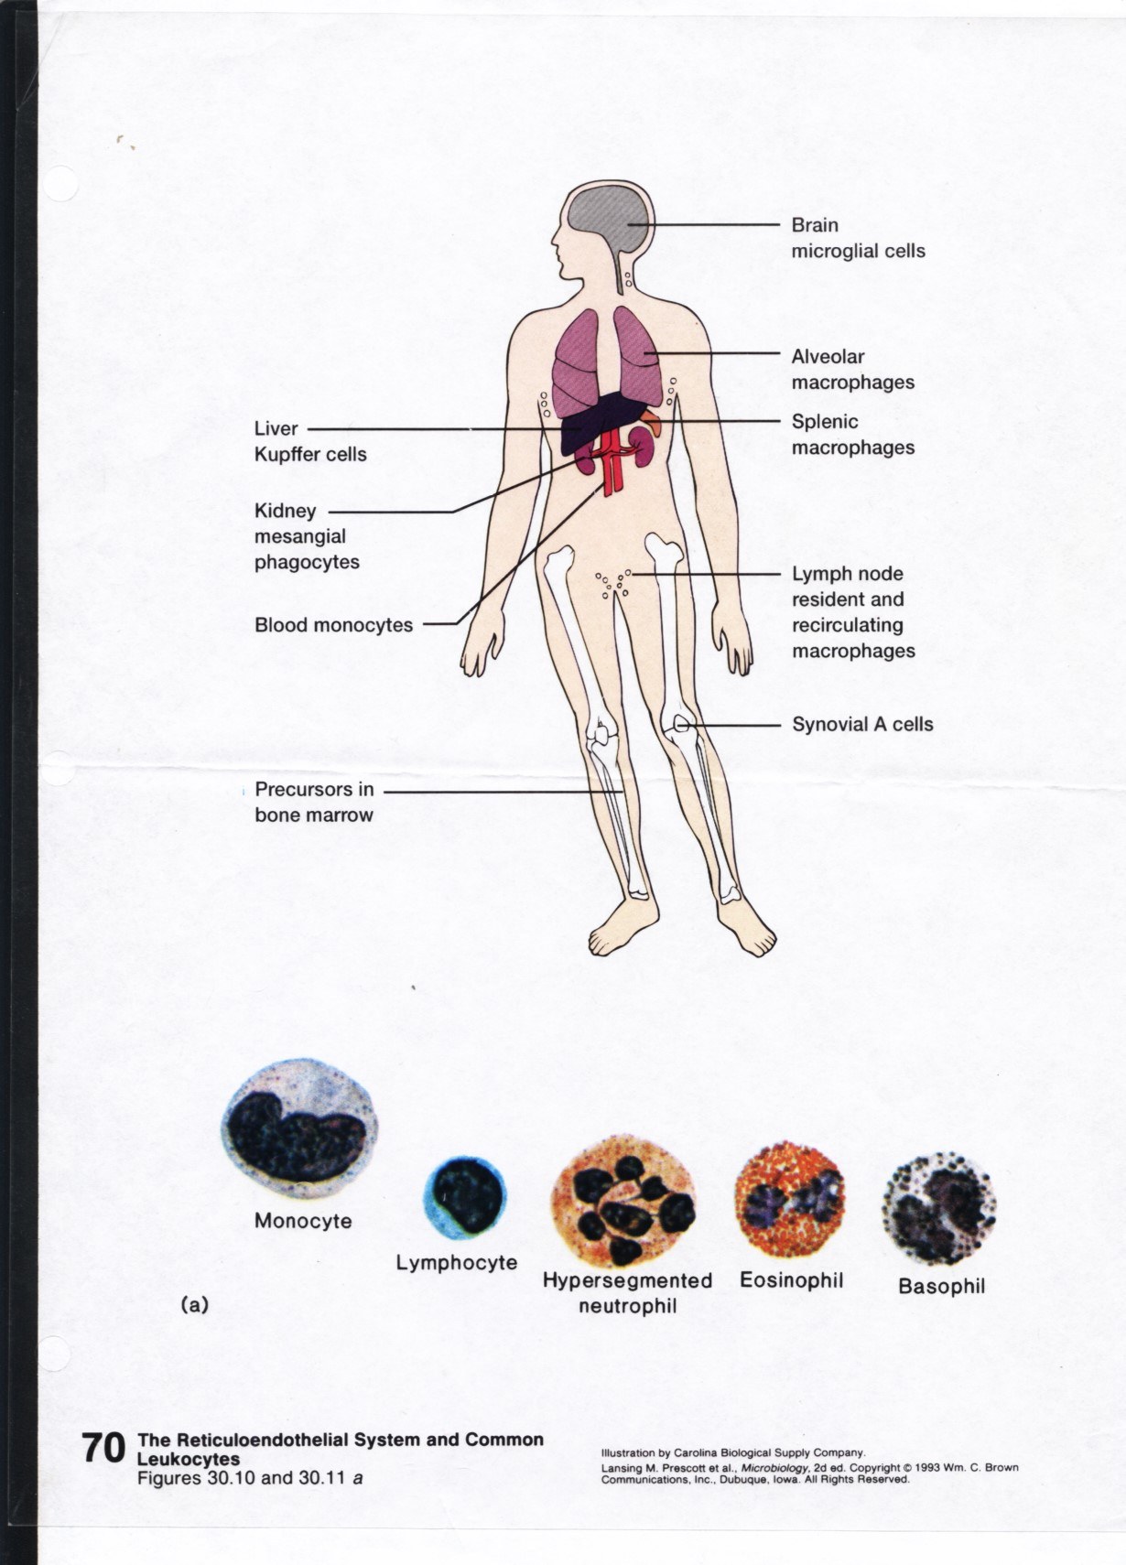

Slide 13
The functions of the monocytes and its derivatives:
1. Production of inflammatory mediators.
2. Phagocytosis of the foreign bodies.
3. Presentation of foreign antigens to the lymphocytes.
4. Production of some immunological mediators.

Slide 14
Cellular components of adaptive immunity:
B: The granulocytes:
There are three types of granulocytes which are:
1 - The Neutrophils.( have neutrally stained cytoplasmic granules):
They are active in bacterial infection. They cause killing of the microorganisms
especially bacteria. Phagocytosis also. They are classified as microphages.
2. -The Eosinophils.( have acidic orange cytoplasmic granules):
The main function of the eosinophils is active against parasitic infection.
They are also active in cases of allergy.
3. The Basophils. ( have basic violet color stained cytoplasmic granules).
they are active in cases of inflammation and allergy.
4. The Mast cells:
They are mainly active in cases of allergy and inflammation.
The basophils may be their precursers.
The granulocytes have lobulated nucleous with two to five lobules.
They have granulated cytoplasm. The granules are colored according to the type of cells.

Slide 15
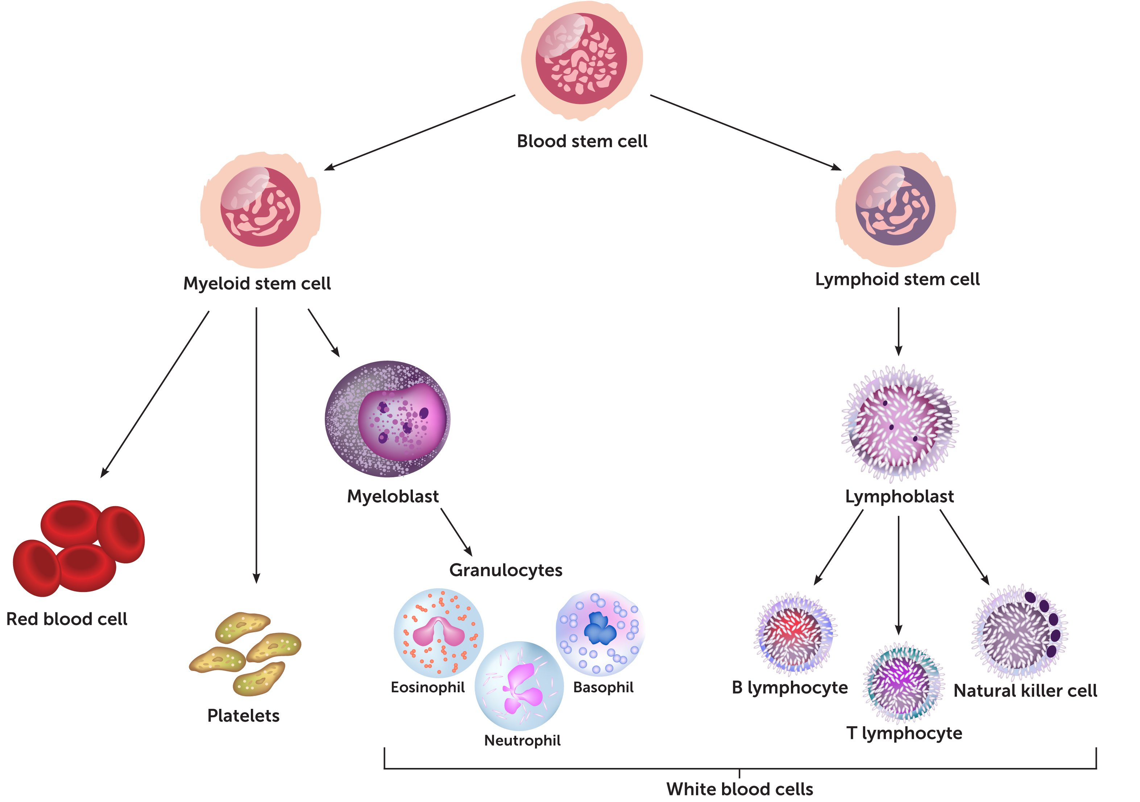
Immune system 7
Immunological cells- Chart:

Slide 16
Cellular components of the adaptive immunity;
Immunological cells;
C: Lymphocytes:
There are three types of lymphocytes which are:
1. B-cells : its final maturation stage is plasms cells . They are the main effector
cells in the humoral immunity. They are responsible of production of the
antibodies.
Also they can present antigens to the T-lymphocytes.
2. T-lymphocytes : which are the active cells in both humoral and cell mediated
immunity. It consists of different types which are:
- T- helper cells.
- T- suppressor cells.
- T- cytotoxic cells.
- T- regulatory cells.
The main functions of T-cells are cytotoxic and regulatory
3. Natural killers: which are active against cancer and virally infected cells.
They are mainly cytotoxic.

Slide 17
The humoral component of the adaptive immunity;
It consists of the following:
1. The complement proteins:
They are a group of heat labile proteins with many functions.
2. The antibodies:
They are five types of a highly specific antibodies produced by B-cells reacting against foreign antigens.
They are IgG , IgM ,IgA , IgE, and IgD.
3. The interferons:
They are specific soluble proteins with antiviral and regulatory immunological functions.
They are three main types, Alpha interferon , Beta interferon, and Gamma interferon.
4. The interleukins: are a group of soluble mediators produced by the
lymphocytes and macrophages with immunological regulatory functions.

Slide 18
Receptors of the adaptive immunity:
There are many receptors participate in the adaptive immune reactions which are:
1. The T-cell receptors: present on the surface of the T-cells which
recognize the foreign antigens.
2. The antibodies: which are produced by B-cells and present on the
surface of the B-cells . They recognize the foreign antigens and
have many functions.
3. The major histocompatibility complexes (MHC): They are specific
molecules help to present the foreign body to the immunological cells.
The main types used for this purpose are type 1(MHC1) and type 2
MHC(MHC2).
4. The antigens:
They are the foreign substance which interact with the immunological receptors to stimulate
the immunological reactions.

