Slide 1


ICU
L4
Anesthesia Technologist
BCS. Anesthesia. and IC
diploma. Community health
Karrar Nader AL-Taie
Anesthesia Technologist
BCS. Anesthesia. and IC
diploma. Community health
Muneer Salman Hasan

Slide 2
Glasgow Coma Scale GCS

Slide 3
Glasgow Coma Scale GCS
The Glasgow Coma Scale (GCS) allows healthcare professionals to consistently evaluate the level of consciousness of a patient. It is commonly used in the context of head trauma, but it is also useful in a wide variety of other non-trauma related settings. Regular assessment of a patient’s GCS can identify early signs of deterioration.
There are three aspects of behavior that are independently measured as part of an assessment of a patient’s GCS – motor responsiveness, verbal performance and eye-opening.
The highest possible score is 15 (fully conscious) and the lowest possible score is 3 (coma or dead)

Slide 4
Glasgow Coma Scale
The assessment is carried out in three stages
1- Eye Opening Response (4 points(
2-Verbal Response (5 points)
3-Motor Response (6 points)

Slide 5
Eye Opening Response
1-Spontaneous--open with blinking at baseline = 4 points
2-To verbal stimuli, command, speech = 3 points
3-To pain only (not applied to face) = 2 points
4-No response = 1 poin

Slide 6
Verbal Response
1- Oriented = 5 points
2-Confused conversation, but able to answer questions = 4 points
3-Inappropriate words = 3 points
4-Incomprehensible speech = 2 points
5-No response = 1 point

Slide 7
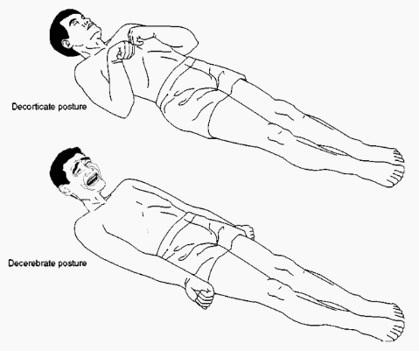
Motor Response
Obeys commands for movement = 6 points
Purposeful movement to painful stimulus= 5 points
Withdraws in response to pain = 4 points
Flexion in response to pain (decorticate posturing)= 3 points
Extension response in response to pain (decerebrate posturing) =2 points
No response = 1 point

Slide 8
GCS 15 [E4, V5, M6]
GCS…[E..,V..,M..]

Slide 9
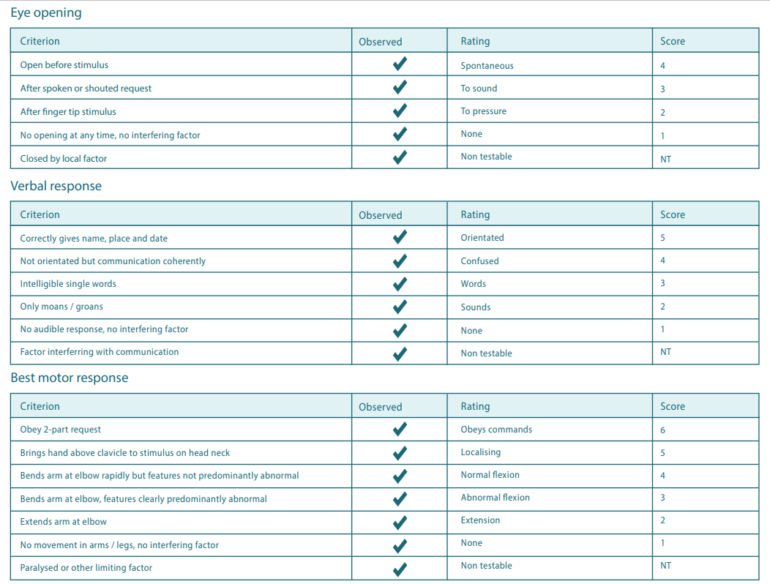

Slide 10
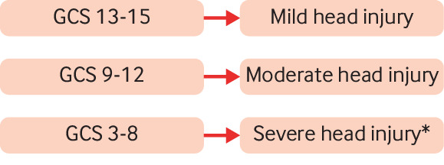
Final assessment

Slide 11
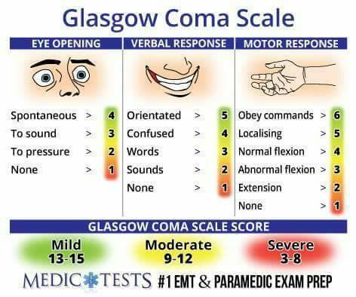

Slide 12
EX./What is the patient’s score based on these findings: when you arrive to the patient’s bedside the patient’s eyes are closed but they open when you speak to the patient . and Confused conversation, but able to answer questions, Purposeful movement to painful stimulus?
Answer/ GCS……[E….,V…..,M…..]

Slide 13
EX./ What is the patient’s score based on these findings: when you arrive to the patient’s bedside the patient’s eyes open To pain only .and Inappropriate words and Extension response in response to pain ?
Answer/ GCS……[E….,V…..,M…..]

Slide 14
EX./ What Glasgow Coma Scale score usually requires intubation because the airway reflexes are affected?
A. 10 or less
B. 9 or greater
C. 8 or less
D. 10 or greater

Slide 15
Assignment
when you arrive to the patient’s bedside the patient’s eyes are closed, but they open when you speak to the patient, the patient doesn’t respond appropriately to questions asked and says words that don’t make sense. the patient can’t obey a motor command. when you apply a central stimulus the patient moves to locate and remove the stimulus.?
A. GCS 12 (E3 V4 M5)
B. GCS 8 (E2 V4 M2)
C. GCS 11 (E3 V3 M5)
D. GCS 10 (E3 V3 M4)

Slide 16
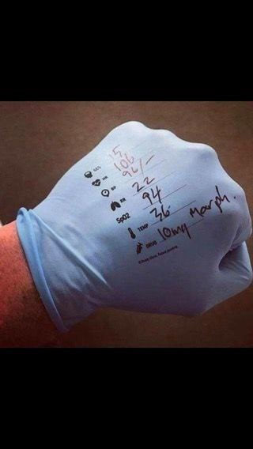

Slide 17


