Slide 1


ICU
L3-2
Anesthesia Technologist
BCS. Anesthesia. and IC
diploma. Community health
Karrar Nader AL-Taie
Anesthesia Technologist
BCS. Anesthesia. and IC
diploma. Community health
Muneer Salman Hasan

Slide 2
Artificial Ventilation
Part 2

Slide 3
2-Invasive positive Mechanical Ventilation ((IPMV))
defined as the delivery of positive pressure to the lungs via an endotracheal or tracheostomy tube. During mechanical ventilation, a predetermined mixture of air (ie, oxygen and other gases) is forced into the central airways and then flows into the alveoli

Slide 4
1-Fraction of inspired oxygen (FIO2)
2-Tidal Volume (VT)
3-Peak Flow/ Flow Rate
4-Respiratory Rate/ Breath Rate / Frequency (F)
5-Minute Volume (VE)
6-I: E Ratio (Inspiration to Expiration Ratio)
7-Sigh
8-peak inspiratory pressure (PIP)
9-Inspirtory Time Ti
10- trigger

Slide 5
1-Fraction of inspired oxygen (FIO2)
The percent of oxygen concentration that the patient is receiving from the ventilator. (Between 21% & 100%)
Initially a patient is placed on a high level of FIO2 (60% or higher)
2-Tidal Volume (VT)
The volume of air delivered to a patient during a ventilator breath. amount of air inspired and expired with each breath.
Usual volume selected is between 6 to 8 ml/ kg
the large tidal volumes may lead to (volutrauma) aggravate the damage inflicted on the lungs

Slide 6
3-Peak Flow/ Flow Rate
The speed of delivering air per unit of time, and is expressed in liters per minute.
The higher the flow rate, the faster peak airway pressure is reached and the shorter the inspiration
The lower the flow rate, the longer the inspiration
4-Respiratory Rate/ Breath Rate / Frequency (F)
The number of breaths the ventilator will deliver/minute (10-16 b/m).
Total respiratory rate equals patient rate plus ventilator rate.

Slide 7
5-Minute Volume (VE)
The volume of expired air in one minute.
Respiratory rate times tidal volume equals minute ventilation VE = (VT x F)
In special cases, hypoventilation or hyperventilation is desired
6-I: E Ratio (Inspiration to Expiration Ratio)
The ratio of inspiratory time to expiratory time during a breath (Usually = 1:2)
7-Sigh
A deep breath.
A breath that has a greater volume than the tidal volume.
It provides hyperinflation and prevents atelectasis.
Sigh volume:Usual volume is 1.5 –2 times tidal volume.
Sigh rate/ frequency :Usual rate is 4 to 8 times an hour

Slide 8
8-peak inspiratory pressure (PIP)
The amount of pressure that need to enter the gas into the lung , the risk of barotrauma is increased and efforts should be made to try to reduce the peak airway pressure.
9-Inspirtory Time (Ti )
Time that need to end the inspiratory phase
Normal renge = 0.33__ 0.6 s
10- trigger
If the machine start breath = control or time trigger
If the patient start breath = patient trigger

Slide 9
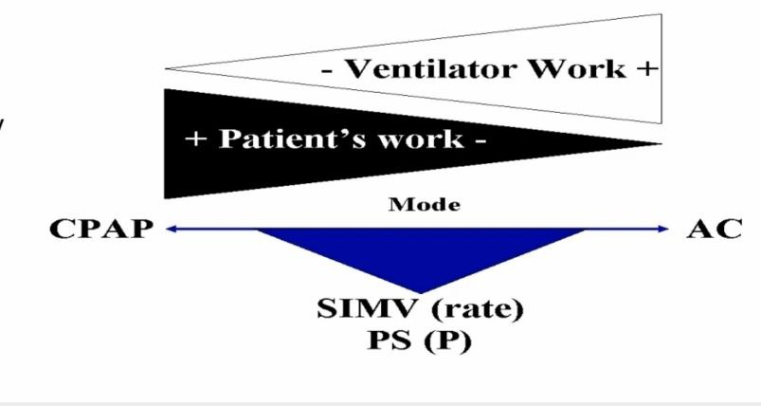
Invasive positive Mechanical Ventilation ((IPMV))
The is three type of mode to ventilate patient in ICU
1-Volume cycle ventilators - Volume mode
2-Pressure cycle ventilators - Pressure mode
3-Time cycle ventilators – Time mode

Slide 10
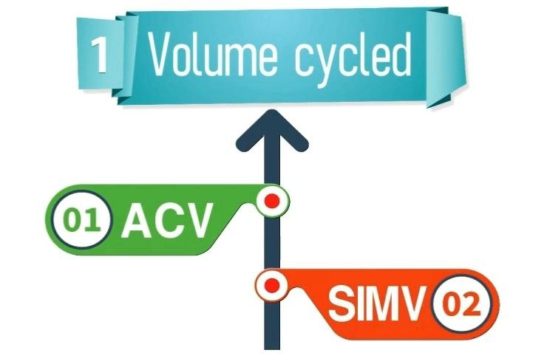
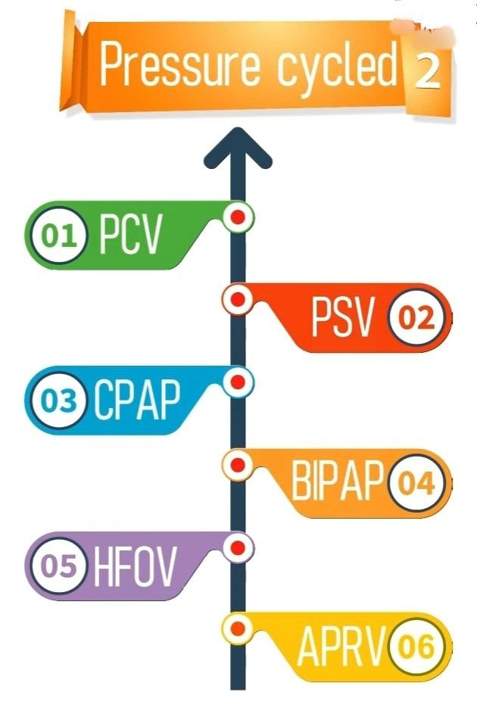
3-VCV

Slide 11
Volume cycle ventilators - Volume mode
Volume is consistent with these modes, pressure is not.
Inspiration is terminated after a preset tidal volume has been delivered by the ventilator.
inspiration stops when the preset tidal volume is achieved.
The amount of pressure required to deliver the set volume depends on:
1 - Patient’s lung compliance
2- Patient–ventilator resistance factors.

Slide 12
Volume mode
1- Assist-control (A/C)
2- Synchronized intermittent mandatory ventilation (SIMV)
3- Control Mode (CM) Continuous Mandatory Ventilation(CMV)

Slide 13
1-Assist-control (A/C)
he ventilator provides the patient with a pre-set tidal volume at a preset rate.
The patient may initiate a breath on his own
ventilator assists by delivering a specified tidal volume to the patient
patient can breathe at a higher rate than the preset number of breaths/minute
In A/C mode, a mandatory (or “control”) rate is selected
peak inspiratory pressure (PIP) must be monitored in volume modes because it varies from breath to breath.
Disadvantages: Hyperventilation

Slide 14
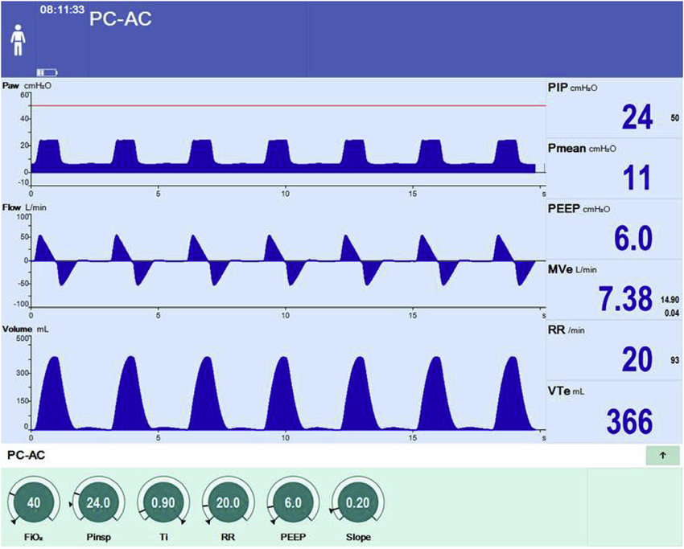
-VT
-RR
-Flow Rate
-I:E ratio
-PEEP
-FIO2
-peak inspiratory pressure (PIP)

Slide 15
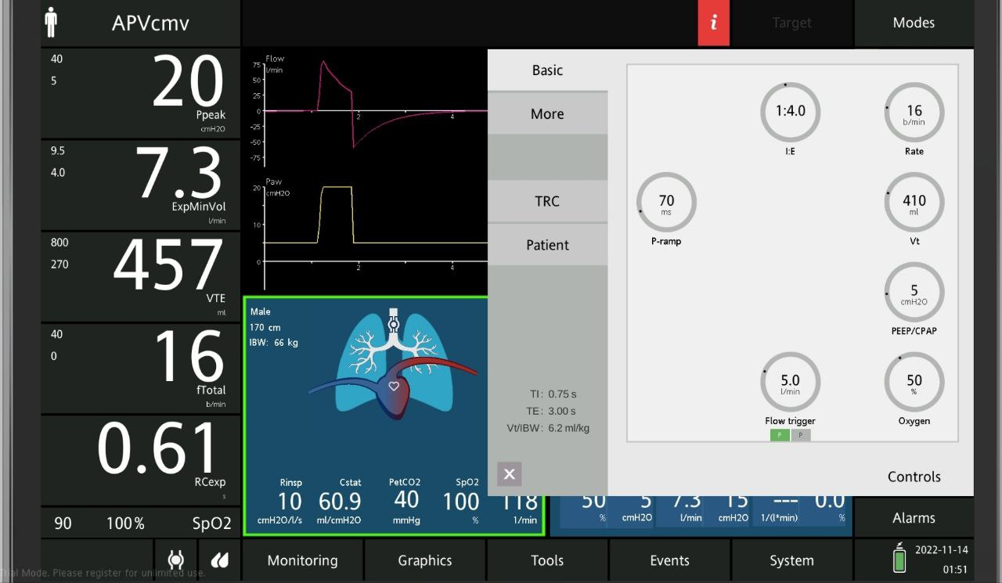

Slide 16
Assist-control ventilation advantage
1-reduce the need for sedation and paralysis
2-decrease the risk of barotrauma
3- improve intrapulmonary gas distribution
4- prevent muscle atrophy

Slide 17
Assist-control ventilation disadvantage
1-The system is volume-cycled, and barotrauma is a concern in stiff lungs. ...
2-If a patient is tachypneic or if not enough time is allowed for exhaling, the patient can develop breath stacking and auto-PEEP. ...
3-Since the patient can initiate breaths, hyperventilation can lead to respiratory alkalosis.

Slide 18
2-Synchronized intermittent mandatory ventilation (SIMV)
pre-set number of breaths/minute at a specified tidal volume and FiO2.
the patient is able to breathe spontaneously
the tidal volume is determined by the patient’s spontaneous effort.
Adding pressure support during spontaneous breaths can minimize the risk of increased work of breathing.
Ventilators breaths are synchronized with the patient spontaneous breath. (no fighting)
Used to wean the patient from the mechanical ventilator

Slide 19
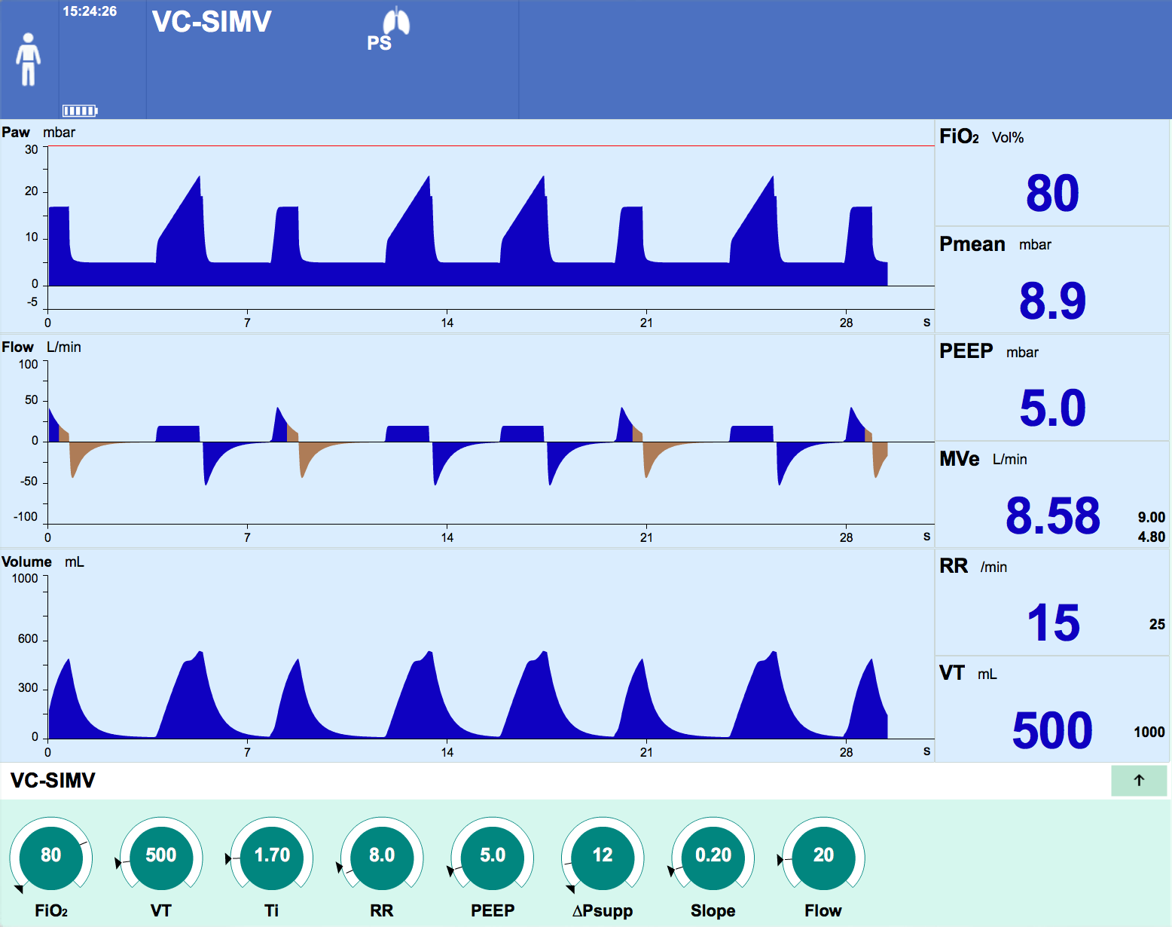
-VT
-RR
-PEEP
I:E - Ti
Flow rate
FiO2

Slide 20
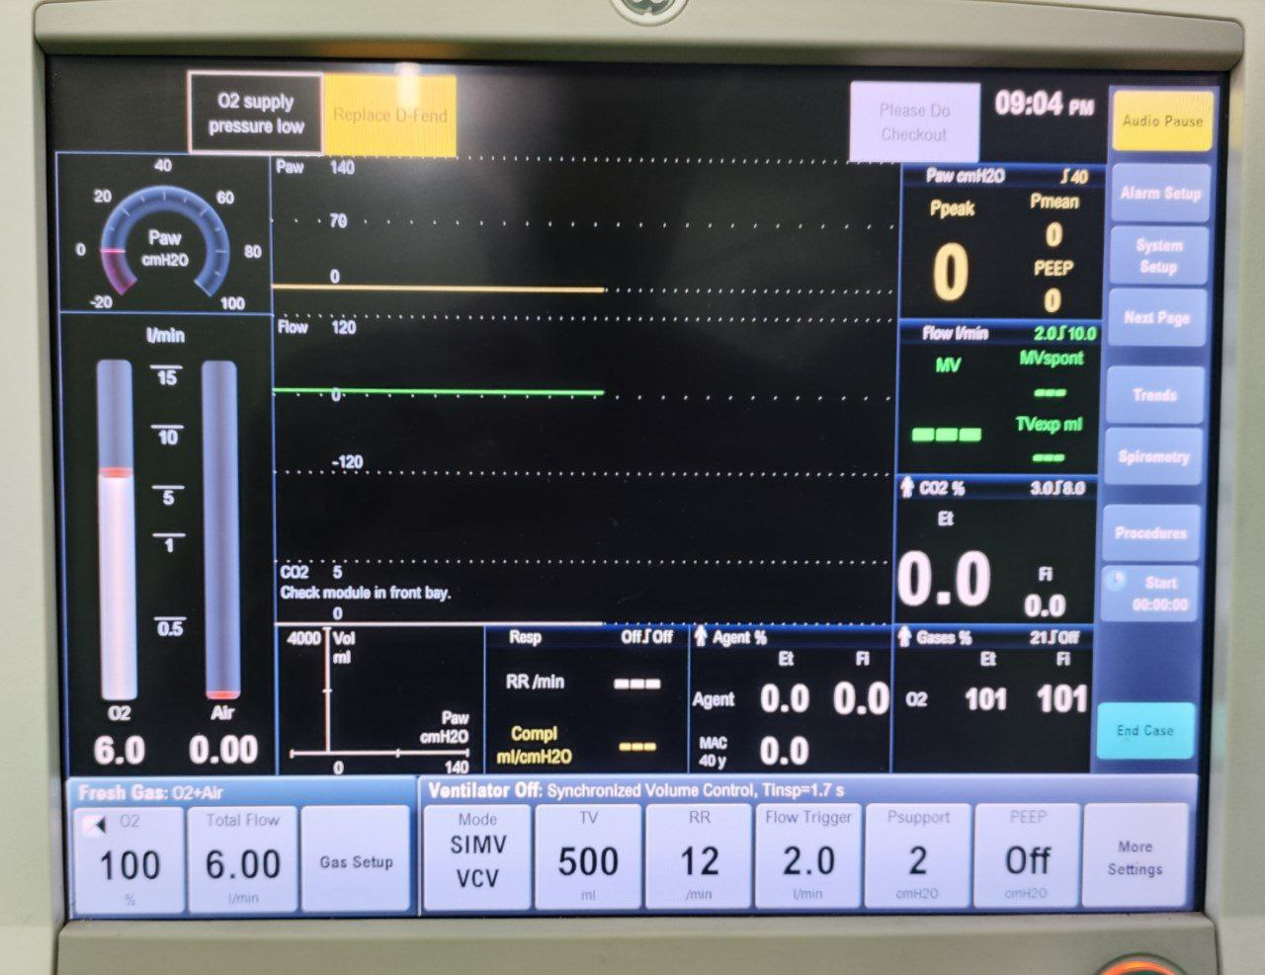

Slide 21
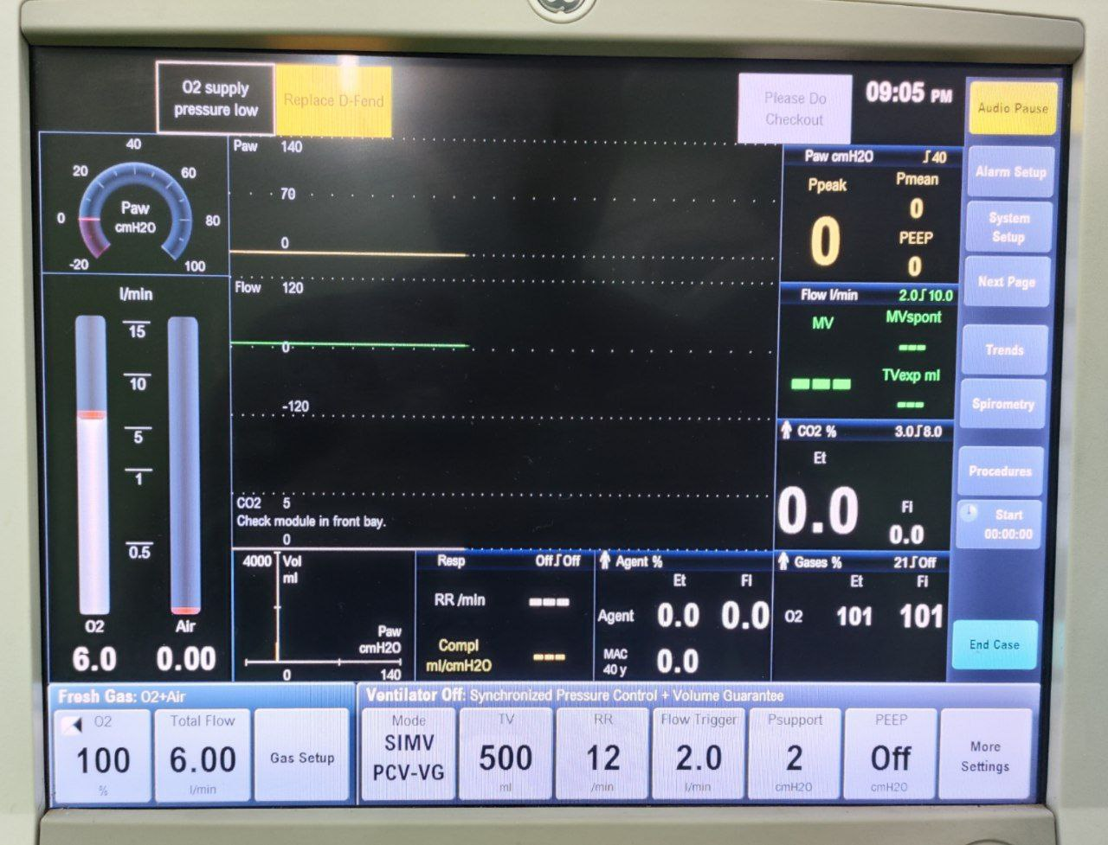

Slide 22
SIMV advantages
1-enables partial mechanical assistance
2-provide a set number of breaths at a fixed tidal volume, 3-3-patient can trigger a spontaneous breath with the volume determined by patient effort
SIMV Disadvantages
- higher level of work the patient must perform to obtain a spontaneous breath.

Slide 23
3-Continuous Mandatory Ventilation(CMV) Volume-controlled ventilation (VCV)
Ventilation is completely provided by the mechanical ventilator with a preset tidal volume, respiratory rate and oxygen concentration
Ventilator totally controls the patient’s ventilation
Patient does not breathe spontaneously. cannot initiate breath

Slide 24
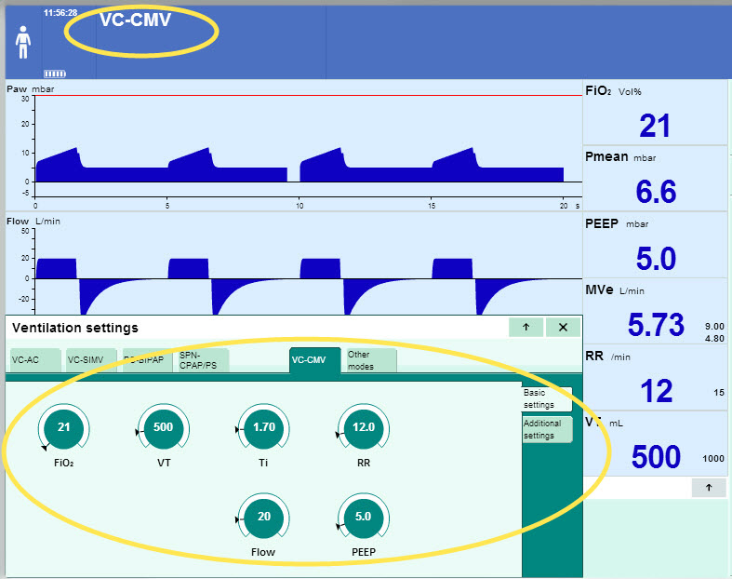
-VT
-RR
Flow rate
I:E - Ti
PEEP
FiO2

Slide 25
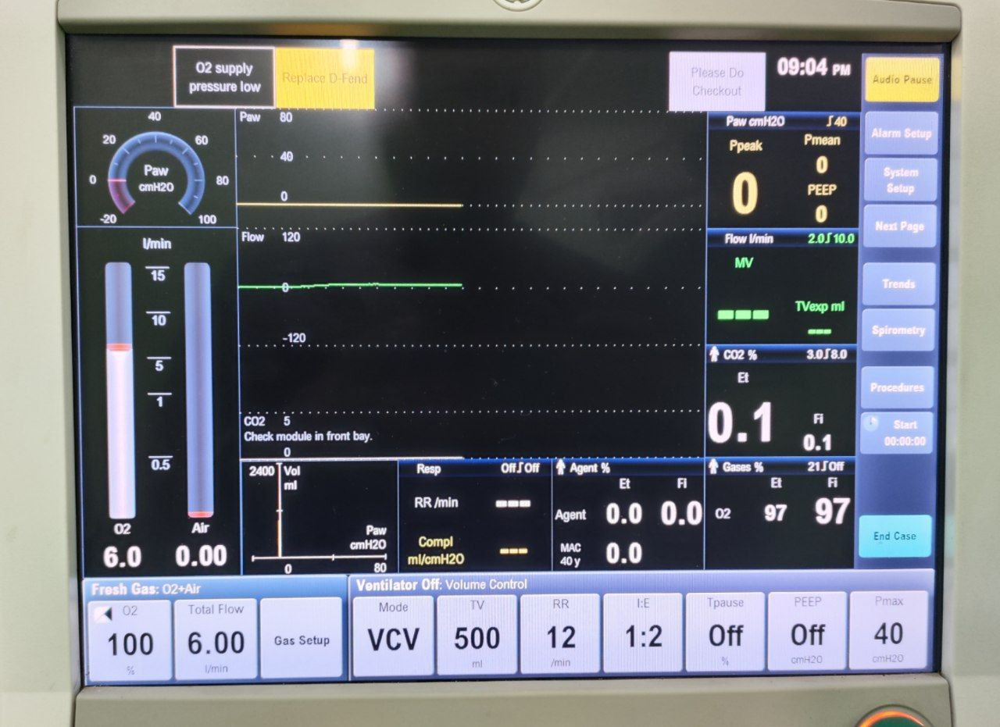

Slide 26
Advantages of VCV: Guaranteed tidal volumes produces a more stable minute volume
Disadvantages of VCV airway pressure increases in response to reduced compliance, increased resistance,

Slide 27


