Slide 1


ICU
L5-1
Anesthesia Technologist
BCS. Anesthesia. and IC
diploma. Community health
Karrar Nader AL-Taie
Anesthesia Technologist
BCS. Anesthesia. and IC
diploma. Community health
Muneer Salman Hasan

Slide 2
CPR
CardioPulmonary Resuscitation

Slide 3
Cardio pulmonary resuscitation (CPR)
Cardio pulmonary resuscitation (CPR) is a technique of basic life support for the purpose of oxygenation to the heart, lungs and brain until and unless the appropriate medical treatment can come and restore the normal cardiopulmonary function
PURPOSE
1-Restore cardiopulmonary functioning.
2-Prevent irreversible brain damage from anoxia
INDICATION CPR
1- Cardiac arrest
2- Respiratory arrest
3-Combination of both

Slide 4
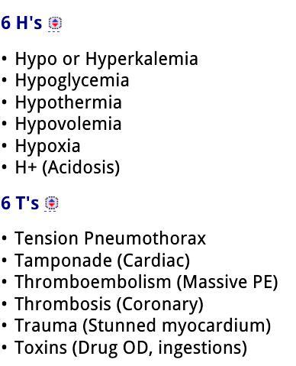
Definition of Cardiac arrest:
It is loss of cardiac function, breathing and loss of consciousness.
Causes of cardiac arrest 6H 6T

Slide 5
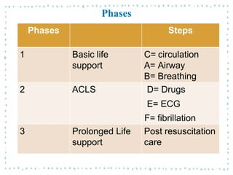
phases of CPR

Slide 6
What is basic life support (BLS)?
It is life support without the use of special equipment.
What is Advanced Life Support (ACLS)?
It is life support with the use of special equipment (eg. Airway, endotracheal tube, defibrillator).

Slide 7
BLS / Basic Life Support
The three basic parts of CPR are easily remembered as "CAB": C for compressions, A for airway, and B for breathing. C is for compressions. Chest compressions can help the flow of blood to the heart, brain, and other organs
-Early recognition
1-Check the victim response (are you Ok)?
2-no breathing or normal breathing (only gasping)
3- no pulse felt within 10 seconds
-CPR sequence
1-C-chest compressions
2-A-airway
3-B-Breathing

Slide 8
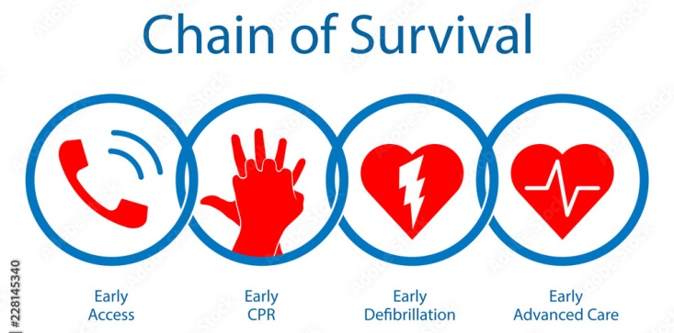

Slide 9
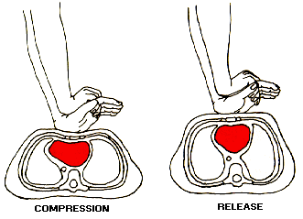
Compression technique
1-petient most be placed on a hard surface
2-the palm of one hand is placed in the concavity of the lower half of the sternum . (2) fingers above the xiphoid process ( avoid xiphisternal juction – fracture and injury)
3- sternum must be depressed at least 5 cm in adults
And 2-4 cm in children and 1-2 cm in infant
3-preformed at a rate of 100-120/ min
4- compression to ventilation ratio
-single rescuer = 30:2
-Tow rescuer = chest compression
Must not be interrupted for ventilation
- 2 minutes = 5 cycles 30:2
- Ensure : rate , depth , recoil

Slide 10
Airway
Loss of tone in the muscles of the airway and falling back of the tongue
procedure opening airway
1-Clear the airway
2- head tilt , chin lift
3-jaw thrust
4- finger sweep
5- Heimlich manoeuver

Slide 11
Breathing
Rescue breathing can be:
1-mouth to mouth breathing
2-mouth to nose
3-mouth to mouth and nose

Slide 12
Assessment of restoration of breathing and circulation
1-Contraction of pupil
2- Improved color of the skin
3- Free movement of the chest wall
4-Swallowing attempts
5- Struggling movements

Slide 13
Signs of restored ventilation and circulation include:
1- Struggling movements
2-Improved color
3-Return of or strong pulse
4-Return of systemic blood pressure

Slide 14
When to terminate BLS
1-Pulse and respiration returns
2-Emergency medical help arrives
3-Physician declared patient is deceased
4-In a non health setting , another indication to stop BLS would be that the rescuer was exhausted and physically unable to continue to perform BLS

Slide 15


