Slide 1


ICU
L8
Anesthesia Technologist
BCS. Anesthesia. and IC
diploma. Community health
Karrar Nader AL-Taie
Anesthesia Technologist
BCS. Anesthesia. and IC
diploma. Community health
Muneer Salman Hasan

Slide 2
DVT
Deep vein thrombosis

Slide 3
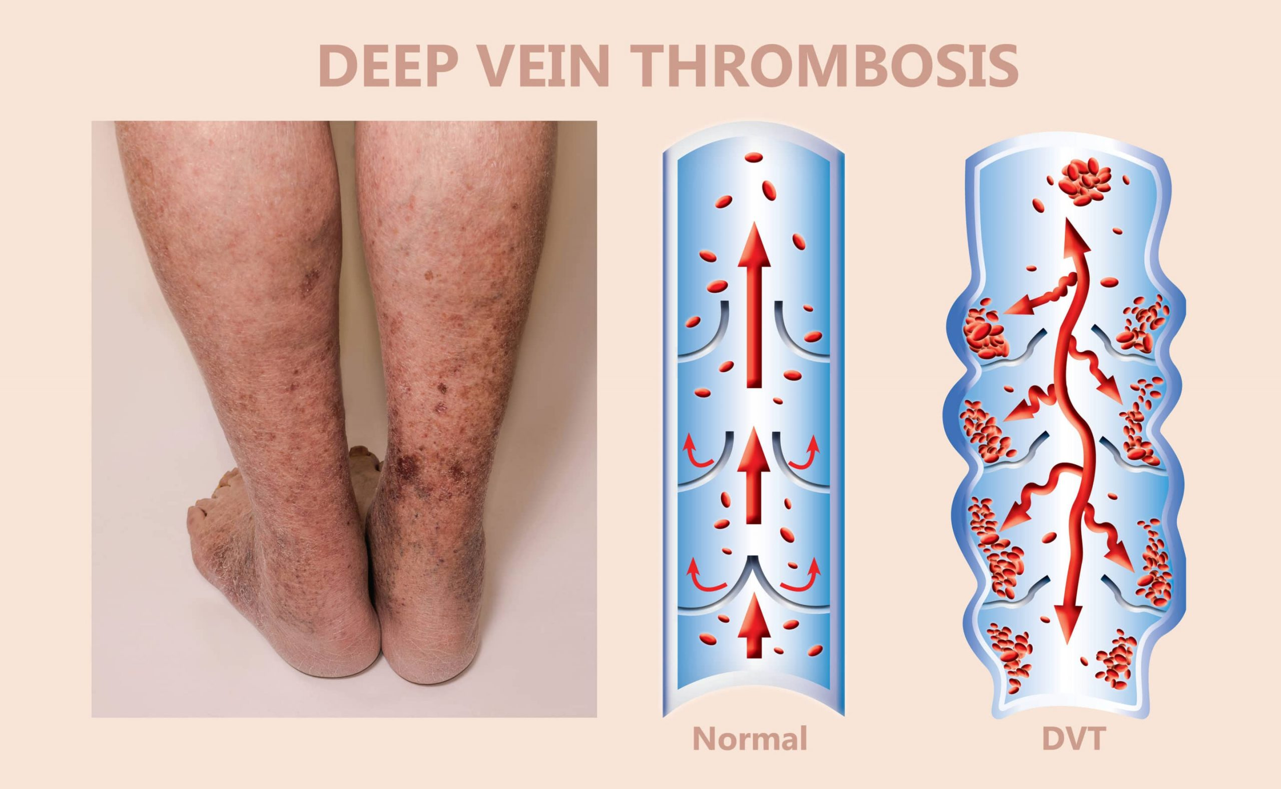

Slide 4
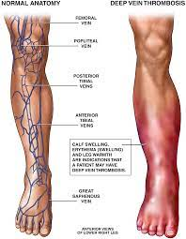
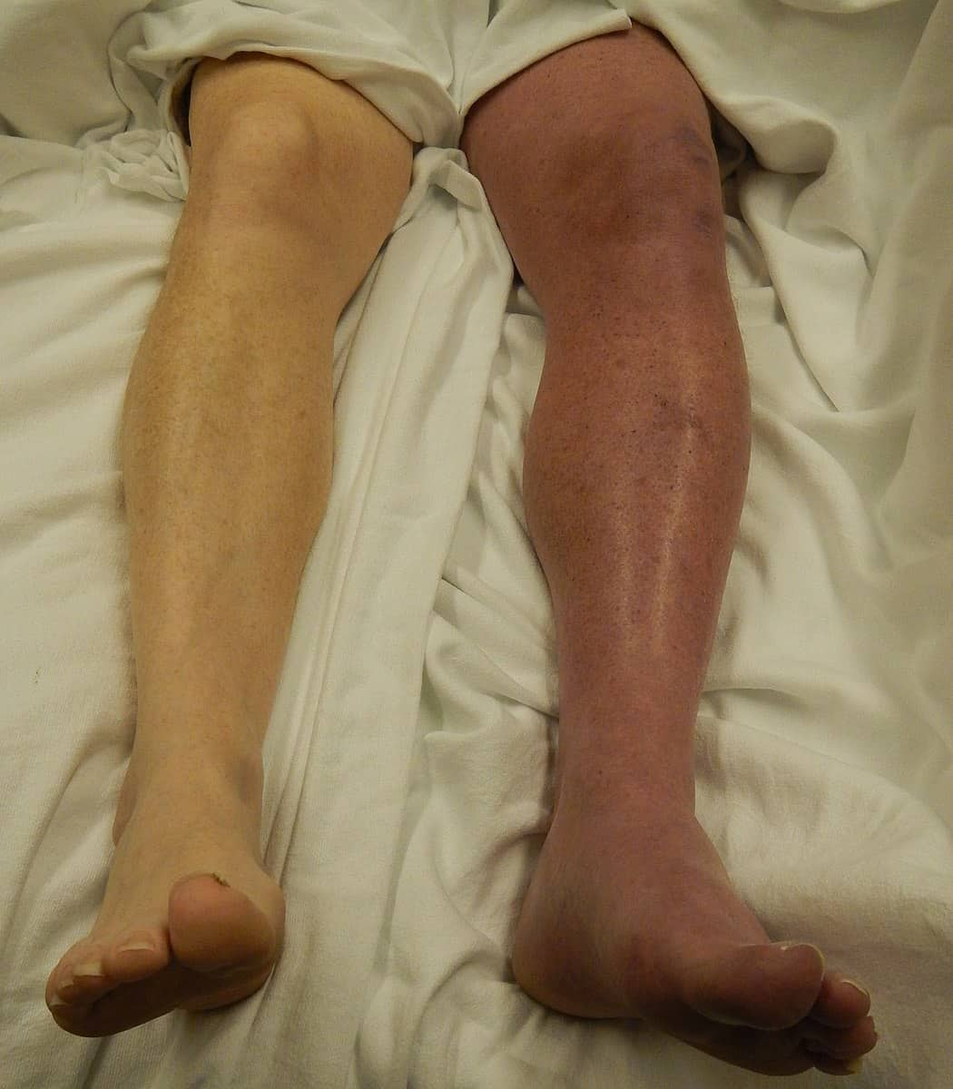
Deep vein thrombosis (DVT)
is a medical condition that occurs when a blood clot forms in a deep vein. These clots usually develop in the lower leg, thigh, or pelvis, but they can also occur in the arm

Slide 5
Causes of Deep Vein Thrombosis (DVT)
Surgery, particularly surgery of the hip or leg, or abdominal surgery.
Trauma or bone fracture.
A long period of bed rest or sitting for a long time
Cancer.
Pregnancy

Slide 6
what is DVT classification?
DVT is classified as acute when the clots are developing or have recently developed,
whereas chronic DVT persists more than 28 days.
Differences between these two types of DVT can be seen with ultrasound. An episode of VTE after an initial one is classified as recurrent.

Slide 7
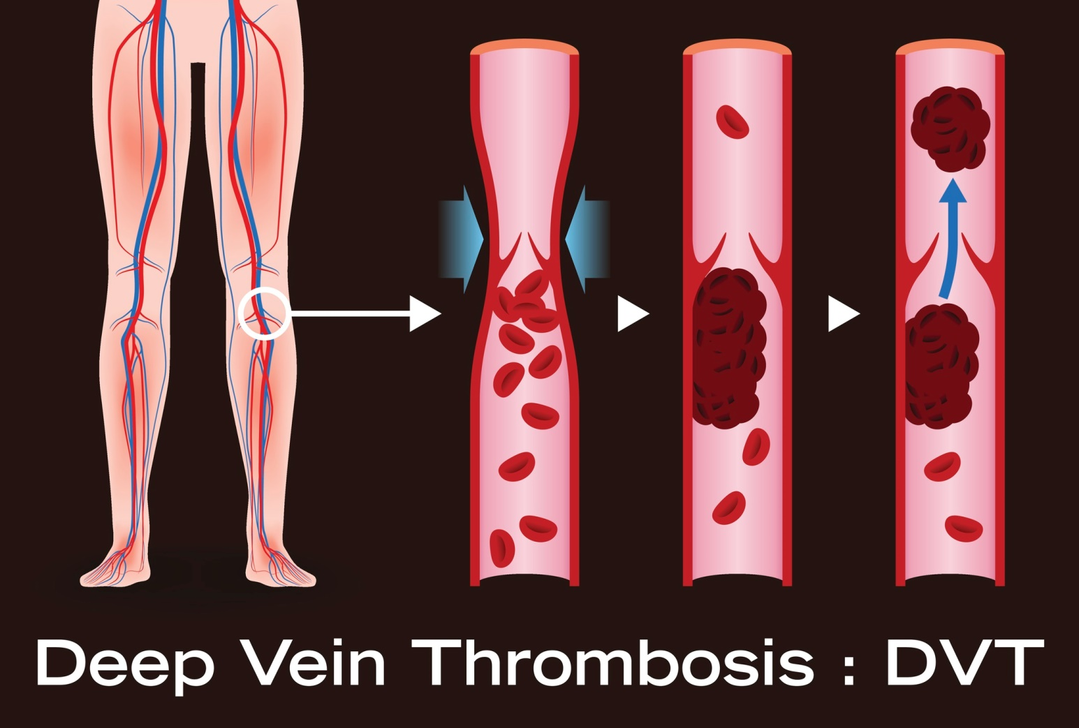

Slide 8
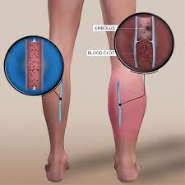
what are risk factors for DVT?
overweight or obese
family history of DVT
pulmonary embolisms
clotting disorders.
smoker

Slide 9
prevent DVT in ICU
aspirin may be helpful in preventing DVT in such patients. When anticoagulation is contraindicated,
There are three main types of anticoagulant medications:
Vitamin K antagonists.
Direct Oral Anticoagulants (DOACs)
Low molecular weight heparins (LMWH)
mechanical thromboprophylaxis using either
graduated compression stockings (GCS)
intermittent pneumatic compression (IPC) may be proposed

Slide 10
stress ulcer
Stress related mucosal injury

Slide 11
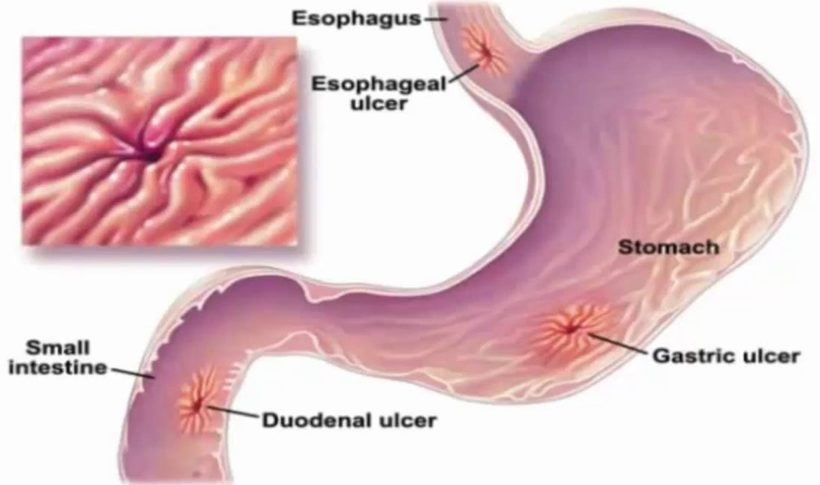
stress ulcer
stress ulceration is defined as ulceration of the upper gastrointestinal (GI) tract (esophagus, stomach, duodenum) that occurs due to hospitalization
Stress ulcers are multiple, superficial erosions which occur mainly in the fundus and body of the stomach. They develop after shock, sepsis, and trauma and A long period of bed rest or sitting for a long time

Slide 12
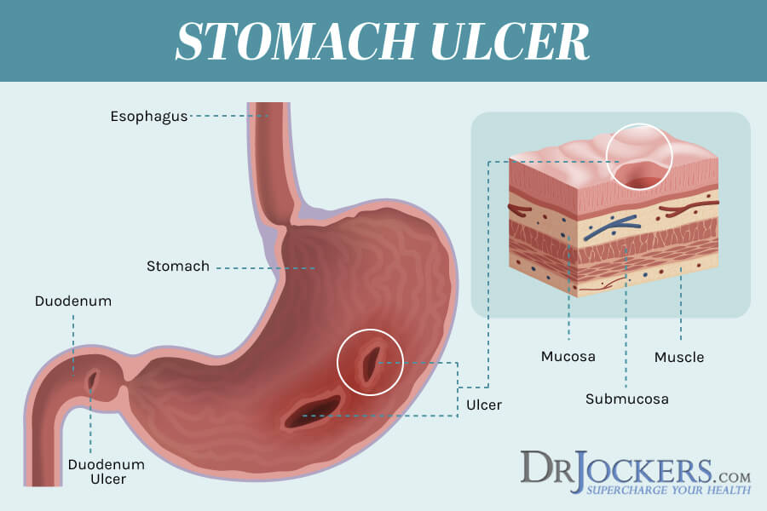
stress ulcers caused
Stress ulcers form when physical stress changes acid levels in the stomach, which damages the lining of the stomach. There are different types of stress ulcers, including Curling ulcers seen in people with severe burns and Cushing ulcers seen in people with severe brain injury

Slide 13
Risk factors for stress ulcer bleeding
Mechanical ventilation (>48hr).
Coagulopathy (platelets 1.5 or PTT>2x control)
Burns involving >30% of the body surface.
Circulatory shock.
Sever sepsis.
Traumatic brain and spinal cord injury.
Renal failure.
Steroid therapy.
Multisystem trauma.

Slide 14
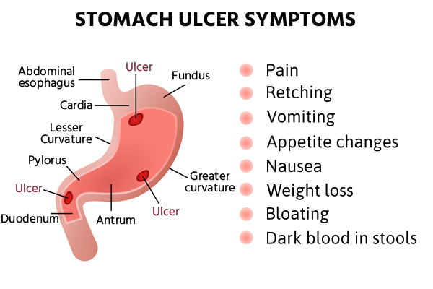

Slide 15
Preventive measures
The goal of prophylaxis for stress ulcer is not to be preventing their appearance but to prevent clinical significant bleeding from these lesions
Anti-histamine type-2
Ranitidine H2 blocker IV 20mg every 12 hr.
Famotidine H2 blocker IV 50MG every 8 hr.
Proton pump inhibitors
Omeprazole PPI NG 20mg once daily.
Lansoprazole PPI NG 30mg once daily.
Pantoprazole PPI IV 40mg once daily.
Cytoprotective Sucralfate
protectant NG 1gram every 6 hr

Slide 16


