Slide 1
ICU
L11
Anesthesia Technologist BCS. Anesthesia. and IC diploma. Community health Karrar Nader AL-Taie
Anesthesia Technologist BCS. Anesthesia. and IC diploma. Community health Muneer Salman Hasan

Slide 2
Nutrition in the ICU

Slide 3
Introduction
Nutritional therapy is an integral part of ICU care. The goals are to provide adequate calories and protein to keep up with ongoing losses, prevent or correct nutrient deficiencies and promote wound healing and immune function.

Slide 4
two types of nutrition in the critically ill patient:
Enteral nutrition(EN)
Parenteral nutrition(PN)

Slide 5
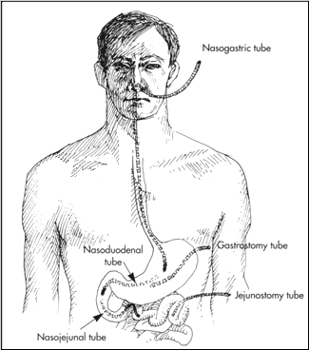
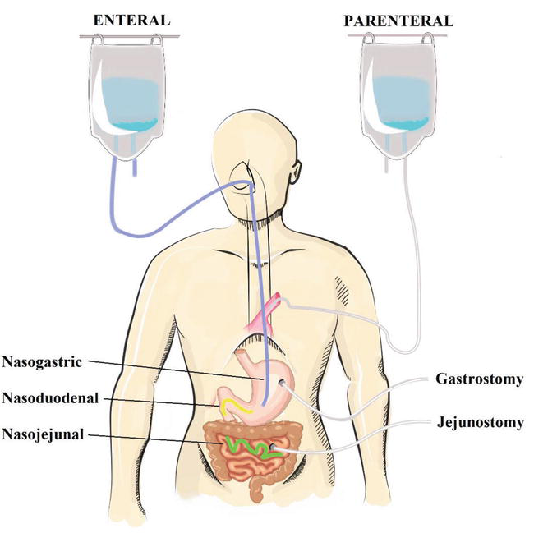
Enteral nutrition(EN):
Commence enteral feeding within 24-48 h of ICU admission if the gastrointestinal tract is functioning and patients have been adequately resuscitated.
using a nasogastric or orogastric tube. Use 12FG in adult. confirm the correct position of the tube by any three of the following methods:
(i) aspiration of gastric contents
(ii) injection of 10-20 ml of air down the tube and auscultating the epigastric area
(iii) radiography.

Slide 6
Basic nutrients of EN
water, carbohydrates, fat, proteins, electrolytes, vitamins, and trace elements.
Vitamins are: B1, B6, B12, pantothenic acid, biotin, folate, vit. A, C, D, E, and K
Trace elements: substances that present in the body in amounts less than 50 micrograms per gram of body tissue, and it is seven trace elements (chromium, copper, iodine, iron, manganese, selenium and zinc.
EN either classical (made locally in special subunits inside the ICU) OR ready-made (comes premixed and ready to be given

Slide 7
Advantages of EN feeding:
Less expensive
Improved gut barrier function.
Improved stimulation of blood flow of the intestine.
Maintenance of gut immunologic function
Contraindications of EN:
Absolute:
Shock
Intestinal ischemia
Complete intestinal obstruction
Relative:
Partial intestinal obstruction
Severe diarrhea.
Pancreatitis.
High fistula

Slide 8
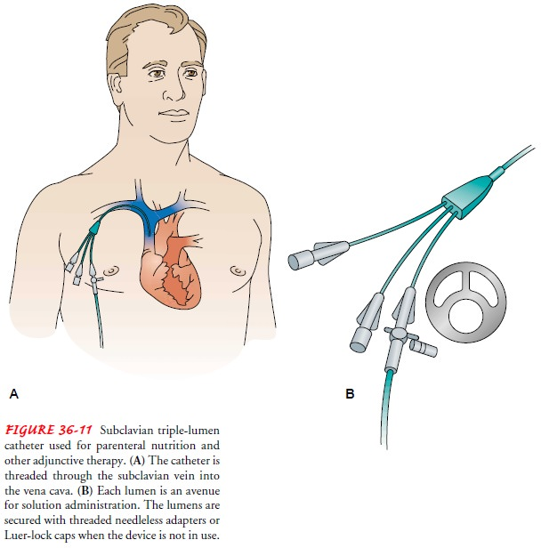
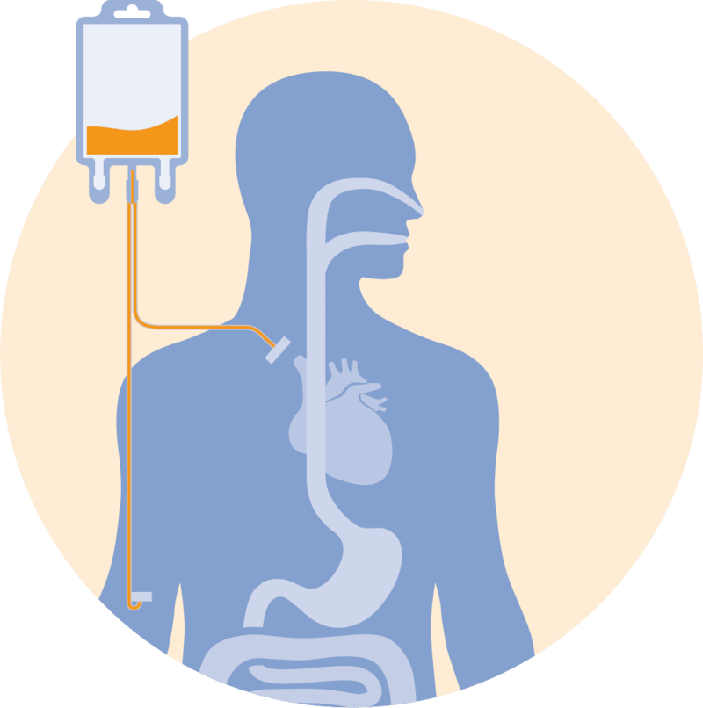
Parenteral nutrition(PN)
Is an IV solution of 10-50% dextrose in water (CHO), amino acids, electrolytes, and additives (vitamins, minerals, and trace elements), Fat emulsions provide fatty acids and calories.

Slide 9
Basic nutrients of PN
Solutions >10% dextrose must be infused via a central line.
1000 ml 5% D/W contains 50 g sugar= 200 calories
1000 ml 25% D/W contains 250 g sugar=1000 calories.
Total calorie=30-40 cal/kg/day.
Water: 30ml/kg/day.
CHO: 60%.
Fat: 40%.
Ptn 1.2-1.5gm/kg/day.
Na:1meq/kg/day
K:2meq/kg/day

Slide 10
Dosage calculation
Example: 80 kg male postoperative:
Water: 30ml x 80 =2400 ml.
Total caloric: 30 x 80 =2400 kcal.
CHO = 2400 x60/100 =1440 kcal.
Fat = 2400- 1440 = 960 kcal.
Protein = 1.2 x 80 = 96 g/day
Na = 1 x 80 = 80 mcg / day
K = 2 x 80 =160 mcg / day
Homework
60 kg male postoperative?
110 kg male postoperative

Slide 11
Indications
Severe malnutrition.
Burns.
Bowel disorders (inflammatory disorders, total bowel obstruction, short bowel syndrome).
Sever acute pancreatitis.
Acute renal failure.
Hepatic failure.
Metastatic cancer.
Post-operative major surgery if NPO > 5 days.

Slide 12
Complications
Catheter related complications:
Infections, sepsis, pneumothorax, hemothorax, arterial puncture, air embolism, arrhythmia.
Metabolic complications:
Hypoglycemia, hyperglycemia, hypokalemia/hyperkalemia, hyponatremia/hypernatremia, hypophosphatemia/hyperphosphatemia, hypocalcemia/hypercalcemia, hypomagnesemia/hypomagnesemia.

Slide 13
Monitoring for patients being given TPN
Blood sugar: 4 hourly until stable. 6-12 h when stable.
WBC count daily.
Electrolytes daily.
Renal function daily.
Liver function, Ca, phosphate, plasma lipidemia (twice weekly)
Plasma albumin, transferrin (weekly).
Urinary urea, trace elements, (alternative weeks).

