Slide 1


Al-Mustaqbal university
Nursing college
Prof.dr.Saadya hadi humade

Slide 2
Puberty:
Before puberty, boys and girls appear very much alike except for their genitalia.
Puberty involves changes in the whole body and the psyche as well as in the expectations of society toward the individual.
Puberty is a period of rapid change in the lives of boys and girls during which the reproductive systems mature and become capable of reproduction.
Puberty begins when the secondary sex characteristics (e.g., pubic hair) appear. Puberty ends when mature sperm are formed or when regular menstrual cycles occur.
Some cultures have required demonstrations of bravery, such as hunting wild animals or displays of self-defense.
Ritual circumcision is another rite of passage in some cultures and religions.

Slide 3
Male:
Male hormonal changes normally begin between 10 and 16 years of age. Outward changes become apparent when the size of the penis and testes increases and there is a general growth spurt.
Testosterone, the primary male sex hormone, causes the boy to grow taller, become more muscular, and develop secondary sex characteristics such as pubic hair, facial hair, and a deeper voice.
The voice deepens but is often characterized by squeaks or cracks before reaching its final pitch.
Testosterone levels are constant, although levels may decrease with age to 50% of peak levels by age 80 years.
Nocturnal emissions (“wet dreams”) may occur without sexual stimulation.
These emissions usually do not contain sperm.

Slide 4
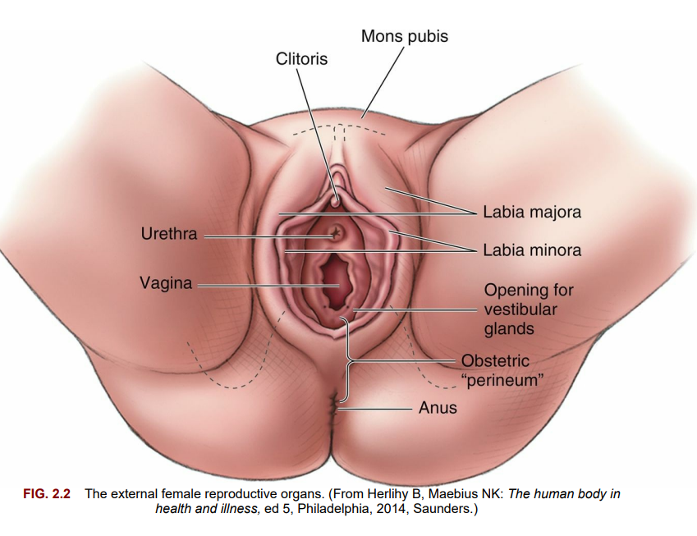

Slide 5
Female:
The first outward change of puberty in girls is development of the breasts.
The first menstrual period (menarche) occurs 2 to 2 years later (age 11 to 15 years).
Female reproductive organs mature to prepare for sexual activity and childbearing.
Girls experience a growth spurt, but this growth spurt ends earlier than the growth spurt experienced by boys.
A girl’s hips broaden as her pelvis assumes the wide basin shape needed for birth.
Pubic hair and axillary hair appear.
The quantity varies, as it does in males.

Slide 6
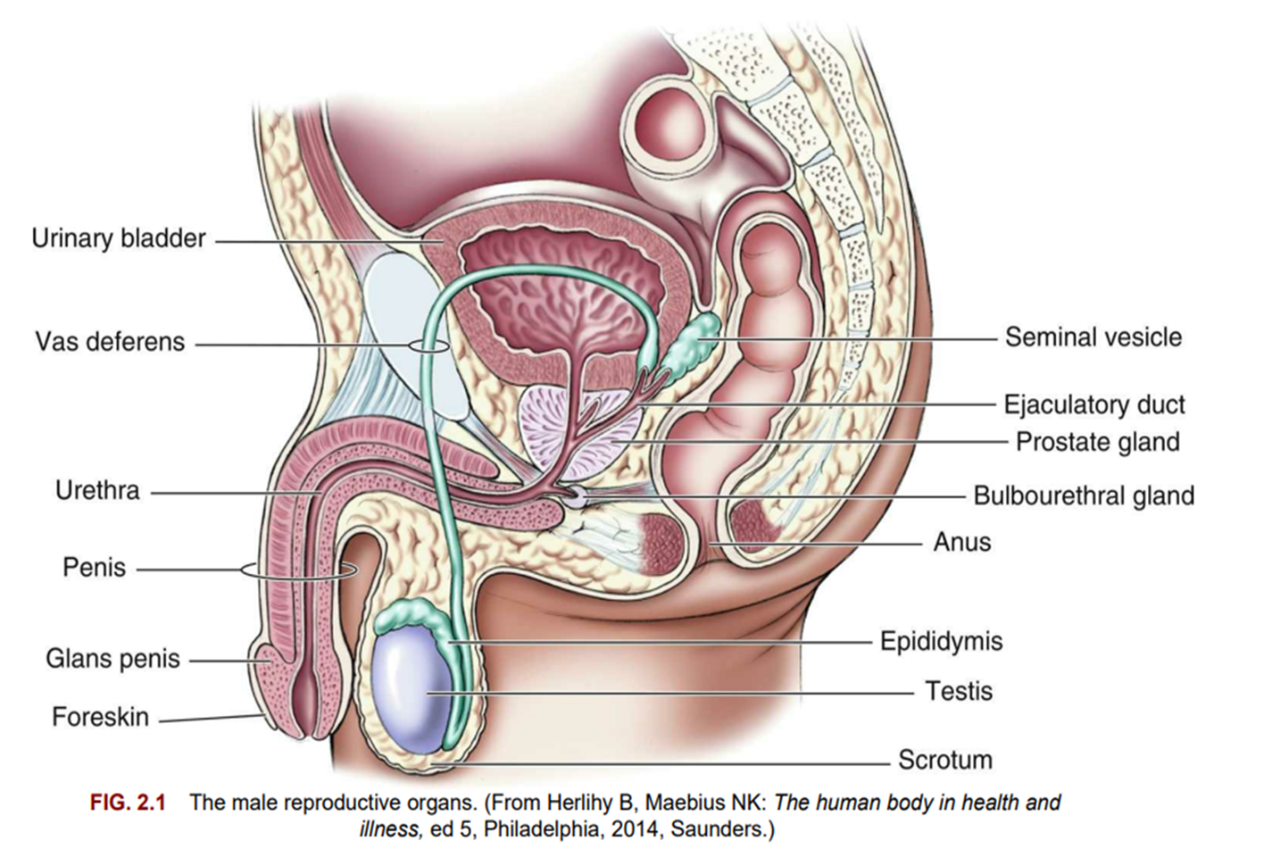

Slide 7
External Genitalia
The penis and the scrotum, which contains the testes, are the male external genitalia.
Penis The penis consists of the glans and the body.
The glans is the rounded, distal end of the penis.
It is visible on a circumcised penis but is hidden by the foreskin on an uncircumcised penis.
Smegma is a cheese-like sebaceous substance that collects under the foreskin and is easily removed with basic hygiene.
At the tip of the glans is an opening called the urethral meatus.
The body of the penis contains the urethra (the passageway for sperm and urine) and erectile tissue (the corpus spongiosum and two corpora cavernosa).
The penis has two functions:
1. Provides a duct to expel urine from the bladder
2. Deposits sperm in a woman’s vagina to fertilize an ovum

Slide 8
Scrotum The scrotum:
is a sac that contains the testes.
The scrotum is suspended from the perineum, keeping the testes away from the body and thereby lowering their temperature, which is necessary for normal sperm production (spermatogenesis).

Slide 9
Internal Genitalia :
The internal genitalia include the testes, vas deferens, prostate, seminal vesicles, ejaculatory ducts, urethra, and accessory glands.
Testes:
The testes (testicles) are a pair of oval glands housed in the scrotum.
They have two functions:
Manufacture male germ cells (spermatozoa or sperm).
Secrete male hormones (androgens) Sperm are made in the convoluted seminiferous tubules that are contained within the testes.
Sperm production begins at puberty and continues throughout the life span of the male.
The production of testosterone, the most abundant male sex hormone, begins with the anterior pituitary gland.

Slide 10
Under the direction of the hypothalamus, the anterior pituitary gland secretes follicle-stimulating hormone (FSH) and luteinizing hormone (LH).
the production of testosterone in the Leydig cells of the testes.
Testosterone has the following effects not directly related to sexual reproduction:
• Increases muscle mass and strength
• Promotes growth of long bones
• Increases basal metabolic rate
• Enhances production of red blood cells
• Produces enlargement of vocal cords
• Affects the distribution of body hair
These effects result in greater strength and stature and a higher hematocrit level in males than in females.
Testosterone also increases the production of sebum, a fatty secretion of the sebaceous glands of the skin, and it may contribute to the development of acne during early adolescence

Slide 11
Ducts Each epididymis:
one from each testicle, stores the sperm.
The sperm may remain in the epididymis for 2 to 10 days, during which time they mature and then move on to the vas deferens.
Each vas deferens:
passes upward into the body, goes around the symphysis pubis, circles the bladder, and passes downward to form (with the ducts from the seminal vesicles) the ejaculatory ducts.
The ejaculatory ducts then enter the back of the prostate gland and connect to the upper part of the urethra, which is in the penis.
The urethra transports both urine from the bladder and semen from the prostate gland to the outside of the body, although not at the same time.

Slide 12
Accessory glands :
The accessory glands are the seminal vesicles, the prostate gland, and the bulbourethral glands, also called Cowper’s glands.
The accessory glands produce secretions (seminal plasma)that have three functions:
Nourish the sperm
Protect the sperm from the acidic environment of the woman’s vagina
Enhance the motility (movement) of the sperm.
The combined seminal plasma and sperm are called semen.
Semen may be secreted during sexual intercourse before ejaculation.
Therefore pregnancy may occur even if ejaculation occurs outside the vagina. Increased heat in the environment around the sperm (testes) increases the motility of the sperm but also shortens their life span.
A constant increase in temperature around the testes can prevent spermatogenesis and lead to permanent sterility

Slide 13
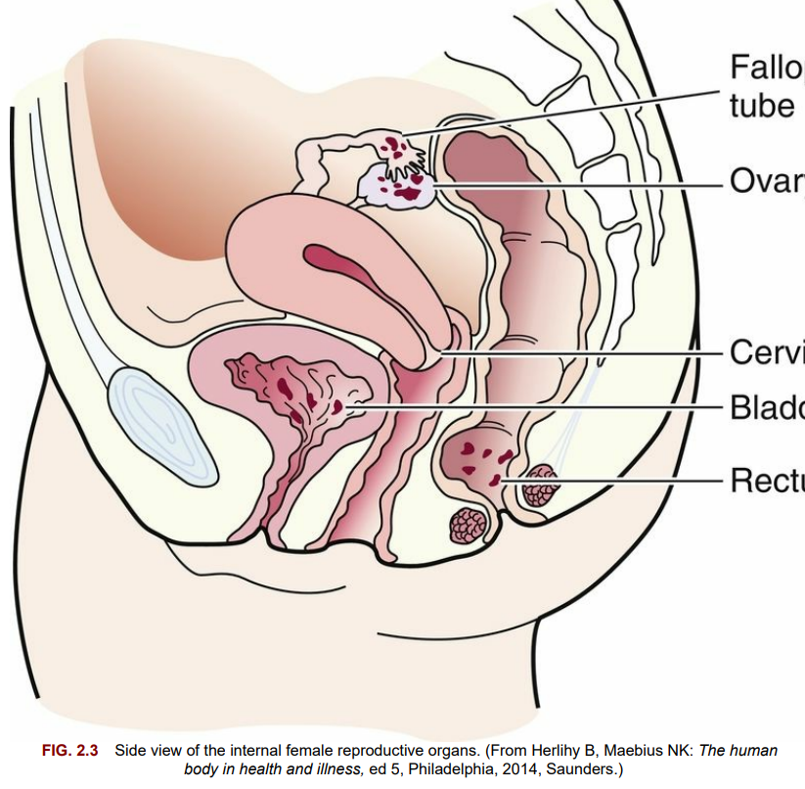

Slide 14
Female :
The female reproductive system consists of :
1- external genitalia,
2- internal genitalia,
3- and accessory structures such as the mammary glands (breasts).
The bony pelvis its importance in the childbearing process.
External Genitalia :
The female external genitalia are collectively called the vulva. They include:
the mons pubis,
labia majora,
labia minora,
fourchette,
clitoris,
vaginal vestibule,
and perineum .

Slide 15
Mons pubis:
1- The mons pubis (mons veneris) is a pad of fatty tissue covered by coarse skin and hair.
It protects the symphysis pubis and contributes to the rounded contour of the female body.
2- Labia majora :
The labia majora are two folds of fatty tissue on each side of the vaginal vestibule.
Many small glands are located on the moist interior surface.
3-Labia minora :
The labia minora are two thin, soft folds of tissue that are seen when the labia majora are separated.
Secretions from sebaceous glands in the labia are bactericidal to reduce infection and lubricate and protect the skin of the vulva.
4- Fourchette
The fourchette is a fold of tissue just below the vagina, where the labia majora and the labia minora meet.
It is also known as the obstetrical perineum.
Lacerations in this area often occur during childbirth.

Slide 16
5- Clitoris
The clitoris is a small, erectile body in the most anterior portion of the labia minora.
It is similar in structure to the penis.
Functionally, it is the most erotic, sensitive part of the female genitalia.
6-Vaginal vestibule
The vaginal vestibule is the area seen when the labia minora are separated and includes five structures:
1. The urethral meatus lies approximately 2 cm below the clitoris.
It has a foldlike appearance with a slit type of opening, and it serves as the exit for urine.
2. Skene ducts (paraurethral ducts) are located on each side of the urethra and provide lubrication for the urethra and the vaginal orifice.
3. The vaginal introitus is the division between the external and internal female genitalia.
4. The hymen is a thin elastic membrane that closes the vagina from the vestibule to various degrees.
5. The ducts of the Bartholin glands (vulvovaginal glands) provide lubrication for the vaginal introitus during sexual arousal and are normally not visible.

Slide 17
Perineum:
The perineum is a strong, muscular area between the vaginal opening and the anus.
The elastic fibers and connective tissue of the perineum allow stretching to permit the birth of the fetus.
The perineum is the site of the episiotomy (incision) if performed or potential tears during childbirth.
*Pelvic weakness or painful intercourse (dyspareunia) may result if this tissue does not heal properly.
Internal Genitalia :
The internal genitalia are the vagina, uterus, fallopian tubes, and ovaries.

Slide 18
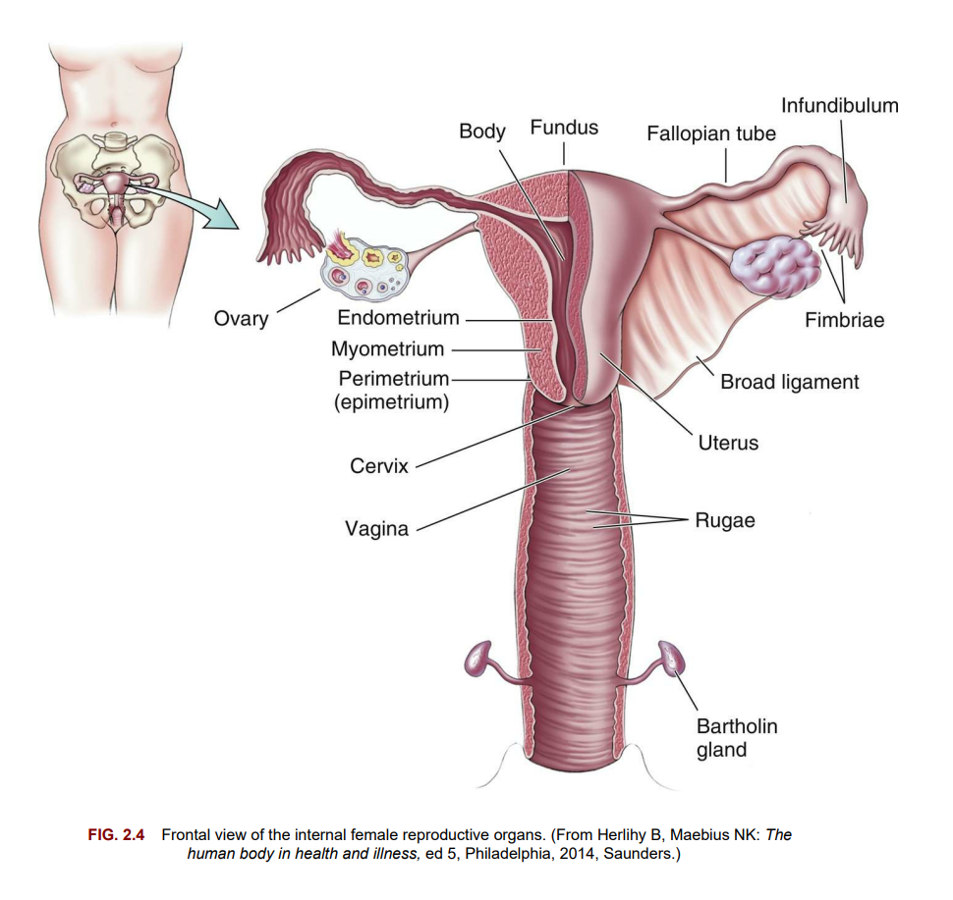

Slide 19
Vagina :
The vagina is a tubular structure made of muscle and membranous tissue that connects the external genitalia to the uterus.
The vagina is self-cleansing and during the reproductive years maintains a normal acidic pH of 4 to 5.
Antibiotic therapy,
frequent douching,
and excessive use of vaginal sprays,
deodorant sanitary pads,
or deodorant tampons
may alter the self-cleansing activity.
The vagina has three functions:
1. Provides a passageway for sperm to enter the uterus
2. Allows drainage of menstrual fluids and other secretions
3. Provides a passageway for the infant’s birth Strong pelvic floor muscles stabilize and support the internal and external reproductive organs.
The most important of these muscles is the levator ani, which supports the three structures that penetrate it: urethra, vagina, and rectum.

Slide 20
Uterus :
The uterus (womb) is a hollow muscular organ in which a fertilized ovum is implanted, an embryo forms, and a fetus develops.
It is shaped like an upside-down pear or light bulb.
In a mature, nonpregnant woman, it weighs approximately 60 g (2 oz) and is 7.5 cm (3 inches) long, 5 cm (2 inches) wide, and 1 to 2.5 cm (0.4 to 1 inch) thick.
The uterus lies between the bladder and the rectum above the vagina.
Several ligaments support the uterus.
1-The broad ligament provides stability to the uterus in the pelvic cavity,
2- the round ligament is surrounded by muscles that enlarge during pregnancy and keep the uterus in place,
3- the cardinal ligaments prevent uterine prolapse,
4-and the uterosacral ligaments are surrounded by smooth muscle and contain sensory nerve fibers that may contribute to the sensation of dysmenorrhea (painful menstruation).
Stretching of the uterine ligaments as the uterus enlarges during pregnancy can cause minor discomfort to the mother.

Slide 21
Nerve supply Because the autonomic:
nervous system innervates the reproductive system, its functions are not under voluntary (conscious) control.
Therefore even a paraplegic woman can have adequate contractions for labor.
Sensations for uterine contractions are carried to the central nervous system via the 11th and 12th thoracic nerve roots.
Pain from the cervix and the vagina passes through the pudendal nerves.
The motor fibers of the uterus arise from the seventh and eighth thoracic vertebrae.
This separate motor and sensory nerve supply allows for the use of a local anesthetic without interfering with uterine contractions and is important in pain management during labor.

Slide 22
Anatomy :
The uterus is separated into three parts:
fundus, corpus, and cervix.
The fundus (upper part) is broad and flat.
The fallopian tubes enter the uterus on each side of the fundus.
The corpus (body) is the middle portion, and it plays an active role in menstruation and pregnancy.
The fundus and the corpus have three distinct layers:
The perimetrium is the outermost or serosal layer that envelops the uterus.
The myometrium is the middle muscular layer that functions during pregnancy and birth.
It has three involuntary muscle layers:
a longitudinal outer layer, a figure-of-eight interlacing middle layer,
and a circular inner layer that forms sphincters at the fallopian tube attachments and at the internal opening of the cervix.
3. The endometrium is the inner or mucosal layer that is functional during menstruation and implantation of the fertilized ovum.
It is governed by cyclical hormonal changes.

Slide 23
The cervix
(lower part) is narrow and tubular and opens into the upper vagina.
The cervix consists of a cervical canal with an internal opening near the uterine corpus (internal os) and an opening into the vagina (the external os).
The mucosal lining of the cervix has four functions:
Lubricates the vagina
Acts as a bacteriostatic agent
Provides an alkaline environment to shelter deposited sperm from the acidic pH of the vagina
Produces a mucous plug in the cervical canal during pregnancy

Slide 24
Fallopian tubes
The fallopian tubes, also called uterine tubes or oviducts, extend laterally from the uterus, one to each ovary .
They vary in length from 8 to 13.5 cm (3 to 5.3 inches).
Each tube has four sections:
The interstitial portion extends into the uterine cavity and lies within the wall of the uterus.
The isthmus is a narrow area near the uterus.
The ampulla is the wider area of the tube and is the usual site of fertilization.
The infundibulum is the funnel-like enlarged distal end of the tube. Fingerlike projections from the infundibulum, called fimbriae, hover over each ovary and “capture” the ovum (egg) as it is released by the ovary at ovulation.

Slide 25
The four functions of the fallopian tubes are to provide the following:
A passageway in which sperm meet the ovum
The site of fertilization (usually the outer one-third of the tube)
A safe, nourishing environment for the ovum or zygote (fertilized ovum)
The means of transporting the ovum or zygote to the corpus of the uterus.
Cells within the tubes have cilia (hairlike projections) that beat rhythmically to propel the ovum toward the uterus. Other cells secrete a protein-rich fluid to nourish the ovum after it leaves the ovary.

Slide 26
Ovaries
The ovaries are two almond-shaped glands, each about the size of a walnut.
They are located in the lower abdominal cavity, one on each side of the uterus, and are held in place by ovarian and uterine ligaments.
The ovaries have two functions:
Production of hormones, chiefly estrogen and progesterone
Stimulation of an ovum’s maturation during each menstrual cycle
At birth, every female infant has all the ova (oocytes) that will be available during her reproductive years (approximately 2 million cells).
These degenerate significantly so that by adulthood the remaining oocytes number only in the thousands.
Of these, only a small percentage are actually released (about 400 during the reproductive years).
Every month, one ovum matures and is released from the ovary.
Any ova that remain after the climacteric (the time surrounding menopause) no longer respond to hormonal stimulation to mature.

Slide 27
Pelvis:
The bony pelvis occupies the lower portion of the trunk of the body.
Four bones attached to the lower spine form the pelvis:
• Two innominate bones
• Sacrum
• Coccyx Each innominate bone is made up of an ilium, pubis, and ischium, which are separate during childhood but fuse by adulthood.
The ilium is the lateral, flaring portion of the hip bone; the pubis is the anterior hip bone.
These two bones join to form the symphysis pubis.
The curved space under the symphysis pubis is called the pubic arch.
The ischium is below the ilium and supports the seated body.
An ischial spine, one from each ischium, juts inward to varying degrees.
These ischial spines serve as a reference point for descent of the fetus during labor.
The posterior pelvis consists of the sacrum and the coccyx.
Five fused, triangular vertebrae at the base of the spine form the sacrum.
The sacrum may jut into the pelvic cavity, causing a narrowing of the birth passageway.
Below the sacrum is the coccyx, the lowest part of the spine.

Slide 28
The bony pelvis has three functions:
1. Supports and distributes body weight
2. Supports and protects pelvic organs
3. Forms the birth passageway

Slide 29
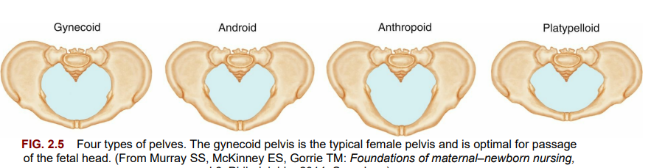

Slide 30
Types of pelves:
There are four basic types of pelves .
Most women have a combination of pelvic characteristics rather than having one pure type. Each type of pelvis has implications for labor and birth:
• The gynecoid pelvis is the classic female pelvis, with rounded anterior and posterior segments. This type is most favorable for vaginal birth.
• The android pelvis has a wedge-shaped inlet with a narrow anterior segment; it is typical of the male anatomy.
• The anthropoid pelvis has an anteroposterior diameter that equals or exceeds its transverse diameter. The shape is a long, narrow oval. Women with this type of pelvis can usually deliver vaginally, but their infant is more likely to be born in the occiput posterior (back of the fetal head toward the mother’s sacrum) position.
• The platypelloid pelvis has a shortened anteroposterior diameter and a flat, transverse oval shape. This type is unfavorable for vaginal birth.

Slide 31
False and true pelves
The pelvis is divided into:
1- the false
2-and true pelves by an imaginary line (linea terminalis) that extends from the sacroiliac joint to the anterior iliopubic prominence.
The upper, or false, pelvis supports the enlarging uterus and guides the fetus into the true pelvis.
The lower, or true, pelvis consists of the pelvic inlet, the pelvic cavity, and the pelvic outlet.
The true pelvis is important because it dictates the bony limits of the birth canal.

Slide 32
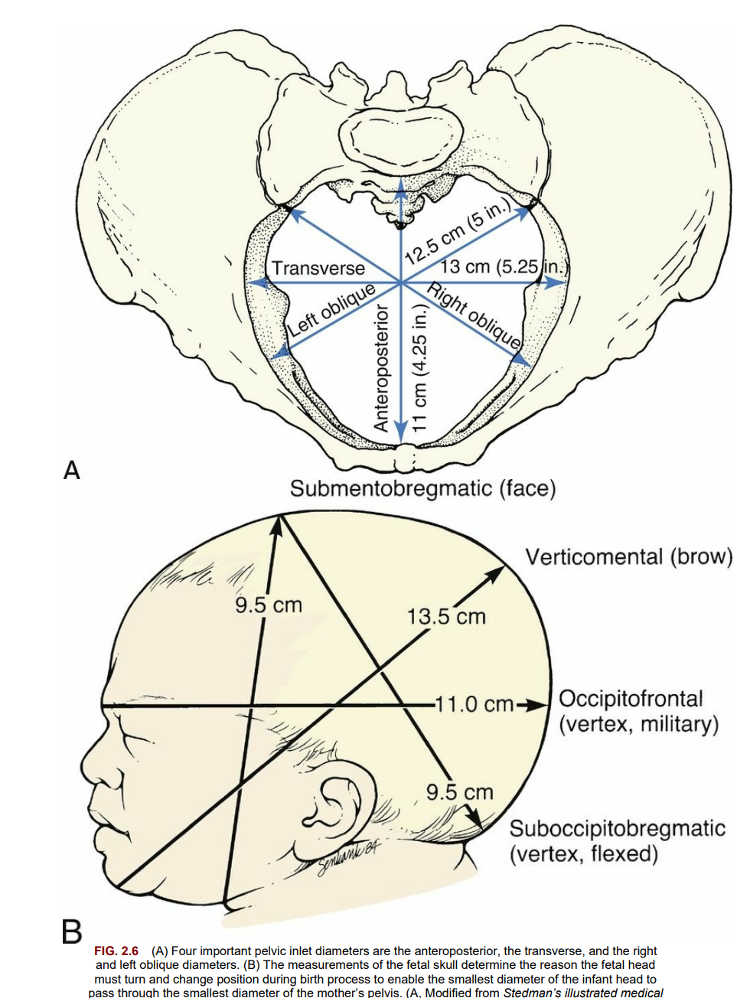

Slide 33
Pelvic inlet
The pelvic inlet, just below the linea terminalis, has obstetrically important diameters.
The anteroposterior diameter is measured between the symphysis pubis and the sacrum and is the shortest inlet diameter.
The transverse diameter is measured across the linea terminalis and is the largest inlet diameter.
The oblique diameters are measured from the right or left sacroiliac joint to the prominence of the linea terminalis.
Measurements of the pelvic inlet :
include the following:
• Diagonal conjugate: The distance between the suprapubic angle and the sacral promontory.
The health care provider assesses this measurement during a manual pelvic examination.
• Obstetric conjugate (the smallest inlet diameter):
Estimated by subtracting 1.5 to 2 cm from the diagonal conjugate (the approximate thickness of the pubic bone).
This measurement determines whether the fetus can pass through the birth canal.
• Transverse diameter: The largest diameter of the inlet. It determines the inlet’s shape.

Slide 34
Pelvic outlet
The transverse diameter of the outlet is a measurement of the distance between the inner surfaces of the ischial tuberosities and is known as the biischial diameter.
The anteroposterior measurement of the outlet is the distance between the lower border of the symphysis pubis and the tip of the sacrum.
It can be measured by vaginal examination.
The sagittal diameters are measured from the middle of the transverse diameter to the pubic bone anteriorly and to the sacrococcygeal bone posteriorly.
The coccyx can move or break during the passage of the fetal head, but an immobile coccyx can decrease the size of the pelvic outlet and make vaginal birth difficult.
A narrow pubic arch can also affect the passage of the fetal head through the birth canal.
Adequate pelvic measurements are essential for a successful vaginal birth. Problems that can cause a pelvis to be small (e.g., a history of a pelvic fracture or rickets) potentially indicate that delivery by cesarean section will be necessary.

Slide 35
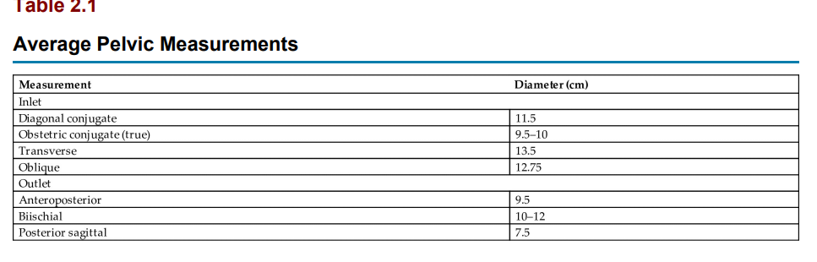

Slide 36
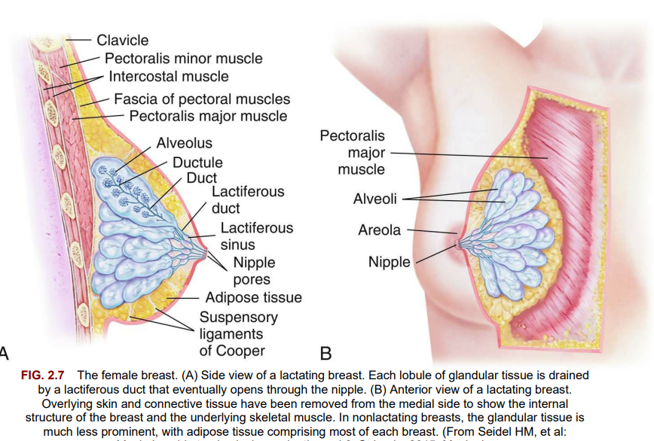

Slide 37
Breasts Female breasts (mammary glands) :
are accessory organs of reproduction.
They produce milk after birth to provide nourishment and maternal antibodies for the infant .
The nipple, in the center of each breast, is surrounded by a pigmented areola.
Montgomery glands (Montgomery tubercles) are small sebaceous glands in the areola that secrete a substance to lubricate and protect the breasts during lactation.

Slide 38
Each breast is composed of 15 to 24 lobes arranged like the spokes of a wheel.
Adipose (fatty) and fibrous tissues separate the lobes.
The adipose tissue affects size and firmness and gives the breasts a smooth outline.
Breast size is primarily determined by the amount of fatty tissue and is unrelated to a woman’s ability to produce milk.
Alveoli (lobules) are the glands that secrete milk.
They empty into approximately 20 separate lactiferous (milk-carrying) ducts.
Milk is stored briefly in widened areas of the ducts, called ampullae or lactiferous sinuses.

Slide 39
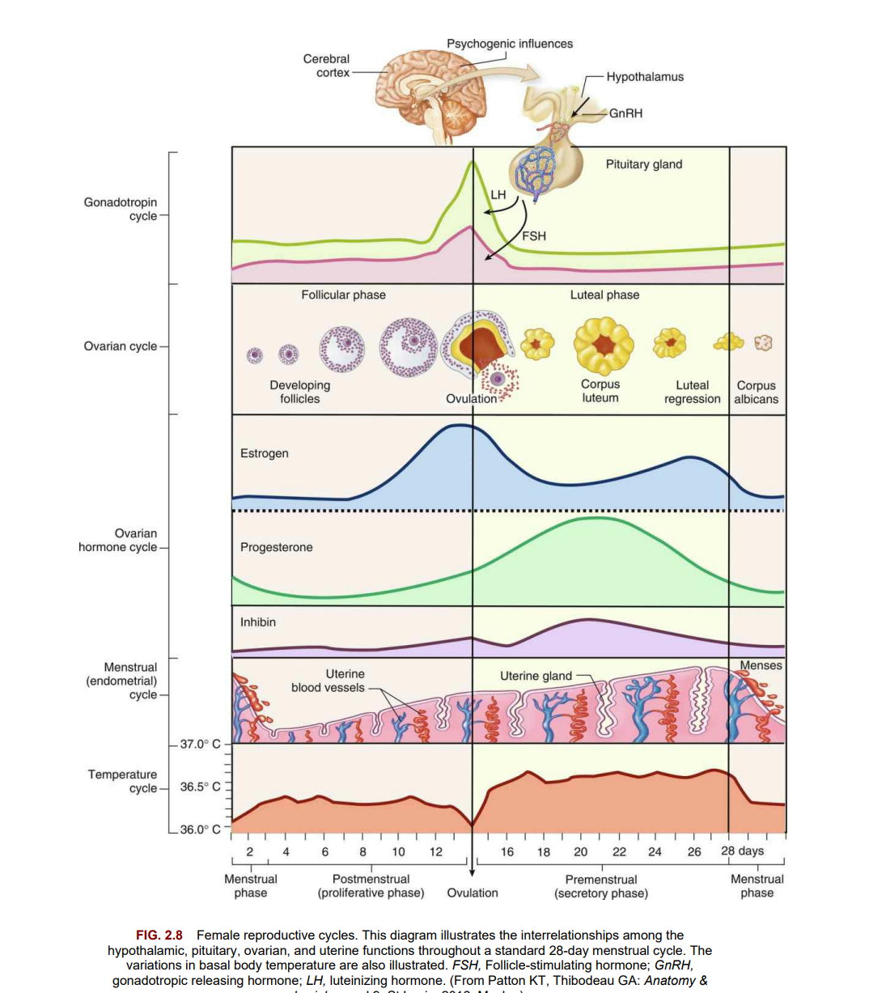

Slide 40
Reproductive Cycle and Menstruation
The female reproductive cycle consists of regular changes in secretions of the anterior pituitary gland, the ovary, and the endometrial lining of the uterus .
The anterior pituitary gland, in response to the hypothalamus, secretes follicle-stimulating hormone (FSH) and luteinizing hormone (LH).
FSH stimulates maturation of a follicle in the ovary that contains a single ovum.
Several follicles start maturing during each cycle, but usually only one reaches final maturity.
The maturing ovum and the corpus luteum (the follicle left empty after the ovum is released) produce increasing amounts of estrogen and progesterone, which leads to enlargement of the endometrium.
A surge in LH stimulates final maturation and the release of an ovum. Approximately 2 days before ovulation, the vaginal secretions increase noticeably.

Slide 41
Female reproductive cycles.
This diagram illustrates the interrelationships among the hypothalamic, pituitary, ovarian, and uterine functions throughout a standard 28-day menstrual cycle.
The variations in basal body temperature are also illustrated.
FSH, Follicle-stimulating hormone;
GnRH, gonadotropic releasing hormone;
LH, luteinizing hormone.
Ovulation occurs when a mature ovum is released from the follicle about 14 days before the onset of the next menstrual period.
The corpus luteum turns yellow (luteinizing) immediately after ovulation and secretes increasing quantities of progesterone to prepare the uterine lining for a fertilized ovum.
Approximately 12 days after ovulation, the corpus luteum degenerates if fertilization has not occurred, and progesterone and estrogen levels decrease.
The drop in estrogen and progesterone levels causes the endometrium to break down, resulting in menstruation.
The anterior pituitary gland secretes more FSH and LH, beginning a new cycle.
The beginning of menstruation, called menarche, occurs at about age 11 to 15 years.

Slide 42
Early cycles are often irregular and may be anovulatory.
Regular cycles are usually established within 6 months to 2 years of the menarche.
In an average cycle, the flow (menses) occurs every 28 days, plus or minus 5 to 10 days.
The flow itself lasts from 2 to 5 days, with a blood loss of 30 to 40 mL and an additional loss of 30 to 50 mL of serous fluid.
Fibrinolysin is contained in the necrotic endometrium being expelled, and therefore clots are not normally seen in the menstrual discharge.

Slide 43
Key Points
Puberty is the time when the reproductive organs mature to become capable of reproduction, and secondary sex characteristics develop.
• A sexually active girl can become pregnant before her first menstrual period because ovulation occurs before menstruation.
• At birth, every female has all the ova that will be available during her reproductive years.
• Testosterone is the principal male hormone.
Estrogen and progesterone are the principal female hormones.
Testosterone secretion continues throughout a man’s life, but estrogen and progesterone secretions are very low after a woman reaches the climacteric.
The penis and scrotum are the male external genitalia.
The scrotum keeps the testes cooler than the rest of the body, promoting normal sperm production.
The two main functions of the testes are to manufacture sperm and to secrete male hormones (androgens), primarily testosterone.
The myometrium (middle muscular uterine layer) is functional in pregnancy and labor.
The endometrium (inner uterine layer) is functional in menstruation and implantation of a fertilized ovum.

Slide 44
• The female breasts are composed of fatty and fibrous tissue and of glands that can secrete milk.
The size of a woman’s breasts is determined by the amount of fatty tissue and does not influence her ability to secrete milk.
• The female reproductive cycle consists of regular changes in hormone secretions from the anterior pituitary gland and the ovary, maturation and release of an ovum, and buildup and breakdown of the uterine lining.
• There are four basic pelvic shapes, but women often have a combination of characteristics.
The gynecoid pelvis is the most favorable for vaginal birth.
• The pelvis is divided into a false pelvis above the linea terminalis and the true pelvis below this line.
The true pelvis is most important in the childbirth process.
The true pelvis is further divided into the pelvic inlet, the pelvic cavity, and the pelvic outlet.
• The egg lives for only 24 hours after ovulation, and fertilization must occur during that time.

Slide 45
Review Questions for the NCLEX® Examination
1- Spermatozoa are produced in the:
vas deferens.
seminiferous tubules.
prostate gland.
Leydig cells.
2. A woman can keep a diary of her menstrual cycles to help determine her fertile period. She understands that after ovulation she will remain fertile for:
1. 2 hours.
2. 24 hours.
3. 3 to 5 days.
4. 7 to 14 days.
3. Which data indicate that a woman may have pelvic dimensions that would be inadequate for a normal vaginal delivery? A woman with a(n):
anthropoid-shaped pelvis with a history of pelvic inflammatory disease
gynecoid-shaped pelvis with a history of rickets
anthropoid-shaped pelvis that previously delivered a 9-lb infant
gynecoid-shaped pelvis with a history of poor nutrition.

Slide 46
Q1-B. Seminiferous Tubules
Rationale: Sperm are made in the convoluted seminiferous tubules of the testes.
Q2--B. 24 hours
Rationale: The egg lives for only 24 hours after ovulation; therefore it is viable for fertilization only for 24 hours.
Q3-B. gynecoid-shaped pelvis with a history of rickets
Rationale: Although the gynecoid-shaped pelvis is considered most favorable for a vaginal delivery, a woman with a history of rickets (a disease in which normal bone formation is disturbed when bone fails to mineralize and becomes soft and distorted) would be the most likely of the choices for inadequate normal vaginal delivery.
An anthropoid-shaped pelvis with a history of PID, although not most favorable, allows for possible vaginal delivery, and history of PID might interfere with conception but not delivery.
Previous delivery of a large infant is evidence of adequate pelvic dimensions for a normal vaginal delivery.
Although poor maternal nutrition can affect the health of the newborn, delivery is not necessarily affected.

Slide 47
4. The muscular layer of the uterus that is the functional unit in pregnancy and labor is the:
1. perimetrium.
2. myometrium.
3. endometrium.
4. cervix.
5. During a prenatal clinic visit, a woman states that she probably will not plan to breastfeed her infant because she has very small breasts and believes she cannot provide adequate milk for a full-term infant. The best response of the nurse would be:
“Ask the physician if he or she will prescribe hormones to build up the breasts.”
“I can provide you with exercises that will build up your breast tissue.
“The fluid intake of the mother will determine the milk output.”
The size of the breast has no relationship to the ability to produce adequate milk.”

Slide 48
Q4- B. myometrium
Rationale: The myometrium is the middle muscular uterine layer and is functional in pregnancy and labor.
The perimetrium is the outermost, or serosal, layer that envelops the uterus.
The endometrium is the inner, or mucosal, layer that is functional during menstruation and implantation of the fertilized ovum.
The cervix is the lower part of the uterus that lubricates the vagina, acts as a bacteriostatic agent, provides an alkaline environment, and produces a mucous plug.
Q5-D. "The size of the breast has no relationship to the ability to produce adequate milk"
Rationale: Breast size is primarily determined by the amount of fatty tissue and is unrelated to a woman's ability to produce milk.
The other answer options are inaccurate.

Slide 49
6. The nurse is leading a class discussing ovulation and menstruation. The nurse explains that ovulation occurs:
14 days after the last menstrual period
14 days before the next menstrual period
at the 16th day of a 32-day menstrual cycle
. 1 week before menses occurs
b and d
a and c
b only 4.
d only
Critical Thinking Questions
A patient is admitted to the labor unit. She has not had any prenatal care. Her history shows that she sustained a fractured pelvis from an automobile accident several years previously. The patient states she is interested in natural childbirth. What is the nurse’s best response?
An adolescent boy fears he is becoming incontinent because he notices his pajama pants are wet on occasion when he awakes in the morning. He asks if there is medicine to stop this problem. What is the best response from the nurse?

Slide 50
Leifer, G. (2019). Introduction to maternity and pediatric nursing.‏

Slide 51
Thanks for listening

