Slide 1


Family planning
Prof.saadya hadi humade

Slide 2
Family planning
Family planning is influenced by many factors, including cultural practices and preferences, religious beliefs, personal preferences, cost, knowledge of various methods, and the laws of human rights practiced in the country of residence.
The nurse’s role is :
to educate and guide the woman or couple concerning available choices,
advantages,
disadvantages,
side effects and
long-term effects.
The final decision rests with the individuals involved.

Slide 3
Contraception:
The nurse can play a part in helping couples choose and correctly use contraceptive methods that enable them to have children who are both wanted and well timed.
The optimum timing between pregnancies is 18 to 24 months.
Contraception does not always prevent pregnancy.
An important consideration for patients is how likely the method is to fail.
A contraceptive technique may fail because the method is ineffective or because the user is using the method inappropriately.
Two proposed goals of Healthy People 2030 (USDHHS, 2010) are particularly relevant to the provision of family planning services:
• Reduce the percentage of unintended pregnancies to no more than 30%
• Reduce the percentage of women who have an unintended pregnancy despite the use of a contraceptive method to no more than 7%

Slide 4
Natural family planning :
fertility awareness Natural family planning involves learning to identify the signs and symptoms associated with ovulation.
The couple either abstains from intercourse or uses a barrier method during the period that is presumed to be fertile.
The ovum is viable up to 24 hours after ovulation, and sperm are viable for 48 to 72 hours in the fallopian tube, although most die within 24 hours.
Natural family planning methods are acceptable to most religions.
They require no administration of systemic hormones or insertion of devices.
They are not only reversible but also can actually be used to increase the odds of achieving pregnancy when the couple desires a child.
Natural family planning requires extensive assessment and charting of all the changes in the menstrual cycle.
The woman must be highly motivated to track the many factors that identify ovulation.

Slide 5
Both partners must be willing to abstain from intercourse for much of the woman’s cycle if the method is used to prevent pregnancy.
They must also be willing to accept the relatively high failure rate of 20%.
Most women use a combination of the following four methods for predicting when they are fertile to increase the predictive value over that of each method on its own.
Basal Body Temperature :
The basal body temperature (BBT) is taken on awakening and before any activity .
This technique is based on the fact that the basal temperature rises very slightly at ovulation (about 0.2° C [0.4° F]) and remains higher in the last half of the cycle.
Unfortunately, BBT is better at identifying that ovulation has already occurred than at predicting when it is about to occur.
The most important time point to identify in attempting conception or contraception is the day before ovulation, rather than the day of ovulation .

Slide 6
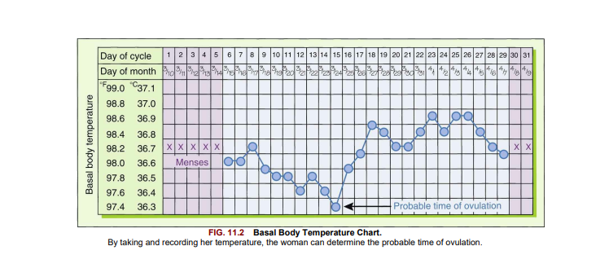

Slide 7
A basal thermometer is calibrated in tenths of a degree or uses an electronic digital format to detect these tiny changes.
The woman charts each day’s temperature to identify her temperature pattern.
A rise in the BBT for the last 14 days of the cycle means that ovulation has probably occurred.
Some electronic models have a memory to retain each day’s temperature, and they display the pattern on a small screen.
Many factors can interfere with the accuracy of the BBT in predicting ovulation. :
Poor sleep,
illness,
jet lag, called jet lag disorder, is a temporary sleep problem that can affect anyone who quickly travels across several time zones.
sleeping late,
alcohol intake the evening before,
or sleeping under an electric blanket
or on a heated waterbed can make the BBT unreliable.

Slide 8
Cervical Mucus: called the Billings method.:
The character and amount of cervical mucus change during the menstrual cycle, because estrogen and progesterone influence the mucus-secreting glands of the cervix.
Immediately after menstruation, the cervical mucus is sticky, thick, and white.
As ovulation nears, the mucus increases and becomes thin, slippery, and clear to aid the passage of sperm into the cervix.
The slippery mucus can be stretched 6 cm or more and has the consistency of egg white.
The stretching characteristic of the mucus is called spinnbarkeit.
After ovulation, the mucus again becomes thicker.
Factors that interfere with the accuracy of cervical mucus assessment include the use of antihistamines, vaginal infections, contraceptive foams or jellies, sexual arousal, and recent coitus.
The noticeable changes in vaginal mucus before ovulation can aid in natural family planning and fertility awareness.
This method can be used in women with irregular cycles.

Slide 9
Calendar (Rhythm) Method :
The woman charts her menstrual cycles on a calendar for several months.
If the cycles are regular, she may be able to predict ovulation.
The rhythm method is based on the fact that ovulation usually occurs about 14 days before the subsequent menstrual period.
This would be about halfway through a 28-day cycle, but would be on day 18 of a 32-day cycle.
A woman is fertile 5 days before and 1 day after ovulation, and barrier methods of contraception can be used during this time to prevent pregnancy.
This method is effective if the menstrual cycles are regular.

Slide 10
Temporary contraception:
Reversible contraception is defined as the temporary prevention of fertility.
Abstinence is 100% effective in preventing pregnancy and STIs. However, most couples believe that their sexual relationship adds to the quality of life.
Therefore abstinence is rarely an option the couple will consider.

Slide 11
Hormonal Contraceptives Hormonal contraceptives:
include one or more of these contraceptive effects:
• Prevent ovulation
• Make the cervical mucus thick and resistant to sperm penetration
Make the uterine endometrium less hospitable if a fertilized ovum does arrive Hormonal contraceptives do not protect either partner from STIs.
Oral contraceptives (“the pill”) Oral contraceptives (OCs) are a popular, highly effective, and reversible method of birth control .
They contain either combined hormones (estrogen and progestin) or progestin alone (“minipill”).
Progestin-only contraceptives should be avoided for postpartum Hispanic women with gestational diabetes who are breastfeeding because of an increased risk of later development of type 2 diabetes .
Combined hormones can be taken about 3 weeks after delivery, although progestin-only pills have a positive effect on lactation .

Slide 12
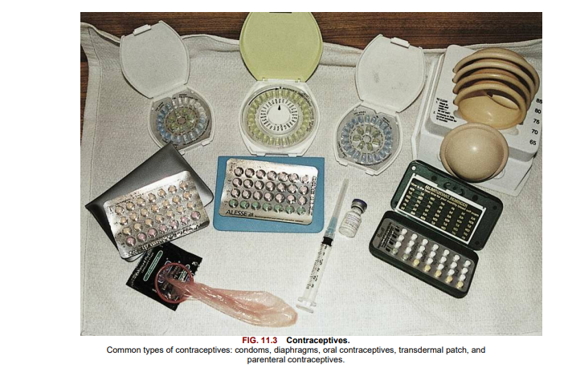

Slide 13
Oral contraceptives require a prescription.
The woman’s history is obtained,
and she will have a physical examination,
including breast and pelvic examinations
and a Pap test.
She should have a yearly physical examination, Pap test, breast examination, and blood pressure check.

Slide 14
Contraceptive regimens Monthly contraception Combination OCs are available in 21- or 28-pill packs.
If the woman has a 21-pill pack, she takes one pill each day at the same time for 21 days and then stops for 7 days.
The woman who has a 28-day pack takes a pill each day; the last seven pills of the pack are inert (inactive) but help her maintain the habit of taking the pill each day.
Menstruation occurs during the 7-day period when either no pills or inert pills are ingested.
Some pills are multiphasic, meaning that their estrogen and progestin content changes during the cycle to mimic natural hormonal activity.
If the woman takes multiphasic pills, it is very important that she take each pill in order.
Taking the pills at the same time each day is important, regardless of the type of OC, to maintain a stable blood level of the hormones.
It is most important that the medication-free interval not be extended beyond 7 days.
Taking the first pill of the cycle on time is most critical in preventing accidental pregnancies.

Slide 15
Extended-dose contraception:
Extended-dose contraception is also known as induced amenorrhea.
Research has shown that there are no specific health benefits to monthly menstruation.
The woman can take an active hormone for 84 days and then the hormone-free placebo for 7 days, resulting in a menstrual period once every 3 months.
Other oral contraceptive regimens can extend the menstrual cycle to once a year.
There are no planned withdrawal bleeds, but some women report spotting or breakthrough bleeding about 3 days a month when they start the regimen.

Slide 16
Side effects and contraindications Common side effects of OCs include :
nausea, headache, breast tenderness, weight gain, and spotting between periods or amenorrhea.
These effects generally decrease within a few months and are seen less frequently with low-dose OCs.
Women with the following disorders should not take OCs or should take them with caution:
Thromboembolic disorders (blood clots)
Cerebrovascular accident or heart disease
Estrogen-dependent cancer or breast cancer
A smoking pattern of more than 15 cigarettes a day for women older than 35 years (the pill is safe for women older than 35 years if they do not smoke)
Impaired liver function
A confirmed or possible pregnancy
Undiagnosed vaginal bleeding

Slide 17
The first episode of menstrual bleeding after an abortion is usually preceded by ovulation, so contraception should begin immediately to prevent pregnancy.
after a term delivery there is a high risk of thromboembolism; therefore the contraceptive is usually started 3 to 4 weeks postpartum.
The use of combination OCs also may reduce breast milk production, and OC use may be contraindicated in the breast-feeding woman until lactation is well established.
Women who breastfeed at least 10 times per day usually do not ovulate for 10 weeks postpartum, but breastfeeding is not a reliable method of contraception.
Progestin-only OCs (minipill) may be used until menstruation returns in women who breastfeed regularly.

Slide 18
Memory Jogger :
the warning signs to report when taking OCs:
• Abdominal pain (severe)
• Chest pain, dyspnea, bloody sputum
• Headache (severe),
weakness,
or numbness of the extremities
• Eye problems (blurring, double vision, vision loss)
• Severe leg pain or swelling, speech disturbance

Slide 19
Extended-dose oral contraceptives have been used successfully to minimize the bloating, fluid retention, and symptoms of PMDD usually associated with oral contraceptives.
*Some medications reduce the effectiveness of OCs, including:
• Some antibiotics (e.g., ampicillin and tetracycline)
• Anticonvulsants
• Rifampin, barbiturates

Slide 20
Nursing care :
The woman needs thorough teaching if the contraceptive pill is to be satisfactory for her.
Teaching should be done in her own language and should be supplemented by generous written materials if she can read.
Teaching points should include:
• How to take the specific drug
• What to do if a dose is missed or if she decides to stop using it and does not want to become pregnant
• Common side effects and signs and symptoms that should be promptly reported
• Backup contraceptive methods, such as barrier methods
• Supplemental barrier methods of contraception to use, in addition to OCs, that also reduce the risk of STIs

Slide 21
Hormone implants :
The etonogestrel implant (Implanon) is a single-rod system that involves the placement of one implant under the skin of the upper, nondominant arm; it provides contraception for 3 years and does not affect bone mineral density.
Implanon can be used during lactation, and when it is discontinued, the woman will have a rapid return to fertility.
Intradermal implants can be removed in the outpatient clinic with the use of a local anesthetic.
The typical failure rate is 0.05%
Medroxyprogesterone acetate:
(Depo-Provera) Medroxyprogesterone acetate is an injectable form of slow-release progestin.
Its contraceptive action is similar to that of the minipill and a hormone implant.
It provides 3 months of highly effective contraception; therefore it must be administered every 3 months for no longer than 2 years.
Fertility returns about 1 year after stopping the injections.

Slide 22
Side effects and contraindications :
The side effects and contraindications of hormone injections are similar to those of OCs and hormone implants.
Menstrual irregularities,
breakthrough bleeding, and
amenorrhea are common complaints and are often the reason that women stop taking the drug.
There is no STI protection with this method.
The typical failure rate is 6%.
Nursing care:
The woman should be taught about the side effects and problems to report.
It should be emphasized that she must return for continued injections if she wants to maintain a constant hormone level, thus preventing pregnancy.
A backup contraceptive method should be taught for use if she decides to stop the injections or is delayed in returning for subsequent injections.
Women with seizure disorders can use this method of contraception without fear of interaction with their antiseizure medication.
Women with coagulation problems or with sickle cell anemia benefit from this type of contraception, which suppresses ovulation and reduces blood loss.

Slide 23
Intrauterine devices An intrauterine device (IUD):
This method is effective (98% or greater) and reversible, and no specific actions are required related to intercourse.
The ParaGard is a small, T-shaped, coppercontaining plastic device that does not contain hormones and is effective for up to 12 years.
The main mechanism of the copper IUD is the production of a hostile environment for the sperm that impedes sperm transport.
Other devices, such as Mirena, that contains a reservoir of progestin or levonorgestrel that is diffused into the uterus each day. The action is local in the uterine cavity, and blood levels do not increase.
This type of IUD impedes the viability of the sperm due to thickened cervical mucus and can sometimes prevent ovulation.
The IUDs that contain hormones should be replaced every 3 to 6 years.
On removal of the IUD, fertility rapidly returns.
The IUD does not protect against STIs.
Side effects and contraindications Cramping and bleeding are likely to occur with insertion.
Increased menstruation and dysmenorrhea may occur, and these are common reasons that a woman decides to have the IUD removed.
The woman who has heavier periods may need iron supplementation.

Slide 24
Nursing care:
The woman is taught about side effects and how to take iron supplements if they are prescribed.
The woman will need to feel for the fine plastic strings (tail) that protrude from the vagina and are connected to the IUD to verify that it is in place.
She should check the tail weekly for the first 4 weeks after insertion, then monthly. The woman is taught to report if she cannot feel the tail that protrudes into the vagina, or if it is longer or shorter than previously.
The nurse can teach her the signs of infection (fever, pain, change in vaginal discharge) and the signs of ectopic pregnancy that should be reported promptly.

Slide 25
Transdermal patch:
Ortho-Evra is a transdermal adhesive patch containing hormones (norelgestromin/ethinyl-estradiol) that is applied to the skin once a week for 3 weeks, followed by a 1-week patch-free interval to allow for menstruation.
The patch provides safe and effective contraception similar to oral contraceptives for women weighing less than 90 Kg or 198 pounds.

Slide 26
Vaginal ring :
A flexible, one-size vaginal ring (NuvaRing) that releases estrogen and progestin locally instead of systemically.
The ring is worn in the vagina for 3 weeks and is removed for 1 week to allow for withdrawal bleeding.
The typical use failure rate is 9%.
Barrier Methods :
Barrier methods work by blocking the entrance of semen into the woman’s cervix.
Spermicides (sperm-killing chemicals):
play a part in some of these methods.
They help the woman avoid the use of systemic hormones.
Some barrier methods offer some protection against STIs by providing a barrier to contact.
Some barrier methods must be applied just before intercourse (condoms, spermicidal foams, and suppositories),
whereas others can be inserted several hours earlier (diaphragm, cervical cap).
Spermicidal foams and suppositories are messy and may drip from the vagina.
These methods are not suitable for people who are uncomfortable with touching their bodies.

Slide 27
They are often used as a backup method for contraception.
Barrier methods are inexpensive per use.
The diaphragm and cervical cap require a fitting and prescription, which adds to their initial cost.
Other barrier methods are over-the-counter (OTC) purchases.
These methods are often chosen as backup methods or when the woman is lactating, or if she cannot tolerate OCs or an IUD.
Diaphragm and cervical cap Diaphragms and cervical caps are rubber domes that fit over the cervix and are used with spermicides to kill sperm that pass the mechanical barrier .
The woman must learn how to insert and remove the diaphragm or cervical cap and to verify proper placement.
User misplacement, especially of the small cervical cap, is a common reason for unintended pregnancy.
The typical failure rate is 12%.

Slide 28
Vaginal sponge:
A vaginal sponge is a soft, concave sponge that contains a spermicide and is moistened thoroughly in water and inserted by the woman with the cupped side against the cervix. A loop facilitates removal after use.
It can be left in place for up to 24 hours after intercourse, then discarded.
The sponge absorbs vaginal secretions and can cause vaginal dryness and subsequent vaginal irritation.
Changes in the shape of the cervix may occur after giving birth, which can affect the proper fitting and effectiveness of the sponge in preventing pregnancy.
The sponge does not protect against STIs.
Side effects and contraindications :Women who have an allergy to latex or spermicides are not good candidates for the diaphragm or cervical cap.
Pressure on the bladder may increase the risk of urinary tract infection.

Slide 29
Nursing care:
The nurse often reinforces the teaching, especially about the use and reapplication of spermicide for repeat intercourse.
The nurse should teach the woman about signs of uterine infection (pain, foul-smelling drainage, or fever) and of sensitivity to the product (irritation or itching).
The woman also should be taught to report signs and symptoms of urinary tract infection: fever, pain, or burning with urination, urgency, or urinary frequency.
Male condom :
Male condoms are sheaths of thin latex, polyurethane, or natural membrane (“skins”) worn on the penis during intercourse.
Condoms collect semen before, during, and after ejaculation.
They come in various styles, such as ribbed, lubricated, and colored, and with or without spermicide.
They are single-use, low-cost items that are widely available from vending machines, drugstores, and family planning clinics.
Latex condoms provide some protection from STIs.

Slide 30
To prevent condom breakage, water-soluble lubricants should be used if the condom or vagina is dry.
Condoms are not reused, because even a pinhole can lead to pregnancy or permit the entry of viruses, including HIV.
The condom package should be checked for the expiration date.
The nurse should educate patients to prevent common condom mistakes, including the following:
• Allowing the penis to lose erection while still in the vagina
• Opening the condom package with the teeth or a sharp object, which can tear the condom
• Unrolling the condom before applying it to the penis
• Using out-of-date condoms (condoms with spermicide last for 2 years; others last for 5 years)
• Using baby oil, cold cream, vegetable oil, or petroleum jelly to lubricate the condom
• Reusing the condom
• Storing condoms in the wallet (heat destroys spermicide)
• Not leaving space between the tip of the penis and the condom to provide a reservoir for ejaculate

Slide 31
Side effects and contraindications :
Side effects of and contraindications to condom use are rare.
Either of the partners may be allergic to latex, in which case a polyurethane condom can often be used successfully.
The failure rate for condoms is 18%.
Female condom Female condoms are essentially used for the same purpose as male condoms – to prevent pregnancy and to protect the woman from STIs.
Two styles of female condoms are currently available:
• Two flexible rings, one that fits into the vagina and one that remains outside, connected by a polyurethane sheath
• A bikini-panty style that has a pouch that fits inside the vagina and can be inserted up to 8 hours before intercourse

Slide 32
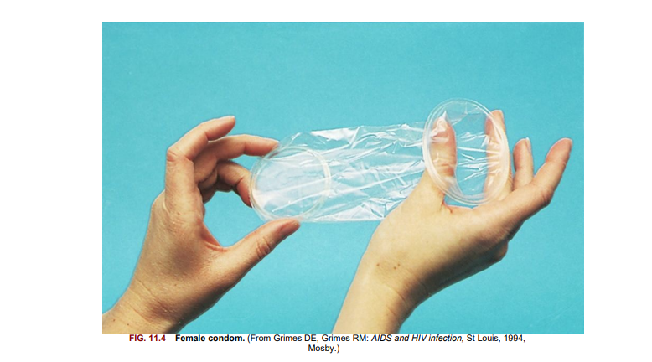

Slide 33
Female condoms are prelubricated, single-use items that are available over the counter.
They allow the woman control over her exposure to infections without having to rely on the cooperation of her partner.
Its failure rate in pregnancy prevention is 5%.
Many women find it unattractive.
Side effects and contraindications :There are few problems with the use of the female condom.
The typical failure rate is 21%.

Slide 34
Spermicides:
Spermicidal foam, cream, jelly, film, and suppository capsules are OTC contraceptives.
They are inserted into the vagina before intercourse to neutralize vaginal secretions, destroy sperm, and block entrance to the uterus.
Each product has specific directions for use.
Vaginal films and suppositories must melt before they are effective, which takes about 15 minutes.
Most spermicides are effective for no more than 1 hour.
Reapplication is needed for repeated coitus.
The woman should not douche for at least 6 to 8 hours after intercourse. Spermicides have an actual failure rate of 21%.
The use of a condom with the spermicide increases the contraceptive effectiveness.
Side effects and contraindications Spermicides can cause local irritation in the vagina or on the penis.
The irritation can cause tiny cracks that provide portals of entry for infection.

Slide 35
Emergency contraception :
The “morning after” pill is a method of preventing pregnancy after unprotected sexual intercourse.
It can be used if contraceptives fail (e.g., a condom tears), in cases of rape, or in other situations as needed.
The one-step emergency contraception ;Plan B contains the progestin levonorgestrel in a 1-dose pill “morning after” regimen that is available in pharmacies without a prescription.
It is most effective if used within 72 hours of unprotected intercourse but may be effective if used within 120 hours after unprotected intercourse.
The one-step emergency contraceptive plan may not be as effective in women weighing over 165 pounds.
An emergency contraceptive, ulipristal acetate (Ella), requires a prescription.
It prevents pregnancy by prolonging ovulation and can be taken within 5 days (or 120 hours) of unprotected sex.
The woman should be referred for counseling and follow-up care after use of the emergency contraceptive.
Placement of a copper IUD within 5 days of unprotected intercourse is also an effective postcoital contraceptive .

Slide 36
Unreliable contraceptive methods:
Withdrawal :
Withdrawal, or coitus interruptus, is withdrawal of the penis before ejaculation.
It demands more self-control than most men can achieve.
Preejaculatory secretions often contain sperm that can fertilize an ovum.
Douching :
Douching after intercourse is not a form of birth control and may actually transport sperm farther into the birth canal.
Breastfeeding:
Breastfeeding inhibits ovulation in many women as long as the infant receives at least 10 feedings in 24 hours, because the prolactin secreted to stimulate milk production also inhibits ovulation.
If the woman supplements with formula, or when the infant begins taking solids, milk intake (and thus prolactin secretion) falls.
Ovulation is then likely, and pregnancy can occur.
Remember that ovulation precedes menstruation – pregnancy can occur before the first menstrual period after birth.

Slide 37
Nursing Tip:
A woman can become pregnant while breastfeeding.
Permanent contraception Sterilization is a permanent method of birth control that is almost 100% effective in preventing pregnancy.
Therefore patients should think carefully about this decision and should consider it permanent.
Advantages :
The advantages of sterilization relate to the fact that the person can consider the risk of pregnancy to be near zero.
Minimal anxiety about becoming pregnant may help the individual to enjoy the sexual relationship more.
Disadvantages :
A major disadvantage of sterilization is : permanence. Divorce, marriage, death of a child, or a change in attitude toward having children may make the person regret his or her decision.
The procedures require surgery, and, although the risks are small,
they are the same as for other surgical procedures:
hemorrhage, infection, injury to other organs, and anesthesia complications.

Slide 38
Male sterilization:
Male sterilization, or vasectomy, is performed by making a cut in each side of the scrotum and cutting each vas deferens, the tube through which the sperm travel.
Because sperm are already present in the system distal to the area of ligation, sterility is not immediate.
Another method of birth control must be implemented until all sperm have left the system, usually about 1 to 3 months.
The man should return to his physician for analysis of his semen to verify that it no longer contains sperm. Female sterilization:
Tubal ligation :
Tubal ligation involves blocking or ligating the fallopian tubes.

Slide 39
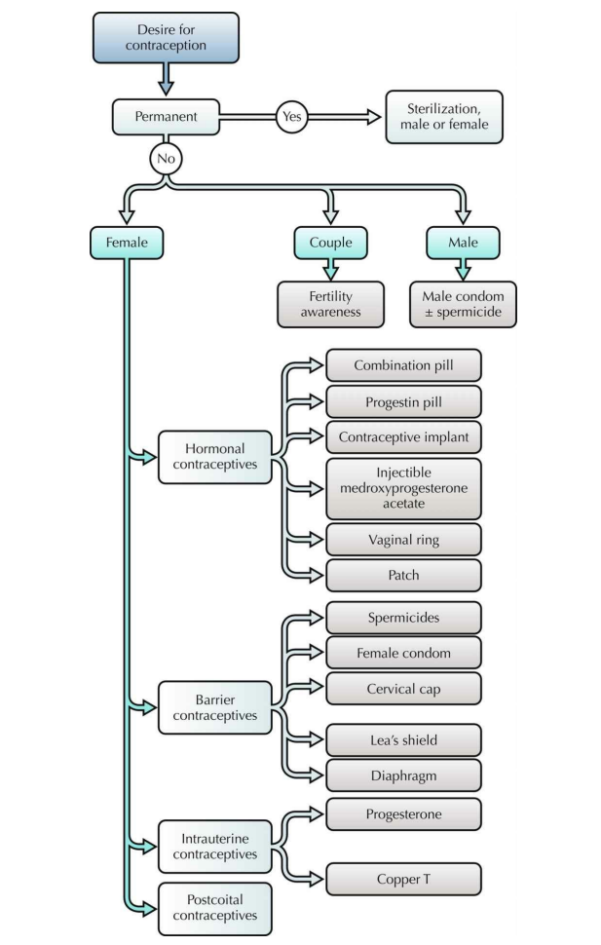

Slide 40
Get Ready for the NCLEX® Examination! Key Points
• Preventive care is cost-effective, because health problems can be caught early and treated.
• Teaching a woman breast self-examination can reduce her risk of death from breast cancer.
• Several self-help measures can relieve some symptoms of premenstrual syndrome.
• Prevention of toxic shock syndrome involves not allowing microorganisms the time to grow in the woman’s reproductive tract.
• Sexually transmitted infections must be adequately treated in all sexual contacts to stop the transmission and to prevent resistance to antibiotics.
• Contraception is an individual choice. The nurse must avoid incorporating personal preferences when educating patients about contraceptive methods.
• Contraceptive choices include temporary contraception, such as barrier methods or hormones, and permanent contraception, such as hysteroscopic sterilization or vasectomy.

Slide 41
• Emergency contraception, Plan B, is a progestin-only medication taken within 72 hours of unprotected sexual intercourse and is available without a prescription.
• Fertility awareness methods can be used both to prevent pregnancy and to increase the chance of achieving it.
• Except for abstinence, condoms (male and female) offer the best protection from STIs.
• Common menopausal symptoms, such as hot flashes and vaginal dryness, stem from the cessation of ovulation and the decrease in hormonal activity, particularly that of estrogen and progesterone.
• Prevention of disabling osteoporosis begins with an adequate calcium and vitamin D intake during youth to achieve maximum bone mass. Reducing the risk for osteoporosis after menopause is best accomplished by an adequate calcium and vitamin D intake combined with exercise.
• Alternative therapies for hormone replacement are available for women who cannot take estrogen

Slide 42
Review Questions for the NCLEX® Examination
Choose the correct teaching for breast self-examination (BSE):
1. Monthly BSE eliminates the need for a professional examination until after age 40 years.
2. BSE should be done 1 week after the beginning of each menstrual period.
3. Dry fingers make it easier to feel very small lumps that are just under the skin.
4. Use the palm of the hand to palpate the breast.
2. Factors that change the normal flora of the vagina and predispose to vaginal infection include (select all that apply):
use of antibiotics.
2. douching.
3. sexual intercourse.
4. daily baths.

Slide 43
3. What is a reliable temporary (reversible) birth control method?
Douching
b. Breastfeeding
c. Transdermal patch
d. Vasectomy
e. IUD
b and e
2. a and d
3. c and e
4. a and b
4. To relieve or reduce symptoms of premenstrual dysphoric disorder, what should the nurse recommend that the woman do?
Avoid simple sugars and caffeine consumption.
2. Use oral contraceptive medication.
3. Avoid physical exercise.
4. Limit water intake to 1000 mL/day.

Slide 44
5. The nurse should teach the woman who is experiencing menopause that (select all that apply):
calcium is best absorbed when vitamin D intake is adequate.
2. weight-bearing exercise is important.
3. lying down and resting after each meal is important.
4. an increased intake of vitamin C will enhance calcium absorption.

Slide 45
Thanks for listening

