Slide 1


Complications During Pregnancy.
Prof.Saadya Hadi Humade

Slide 2
KEY TERMS
abortion
age of viability
cerclage (sĕr-KLĂHZH,)
disseminated intravascular coagulation (DIC)
eclampsia (ĕ-KLĂMP-sē-ă,)
erythroblastosis fetalis (ĕ-rĭth-rō-blăs-Ō-sĭs fĕ-TĂ-lĭs,)
gestational diabetes mellitus (GDM)
hydramnios (hī-DRĂM-nē-ŏs,)
incompetent cervix (ĭn-KŎM-pă-tănt SŬR-vĭkz,)
isoimmunization (ī-sō-ĭm-myū-nĭ-ZĀ-shŭn,)
macrosomia (măk-rō-SŌ-mē-ă,)
preeclampsia (prē-ĕ-KLĂMP-sē-ă,)
preterm labor (p. 90) products of conception (POC)
teratogen (TĔR-ă-tō-jĕn,)
tonic-clonic seizures)

Slide 3
Assessment of fetal health Extraordinary technical advances have enabled the management of high-risk pregnancies so that both the mother and the fetus have positive outcomes.
The nurse can provide the psychosocial support that will allay or reduce parental anxiety.
Amniocentesis common diagnostic tests that assess the status of the fetus.

Slide 4
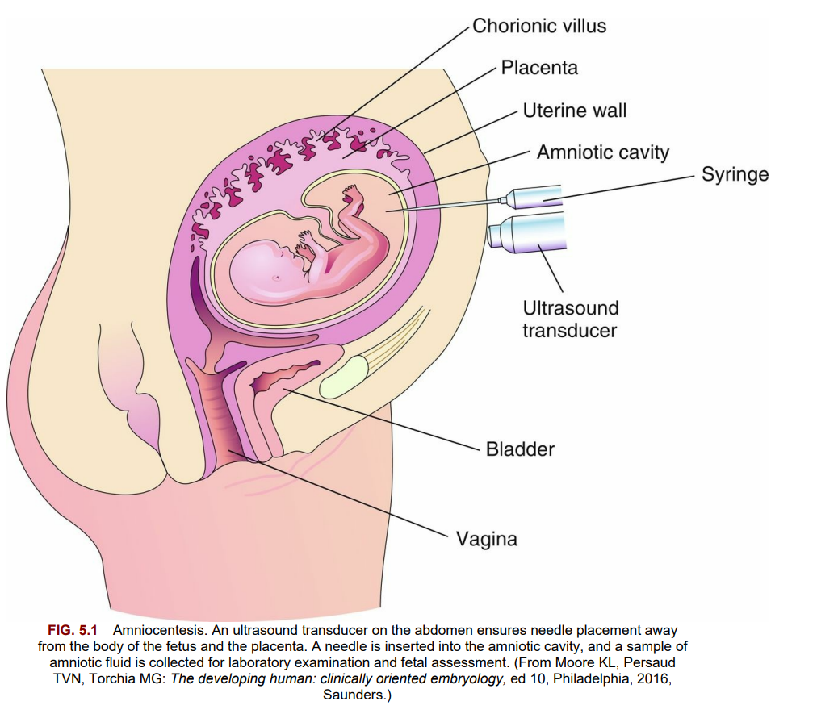

Slide 5
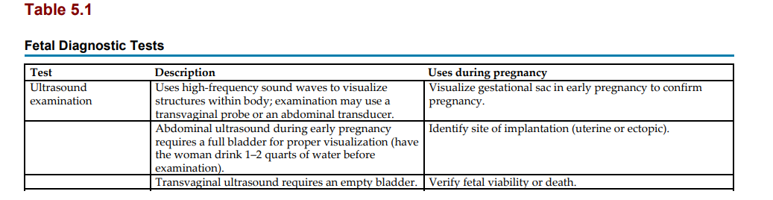

Slide 6
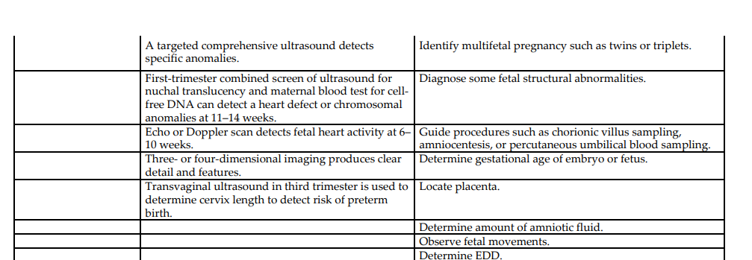

Slide 7
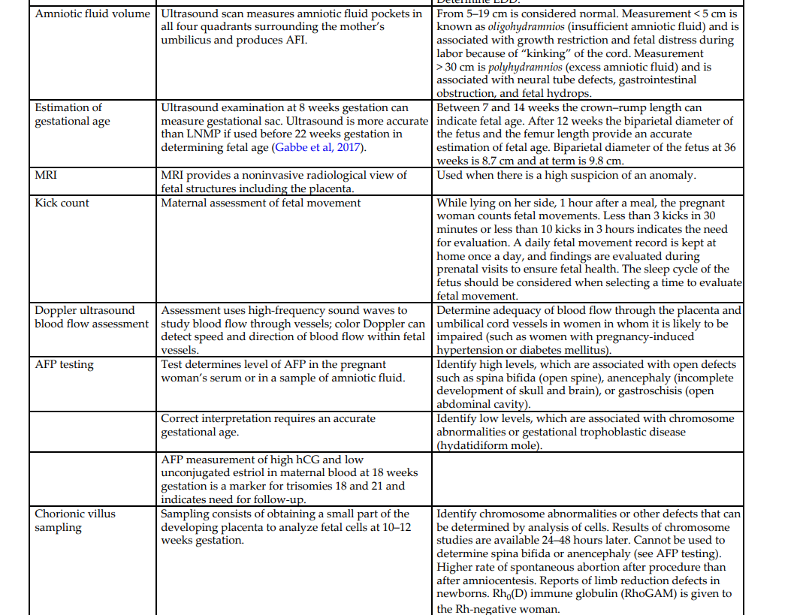

Slide 8
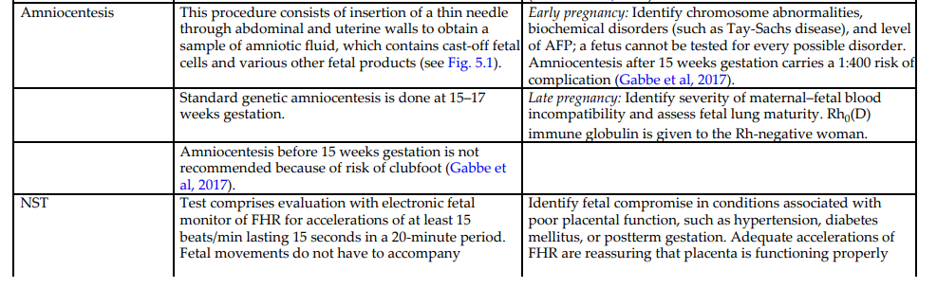

Slide 9
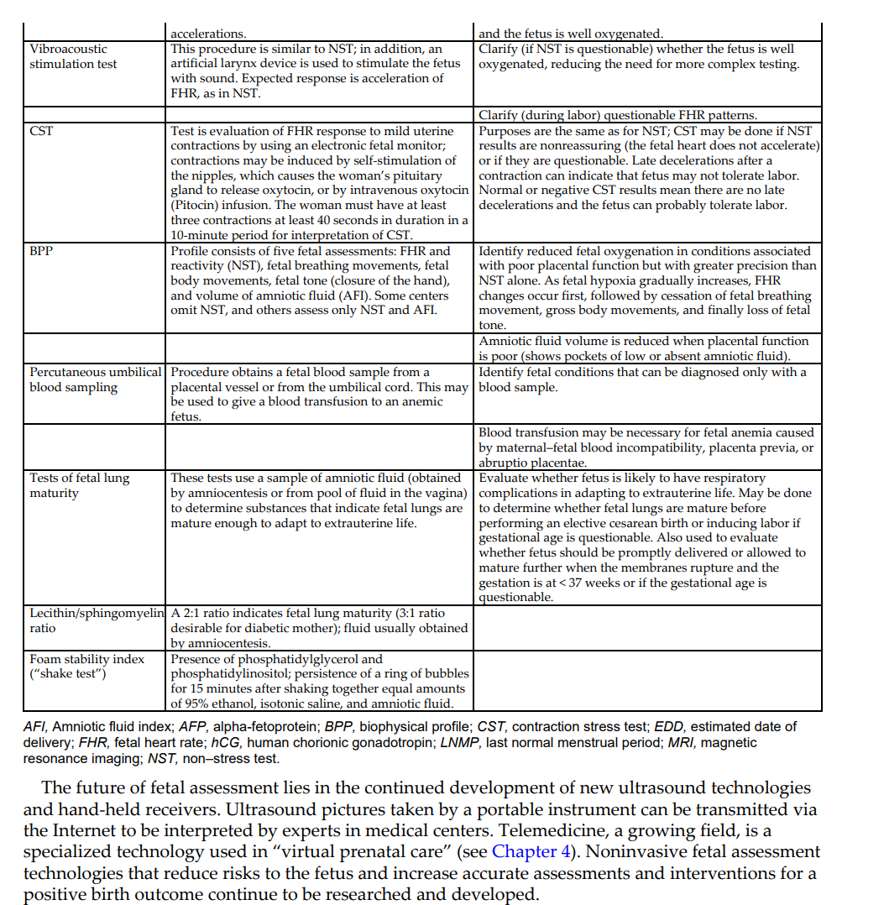

Slide 10
Danger Signs in Pregnancy The nurse should teach the woman to report promptly any danger signs that occur during pregnancy, including the following:
• A sudden gush of fluid from vagina
• Vaginal bleeding
• Abdominal pain
• Abnormal “kick count”
• Persistent vomiting
• Epigastric pain
• Edema of face and hands
• Severe, persistent headache
• Blurred vision or dizziness
• Chills with fever greater than 38.0°C (100.4°F)
• Painful urination or reduced urine output

Slide 11
Pregnancy-related complications Hyperemesis gravidarum :
the woman with hyperemesis gravidarum has excessive nausea and vomiting that can significantly interfere with her food intake and fluid balance.
Fetal growth may be restricted, resulting in a lowbirth-weight infant. Dehydration impairs perfusion of the placenta, reducing the delivery of blood oxygen and nutrients to the fetus.
Manifestations Hyperemesis gravidarum differs from “morning sickness” of pregnancy in one or more of the following ways:
• Persistent nausea and vomiting, often with complete inability to retain food and fluids
• Significant weight loss (more than 5% of prepregnant weight)
• Dehydration as evidenced by a dry tongue and mucous membranes, decreased turgor (elasticity) of the skin, scant and concentrated urine, and a high serum hematocrit level
• Electrolyte and acid-base imbalances
• Ketonuria
• Psychological factors such as unusual stress, emotional immaturity, passivity, or ambivalence about the pregnancy

Slide 12
Treatment
The medical treatment for hyperemesis gravidarum is to correct dehydration and electrolyte or acidbase imbalances with oral or intravenous fluids.
Antiemetic drugs such as Diclegis (doxylamine succinate and pyridoxine hydrochloride) at bedtime, transdermal clonidine, and oral ondansetron may be prescribed for more severe symptoms in the outpatient setting.
Occasionally, severe cases necessitate hospitalization and total parenteral nutrition. The woman may need hospital admission to correct dehydration and inadequate nutrition if home measures are unsuccessful.
Thiamine is often administered before intravenous dextrose to prevent Wernicke’s syndrome, which is characterized by double vision and ataxia .
The condition is self-limiting in most women, although it is quite distressing to the woman and her family.

Slide 13
Nursing care
Nursing care focuses on patient teaching because most care occurs in the home.
The woman should be taught how to reduce factors that trigger nausea and vomiting. She should avoid food odors, which may abound in meal preparation areas and tray carts if she is hospitalized.
If she becomes nauseated when her food is served, the tray should be removed promptly and offered again later.
Accurate intake and output and daily weight records are kept to assess fluid balance.
Frequent, small amounts of food and fluid keep the stomach from becoming too full, which can trigger vomiting.
Easily digested carbohydrates, such as crackers or baked potatoes, are tolerated best. Foods with strong odors should be eliminated from the diet.

Slide 14
Taking liquids between solid meals helps to reduce gastric distention.
Sitting upright after meals reduces gastric reflux (backflow) into the esophagus.
The emesis basin is kept out of sight so that it is not a visual reminder of vomiting.
It should be emptied at once if the woman vomits, and the amount should be documented on the intake and output record.
Stress may contribute to hyperemesis gravidarum; stress may also result from this complication.
The nurse should provide support by listening to the woman’s feelings about pregnancy, child rearing, and living with constant nausea.
Although psychological factors may play a role in some cases of hyperemesis gravidarum, the nurse should not assume that every woman with this complication is adjusting poorly to her pregnancy.

Slide 15
Bleeding disorders of early pregnancy :Including:
spontaneous abortion (miscarriage).
ectopic pregnancy .
and hydatidiform mole .
Maternal blood loss decreases the oxygen-carrying capacity of the blood, resulting in fetal hypoxia, and places the fetus at risk.

Slide 16
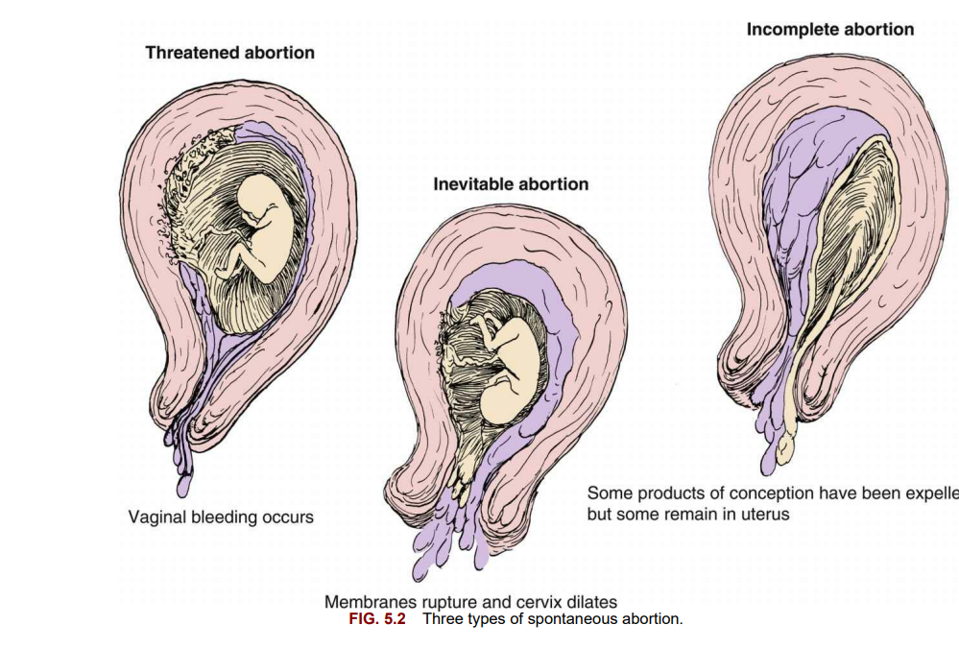

Slide 17
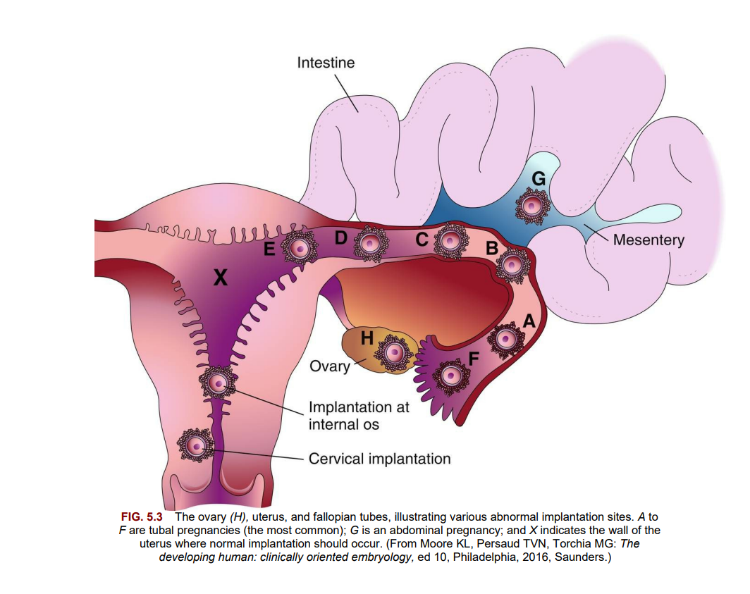

Slide 18
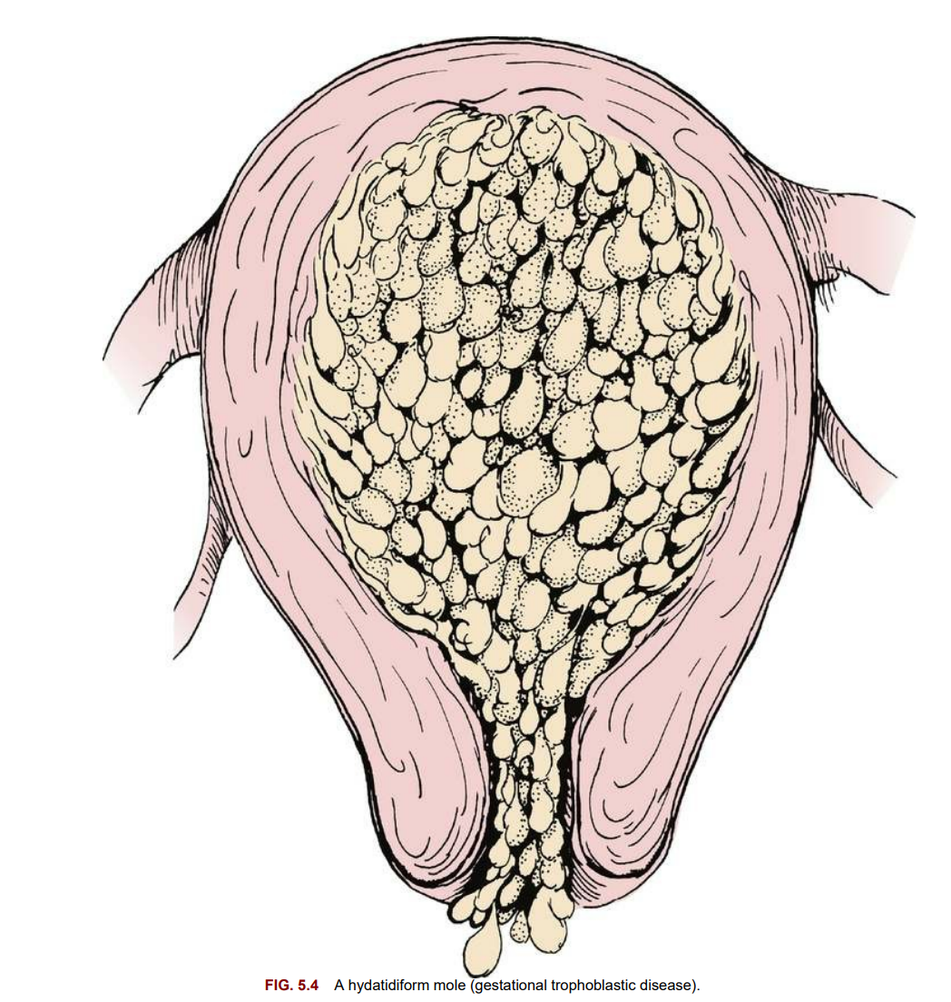

Slide 19
Abortion :
is the spontaneous (miscarriage) or intentional termination of a pregnancy before the age of viability (20 weeks gestation).

Slide 20
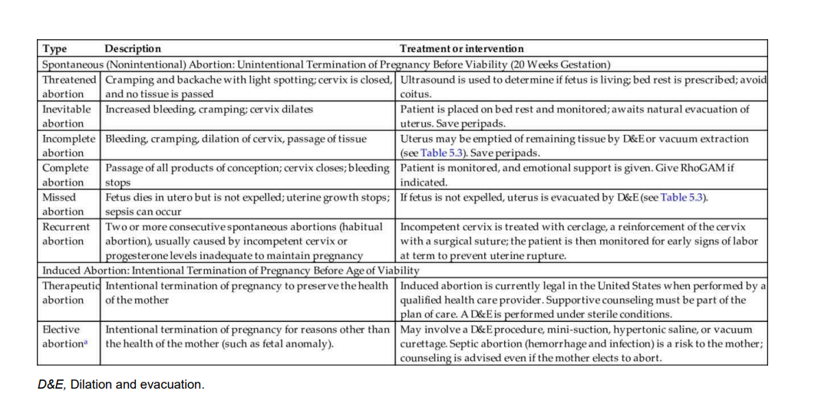

Slide 21
Treatment :
When a threatened abortion occurs, efforts are made to keep the fetus in utero until the age of viability.
In recurrent pregnancy loss, causes are investigated;
these can include genetic, immunological, anatomical, endocrine, or infectious factors.
Cerclage, or suturing an incompetent cervix that opens when the growing fetus presses against it, is successful in most cases.
A low human chorionic gonadotropin (hCG) level or low fetal heart rate by 8 weeks gestation may be an ominous sign.
Termination of pregnancy after 20 weeks of gestation (age of viability) is called preterm labor .

Slide 22
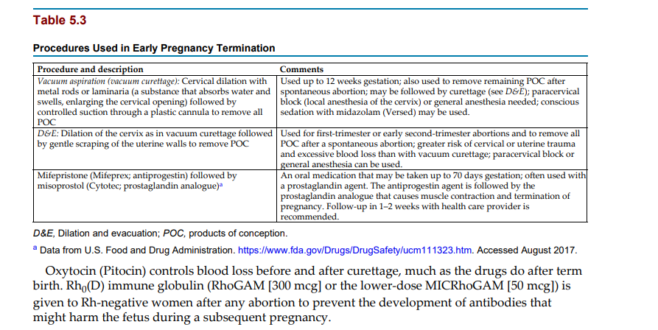

Slide 23
Nursing care :
Physical care The nurse documents the amount and character of bleeding and saves anything that looks like clots or tissue for evaluation by a pathologist.
A pad count and an estimate of how saturated each is (e.g., 50%, 75%) documents blood loss most accurately.
A woman with threatened abortion who remains at home is taught to report increased bleeding or passage of tissue.
The nurse should check the hospitalized woman’s bleeding and vital signs to identify hypovolemic shock resulting from blood loss. She should not eat (nothing by mouth [NPO] status) if she has active bleeding to prevent aspiration if anesthesia is required for dilation and evacuation treatment.
Laboratory tests such as a hemoglobin level and hematocrit are ordered.
After vacuum aspiration or curettage, the amount of vaginal bleeding is observed. Blood pressure, pulse, and respirations are checked every 15 minutes for 1 hour, then every 30 minutes until discharge from the postanesthesia care unit.
The woman’s temperature is checked on admission to the recovery area and every 4 hours until discharge to monitor for infection.
Most women are discharged directly from the recovery unit to their home after curettage.

Slide 24
Guidelines for self-care at home include the following:
• Report increased bleeding. Do not use tampons, which may cause infection.
• Take temperature every 8 hours for 3 days. Report signs of infection (temperature of 38°C [100.4°F] or higher; foul odor or brownish color of vaginal drainage).
• Take an oral iron supplement if prescribed.
• Resume sexual activity as recommended by the health care provider (usually after the bleeding has stopped).
• Return to the health care provider at the recommended time for a checkup and contraception information.
• Pregnancy can occur before the first menstrual period returns after the abortion procedure.

Slide 25
Ectopic Pregnancy
Ectopic pregnancy occurs when the fertilized ovum (zygote) is implanted outside the uterine cavity .
Of all ectopic pregnancies, 95% occur in the fallopian tube (tubal pregnancy).
An obstruction or other abnormality of the tube prevents the zygote from being transported into the uterus.
Scarring from a previous pelvic infection or deformity of the fallopian tubes or inhibition of normal tubal motion to propel the zygote into the uterus may result from the following:
• Hormonal abnormalities
• Inflammation
• Infection
• Adhesions
• Congenital defects
• Endometriosis (uterine lining occurring outside the uterus)
Use of an intrauterine device for contraception may contribute to ectopic pregnancy because these devices promote inflammation within the uterus.
A woman who has had a previous tubal pregnancy or a failed tubal ligation is also more likely to have an ectopic pregnancy.

Slide 26
A zygote that is implanted in a fallopian tube cannot survive for long because the blood supply and size of the tube are inadequate.
The zygote or embryo may die and be resorbed by the woman’s body, or the tube may rupture with bleeding into the abdominal cavity, creating a surgical emergency

Slide 27
Manifestations
The woman has a history of a missed menstrual period and often complains of lower abdominal pain, sometimes accompanied by light vaginal bleeding.
If the tube ruptures, she may have sudden severe lower abdominal pain, vaginal bleeding, and signs of hypovolemic shock .
The amount of vaginal bleeding may be minimal, because most blood is lost into the abdomen rather than externally through the vagina.
Shoulder pain is a symptom that often accompanies bleeding into the abdomen .

Slide 28
Signs and Symptoms of Hypovolemic Shock
• Fetal heart rate changes (increased, decreased, less fluctuation)
• Rising, weak pulse (tachycardia)
• Rising respiratory rate (tachypnea)
• Shallow, irregular respirations; air hunger
• Falling blood pressure (hypotension)
• Decreased (usually less than 30 mL/h) or absent urine output
• Pale skin or mucous membranes
• Cold, clammy skin
• Faintness
• Thirst

Slide 29
Treatment :
A sensitive pregnancy test for hCG is done to determine if the woman is pregnant.
Transvaginal ultrasound examination determines whether the embryo is growing within the uterine cavity.
Culdocentesis (puncture of the upper posterior vaginal wall with removal of peritoneal fluid) may occasionally be performed to identify blood in the woman’s pelvis, which suggests tubal rupture.
A laparoscopic examination may be done to view the damaged tube with an endoscope (lighted instrument for viewing internal organs).
The physician attempts to preserve the tube if the woman wants other children, but this is not always possible.
The priority medical treatment is to control blood loss.
Blood transfusion may be required for massive hemorrhage.
Depending on the gestation and the amount of damage to the fallopian tube, one of the following three courses of treatment is chosen:
No action is taken if the woman’s body is resorbing the pregnancy.
Medical therapy with methotrexate (if the tube is not ruptured) inhibits cell division in the embryo and allows it to be resorbed.
Surgery to remove the products of conception (POC) from the tube is performed if damage is minimal; severe damage requires removal of the entire tube and occasionally the uterus.

Slide 30
Nursing care
Nursing care includes observing for hypovolemic shock as in spontaneous abortion.
Vaginal bleeding is assessed, although most lost blood may remain in the abdomen.
The nurse should report increasing pain, particularly shoulder pain, to the physician. If the woman has surgery, preoperative and postoperative care as follows:
• Measurement of vital signs to identify hypovolemic shock and temperature to identify infection
• Assessment of lung and bowel sounds
• Intravenous fluid; blood replacement may be ordered if the loss was substantial
• Antibiotics as ordered
• Pain medication, often with patient-controlled analgesia after surgery
• NPO status preoperatively; oral intake usually resumes after surgery, beginning with ice chips and then clear liquids, and is advanced as bowel sounds resume
• Indwelling Foley catheter as ordered; urine output is a significant indicator of fluid balance and will fall or stop if the woman hemorrhages; minimum acceptable urine output is 30 mL/h
• Bed rest before surgery; progressive ambulation postoperatively; the nurse should have adequate assistance when the woman first ambulates because she is more likely to faint if she lost a significant amount of blood

Slide 31
In addition to physical preoperative and postoperative care, the nurse provides emotional support, because the woman and her family may experience grieving similar to that accompanying spontaneous abortion.
Loss of a fallopian tube threatens future fertility and is another source of grief.
However, future pregnancies are possible if the remaining fallopian tube is normal.

Slide 32
Hydatidiform Mole
Hydatidiform mole (gestational trophoblastic disease; also known as a molar pregnancy) occurs when the chorionic villi (fringelike structures that form the placenta) increase abnormally and develop vesicles (small sacs) that resemble tiny grapes (see Fig. 5.4).
The mole may be complete, with no fetus present, or partial, in which only part of the placenta has the characteristic vesicles.
Hydatidiform mole may result in hemorrhage, clotting abnormalities, hypertension, and a possibility of later development of cancer (choriocarcinoma).
Chromosome abnormalities are found in many cases of hydatidiform mole.
It is more likely to occur in women at the age extremes of reproductive life, and a woman who has had one molar pregnancy has a 1% chance of another molar pregnancy in the future .

Slide 33
Manifestations
Signs associated with hydatidiform mole appear early in pregnancy and can include the following:
• Bleeding, which may range from spotting to profuse hemorrhage and may be brown in color; cramping may be present
• Rapid uterine growth and a uterine size that is larger than expected for the gestation
• Failure to detect fetal heart activity
• Signs of hyperemesis gravidarum
• Unusually early development of gestational hypertension
• Higher than expected levels of hCG
• A distinctive “snowstorm” pattern on ultrasound but no evidence of a developing fetus in the uterus

Slide 34
Treatment
Transvaginal ultrasound verifies the diagnosis.
The uterus is evacuated by vacuum aspiration and dilation and evacuation.
The level of hCG is tested and retested until it is undetectable, and the levels are followed for at least 1 year.
Persistent or rising levels suggest that vesicles remain or that malignant change has occurred.
The woman should delay conceiving until follow-up care is complete because a new pregnancy would confuse tests for hCG. Rh0 (D) immune globulin is prescribed for the Rh-negative woman.

Slide 35
Nursing care
The nurse observes for bleeding and shock; care is similar to that given in spontaneous abortion and ectopic pregnancy.
If the woman also experiences hyperemesis or preeclampsia, the nurse incorporates care related to those conditions.
The woman has also lost a pregnancy, so the nurse should provide care related to grieving, similar to that for a spontaneous abortion.
The need to delay another pregnancy may be a concern if the woman is nearing the end of her reproductive life and wants a child; therefore the need for follow-up examinations is reinforced.
The woman is encouraged and taught how to use contraception

Slide 36
Bleeding disorders of late pregnancy Placenta previa or abruptio placentae often cause bleeding in late pregnancy (Table 5.4).

Slide 37
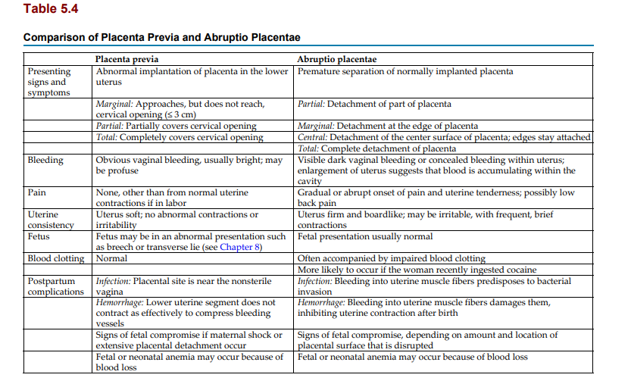

Slide 38
Placenta Previa
Placenta previa occurs when the placenta develops in the lower part of the uterus rather than the upper part.
There are three degrees of placenta previa, depending on the location of the placenta in relation to the cervix (Fig. 5.5A), as follows:
Marginal: Placenta reaches within 2 to 3 cm of the cervical opening
Partial: Placenta partly covers the cervical opening
Total: Placenta completely covers the cervical opening

Slide 39
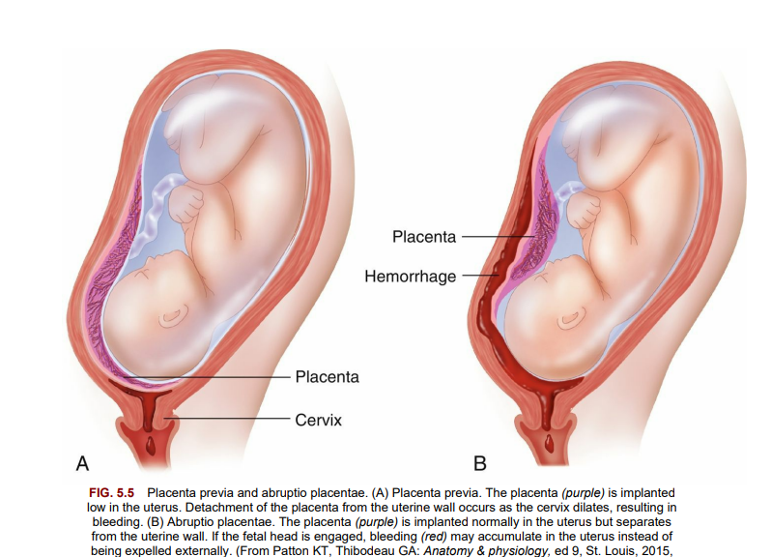

Slide 40
Manifestations:
Painless vaginal bleeding, usually bright red, is the main characteristic of placenta previa.
The woman’s risk of hemorrhage increases as term approaches and the cervix begins to efface (thin) and dilate (open).
These normal prelabor changes disrupt the placental attachment.
The fetus is often in an abnormal presentation (e.g., breech or transverse lie) because the placenta occupies the lower uterus, which often prevents the fetus from assuming the normal head-down presentation.
The fetus or neonate may have anemia or hypovolemic shock because some of the blood lost may be fetal blood.
Fetal hypoxia may occur if a large disruption of the placental surface reduces the transfer of oxygen and nutrients.

Slide 41
A woman with placenta previa is more likely than others to experience an infection or hemorrhage after birth for the following reasons:
• Infection is more likely to occur because vaginal organisms can easily reach the placental site, which is a good growth medium for microorganisms.
• Postpartum hemorrhage may occur because the lower segment of the uterus, where the placenta was attached, has fewer muscle fibers than the upper uterus.
The resulting weak contraction of the lower uterus does not compress the open blood vessels at the placental site as effectively as would the upper segment of the uterus.

Slide 42
Treatment
The goal is to maintain the pregnancy until the fetal lungs are mature enough that respiratory distress is less likely.
Delivery will be done if bleeding is sufficient to jeopardize the mother or fetus, regardless of gestational age.
The woman should lie on her side or have a pillow under one hip to avoid supine hypotension.
If bleeding is extensive or the gestation is near term, a cesarean section is performed for partial or total placenta previa.
The woman with a low-lying placenta or marginal placenta previa may be able to deliver vaginally unless the blood loss is excessive.

Slide 43
Nursing care
The priorities of nursing care include monitoring the fetal heart and the character of contractions.
Documenting and reporting vaginal blood loss and signs and symptoms of shock are important.
Vital signs are taken every 15 minutes if the woman is actively bleeding, and oxygen is often given to increase the amount delivered to the fetus.
Vaginal examination is not done because it may precipitate bleeding if the placental attachment is disrupted.
The fetal heart rate is monitored continuously.
The nurse implements care for a cesarean delivery as needed .
The parents of the infant are often fearful for their child, particularly if a preterm delivery is required.
Supportive care should be provided.

Slide 44
Abruptio Placentae
An abruptio placenta is the premature separation of a placenta that is normally implanted.
Predisposing factors include the following:
• Hypertension
• Cocaine (which causes vasoconstriction)
• Cigarette smoking and poor nutrition
• Blows to the abdomen, such as might occur in battering or accidental trauma
• Previous history of abruptio placentae
• Folate deficiency Abruptio placentae may be partial or total (see Fig. 5.5B);
it may be marginal (separating at the edges) or central (separating in the middle). Bleeding may be visible or concealed behind the partially attached placenta.

Slide 45
Manifestations
Bleeding accompanied by abdominal or low back pain is the typical characteristic of abruptio placentae.
In contrast to the bleeding in placenta previa, most or all of the bleeding may be concealed behind the placenta.
Obvious dark red vaginal bleeding occurs when blood leaks past the edge of the placenta.
The woman’s uterus is tender and unusually firm (boardlike) because blood leaks into its muscle fibers.
Frequent, cramplike uterine contractions often occur (uterine irritability).
The fetus may or may not have problems, depending on how much placental surface is disrupted.
As in placenta previa, some of the blood lost may be fetal, and the fetus or neonate may have anemia or hypovolemic shock.

Slide 46
Disseminated intravascular coagulation (DIC)
is a complex disorder that may complicate abruptio placentae.
The large blood clot that forms behind the placenta consumes clotting factors, which leaves the rest of the mother’s body deficient in these factors.
Clot formation and anticoagulation (destruction of clots) occur simultaneously throughout the body in the woman with DIC.
She may bleed from her mouth, nose, incisions, or venipuncture sites because the clotting factors are depleted.
Postpartum hemorrhage may also occur because the injured uterine muscle does not contract effectively to control blood loss.
Infection is more likely to occur because the damaged tissue is susceptible to microbial invasion.

Slide 47
Treatment:
The treatment of choice,
immediate cesarean delivery, is performed because of the risk for maternal shock, clotting disorders, and fetal death.
Blood and clotting factor replacement may be needed because of DIC.
The mother’s clotting action quickly returns to normal after birth because the source of the abnormality is removed.

Slide 48
Nursing care
Preparation for cesarean section and close monitoring of vital signs and fetal heart are essential.
Signs of shock and bleeding from the nose, the gums, or other unexpected sites should be promptly reported.
Rapid increase in the size of the uterus suggests that blood is accumulating within it.
The uterus is usually very tender and hard.
Nursing care after delivery is similar to that with placenta previa.
The fetus sometimes dies before delivery.

Slide 49
Care of the Pregnant Woman With Excessive Bleeding:
1- Document blood loss.
2- Closely monitor vital signs including intake and output.
3- Observe for:
• Pain
• Uterine rigidity or tenderness
4- Verify that orders for blood typing and crossmatch have been implemented. Monitor intravenous infusion.
5- Prepare for surgery, if indicated.
6- Monitor fetal heart rate and contractions.
7-Monitor laboratory results including coagulation studies.
8-Administer oxygen by mask.
9- Prepare for newborn resuscitation.

Slide 50
Hypertension during pregnancy :
Preeclampsia and Eclampsia
Hypertension may exist before pregnancy; this is known as chronic hypertension. When hypertension develops as a complication during pregnancy, it is known as gestational hypertension (GH).
GH is a transient form of hypertension during pregnancy but can become chronic hypertension later in life.
The term preeclampsia is defined as an increase in blood pressure that occurs after 20 weeks gestation with proteinuria (protein in the urine) in a woman who had a normal blood pressure before pregnancy .

Slide 51
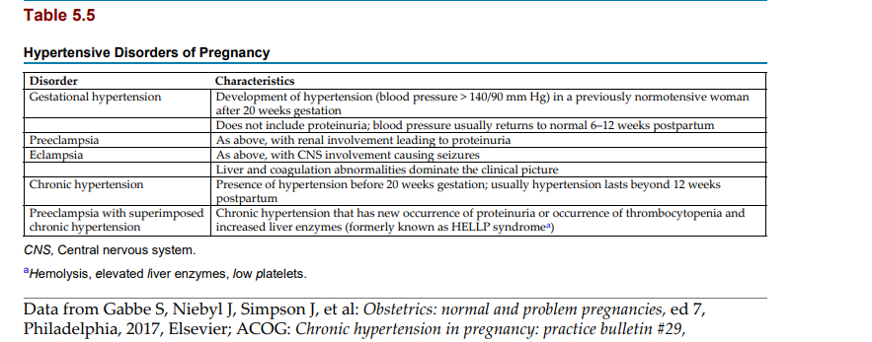

Slide 52
Symptoms of mild preeclampsia are:
• Systolic blood pressure greater than 140 mm Hg but less than 160 mm Hg
• Diastolic blood pressure greater than 90 mm Hg but less than 110 mm Hg Blood pressure should be assessed on several visits between 1 and 7 days apart. Symptoms of severe preeclampsia are:
Sustained blood pressure of systolic 160 mm Hg and diastolic 110 mm Hg and greater
Proteinuria—urine dipstick results of 1 + or greater on two separate urine specimens Other symptoms include excess weight gain more than 1.8 kg (4 lb) in 1 week in the second or third trimester.
Edema is not always present in preeclampsia.
Preeclampsia progresses to eclampsia when convulsions occur.
Convulsions as a result of eclampsia can occur antepartum, intrapartum, or postpartum (one sometimes hears the term toxemia, an old term for preeclampsia).
The cause of GH is unknown, but birth is its cure.
GH usually develops after 20 weeks gestation.
Vasospasm (spasm of the arteries) is the main characteristic of GH.
Although the cause is unknown, any of several risk factors increases a woman’s chance of developing GH.

Slide 53
Risk Factors for Preeclampsia:
• First pregnancy
• Obesity
• Family history of preeclampsia
• Age more than 35 years or less than 19 years
• Multifetal pregnancy (e.g., twins)
• Chronic hypertension
• Chronic renal disease
• Diabetes mellitus
• Autoimmune disease
• History of a pregnancy interval more than 10 years

Slide 54
Chronic Hypertension During Pregnancy:
In pregnant patients with chronic hypertension, new-onset proteinuria, a sudden increase in blood pressure that was previously controlled, or a sign of kidney involvement is indicative of preeclampsia.
Antihypertensives may not be given to women with mild hypertension, but frequent prenatal visits and fetal monitoring are scheduled.
Medication is prescribed if the blood pressure exceeds the moderate range. Labetalol is the antihypertensive drug of choice during pregnancy, as angiotensin-converting enzyme inhibitors are contraindicated.
However, labetalol should not be used in patients with asthma or heart failure .Management of the pregnant patient with chronic hypertension who develops preeclampsia requires frequent fetal evaluations including ultrasound examinations and non–stress tests and possibly early delivery at 36 to 37 weeks gestation.
Severe preeclampsia is defined as a blood pressure greater than 160/110 mm Hg on two occasions 4 or more hours apart, especially if the patient is on bed rest. The patient should be instructed to report symptoms such as headaches or visual changes, and the nurse will monitor laboratory tests for abnormal results.

Slide 55
GH is closely related to the development of complications as: 1.abruptio placentae,
2.fetal growth restriction,
3.preeclampsia,
4.prematurity,
5.and stillbirth,
so special care of the pregnant woman with hypertension is essential.
GH is associated with an increased risk of type 2 diabetes mellitus in the offspring as an adult .

Slide 56
Manifestations of gestational hypertension
Vasospasm impedes blood flow to the mother’s organs and placenta, resulting in one or more of these signs:
hypertension,
edema, and
proteinuria.
Severe GH can also affect the central nervous system, eyes, urinary tract, liver, gastrointestinal system, and blood clotting function.

Slide 57
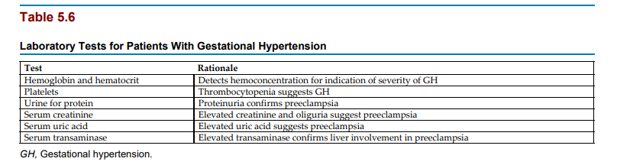

Slide 58
Hypertension
Despite an increase in blood volume and cardiac output, most pregnant women do not experience a rise in blood pressure because they have a resistance to factors that cause vasoconstriction.
In addition, the resistance to blood flow in their vessels (peripheral vascular resistance) decreases because of the effects of hormonal changes.
A blood pressure of 140/90 mm Hg or greater is considered to constitute hypertension in pregnancy.
Edema Edema can occur because fluid leaves the blood vessels and enters the tissues.
Edema is not essential to the diagnosis, as many pregnant women experience edema that is not related to blood pressure. The woman may notice facial swelling or may stop wearing rings because they are hard to remove.
Edema is severe if a depression remains after the tissue is compressed briefly with the finger (pitting edema).
Edema resolves quickly after birth as excess tissue fluid returns to the circulation and is excreted in the urine.
Urine output may reach 6 L/day and often exceeds fluid intake.

Slide 59
Proteinuria :
Proteinuria develops as reduced blood flow damages the kidneys.
This damage allows protein to leak into the urine.
A clean-catch (midstream) or catheterized urine specimen is used to check for proteinuria because vaginal secretions might lead to a false-positive result.

Slide 60
Other manifestations of preeclampsia :
Other signs and symptoms occur with severe preeclampsia.
All are related to decreased blood flow and edema of the organs involved.
Central nervous system A severe, unrelenting headache may occur because of brain edema and small cerebral hemorrhages.
The severe headache often precedes a convulsion.
Deep tendon reflexes become hyperactive because of central nervous system irritability.
Eyes Visual disturbances such as blurred or double vision or “spots before the eyes” occur because of arterial spasm and edema surrounding the retina.
Visual disturbances often precede a convulsion.
Urinary tract Decreased blood flow to the kidneys reduces urine production (oliguria) and worsens hypertension.
Respiratory system Pulmonary edema (accumulation of fluid in the lungs) may occur with severe preeclampsia.

Slide 61
Gastrointestinal system and liver:
Epigastric pain or nausea occurs because of liver edema, ischemia, and necrosis and often precedes a convulsion.
Liver enzyme levels are elevated because of reduced circulation, edema, and small hemorrhages.
Blood clotting HELLP syndrome is a variant of GH that involves hemolysis (breakage of erythrocytes), elevated liver enzymes, and low platelets.
Hemolysis occurs as erythrocytes break up when passing through small blood vessels damaged by hypertension.
Obstruction of hepatic blood flow causes the liver enzyme levels to become elevated.
Low platelet levels occur when the platelets gather at the site of blood vessel damage, reducing the number available in the general circulation.
Low platelet levels cause abnormal blood clotting.

Slide 62
HELLP syndrome is more common in preeclamptic women conservatively managed but may occur in women without hypertension and proteinuria .
epigastric pain, nausea, vomiting, and malaise may signal that HELLP syndrome is developing.
Liver enzyme laboratory reports should be monitored.
HELLP syndrome can also develop postpartum, and all patients with hypertension should be closely monitored during the postpartum period.
The patient with severe HELLP syndrome is monitored in the intensive care unit and given magnesium sulfate to prevent convulsions and antihypertensive medications.
The need for delivery of the fetus after steroid therapy to improve fetal lung function is evaluated, and the woman is monitored closely for bleeding.
Postpartum, the mother is evaluated for fluid intake and output, laboratory values, and pulse oximetry for at least 48 hours.
Most patients improve after delivery.

Slide 63
Eclampsia:
Progression to eclampsia occurs when the woman has one or more generalized tonic-clonic seizures.
Facial muscles twitch; this sign is followed by generalized contraction of all muscles (tonic phase), then alternate contraction and relaxation of the muscles (clonic phase).
An eclamptic seizure may result in cerebral hemorrhage, abruptio placentae, fetal compromise, or death of the mother or fetus.
Responsibilities of the nurse include administration of magnesium to control seizures, close fetal monitoring as well as monitoring of uterine contractions, and measures to prevent aspiration.
Delivery may be expedited.

Slide 64
Effects on the fetus Preeclampsia reduces maternal blood and nutrition flow through the placenta and decreases the oxygen available to the fetus.
Fetal hypoxia may result in meconium (first stool) passage into the amniotic fluid or fetal distress.
The fetus may have intrauterine growth restriction (IUGR) and at birth may be long and thin with peeling skin if the reduced placental blood flow has been prolonged.
Fetal death sometimes occurs.
Treatment Medical care focuses on prevention and early detection of GH.
Drugs are sometimes needed to prevent convulsions and to reduce blood pressure that is dangerously high.

Slide 65
Prevention Correction of some risk factors reduces the risk for preeclampsia.
For example, improving the diet, particularly of the pregnant adolescent, may prevent preeclampsia and promote normal fetal growth.
Other risk factors, such as family history, cannot be changed.
Early and regular prenatal care allows preeclampsia to be diagnosed promptly so that it is more effectively managed.
administration of low-dose aspirin starting between 12 and 14 weeks gestation to patients with high risk of developing eclampsia .

Slide 66
Management :
Treatment of preeclampsia depends on the severity of hypertension and on the maturity of the fetus.
Treatment focuses on
(1) maintaining blood flow to the woman’s vital organs and the placenta and
(2) preventing convulsions.
Birth is the cure for preeclampsia.
If the fetus is mature, pregnancy is ended by labor induction or cesarean birth.
If preeclampsia is severe, the fetus is often in greater danger from being in the uterus than from being born prematurely.
Some women with mild preeclampsia can be managed at home if they can comply with treatment and if home nursing visits are possible.
If the woman has severe preeclampsia or cannot comply with treatment or if home nursing visits are not available, the woman is usually admitted to the hospital.

Slide 67
Conservative treatment, :
whether at home or in the hospital, includes the following:
• Activity restriction to allow blood that would be circulated to skeletal muscles to be conserved for circulation to the mother’s vital organs and the placenta.
The woman should remain on reduced activity with frequent rest periods lying on her side to improve blood flow to the placenta.
• Maternal assessment of fetal activity (“kick counts”) .
The woman should report a decrease in movements or if none occur during a 3-hour period
• Blood pressure monitoring two to four times per day in the same arm and in the same position.
A family member must be taught the technique if the woman can safely remain at home.
• Daily weight measurement on the same scale, in the same type of clothing, and at the same time of day to observe for sudden weight gain.
• Checking urine for protein with a dipstick using a first-voided, clean-catch specimen, as needed .

Slide 68
Home Care Considerations Hypertension in Pregnancy Patient teaching for home care should include the following:
• Exercise may have to be curtailed
• Avoid weight loss programs
• Discontinue smoking and alcohol use
• Primary management is without drugs because blood pressure normally falls in the first two trimesters of pregnancy
• Daily blood pressure measurement
• Daily weight
• Urine dipstick for protein, as needed
• Monitor fetal kicks and uterine activity
• Balanced diet with sufficient protein to replace loss
• Teach signs and symptoms of problems to report
• Encourage side lying during rest periods

Slide 69
Diuretics and sodium restriction are not prescribed for preeclampsia.
Aspirin therapy may be given after the first trimester to minimize the risk of developing preeclampsia .
The intake of high-salt foods is discouraged.
The woman’s diet should have adequate calories and protein.

Slide 70
Drug therapy Several drugs may also be used to treat GH, :
Magnesium sulfate is an anticonvulsant administered to prevent seizures.
It also may slightly reduce the blood pressure, but its main purpose is as an anticonvulsant.
It is usually given by intravenous infusion (controlled with an infusion pump). Administration continues for at least 12 to 24 hours after birth because the woman remains at risk for seizures.
Steroids may be given to aid in fetal lung maturity if labor induction is planned. The kidneys excrete magnesium.
Poor urine output (less than 30 mL/h) may allow serum levels of magnesium to reach toxic levels.
Excess magnesium first causes loss of the deep tendon reflexes, which is followed by depression of respirations; if levels continue to rise, collapse and death can occur.
Close monitoring of the respiratory rate is essential in women who receive magnesium sulfate.
Calcium gluconate reverses the effects of magnesium and should be available for immediate use when a woman receives magnesium sulfate.

Slide 71
An essential nursing responsibility when caring for women receiving magnesium sulfate is:
to monitor contractions during labor and to take measures to maintain a firm uterine fundus postpartum.
The nurse should alert the newborn nursery staff when magnesium sulfate has been administered during labor because if the newborn is treated with aminoglycosides (such as kanamycin [Kantrex] or neomycin), an interaction can occur and can result in toxic responses in the newborn.
Antihypertensive drugs are used to reduce blood pressure when it reaches a level that might cause intracranial bleeding, usually greater than 160/110 mm Hg.
Severe hypertension can harm the fetus by causing abruptio placentae or placental infarcts (death of placental tissue).
The goal of antihypertensive therapy is a gradual reduction of blood pressure to normal levels.
The nurse should observe for untoward signs such as sudden hypotension.
Hydralazine and labetalol are the drugs most often used.
Long-acting oral nifedipine has been shown to be safe and effective.

Slide 72
Nursing care
Nursing care focuses on
assisting women to obtain prenatal care,
helping them cope with therapy,
caring for acutely ill women, and
administering medications.
Promoting prenatal care :Nurses can promote awareness of how prenatal care allows risk identification and early intervention if complications arise.
Nurses can help the woman to feel like an individual— especially in busy clinics, which often seem impersonal—thus encouraging her to return regularly.
Helping to cope with therapy The nurse helps the woman to understand the importance of reduced activity and frequent rest periods and to plan ways to manage them.
Activity diverts blood from the placenta, reducing the infant’s oxygen supply, so the nurse must impress on the woman how important rest is to her child’s well-being. Positioning the patient on her side during bed rest helps to improve blood flow to the placenta and more effectively provides oxygen and nutrients to the fetus.

Slide 73
Caring for the acutely ill woman
The acutely ill woman requires intensive nursing care directed by an experienced registered nurse.
A quiet, low-light environment reduces the risk of seizures.
The woman should remain on bed rest on her side, often the left side, to promote maximum fetal oxygenation.
Side rails should be padded and raised to prevent injury if a convulsion occurs.
Stimulation such as loud noises or bumping of the bed should be avoided. Visitors are usually limited to one or two support persons.
Suction equipment is available for immediate use.
If a seizure occurs, the nursing focus is to prevent injury and restore oxygenation to the mother and fetus.

Slide 74
8- If the woman is not already on her side, the nurse should try to turn her before the seizure begins.
9- The nurse does not forcibly hold the woman’s body but protects her from injury caused by striking hard surfaces.
10-Breathing can stop during a seizure. An oral airway, inserted after the seizure, facilitates breathing and suctioning of secretions.
11-Aspiration of secretions can occur during a seizure, so the health care provider may order chest radiographs and arterial blood gas measurements.
12-Oxygen by face mask improves fetal oxygenation.
13- The woman is reoriented to the environment when she regains consciousness.
14- Labor may progress rapidly after a seizure, often while the woman is still drowsy, and the fetus is monitored continuously .

Slide 75
Providing postpartum care Preeclampsia :
is of concern to the prenatal patient and the fetus and continues to be a threat in the postpartum period.
Women with chronic hypertension are at risk for pulmonary edema, renal failure, and convulsions.
Close monitoring for 48 hours after delivery is essential.
Women requiring antihypertensive drugs postpartum who are breastfeeding are usually given methyldopa or labetalol.
Other antihypertensive drugs may have adverse effects on the breastfeeding infant. Diuretics decrease milk production and are generally not administered.

Slide 76
Blood incompatibility between the pregnant woman and the fetus :
The placenta allows maternal and fetal blood to be close enough to exchange oxygen and waste products without actually mixing .
However, small leaks that allow fetal blood to enter the mother’s circulation may occur during pregnancy or when the placenta detaches at birth.
No problem occurs if maternal and fetal blood types are compatible.
However, if the maternal and fetal blood factors differ, the mother’s body will produce antibodies to destroy the foreign fetal red blood cells (RBCs), or erythrocytes.
These antibodies will pass through the placenta to the fetus and destroy the Rh-positive blood cells in the fetus.

Slide 77
Rh and ABO Incompatibility :
The Rh-positive blood type is a dominant trait.
The Rh-positive person may have inherited two Rh-positive genes or may have one Rh-positive and one Rh-negative gene.
This explains why two Rh-positive parents can conceive a child who is Rh negative. People either have the Rh blood factor on their erythrocytes or they do not.
If they have the factor, they are Rh positive; if not, they are Rh negative.
An Rh-positive person can receive Rhnegative blood with no untoward effects (if all other factors are compatible) because this factor is absent in Rh-negative blood.
However, the reverse is not true—Rh incompatibility between the woman and fetus can occur only if the woman is Rh negative and the fetus is Rh positive.
A person with Rh-negative blood is not born with antibodies against the Rh factor. However, exposure to Rh-positive blood causes the person to make antibodies to destroy Rh-positive erythrocytes.
The antibodies remain ready to destroy any future Rh-positive erythrocytes that enter the circulation (sensitization).

Slide 78
If fetal Rh-positive blood leaks into the Rh-negative mother’s circulation, her body may respond by making antibodies to destroy the Rh-positive erythrocytes.
This process is called isoimmunization.
Because this leakage usually occurs at birth, the first Rh-positive child is rarely seriously affected.
However, the woman’s blood levels of antibodies increase rapidly each time she is exposed to more Rh-positive blood (in subsequent pregnancies with Rh-positive fetuses).
Antibodies against Rh-positive blood cross the placenta and destroy the fetal Rh-positive erythrocytes before the infant is born.
A similar response occurs with ABO incompatibility when the mother is type O and the infant’s blood type is type A or type B, but the response is rarely life threatening in the newborn, although the newborn may develop jaundice after birth and should be monitored.

Slide 79
Manifestations:
The woman has no obvious effects if her body produces anti-Rh antibodies.
Rising antibody titers in laboratory tests evidence increased levels of these antibodies in her blood.
Noninvasive DNA testing of maternal plasma can also determine fetal Rh status.
When these maternal anti-Rh antibodies cross the placenta and destroy fetal erythrocytes, erythroblastosis fetalis results (Fig. 5.6).

Slide 80
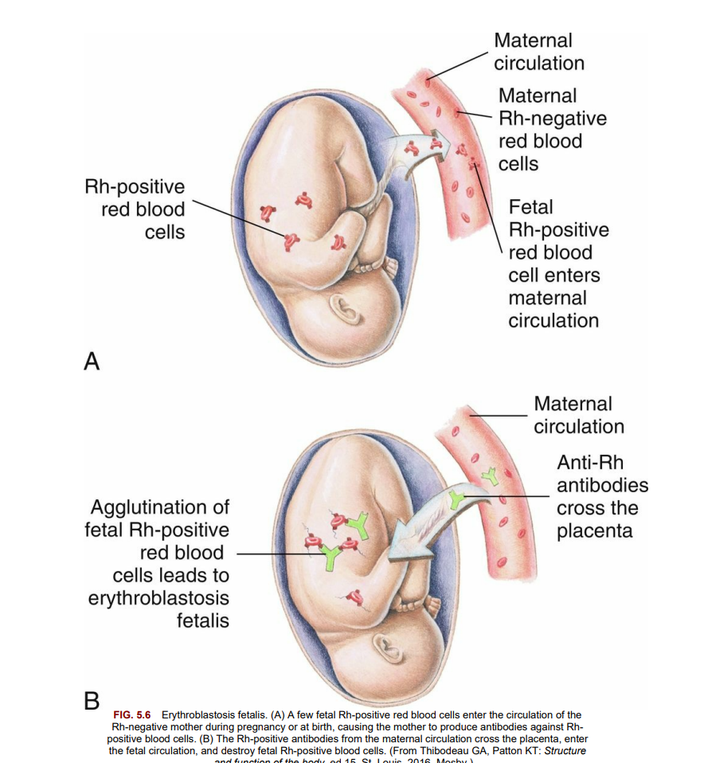

Slide 81
Prevention, treatment, and nursing care Primary management to prevent the manufacture of anti-Rh antibodies:
is by giving Rh0 (D) immune globulin (RhoGAM) to the Rh-negative woman at 28 weeks gestation and within 72 hours after birth of an Rh-positive infant or abortion .
It is also given after amniocentesis and to women who experience bleeding during pregnancy because fetal blood may leak into the mother’s circulation at these times.
Rh0 (D) immune globulin has greatly decreased the incidence of infants with Rh-incompatibility problems.

Slide 82
The woman who is sensitized to destroy Rh-positive blood cells
is carefully monitored during pregnancy to determine if too many fetal erythrocytes are being destroyed.
Several fetal assessment tests may be used, including the Coombs test, amniocentesis, or percutaneous umbilical blood sampling .
Doppler ultrasound to detect increased blood flow in the middle cerebral artery of the fetus (fetal middle cerebral artery peak systolic velocity (MCA-PSV)) detects fetal anemia that can occur as a result of Rh incompatibility.
An intrauterine transfusion may be performed for the severely anemic fetus.
The Rh factor should be documented on the chart, and the health care provider should be notified if the woman is Rh negative.

Slide 83
Pregnancy complicated by medical conditions :
The chronic health problems diabetes mellitus, heart disease, anemia, and infections.
Diabetes mellitus :
Types of diabetes mellitus include the following :
• Type 1 diabetes mellitus: Usually caused by an autoimmune destruction of the beta cells of the pancreas resulting in insulin deficiency.
• Type 2 diabetes mellitus: Usually caused by insulin resistance; usually has a strong genetic predisposition and is associated with obesity.
• Pregestational diabetes mellitus:
Type 1 or 2 diabetes mellitus that existed before pregnancy occurred.
• Gestational diabetes mellitus (GDM): Glucose intolerance with onset during pregnancy.
In true GDM, glucose usually returns to normal by 6 weeks postpartum, although women with GDM have increased risk of developing type 2 diabetes mellitus later in life .

Slide 84
Pathophysiology Diabetes mellitus is a disorder in which there is inadequate insulin to move glucose from the blood into body cells.
It occurs because the pancreas produces no insulin or
insufficient insulin or
because cells resist the effects of insulin.
Essentially, cells starve because they cannot obtain glucose. To compensate, the body metabolizes protein and fat for energy, which causes ketones and acids to accumulate (ketoacidosis).
The person loses weight despite eating large amounts of food (polyphagia).
Fatigue and lethargy accompany cell starvation.
To dilute excess glucose in the blood, thirst increases (polydipsia), and fluid moves from the tissues into the blood.
This results in tissue dehydration and the excretion of large amounts (polyuria) of glucose-bearing urine (glycosuria).

Slide 85
Effect of Pregnancy on Glucose Metabolism Pregnancy affects a woman’s metabolism (whether or not she has diabetes mellitus) to make ample glucose available to the growing fetus.
Hormones (estrogen and progesterone), an enzyme (insulinase) produced by the placenta, and increased prolactin levels have two effects:
• Increased resistance of cells to insulin
• Increased speed of insulin breakdown

Slide 86
Most women respond to these changes by secreting extra insulin to maintain normal carbohydrate metabolism while still providing plenty of glucose for the fetus.
If the woman cannot increase her insulin production, she will have periods of hyperglycemia (increased blood glucose levels) as glucose accumulates in the blood. Because the fetus continuously draws glucose from the mother, maternal hypoglycemia (low blood glucose) can occur between meals and during the night.
There is also a normally increased tissue resistance to maternal insulin action in the second and third trimesters, and the fetus is then at risk for organ damage resulting from hyperglycemia.
The newborn is at risk for hypoglycemia because it leaves the high insulin environment that was in utero and enters a lower insulin environment, and close monitoring of the newborn is required following birth.
Preexisting Diabetes Mellitus Women who are diabetic before pregnancy must alter the management of their condition.

Slide 87
The time of major risk for congenital anomalies to occur from maternal hyperglycemia is during the embryonic period of development in the first trimester.
Therefore women who have diabetes mellitus before pregnancy have a greater risk of having a newborn with a congenital anomaly than a woman who develops GDM, which usually manifests after the first trimester.
With careful management, most diabetic women can have successful pregnancies and healthy babies.

Slide 88
Effects of Diabetes Mellitus in Pregnancy Maternal effects :
1- Spontaneous abortion
2- Gestational hypertension
3- Preterm labor and premature rupture of membranes
Hydramnios (excessive amniotic fluid; also called polyhydramnios)
4- Infections: • Vaginitis • Urinary tract infections
5- Complications of large fetal size:
Birth canal injuries
Cesarean birth
Ketoacidosis
Fetal and neonatal effects Congenital abnormalities Complications of large fetal size (macrosomia)
Intrauterine growth restriction
Birth injury
6- Delayed lung maturation;
respiratory distress syndrome
Neonatal hypoglycemia
Neonatal hypocalcemia
Neonatal hyperbilirubinemia and jaundice Neonatal polycythemia (excess erythrocytes) caused by hypoxia
Perinatal death

Slide 89
Gestational Diabetes Mellitus GDM is common and resolves quickly after birth; many women who develop GDM develop overt type 2 diabetes mellitus later in life.
The following factors in a woman’s history are high risk for GDM :
• Maternal obesity (greater than 90 kg or 198 lb)
• Large infant (greater than 4000 g or about 9 lb, macrosomia)
• Maternal age older than 25 years
• Previous unexplained stillbirth or infant having congenital abnormalities
• History of GDM in a previous pregnancy
• Family history of diabetes mellitus
• Fasting glucose more than 126 mg/dL or postmeal glucose more than 200 mg/dL

Slide 90
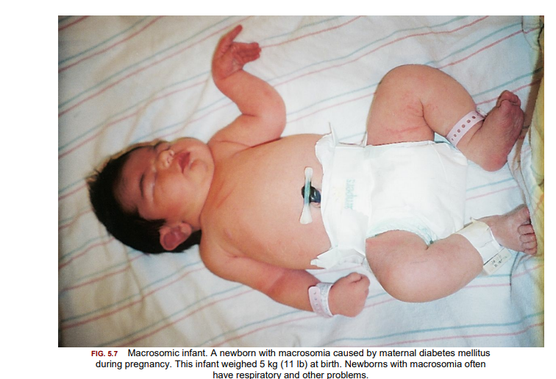

Slide 91
Treatment :
A nonpregnant woman with diabetes mellitus is treated with a balance of insulin or an oral hypoglycemic drug (agent that reduces blood glucose level), diet, and exercise.
People with mild diabetes mellitus do not need drugs and control their condition by diet and exercise alone.
Medical therapy during pregnancy includes identification of GDM, diet modifications, monitoring of blood glucose levels, insulin, exercise, and selected fetal assessments throughout pregnancy.

Slide 92
Identification of gestational diabetes mellitus If the woman does not have preexisting diabetes mellitus, a prenatal screening test to identify GDM is routinely performed between 24 and 28 weeks gestation, but it may be done earlier if risk factors are present.
In the prenatal screening test for GDM, the woman drinks 50 g of an oral glucose solution (fasting is not necessary, but fasting increases the sensitivity of the test) ,and a blood sample is taken 1 hour later and is analyzed for glucose.
If the blood glucose level is 130 to 140 mg/dL or higher, a more complex, 3-hour glucose tolerance test is done.
Two abnormal 3- hour glucose tolerance tests are diagnostic for GDM.

Slide 93
Diet modifications:
The woman is counseled to avoid single large meals with high amounts of simple carbohydrates.
A balanced food intake is divided among meals and at least three to four snacks throughout the day to maintain stable blood glucose levels.
The timing and content of meals and snacks may require adjustment to prevent early-morning hypoglycemia.
Foods that release glucose slowly are preferred to avoid rapid changes in blood glucose.
If the woman’s body mass index is between 22 and 27, the daily caloric intake should be 30 to 35 kcal/kg of normal weight.
If the woman’s body mass index is more than 30, the daily caloric intake should be 15 kcal/kg of actual weight .
The bedtime snack is important to minimize the risk of hypoglycemia.
Dietary guidance in collaboration with a registered dietitian is important.

Slide 94
Monitoring of blood glucose levels To ensure a successful pregnancy, the woman must keep her blood glucose levels as close to normal as possible and be taught the signs and symptoms of both hypoglycemia and hyperglycemia .
Glycosylated hemoglobin (HgbA1C) is performed every 3 months to provide an indication of long-term (4- to 6- week) glucose control; lower values indicate successful glucose management of the pregnant diabetic.
HgbA1C monitoring cannot be used as a guide to adjust daily insulin needs during pregnancy, but it may warn of a risk for fetal anomalies.

Slide 95
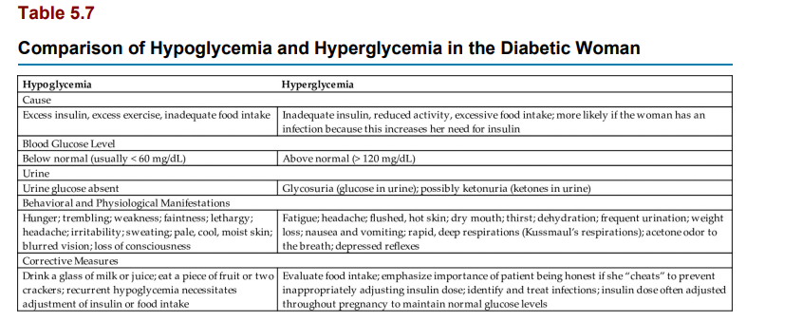

Slide 96
Monitoring of ketones Urine ketones may be checked to identify the need for more carbohydrates.
If the woman’s carbohydrate intake is insufficient, she may metabolize fat and protein to produce glucose, resulting in ketonuria.
However, ketonuria that is accompanied by hyperglycemia requires prompt evaluation for diabetic ketoacidosis.
Ketoacidosis can be rapidly fatal to the fetus.
It is more likely to occur if the woman has preexisting diabetes or if she has an infection.

Slide 97
Insulin administration Oral hypoglycemic drugs can successfully treat GDM which does not cross the placenta, has been considered superior to metformin, which does cross the placenta but has not been shown to be teratogenic to the fetus.
GDM may be controlled by diet and exercise alone, or the woman may require insulin injections.
The dose and frequency of insulin injections are tailored to a woman’s individual needs.
Insulin is often administered on a sliding scale, in which the woman varies her dose of insulin based on each blood glucose level.
The insulin regimen of a diabetic woman is different during pregnancy than in the nonpregnant state.
Typically, insulin dosage may have to be reduced to avoid hypoglycemia in the first trimester, when nausea decreases appetite and physical activity may be reduced.
In the second trimester, increasing placental hormones increases insulin resistance ,and the dosage of insulin may have to be increased.
Insulin requirements may decrease again at 38 weeks gestation.
GDM resolves promptly after birth, when the insulin-antagonistic (diabetogenic) effects of pregnancy cease.

Slide 98
Insulin as part and lispro are fast-acting insulins that are highly effective if given before meals.
Glargine insulin is not recommended for use during pregnancy because of variations in the basal insulin needs during pregnancy.
The use of an insulin pump has proved of great value for glucose control in pregnant and nonpregnant patients with diabetes mellitus and reduces hypoglycemic events.

Slide 99
Exercise :
A pregnant woman with preexisting diabetes mellitus may have vascular damage, and exercise may then result in ischemia (decreased circulation) to the placenta and result in hypoxia (decreased oxygen) to the fetus.
The health care provider should prescribe the level of exercise, and blood glucose levels should be monitored closely.
In GDM, however, exercise can help control blood glucose levels, and diet and exercise can minimize the need for insulin.
The woman with GDM should be counseled that exercise after meals is preferred because glucose levels are higher at that time.
Hypoglycemia can occur if the woman exercises when the effects of the last insulin dose are at peak.
Hyperglycemia can occur if the woman exercises when the effects of the last dose of insulin have decreased.
Therefore blood glucose levels should be monitored before, during, and after exercise, and a hard candy should be on hand to deal with hypoglycemia .

Slide 100
Fetal assessments Assessments:
may identify fetal growth and the ability of the placenta to provide oxygen and nutrients.
Ultrasound examinations can identify IUGR, macrosomia, excess amniotic fluid (polyhydramnios) in the woman with poorly controlled diabetes, or decreased amniotic fluid (oligohydramnios) in placental failure.
Diabetes can affect the blood vessels that supply the placenta, impairing the transport of oxygen and nutrients to the fetus and the removal of fetal wastes. The non–stress test, contraction stress test, and biophysical profile provide information about how the placenta is functioning.
Tests of fetal lung maturity are common if early delivery is considered.

Slide 101
Care during labor Labor :
is work (exercise) that affects the amount of insulin and glucose needed.
Some women receive an intravenous infusion of a dextrose solution plus regular insulin as needed.
Regular insulin is the only type given intravenously.
Blood glucose levels are assessed hourly, and the insulin dose is adjusted accordingly.
Because macrosomia (large fetal size) is a common complication of GDM, close monitoring of the fetus during labor is essential, and cesarean delivery may be indicated.
Care of the neonate Infant complications after birth may include hypoglycemia, respiratory distress, and injury caused by macrosomia.
Some infants experience growth restriction because the placenta functions poorly. Neonatal nurses and a neonatologist (a physician specializing in care of newborns) are often present at the birth.

Slide 102
Nursing care:
Nursing care of the pregnant woman with diabetes mellitus involves helping her to learn to care for herself and providing emotional care to meet the demands imposed by this complication.
Care during labor primarily involves careful monitoring for signs of fetal distress.
Teaching self-care Most women with preexisting diabetes mellitus already know how to check their blood glucoselevel and administer insulin.
They should be taught why diabetes management changes during pregnancy.
The woman with newly diagnosed GDM must be taught these self-care skills.
The woman is taught how to select appropriate foods for the prescribed diet.
She is more likely to maintain the diet if her caregivers are sensitive to her food preferences and cultural needs.
A dietitian can determine foods to meet her needs and help find solutions to problems in adhering to the diet.
The woman who takes insulin may experience episodes of hypoglycemia (low blood glucose) or hyperglycemia (high blood glucose) .
The woman is taught how to recognize and respond to each condition, and family members are included in the teaching.
Maintaining glycemic control during pregnancy is essential to prevent later complications such as macrosomia.
Follow-up care is important, as patients with GDM have increased risk of developing type 2 diabetes mellitus 5 to 10 years after delivery.

Slide 103
Providing emotional support :
Pregnant women with diabetes mellitus often find that living with glucose monitoring, diet control, and frequent insulin administration is bothersome.
The expectant mother may be anxious about the outcome for herself and her child.
Therapeutic communication helps her to express her frustrations and fears.

Slide 104
Encouraging breastfeeding :
Studies have shown that newborns who have been exclusively breastfed have a lower incidence of developing diabetes mellitus later in life.
Breastfeeding should be encouraged if the newborn does not have perinatal complications related to maternal diabetes mellitus, such as macrosomia, respiratory problems, or anomalies.
Blood glucose levels of newborns are monitored closely in the first 24 hours of life. Breastfeeding uses glucose reserves in the mother, and glucose monitoring of the mother after breastfeeding is important.
Taking in fluids or food before or during breastfeeding may be desirable.

Slide 105
Postpartum contraception:
The preferred method of postpartum contraception for the woman with GDM is one of the barrier methods or an intrauterine device .
The side effects of combined oral contraceptive use, such as the development of blood clots and cardiac problems, may be increased in women with GDM.
Carbohydrate metabolism may be affected by the progestin in the combined oral contraceptive, and an increased resistance to insulin may occur.
The combined oral contraceptive should not be the first-line recommendation.
A progestin-only oral contraceptive may be preferred .

Slide 106
Anemia :
Anemia is the reduced ability of the blood to carry oxygen to the cells.
Hemoglobin levels that are less than 10.5 g/dL in the second trimester and that are less than 11 g/dL in the first and third trimesters indicate anemia during pregnancy .
Four anemias are significant during pregnancy: two nutritional anemias (iron-deficiency anemia and folic acid–deficiency anemia) and two anemias resulting from genetic disorders (sickle cell disease and thalassemia).
Nutritional Anemias Most women with anemia have vague symptoms, if any.
The anemic woman may fatigue easily and have little energy.
Her skin and mucous membranes are pale.
Shortness of breath, a pounding heart, and a rapid pulse may occur with severe anemia. The woman who develops anemia gradually has fewer symptoms than the woman who becomes anemic abruptly, such as through blood loss.

Slide 107
Iron-deficiency anemia :
Pregnant women need additional iron for their own increased blood volume, for transfer to the fetus, and for a cushion against the blood loss expected at birth.
The RBCs are small (microcytic) and pale (hypochromic) in iron-deficiency anemia.
The tannic acid in tea and bran may decrease absorption of iron from foods eaten at the same meal.
Prevention Iron supplements are commonly used to meet the needs of pregnancy and maintain iron stores. Vitamin C may enhance the absorption of iron.
Iron should not be taken with milk or antacids because calcium impairs absorption.

Slide 108
Treatment The woman with iron-deficiency anemia:
needs extra iron to correct the anemia and replenish her stores.
She is treated with oral doses of elemental iron and continues this therapy for about 3 months after the anemia has been corrected.
Folic acid–deficiency anemia Folic acid (also called folate or folacin) deficiency is characterized by large, immature RBCs (megaloblastic anemia).
Iron-deficiency anemia is often present at the same time.
Anticonvulsants, oral contraceptives, sulfa drugs, and alcohol can decrease the absorption of folate from food.

Slide 109
Prevention Folic acid is essential for normal growth and development of the fetus. Folic acid deficiency has been associated with neural tube defects in the newborn.
A daily supplement of 400 to 800 mcg (0.4 to 0.8 mg) ensures adequate folic acid and is now recommended for all women of childbearing age .
Treatment:
Treatment of folate deficiency is with folic acid supplementation as noted previously because diet alone cannot provide the folic acid needed.
The preventive dosage of supplementary folic acid may be higher for women who have previously had a child who had a neural tube defect.

Slide 110
Genetic Anemia's
Sickle cell disease In contrast to people with nutritional anemias, people with sickle cell disease have abnormal hemoglobin that causes their erythrocytes to become distorted into a sickle (crescent) shape during episodes of hypoxia or acidosis.
It is an autosomal recessive disorder, meaning that the affected person receives an abnormal gene from each parent.
The abnormally shaped blood cells do not flow smoothly, and they clog small blood vessels.
The sickle cells are destroyed more rapidly, resulting in chronic anemia.
Pregnancy may cause a sickle cell crisis, with massive erythrocyte destruction and occlusion of blood vessels.
The main risk to the fetus is occlusion of vessels that supply the placenta, leading to preterm birth, growth restriction, and fetal death.
The woman should have frequent evaluation and treatment for anemia during prenatal care.
Fetal evaluations concentrate on fetal growth and placental function.
Oxygen and fluids are provided continuously during labor to prevent sickle cell crisis. Genetic counseling should be offered.

Slide 111
Thalassemia :
Thalassemia is a genetic trait that causes an abnormality in one of two chains of hemoglobin, the alpha (α) or beta (β) chain.
The β chain variety is most often encountered in the United States.
The person can inherit an abnormal gene from each parent, causing β-thalassemia major, or Cooley’s anemia.
If only one abnormal gene is inherited, the person will have β-thalassemia minor. The woman with β-thalassemia minor usually has few problems other than mild anemia, and the fetus does not appear to be affected.
However, administration of iron supplements may cause iron overload in a woman with β-thalassemia because the body absorbs and stores iron in higher-thanusual amounts.
Nursing Care for Anemias During Pregnancy The woman is taught which foods are high in iron and folic acid to help her prevent or treat anemia.
She is taught how to take the supplements so that they are optimally effective. For example, the nurse explains that although milk is good to drink during pregnancy, it should not be taken at the same time as the iron supplement, or the iron will not be absorbed as easily.
Foods high in vitamin C may enhance absorption.

Slide 112
Foods Recommended in Pregnancy:
Foods high in iron Meats, chicken, fish, liver, legumes, green leafy vegetables, whole or enriched grain products, nuts, blackstrap molasses, tofu, eggs, dried fruits ;
Foods high in folic acid Green leafy vegetables, asparagus, green beans, fruits, whole grains, liver, legumes, yeast Foods high in vitamin c (may enhance absorption of iron) Citrus fruits and juices, strawberries, cantaloupe, cabbage, green and red peppers, tomatoes, potatoes, green leafy vegetables
To prevent or correct nutritional anemias, such as iron and folic acid deficiencies, the nurse should teach all women appropriate food sources for those nutrients.
The woman is taught that when she takes iron, her stools will be dark green to black and that mild gastrointestinal discomfort may occur.
She should contact her obstetrician or nurse-midwife if these side effects trouble her; another iron preparation may be better tolerated.
She should not take antacids with iron.
The woman with sickle cell disease requires close medical and nursing care.
She should be taught to prevent dehydration and activities that cause hypoxia.
The woman with β-thalassemia is taught to avoid situations in which exposure to infection is more likely (e.g., crowds during flu season) and to report any symptoms of infection promptly.

Slide 113
Infections The acronym TORCH :
has been used to describe infections that can be devastating for the fetus or newborn. The letters stand for the first letters of four infections or infectious agents: Toxoplasmosis, Rubella, Cytomegalovirus, and Herpes simplex virus; the O is sometimes used to designate “Other” infections.
However, there are many more infections that can be devastating for the mother, fetus, or newborn.
Some of these are damaging any time they are acquired, whereas others are relatively harmless except when acquired during pregnancy.
routine prenatal laboratory testing.

Slide 114
Cytomegalovirus (CMV) infection :
is a herpes infection that is sexually transmitted.
The infection is often asymptomatic in the mother.
CMV immunoglobulin can be given to the symptomatic mother during pregnancy .
an infected infant may have some of the followingserious problems:
• Intellectual impairment
• Seizures
• Blindness
• Deafness
• Dental abnormalities
• Petechiae (often called a “blueberry muffin” rash).
Treatment and nursing care Primary prevention :
via hand hygiene is essential.
Therapeutic pregnancy termination may be offered if CMV infection is discovered during early pregnancy.
Ganciclovir or valganciclovir are antiviral drugs that hold promise in improving the developmental outcome in newborns .

Slide 115
Rubella
Rubella is a mild viral disease with a low fever and rash.
Rubella occurring in very early pregnancy can disrupt the formation of major body systems, whereas rubella acquired later is more likely to damage organs that are already formed.
Some effects of rubella on the embryo or fetus include the following:
• Microcephaly (small head size)
• Intellectual impairment
• Congenital cataracts
• Deafness
• Cardiac defects
• IUGR Treatment and nu

Slide 116
Treatment and nursing care Immunization against rubella infection has been available for some time, but some women of childbearing age are still susceptible.
When a woman of childbearing age is immunized, she should not get pregnant for at least 1 month after the immunization.
The vaccine is offered during the postpartum period to nonimmune women.
It is not given during pregnancy because it is a live attenuated (weakened) form of the virus.

Slide 117
Herpesvirus :
There are two types of herpesviruses.
Type 1 is more likely to cause fever blisters or cold sores.
Type 2 is more likely to cause genital herpes.
After the primary infection occurs, the virus becomes dormant in the nerves and may be reactivated later as a recurrent (secondary) infection.
Initial infection during the first half of pregnancy may cause spontaneous abortion. The infant is infected in one of the following ways:
• The virus ascends into the uterus after the membranes rupture.
• The infant has direct contact with infectious lesions during vaginal delivery. Neonatal herpes infection can be either localized or disseminated (widespread).
Disseminated neonatal infection has a high mortality rate, and survivors may have neurological complications.

Slide 118
Treatment and nursing care Avoiding contact with the lesions can prevent neonatal herpes infection.
If the woman has active genital herpes lesions when the membranes rupture or labor begins, a cesarean delivery may be required to prevent fetal contact during birth or the development of an ascending infection.
Cesarean birth is not necessary if there are no active genital lesions.
The mother and infant do not need to be isolated as long as direct contact with lesions is prevented .
Breastfeeding is safe if there are no lesions on the breasts.
Antiviral drugs such as acyclovir may be given orally during pregnancy to reduce the occurrence of active lesions at the time of birth .
Infected newborns may receive acyclovir and are followed closely after birth.

Slide 119
Hepatitis B Blood,
saliva, vaginal secretions, semen, and breast milk can transmit the virus that causes hepatitis B infection;
the infection can also cross the placenta.
The woman may be asymptomatic or acutely ill with chronic low-grade fever, anorexia, nausea, and vomiting.
Some become chronic carriers of the virus.
The fetus may be infected transplacentally or by contact at birth with blood or vaginal secretions.
The infant may become a chronic carrier and a continuing source of infection.

Slide 120
Persons at Higher Risk for Hepatitis B Infection:
• Intravenous drug users
• Persons with multiple sexual partners
• Persons with repeated infection with sexually transmitted infections
• Health care workers with occupational exposure to blood products and needle sticks
• Hemodialysis patients
• Recipients of multiple blood transfusions or other blood products
• Household contact with hepatitis carrier or hemodialysis patient
• Persons arriving from countries where there is a higher incidence of the disease

Slide 121
Treatment and nursing care All women should be screened for hepatitis B during the course of prenatal care, and the screening should be repeated during the third trimester for women in high-risk groups.
Infants born to women who are positive for hepatitis B should receive a single dose of hepatitis B immune globulin (for temporary immunity right after birth) followed by hepatitis B vaccine (for long-term immunity).
The Centers for Disease Control and Prevention (CDC) recommends routine immunization with hepatitis B vaccine for all newborns (infants born to carrier mothers and to noncarrier mothers) at birth and at ages 1 to 2 months and 6 to 18 months. Immunization during pregnancy is not contraindicated.
If possible, injections should be delayed until after the infant’s first bath so that blood and other potentially infectious secretions are removed to avoid introducing them under the skin.
Because they have occupational exposure to blood and other infectious secretions, health care staff should be immunized against hepatitis B.

Slide 122
Sexually Transmitted Infections Sexually transmitted infections (STIs), formerly known as sexually transmitted diseases, are infections for which a common mode of transmission is sexual intercourse, although several can also be transmitted in other ways.
Herpesvirus. Other infections that are typically transmitted sexually are syphilis, gonorrhea, chlamydia, trichomoniasis, and condylomata acuminata (genital warts).
Changes in the vaginal secretions that occur during pregnancy can increase the risk of developing a vaginal infection.
The high estrogen levels present during pregnancy thicken the vaginal mucosa and increase secretions that have a high glycogen content.
This makes the woman susceptible to yeast infections and other microorganisms.
Later in pregnancy the pH of the vagina decreases, resulting in a protective effect.
All sexual contacts of persons infected with a disease that can be sexually transmitted should be informed and treated; otherwise the cycle of infection and reinfection will continue.
Consistent use of a latex condom, including the female condom, helps to reduce the sexual spread of STIs.

Slide 123
Human immunodeficiency virus Human immunodeficiency virus (HIV) is the causative organism of acquired immunodeficiency syndrome (AIDS).
HIV infection is acquired in one of the following four ways:
Unprotected (through condom nonuse, breakage, or slippage) sexual contact (anal, vaginal, or oral) with an infected person
Sharing a needle with an infected person
Mucous membrane exposure to infected body fluids
Perinatal exposure (infants) .
The infant may be infected in one of the following three ways:
Transplacentally
Through contact with infected maternal secretions at birth
Through breast milk The infected woman has a 20% to 40% chance of transmitting the virus to her fetus prenatally.
Infants born to HIV-positive women will be HIV positive at birth because maternal antibodies to the virus pass through the placenta to the infant.
A period of 3 to 6 months is needed to identify infants who are truly infected.

Slide 124
Nursing care Counseling should be provided to all women concerning behaviors that place them at risk for contracting HIV (Box 5.7).
HIV testing is recommended for all prenatal patients.
HIV-positive women should be educated that the transmission of HIV infection to the newborn can be greatly reduced by appropriate drug therapy.
Pregnant women with AIDS are more susceptible to infection, and the fetus may develop an impaired immune system that increases the risk of opportunistic infections after birth.
Breastfeeding is contraindicated for mothers who are HIV positive.

Slide 125
High-Risk Factors for Human Immunodeficiency Virus • Intravenous drug abuse and needle sharing
• Multiple sexual partners
• Prostitution
• History of sexually transmitted diseases
• Immigration from area where infection is endemic
• Sexual partner in a high-risk group
• Sexual partner with human immunodeficiency virus (HIV) infection

Slide 126
The fetus and the woman are monitored closely during the antepartum period.
All infants born to HIV-positive women are presumed to be HIV positive, and standard precautions are initiated for both mother and infant.
The infant may receive drug therapy with zidovudine starting 6 to 12 hours after birth and continuing during the first 6 weeks of life.
The nurse should anticipate and help the mother cope with the anxiety that is almost certain to occur about whether the neonate is infected.
Social services can help the family with the care of the child at home.
Women should be taught about the risks of sharing needles, the importance of using condoms, and the need to avoid oral sex.

Slide 127
Nonviral Infections Toxoplasmosis Toxoplasmosis:
is caused by Toxoplasma gondii, a parasite that may be acquired by contact with cat feces or raw meat and transmitted through the placenta.
The woman is usually asymptomatic or has mild symptoms.
Congenital toxoplasmosis includes the following possible signs in the newborn:
• Low birth weight
• Enlarged liver and spleen
• Jaundice
• Anemia
• Inflammation of eye structures
• Neurological damage

Slide 128
Treatment and nursing care :
Treatment of the mother reduces the risk of congenital infection.
Pyrimethamine and sulfadiazine are used after the first trimester and leucovorin after 18 weeks gestation.
Spiramycin, although controversial, is typically well tolerated.
Treatment of infants involves pyrimethamine, sulfadiazine, and leucovorin for 1 year, which may reduce the severity of the congenital effects of the disease.
Nurses can teach women the following measures to reduce the likelihood of acquiring the infection:
• Cook all meat thoroughly.
• Wash hands and all kitchen surfaces after handling raw meat.
• Avoid touching the mucous membranes of the eyes or mouth while handling raw meat.
• Avoid uncooked eggs and unpasteurized milk.
• Wash fresh fruits and vegetables well.
• Avoid materials contaminated with cat feces, such as litter boxes, sand boxes, and garden soil.

Slide 129
Urinary Tract Infections :
Urinary tract infections (UTIs) are common in women because of the short urethra and the ease of contamination of the urethra from the rectum and because of contamination from the vagina during sexual activity.
The urinary tract is normally self-cleaning because acidic urine inhibits the growth of microorganisms and flushes them out of the body with each voiding.
Pregnancy alters this self-cleaning action, as pressure on urinary structures keeps the bladder from emptying completely and the ureters dilate and lose motility under the relaxing effects of the hormone progesterone.
Urine that is retained in the bladder becomes more alkaline, providing a favorable environment for the growth of microorganisms.
Some women have excessive microorganisms in their urine but no symptoms (asymptomatic bacteriuria).
The asymptomatic infection may eventually cause cystitis (bladder infection) or pyelonephritis (kidney infection).
The woman with cystitis has the following signs and symptoms:
• Burning with urination
• Increased frequency and urgency of urination
• A normal or slightly elevated temperature

Slide 130
If not treated, cystitis can ascend in the urinary tract and cause pyelonephritis. Pyelonephritis is a particularly serious infection in pregnancy and is accompanied by the following signs and symptoms:
• High fever
• Chills
• Flank pain or tenderness
• Nausea and vomiting Maternal hypertension, chronic renal disease, and preterm birth may occur with pyelonephritis during pregnancy.
The high maternal fever is dangerous for the fetus because it increases the fetal metabolic rate, which increases fetal oxygen needs to levels that the mother cannot readily supply.

Slide 131
Treatment UTIs are treated with short-term oral antibiotics.
Asymptomatic bacteriuria is treated with oral antibiotics for 10 days.
Pyelonephritis is treated with multiple antibiotics, initially administered intravenously.
Cystitis in pregnant women is treated with a full 7 days of antibiotic therapy.

Slide 132
Nursing care All female patients should be taught how to reduce the introduction of rectal microorganisms into the bladder.
For example, a front-to-back direction should be used when wiping after urination or a bowel movement, when doing perineal cleansing, or when applying and removing perineal pads.
The nurse can begin teaching during the woman’s prenatal visits and reinforce the training during the postpartum stay.
The mother should be taught how to clean and diaper an infant girl to avoid fecal contamination of her urethra.
Adequate fluid intake promotes frequent voiding.
Drinking at least eight glasses of liquid per day and excluding caffeine-containing beverages help to flush urine through the urinary tract regularly.
Cranberry juice may make the urine more acidic and less conducive to the growth of infectious organisms.
Sexual intercourse mildly irritates the bladder and urethra, which can promote a UTI. Urinating before intercourse reduces irritation; urinating afterward flushes urine from the bladder.
Using water-soluble lubricant during intercourse can also reduce periurethral irritation. Pregnant women should be taught the signs and symptoms of cystitis and pyelonephritis so that they will know to seek treatment at once.

Slide 133
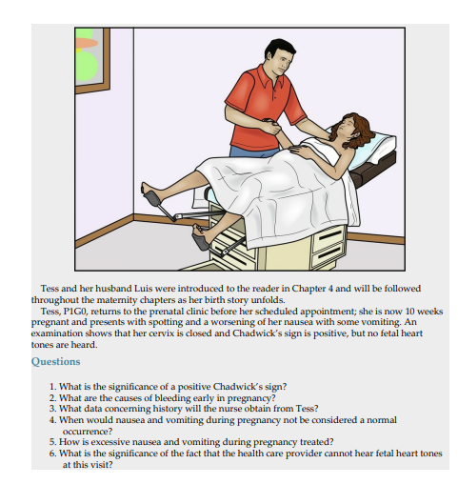

Slide 134
Get Ready for the NCLEX® Examination! Key Points
• Hyperemesis gravidarum is persistent nausea and vomiting of pregnancy and often interferes with nutrition and fluid balance.
• The most common reason for early spontaneous abortion is abnormality of the developing fetus or the placenta.
• If a woman has a tubal rupture from an ectopic pregnancy, the nurse should observe for shock.
• Because of hemorrhage into the abdomen in the case of a tubal rupture, vaginal blood loss may be minimal, even though intraabdominal blood loss can be massive.
• A woman with gestational trophoblastic disease (hydatidiform mole) should have follow-up medical care for 1 year to detect the possible development of choriocarcinoma. She should not 254 become pregnant during this time.
• Placenta previa refers to abnormal implantation of the placenta in the lower part of the uterus.
• Abruptio placentae refers to premature separation of the placenta that is normally implanted.
• The three main manifestations of preeclampsia are hypertension, edema, and proteinuria.
• Patients at risk for preeclampsia should be given low-dose aspirin after the first trimester. Eclampsia occurs when the woman has a seizure.

Slide 135
• A positive non–stress test indicates heart accelerations and is reassuring of fetal health.
• A negative contraction stress test indicates there are no late decelerations after a uterine contraction and denotes fetal health.
• An abortion is the termination of pregnancy before the fetus is viable.
• Positioning the mother on her left side during bed rest helps improve blood flow to the placenta and prevent pressure on the vena cava.
• A blood pressure of 140/90 mm Hg or greater is considered hypertension in the pregnant patient.
• A routine, noninvasive ultrasound examination can confirm pregnancy, detect some anomalies, and show the sex of the fetus.
• Rh0 (D) immune globulin (RhoGAM) can be administered to an Rh-negative mother to prevent blood incompatibilities between the mother and an Rh-positive fetus (erythroblastosis fetalis).
• Gestational diabetes mellitus first occurs during pregnancy and resolves after pregnancy. The newborn may be excessively large (macrosomia), and the mother may develop diabetes mellitus later in life. Control of blood glucose level is essential to protect the fetus.
• Dietary management of women with gestational diabetes mellitus is essential for a positive outcome for the mother and fetus.

Slide 136
• TORCH diseases of pregnancy include :
toxoplasmosis, rubella, cytomegalovirus, and herpes, with the o also denoting others.
• All pregnant women should be assessed for Zika virus exposure during each prenatal visit.
• The nurse must consider the physiological changes that occur during pregnancy to understand and care for the pregnant trauma victim. Both the mother and the fetus must be monitored closely.
• Urinary tract infections are more common during pregnancy because compression and dilation of the ureters result in urine stasis. Preterm labor is more likely to occur if a woman has pyelonephritis.
• The fetus of a woman who takes drugs (legal or illicit) or drinks alcohol is exposed to higher levels of the substance for a longer time because the substances become concentrated in the amniotic fluid and the fetus ingests the fluid.
• Drugs and alcohol consumed by the mother can cross the placenta and adversely affect the developing fetus.
• The nurse must be prepared to recognize the effects of adverse environmental factors on the maternal–infant patient.

Slide 137
Review Questions for the NCLEX® Examination
A woman has an incomplete abortion followed by vacuum aspiration. She is now in the recovery room with her husband and is crying softly. Select the most appropriate nursing action.
1- Leave the couple alone except for necessary recovery-room care.
2. Tell the couple that most abortions are for the best because the infant would have been abnormal.
3. Tell the couple that spontaneous abortion is very common and does not mean that they cannot have other children.
4. Express your regret at their loss and remain nearby if they want to talk about it.
2. The health care provider gives magnesium sulfate intravenously to a woman with a diagnosis of preeclampsia. Which of the following nursing interventions are priority when caring for a patient who has received magnesium sulfate? (Select all that apply.)
Monitor uterine tone.
Monitor urine output.
Keep patient NPO.
Monitor respiratory rate.
1. a and b
2. c and d
3. b and d
4. a and c

Slide 138
3. A woman who has gestational trophoblastic disease (hydatidiform mole) should continue to receive follow-up medical care after initial treatment because:
choriocarcinoma sometimes occurs after initial treatment.
she has lower levels of immune factors and is vulnerable to infection.
anemia complicates most cases of hydatidiform mole.
permanent elevation of her blood pressure is more likely.
4. Select the primary difference between the symptoms of placenta previa and abruptio placentae.
Fetal presentation
Presence of pain
Abnormal blood clotting
Presence of bleeding

Slide 139
5. During a prenatal clinic visit, your intervention with an abused woman is successful if you have assessed the status of the woman and:
persuaded her to leave her abusive partner.
informed her of her safety options.
convinced her to notify the police.
placed her in a shelter for abused women.
6. If a pregnant woman is admitted to the emergency department in shock after an accident, the nurse would help relieve the effect of shock by:
placing her in Trendelenburg position
placing her flat in bed in a supine position
placing a small pillow under her left hip
closely observing and documenting fetal heart rate and contractions
1. c and d
2. a and d
3. b and d
4. d only

Slide 140
Thanks for listening

