Slide 1
infertility

Slide 2
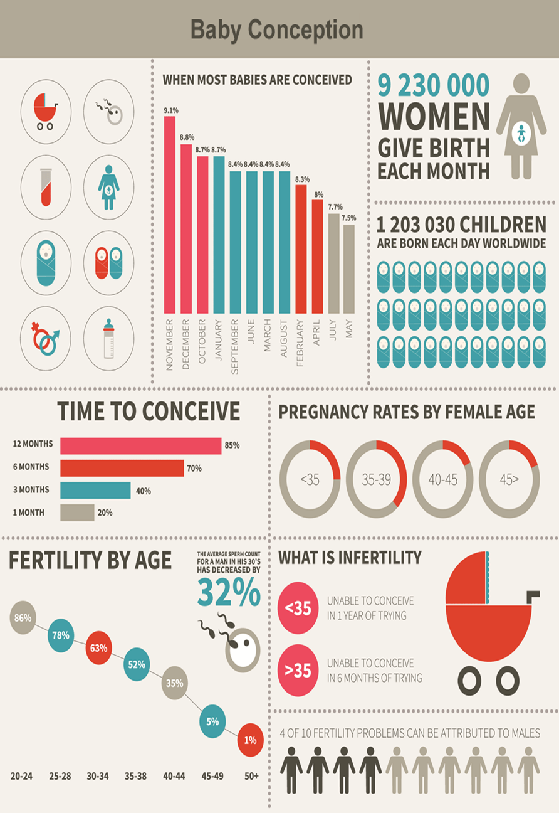

Slide 3
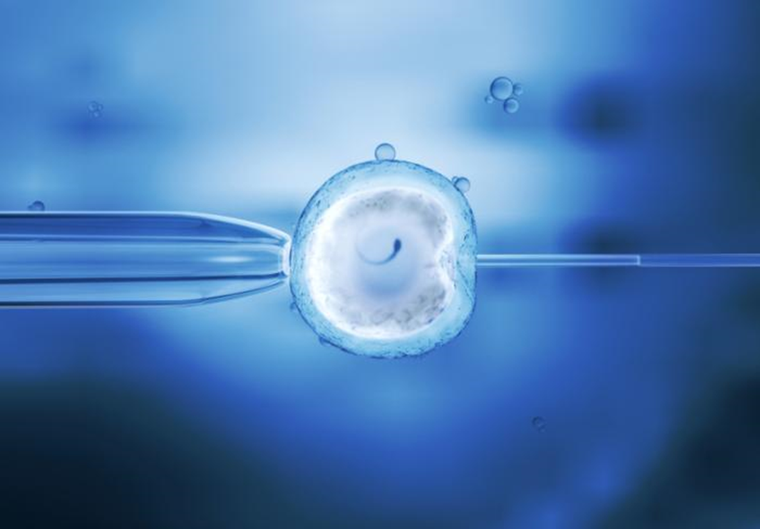
IVF in action
Intracytoplasmic sperm injection (ICSI): A single sperm is injected into an egg to achieve fertilization during an IVF procedure. The likelihood of fertilization improves significantly for men with low sperm concentrations

Slide 4
What is infertility?
infertility is defined as not being able to get pregnant (conceive) after one year (or longer) of unprotected sex.
Because fertility in women is known to decline steadily with age, female partner are over the age of 35, should see a fertility specialist after six months.
After age 40, we recommend seeking help right away because know fertility declines as age increases

Slide 5
There are 2 types of infertility:
Primary infertility refers to couples who have not become pregnant after at least 1 year having sex without using birth control methods.
Secondary infertility refers to couples who have been able to get pregnant at least once, but now are unable

Slide 6
Symptoms:
The main symptom of infertility is not getting pregnant.
There may be no other obvious symptoms.
Sometimes, women with infertility may have irregular or absent menstrual periods.
In some cases, men with infertility may have some signs of hormonal problems, such as changes in hair growth or sexual function.
Most couples will eventually conceive, with or without treatment

Slide 7
All of the steps during ovulation and fertilization need to happen correctly in order to get pregnant.
Sometimes the issues that cause infertility in couples are present at birth, and sometimes they develop later in life.
Infertility causes can affect one or both partners.
Sometimes, no cause can be found.

Slide 8
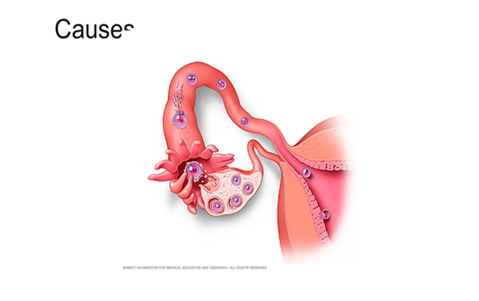

Slide 9
Causes of male infertility
These may include:
Abnormal sperm production or function due to undescended testicles,
genetic defects,
health problems such as diabetes,
or infections such as chlamydia,
gonorrhea,
mumps or HIV.
Enlarged veins in the testes (varicocele) also can affect the quality of sperm.
Problems with the delivery of sperm due to sexual problems, such as:
premature ejaculation;
certain genetic diseases, such as cystic fibrosis;
structural problems, such as a blockage in the testicle;
or damage or injury to the reproductive organs.
Overexposure to certain environmental factors, such :
chemicals, and radiation.
Cigarette smoking, alcohol,
anabolic steroids, and taking medications to treat bacterial infections,
high blood pressure and depression also can affect fertility.
Frequent exposure to heat, , can raise body temperature and may affect sperm production.
Damage related to cancer and its treatment, including radiation or chemotherapy.
Treatment for cancer can impair sperm production, sometimes severely

Slide 10
Causes of female infertility: may include:
Ovulation disorders:
These include hormonal disorders such as polycystic ovary syndrome. Hyperprolactinemia,
(hypothyroidism) can affect the menstrual cycle or cause infertility.
Other underlying causes may include too much exercise,
eating disorders or tumors.
Uterine or cervical abnormalities, including :
abnormalities with the cervix,
shape of the uterus. (uterine fibroids) may cause infertility by blocking the fallopian tubes or stopping a fertilized egg from implanting in the uterus.
Fallopian tube damage or blockage:
inflammation of the fallopian tube (salpingitis). This can result from pelvic inflammatory disease, which is usually caused by a sexually transmitted infection,
adhesions.
Endometriosis:
which occurs when endometrial tissue grows outside of the uterus, may affect the function of the ovaries, uterus and fallopian tubes.

Slide 11
Primary ovarian insufficiency (early menopause) :
when the ovaries stop working and menstruation ends before age 40.
Although the cause is often unknown,
certain factors are associated with early menopause, including immune system diseases, certain genetic conditions such as Turner syndrome or carriers of Fragile X syndrome,
and radiation or chemotherapy treatment.
Pelvic adhesions:
bands of scar tissue that bind organs that can form after pelvic infection,
appendicitis,
endometriosis or
abdominal or pelvic surgery.
Cancer and its treatment:
Certain cancers — particularly reproductive cancers — often impair female fertility.
Both radiation and chemotherapy may affect fertility
Primary ovarian insufficiency (early menopause), when the ovaries stop working and menstruation ends before age 40. Although the cause is often unknown, certain factors are associated with early menopause, including immune system diseases, certain genetic conditions such as Turner syndrome or carriers of Fragile X syndrome, and radiation or chemotherapy treatment.
Pelvic adhesions, bands of scar tissue that bind organs that can form after pelvic infection, appendicitis, endometriosis or abdominal or pelvic surgery.
Cancer and its treatment. Certain cancers — particularly reproductive cancers — often impair female fertility. Both radiation and chemotherapy may affect fertility

Slide 12
Risk factors
Many of the risk factors for both male and female infertility are the same. They include:
Age. Women's fertility gradually declines with age, especially in the mid-30s, and it drops rapidly after age 37.
Infertility in older women is likely due to the lower number and quality of eggs, and can also be due to health
Tobacco use.
Alcohol use.
Being overweight.
Exercise issues

Slide 13
Diagnosis
Tests for men
Semen analysis.
Hormone testing. check level of testosterone and other male hormones.
Genetic testing. This may be done to find out whether a genetic defect is the cause of infertility.
Testicular biopsy.This procedure removes a small amount of testicle tissue so a lab can check it under a microscope. Or it may be used to collect sperm for assisted reproductive techniques, such as in vitro fertilization (IVF).
Imaging.
ultrasound can check for problems in the scrotum, in the glands that make fluids that become semen or in the tube that carries sperm out of the testicles.
A brain MRI can check for tumors of the pituitary gland that are not cancer.
These tumors can cause the gland to make too much of the hormone prolactin, which could lead the body to make less sperm or none.
Other testing. In rare cases, other tests may be done to check the quality of sperm. For example, a semen sample may need to be checked for problems with DNA that might damage sperm.

Slide 14
diagnosis for women:
relies on the ovaries releasing healthy eggs.
a physical exam, including a regular pelvic exam. Infertility tests may include:
Ovulation testing. A blood test measures hormone levels to find out ovulating.
Thyroid function test. This blood test can be done if your health care team thinks infertility might be related to a problem with the thyroid gland.
Hysterosalpingography.
Hysterosalpingography (his-tur-o-sal-ping-GOG-ruh-fee) checks on the condition of the uterus and fallopian tubes.
Ovarian reserve testing. for ovulation. The method often begins with hormone testing early in the menstrual cycle.
Other hormone tests. These check the levels of hormones that control ovulation. They also check pituitary hormones that control processes involved in having a baby.
Imaging tests.
Hysteroscopy.
Laparoscopy. Laparoscopy (lap-u-ros-kuh-pee) involves a small cut beneath the navel.

Slide 15
There are 3 main types of fertility treatment:
medicines.
surgical procedures.
assisted conception – including intrauterine insemination (IUI) and in vitro fertilisation (IVF)

Slide 16
Fertility Treatments
3 treatments commonly used for :
Intrauterine insemination (IUI)
In vitro fertilization (IVF)
Donor eggs.
Gestational carrier (surrogacy)
Egg freezing.
Fertility drugs.
What is the first treatment for infertility?
Clomiphene citrate 100mg with artificial insemination (IUI) remains the first line treatment of choice for unexplained infertility.

Slide 17
If your irregular ovulation is caused by polycystic ovary syndrome (PCOS), the drug Metformin can also be an option Hormone shots also come with a slight risk of ovarian hyper stimulation syndrome, where the ovaries become swollen and painful.

Slide 18
Fertility drugs :
are taken at the start of IVF, but can also take them on their own for ovulation issues.
Oral meds like Clomid and letrozole are used to stimulate the ovaries and correct irregular ovulation.
Both drugs work by suppressing estrogen production, which boosts the production of ovulation-stimulating hormones.
If oral medications don’t work, there are hormone shots called gonadotropins that directly stimulate ovulation.

Slide 19
