Slide 1
Staining
Lap9
By:
Dr. Noor Ali Jabbar

Slide 2
INTRODUCTION
In 1884 Hans Christian Gram described this method of staining, which is the most important stain in routine bacteriology. It is differential stain used for the identification of Bacteria

Slide 3
Requirement
a. Crystal violet Composition: Crystal violet and distilled water.
b. Gram’s iodine Act as mordant.
Composition – Iodine, potassium
iodide and distilled water
c. Absolute alcohol/acetone : Decolouriser.
d. Dilute safranin Counter stain.
Safranin and distilled water.

Slide 4
Procedure
1. Preparation of film – A thin uniform smear is absolutely essential.
2. Fixation of the smear – The smear is dried in air and fixed by passing the slide (Smeared slide up) rapidly over the spirit lamp or Bunsen burner by holding the slide with the thumb and index finger. (DON’T OVER HEAT). The slide is then allowed to cool.
The object of this fixing is to coagulate the aluminous material whereby the film adheres better to the glass and thus may not be detached in the subsequent processes. A film should never be heated over not be detached in the subsequent processes. A film should never be heated over the flame until it is thoroughly dried up.
3. Cover the smear with crystal violet solution and allow to remain
on the slide for 1 minute.

Slide 5
4. Discard the crystal violet stain and hold the slide at a steep and wash off the residual stain with an excess of iodine solution.
Cover the smear with fresh iodine solution and leave it for 1minute.
5. Rinse the smear with absolute alcohol and continue application until no more color appears to flow from the preparation (about15-20 seconds).if acetone is used for depolarization , wash immediately.
6. Wash with water

Slide 6
7. Cover the smear with dilute safranin and allow it to remain for1 minute.
8. Rinse with water and dry in air or between blotting paper.

Slide 7
Differential staining
Acceptance of stains is an important property of bacteria and is the base division of bacteria to 2 principal groups Gram positive and Gram negative in taxonomy. Gram staining

Slide 8
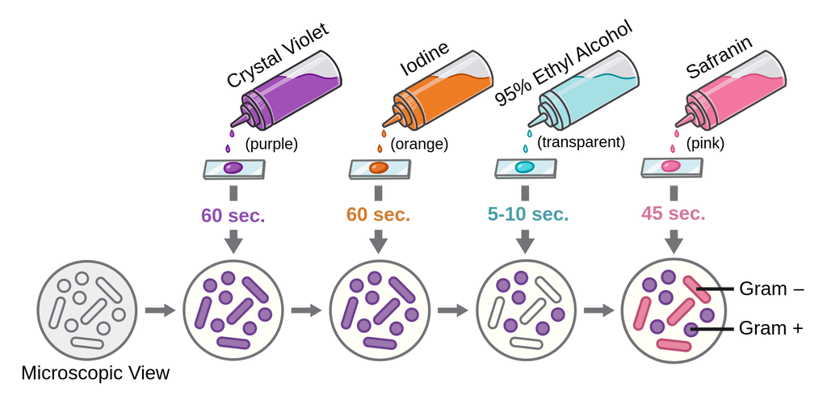

Slide 9
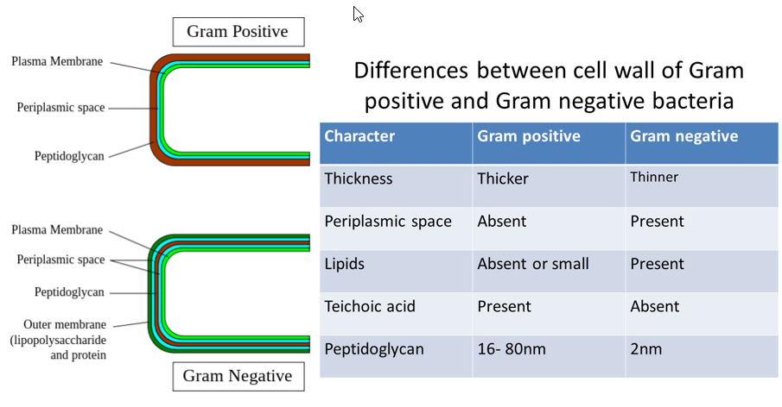

Slide 10
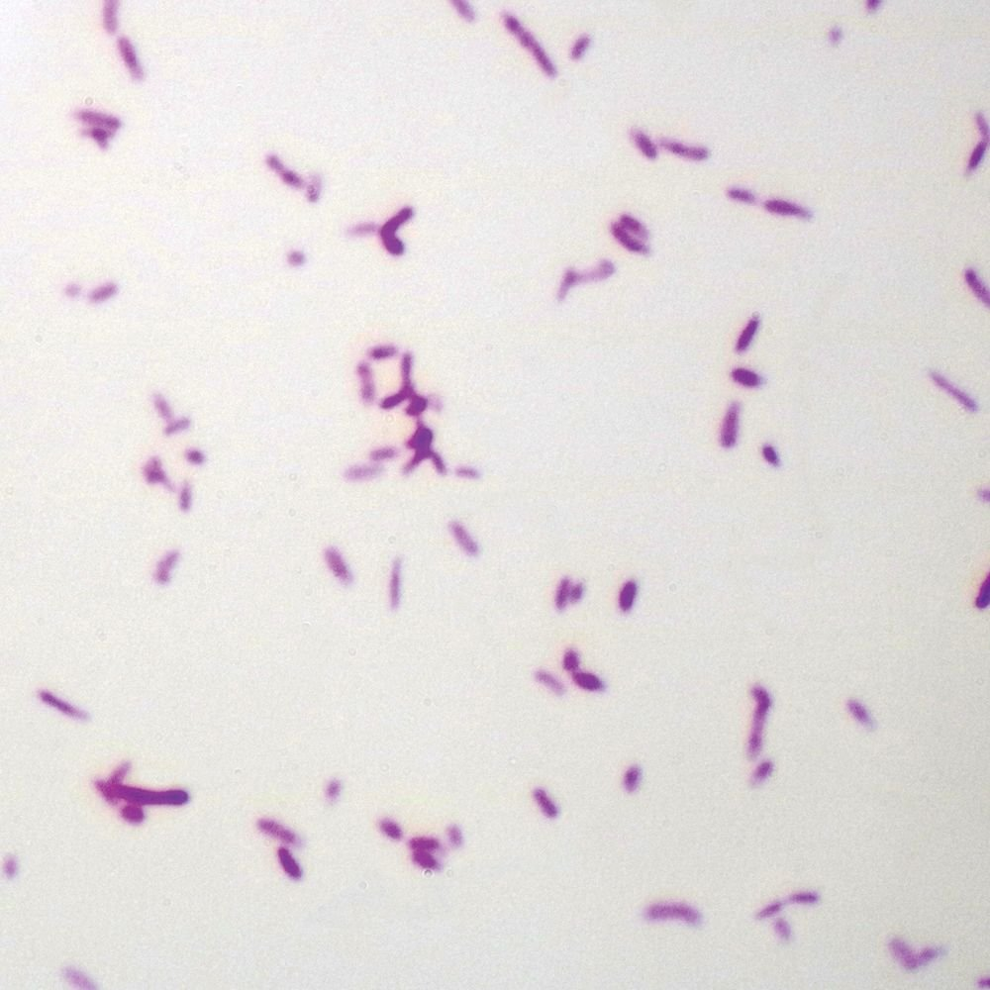
G- bacilli

Slide 11
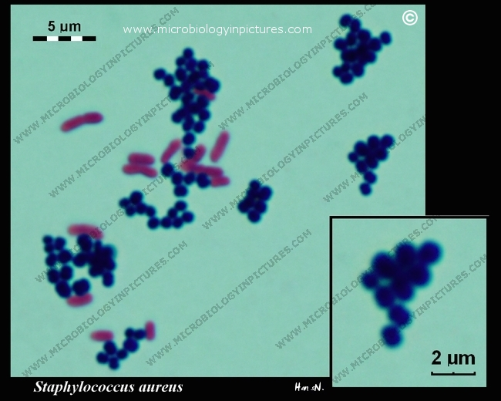
E.Coli + Staph.aureus

Slide 12
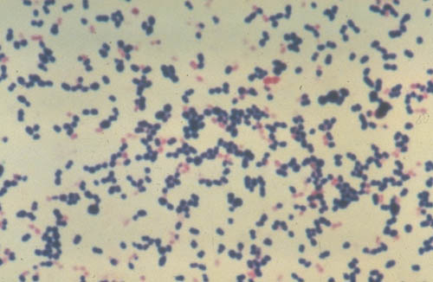
Cocci G+, G-

