Slide 1

Fundamental of Control Engineering
Block Diagram Reduction Lecture-5

Slide 2
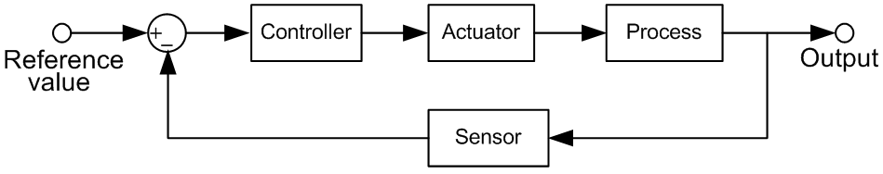


The Block Diagram
Chapter 3
Dynamic Response
Block diagram is a graphical tool to visualize the model of a system and evaluate the mathematical relationships between its components, using their transfer functions.
In many control systems, the system equations can be written so that their components do not interact except by having the input of one part be the output of another part.
The transfer function of each components is placed in a box, and the input-output relationships between components are indicated by lines and arrows.

Slide 3
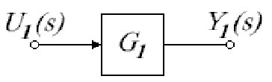
The Block Diagram
Chapter 3
Dynamic Response
Using block diagram, the system equations can be simplified graphically, which is often easier and more informative than algebraic manipulation.

Slide 4

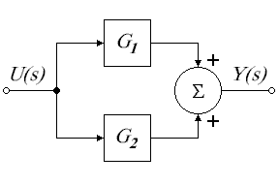
Elementary Block Diagrams
Chapter 3
Dynamic Response
Blocks in series
Blocks in parallel with their outputs added
Pickoff
point
Summing
point

Slide 5
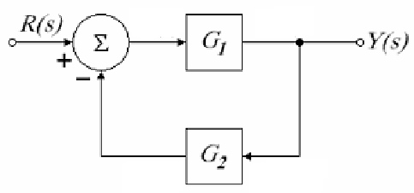
Elementary Block Diagrams
Chapter 3
Dynamic Response
Single loop
negative feedback
Negative
feedback
?
What about single loop with positive feedback?

Slide 6
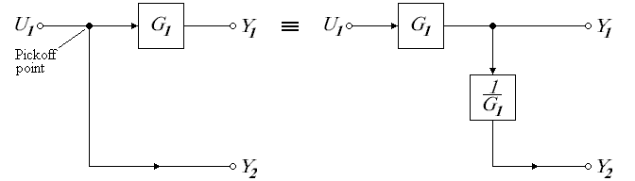
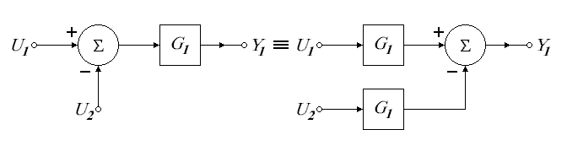
Block Diagram Algebra
Chapter 3
Dynamic Response

Slide 7
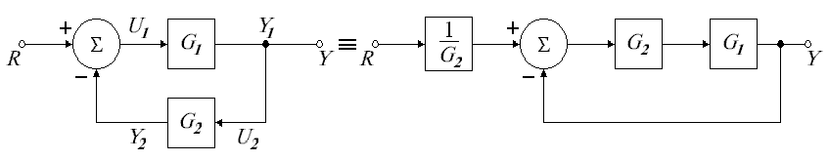
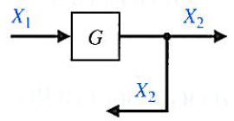
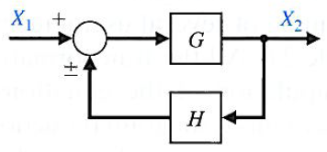
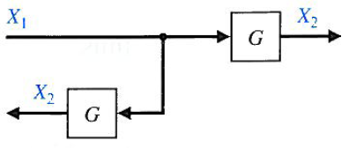
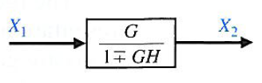
Block Diagram Algebra
Chapter 3
Dynamic Response

Slide 8
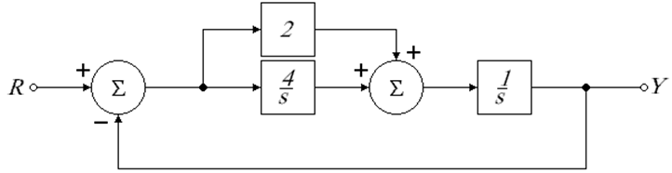
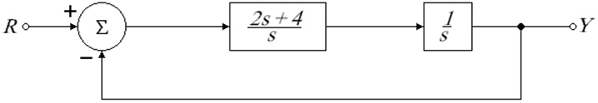
Transfer Function from Block Diagram
Chapter 3
Dynamic Response
Example:
Find the transfer function of the system shown below.

Slide 9
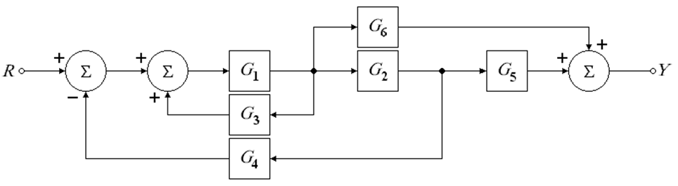
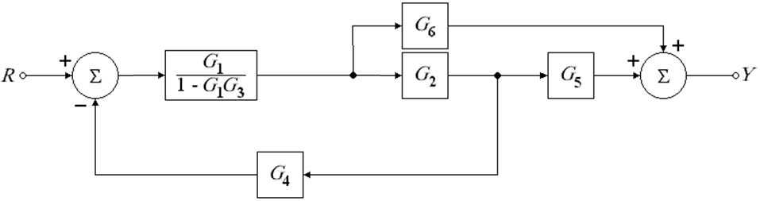
Transfer Function from Block Diagram
Chapter 3
Dynamic Response
Example:
Find the transfer function of the system shown below.

Slide 10
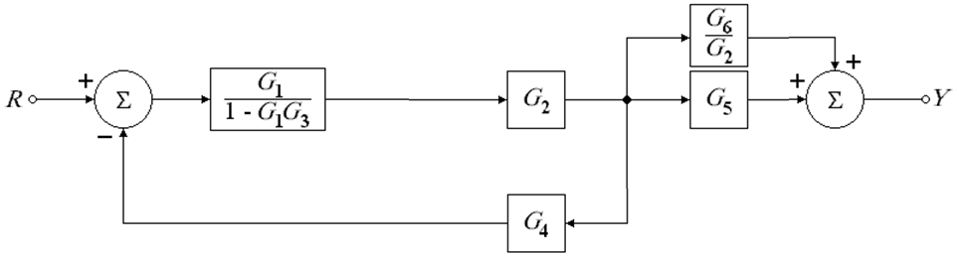
Transfer Function from Block Diagram
Chapter 3
Dynamic Response

Slide 11
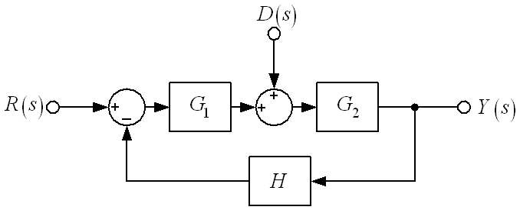
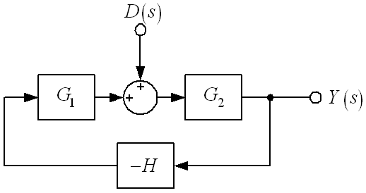
Transfer Function from Block Diagram
Chapter 3
Dynamic Response
Example:
Find the response of the system Y(s) to simultaneous application of the reference input R(s) and disturbance D(s).
When D(s) = 0,
?
When R(s) = 0,

Slide 12
Transfer Function from Block Diagram
Chapter 3
Dynamic Response

Slide 13


