Slide 1

Prepared By
Alaa Mohammed
MSc optometry
جامعة المستقبل
كلية التقنيات الصحية والطبية
قسم التقنيات البصرية
Object Spectacle
How can Write a prescription for patients
&
How can Read a prescription for patients
Lecture 9 & 10
How can write a prescription of spectacle for patients .
First point we must know the basic for the prescription of spectacle .

Slide 2
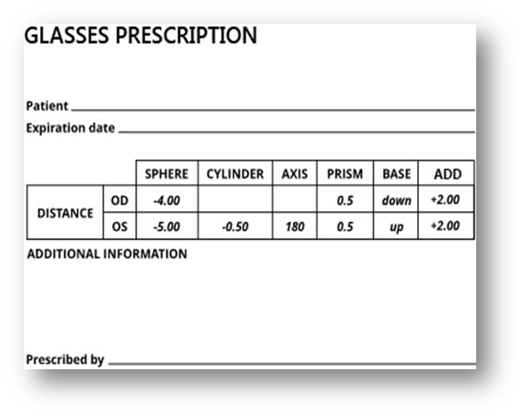
Patients information .
a.Name b. age
c. Gender e. history
2. Visit date
Day/ month / year
3. Distance corrected .
Right Eye ( RE ) = sphere _ cylinder _ axis
Left Eye ( LE ) = sphere _ cylinder _ axis
4. Near correction ( ADD )
5. I.P.D inter pupillary distance
6. Prism Diopter
7. Recommendations
8. Optometrist Signature

Slide 3
_ After take patient’s information , full name , age , gender & visit date . we should take patient’s history ( vision history ) and ask about chief complain for patient .
_ chief complain it’s important point to help patient , for example there is some his / her work for far don’t care for near and other one his / her work on near don’t care for far vision if there is a simple VA uncorrected like 6/12 .
_ After that we should know the correct vision by Spherical lens or Aspherical lens or both .
As we knew there is tow type of spherical lens , a. concave lens ( - ) b. convex lens ( + ) .
With spherical lens we right the number of diopter power with sign – or + depend on the lens.
For example -1.00 D sph , + 1.00 D sph
It mean we right the number of minus diopter for concave lens corrected .
And number of plus diopter for convex lens corrected .
.

Slide 4
_And tow type of Aspherical lens , a. cylinder with axis b. toric
cylinder lens we write number of diopter power – or + depend on the used to correct VA with the axis for corrected meridian for example -1.00 axis 110 , + 1.00 axis 70
Toric lens it mean we write spherical lens and Aspherical lens together .
For example , + 1.00 D sph / + 0.75 D cyl Axis 90
- 1.00 D sph / - 0.75 D cyl Axis 180
+1.00 D sph / - 0.75 D cyl Axis 60
- 1.00 D sph / + 0.75 D cyl Axis 120
NOTE ( Cylinder lens & Toric lens must followed its Axis ) due to theses lenses correct meridian

Slide 5
_ After complete far correction , now test near vision .
_ near vision , to see near object clear we need a good accommodation and convergence movement ,
Accommodation reduce with increase age for that almost of people need spectacle for near vision after 40 years old
And there is some people complain from near vision with normal accommodation because convergence insufficiency .
_ Who need near vision corrected ?
Presbyopia patient = patient after 40 years old .
Pre presbyopia patient = some people with hard near work need spectacle for near from 37 years old .
Pseudophakia patient = with single focal lens (IOL) .
Aphakia patient = without lens natural or artificial lens .
_ After that we should measure the ( IPD ) inter pupillary distance for far and for near we subtract 3mm from IPD
_ some patients need prism lenses for that our prescription contain prism table .

Slide 6
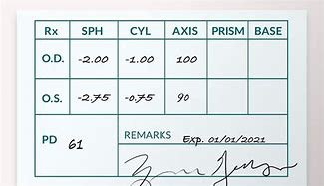
_ last thing our recommendations as patient’s order , like type of lens ,which coated on it ,type of frame and we can help the patient to choose the best of lens and frame according to patient’s job…….

Slide 7
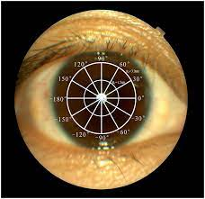
_After we know the basics for prescription for spectacle now be easy for us to write and read it .
_ we screening the refractive media of the eye like circle meridian began from 0 meridian to 180 meridian

Slide 8
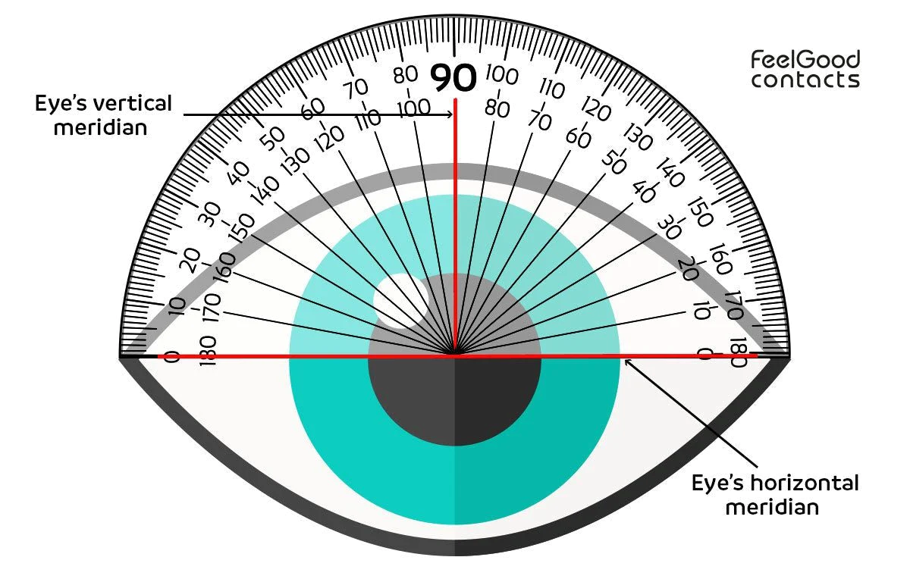
_ if all meridian neutral with same degree it mean Spherical lens , concave or convex
And if one meridian neutral with degree and other meridian with other degree it mean Aspherical lens , cylinder or toric lens .

Slide 9
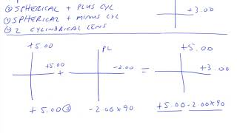
Thank you
And the best for all

