Slide 1
Epidemic , Endemic and control steps
dr.salim kareem hajwal

Slide 2
Epidemic :A clear excess in the number of cases of a given disease (over the expected level) i.e in comparison with the expected level or what is expected in a given time period .

Slide 3
Expected level can be known by comparing with previous reports , If expected number was zero and we have two cases , it means an epidemic . Iraq is free from polio then the appearance of two cases of polio means an epidemic .We usually compare with average of the previous five years .

Slide 4
Every epidemic should be reported but not every one should be investigated , a case of HIV or cholera should be reported and investigated , while 30 cases of gastroenteritis do not need investigation.

Slide 5
Endemic – Persistent, usual, or expected diseases or health-related state or event in a defined population over a given period of time
                Pandemic – Epidemic affecting a large number of people, many countries, continents, or regions

Slide 6
Endemic vs. Epidemic
No. of Cases of a Disease
Endemic
Epidemic
Time

Slide 7
Common source, propagated, and mixed epidemics
Common source
  Point
  Propagated

Slide 8
Common source
Tend to result in more cases occurring more rapidly and sooner than host-to-host epidemics
Identifying and removing exposure to the common source typically causes the epidemic to rapidly decrease.

Slide 9
Common source
Examples
  anthrax, traced to milk or meat from infected animals
  botulism, traced to soil-contaminated food.
  and cholera traced to fecal contamination of food and water

Slide 10
Point source epidemic
No. of cases
Duration

Slide 11
Propagated
Arise from infections being transmitted from one infected person to another.
Transmission can be through direct or indirect routes
Host-to-host epidemics rise and fall more slowly than common source epidemics

Slide 12
Propagated epidemic
No. of cases
Duration

Slide 13
Examples of propagated epidemics
  tuberculosis
  whooping cough
  Influenza
  measles

Slide 14
Disease transmission
Disease transmission usually occurs by
  direct, person-to-person contact (e.g., STDs)
  fomite-borne (e.g., Hepatitis A spread by a contaminated eating utensil)
  vehicle-borne (e.g., HIV/AIDS spread through needle sharing drug users)
  vector-borne transmission (e.g., Malaria spread through mosquitoes)

Slide 15
Mixed epidemics
Occurs when a common source epidemic is followed by person-to-person contact and the disease is spread as a propagated outbreak.
Example – Shigellosis occurred among a group of 3000 women attending a wedding festival. Over the next few weeks, subsequent generations of shigella cases spread by person-to-person transmission from festival attendees.

Slide 16
Concepts and principles of case as used in epidemiology
A case is a person who has been diagnosed as having a disease, disorder, injury, or condition.

Slide 17
Primary case, index case
The first disease case in the population is the primary case.
The first disease case brought to the attention of the epidemiologist is the index case.
The index case is not always the primary case.

Slide 18
Secondary case
Those persons who become infected and ill once a disease has been introduced into a population and who became infected from contact with the primary case.

Slide 19
Different levels of diagnosis
Suspect
Probable
Confirmed

Slide 20
Different levels of diagnosis
As more information (such as laboratory results) becomes available to the physician or to the nurse, he or she generally upgrades the diagnosis.
When all criteria are met and they meet the case definition, the case is classified as a confirmed case.

Slide 21
Suspect case
An individual or group of individuals who have all of the signs and symptoms of a disease or condition yet has not been diagnosed as having the disease, nor have the cause of the symptoms connected to a suspected pathogen (i.e., any virus, microorganism, or other substance that causes disease)

Slide 22
Triangle is based on the communicable disease mode
Shows the interaction and interdependence of agent, host, environment, and time as used in the investigation of diseases and epidemics.
  Agent is the cause of the disease
  Host is an organism, usually a human or an animal, that harbors a disease
  Environment is those surroundings and conditions external to the human or animal that cause or allow disease transmission.
  Time accounts for incubation periods, life expectancy of the host or the pathogen, and duration of the course of the illness or condition.

Slide 23
Stopping an epidemic
An epidemic can be stopped when one of the elements of the triangle is interfered with, altered, changed, or removed from existence, so that the disease no longer continues along its mode of transmission and routes of infection.

Slide 24
Steps for investigations of an epidemic :
First step :
Verify the diagnosis of an epidemic or outbreak
Determine whether there is an outbreak – an excess number of cases from what would be expected
Compare the current rate with the previous rate of the disease .

Slide 25
Second step :Establish a case definition
Non-ambiguous
Clinical / diagnostic verification
Person / place / time descriptions
Identify and count cases of illness
Put criteria for case definition ; a statement about clinical observation , Lab test , x-ray with some restriction to time, person , place.
Classify cases according to degree of severity .( mild , moderate and severe)

Slide 26
Step 3: Plot an Epidemic Curve
Graph of the number of cases (y-axis) by their date or time of onset (x-axis)
Interpreting an epidemic curve
  Overall pattern: increase, peak, decrease
    Type of epidemic?
    Incubation period?

Slide 27
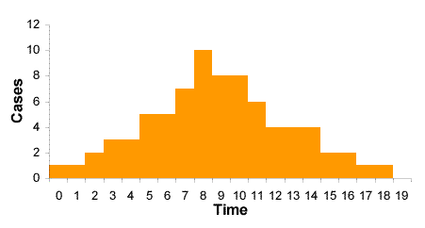
Vector-borne Disease
  Starts slowly
  Time between the first case and the peak is comparable to the incubation period.
  Slow tail

Slide 28
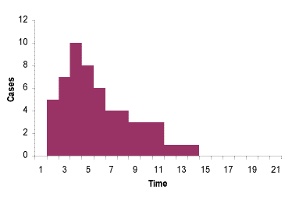
Point Source Transmission
  This is the most common form of transmission in food-borne disease, in which a large population is exposed for a short period of time.

Slide 29
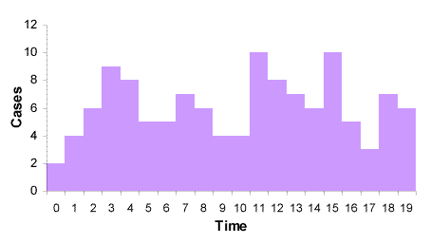
Continuing Common Source or Intermittent Exposure
  In this case, there are several peaks, and the incubation period cannot be identified.

Slide 30
Step 4 :
Calculate the attack rate :
Which is a special form of incidence rate where the duration is the period of the epidemic.

Slide 31
Step 5:
Test hypothesis , is the difference between the risk association due to chance factor or not .
Asses the attributable risk AR among exposed and non exposed persons and the relative risk RR .

Slide 32
Step 6:
1- taking sample from source (water, food soil ,blood , stool ,)
2- contact tracing which help in identifying additional cases by asking the diseased person , mothers of diseased children or relatives

Slide 33
Step 7 :
Control measures to stop the epidemic.
1-attack the source and the mode of transmissions.
2-treat and isolate all cases .
3-increase resistance of local population.
4-continue surveillance to ensure that control measures have been effective .
Step 8: Report what have been done (results and conclusion)
Step 9: recommendations to prevent and control further spread and to prevent recurrence.

Slide 34
Objectives of investigation of an epidemic :
1- to know the source of the epidemic.
2-to satisfy the people( the politics and the community leaders ) inorder to calm them.
3-to train the juniors .
4- scientific values ( scientific researches ) to discover new findings regarding the etiology or the control measures .

Slide 35
Three levels of prevention used in public health and epidemiology
Primary prevention (occurs prior to exposure)
  Immunization
  Sanitation
  Education
  Media campaigns
  Warning labels

Slide 36
Active primary prevention
Requires behavior change on part of subject
  Wearing protective devises
  Obtaining vaccinations
                Passive primary prevention
Require behavior change
  Vitamin fortified foods
  Fluoridation of public water supplies

Slide 37
Secondary prevention
Occurs to reduce the progress of disease
The disease already exists in the person
  Cancer screening – cancer already present. The goal is to detect the cancer before clinical symptoms arise in order to improve prognosis

Slide 38
Tertiary prevention
To reduce the limitation of disability from disease
The disease has already occurred
  Physical therapy for stroke victims
  Halfway houses for recovering alcoholics
  Shelter homes for the developmentally disabled
  Fitness programs for heart attack patients

Slide 39
THANKS

