Slide 1


Department of Anesthesia Techniques
Title of the lecture:- Fungi
Prof. Dr. Younis A. Alkhafaji
Younis.Abdulridha@uomus.edu.iq
Lec -11 Fungi
Fungus: is a member of a large group of eukaryotic organisms, filamentous, heterotrophs with cell walls made of chitin that includes microorganisms such as yeasts (unicellular) and molds (multicellular), as well as mushrooms. These organisms are classified as a kingdom Fungi.
Why Study Fungi?
֍ Are microorganisms can cause human disease directly or by
toxins.
֍ Can affect plants we eat.

Slide 2
Department of Anesthesia Techniques
Title of the lecture:- Fungi
Younis.Abdulridha@uomus.edu.iq
Modes of nutrition
All fungi are heterotrophs; are not able to ingest their food like animals do, nor can they manufacture their own food the way plants do. Instead, fungi feed by absorption of nutrients from the environment around them. They accomplish this by growing through and within the substrate on which they are feeding. Most fungi are saprophytes, feeding on dead or decaying material.
֍ Fungi=absorptive heterotrophs
֍ Heterotroph (chemo-organotrophs): an organism incapable of synthesizing carbohydrates from inorganic sources; requires preformed organic carbon source for growth.
The body of a fungus (thallus ) consists largely of filamentous chains of cells called hyphae , some hyphae have septa (septate), some don’t (aseptate ).
The hyphae secrete digestive enzymes which break down the substrate, making it easier for the fungus to absorb the nutrients which the substrate contains.
Therefore, the natural habitat of almost all fungi is soil or water containing decaying organic matter. تحتوي مواد عضوية متفسخة

Slide 3
Department of Anesthesia Techniques
Title of the lecture:- Fungi
Younis.Abdulridha@uomus.edu.iq
General Properties of Fungi:
1- Fungus is a member of eukaryotic organisms which includes yeasts and Molds. الخمائر والعفن
2- Fungi feed by absorption of nutrients from environment. Hyphae secrets digestive enzymes which breaks down the substrate الركيزة and makes it easier for fungus to absorb the nutrients
3- Fungi vary widely in size & shape from unicellular microscopic organism to multicellular organism.
4- Spore size, shape & structure are used in the classification & identification
of fungi.
5- Hypae and other structures form mycelium.
6- Fungi reproduces sexually and asexually.
7- Fungi are classified based upon hypae, spore and reproduction.
8- Fungal infections are localized skin infections and systemic infections.
9- Mycoses are diseases caused by fungi.
10- Many are ecologically important saprophytes (consume dead and decaying matter).

Slide 4
Department of Anesthesia Techniques
Title of the lecture:- Fungi
Younis.Abdulridha@uomus.edu.iq
Basic Structures
Hypha: fundamental tube-like structural units of fungi
a- Septate: divided by cross walls.
b- Aseptate: lacking cross walls.
Mycelium : a mass of hyphae forming the vegative portion of the Fungus
a- Aerial - growing or existing in the air
b- Vegetative - absorbs nutrients
c- Fertile - bears conidia or spores for reproduction.
Spores
Sporulation & Spores - Fusion of nuclear material.

Slide 5
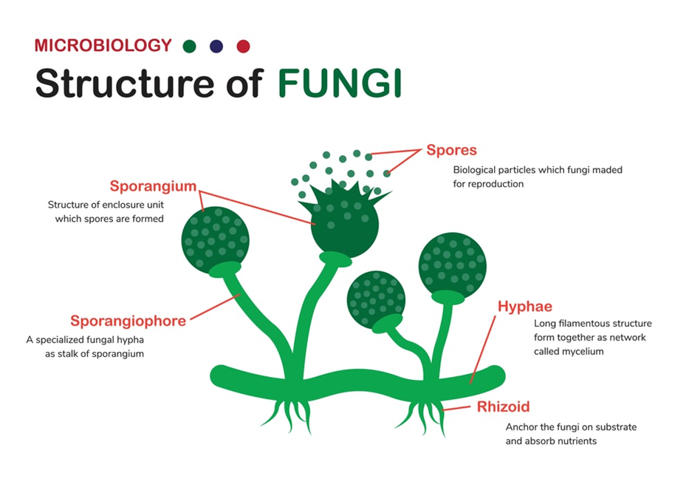
Department of Anesthesia Techniques
Title of the lecture:- Fungi
Younis.Abdulridha@uomus.edu.iq

Slide 6
Department of Anesthesia Techniques
Title of the lecture:- Fungi
Younis.Abdulridha@uomus.edu.iq
Fungi Reproduction
1- Sexual Reproduction
2- asexual Reproduction
It occurs by the following methods.
1- Fragmentation In this process, the mycelium breaks into two or more similar fragments. Each fragment grows into a new mycelium.
2- Budding The parent cell produces one or more projections called buds, which later develop necessary structures and detach to grow into new individuals. Budding is common in unicellular forms like yeast.
3- Fission In this process, the parent cell splits into two equal halves, each of which develop into a new individual. Fission is also common in yeast.

Slide 7
Department of Anesthesia Techniques
Title of the lecture:- Fungi
Younis.Abdulridha@uomus.edu.iq
SPORES
• Asexual spores
– Arthrospore
– Blastospore
– Chlamydospore
– Conidia
• Microconidia
• Macroconidia
•Sexual spores
-sexual reproduction is NOT common in fungi.
– Ascospore
– Basidiospore
– Zygospore

Slide 8
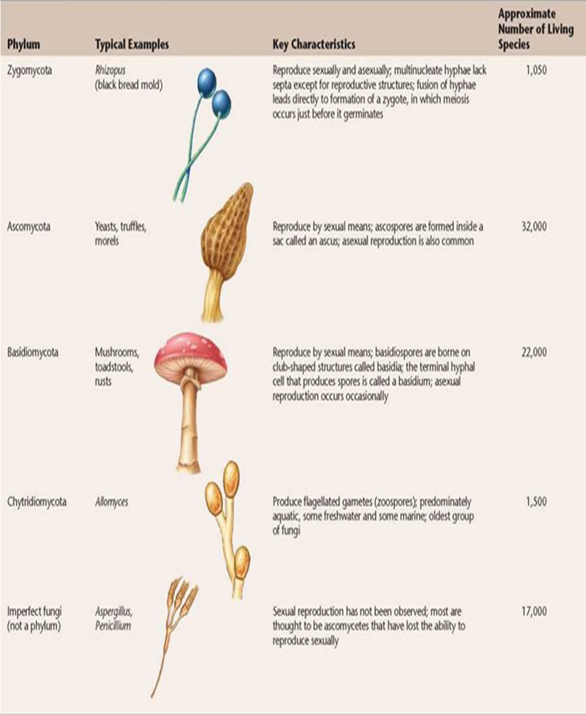

Slide 9
Department of Anesthesia Techniques
Title of the lecture:- Fungi
Younis.Abdulridha@uomus.edu.iq
Fungi form two key mutualistic symbiotic associations:
1- Lichens: A lichen is a mutualistic symbiotic association between a fungus and a photosynthetic algae or cyanobacterium.
2-Mycorrhizae: Mycorrhizae are mutualistic symbiotic associations between fungi and the roots of plants.
Classification of fungi
- Depending on Morphology
1- Yeasts
- Unicellular fungi, nonfilamentous, typically oval or spherical cells. Reproduce by mitosis:
- Yeasts are facultative anaerobes, which allows them to grow in a variety of environments. When oxygen is available, they carry out aerobic respiration, when oxygen is not available, they ferment carbohydrates to produce ethanol and carbon dioxide.

Slide 10
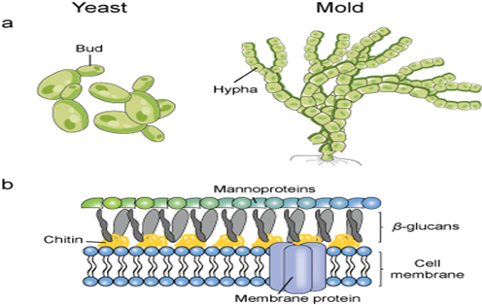
Department of Anesthesia Techniques
Title of the lecture:- Fungi
Younis.Abdulridha@uomus.edu.iq
2- Molds
The molds form large multicellular aggregates of long branching
filaments, called hyphae. There are vegetative hyphae and reproductive hyphae. Spores are borne on the reproductive hyphae. Spore size, shape and structure are used in the classification and identification of fungi

Slide 11
Department of Anesthesia Techniques
Title of the lecture:- Fungi
Younis.Abdulridha@uomus.edu.iq
3- Yeast like fungi
Grow partly as yeasts and partly as elongated cells resembling hyphae which are called pseudo hyphae . e.g. Candida albicans
4- Dimorphic fungi
Most fungi causing systemic infections are dimorphic:
֎Dimorphism in pathogenic fungi typically depends on temperature:
֎At 37ᴼC: Yeast form.
֎At 25ᴼC: Mold form.
Dimorphism in nonpathogenic fungi may depend on other factors: Carbon dioxide concentration.

Slide 12
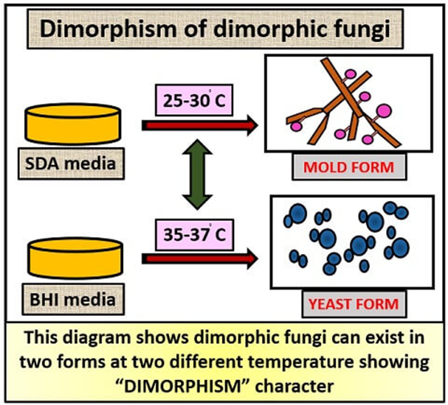
Department of Anesthesia Techniques
Title of the lecture:- Fungi
Younis.Abdulridha@uomus.edu.iq

