Slide 1


Department of Anesthesia Techniques
Prof. Dr. Younis A. Alkhafaji
Lect. 5 : Histology
Is the study of the tissues of the body and how these tissues are arranged to constitute organs..
Tissues are aggregates or groups of cells organized to perform one or more specific functions Tissues are made of two interacting components: cells and extracellular matrix (ECM). The ECM consists of many kinds of molecules, most of which form complex structures, such as collagen fibrils and basement membranes
The functions of ECM
Supports for the cells
Transporting nutrients to the cells
Carrying away their wastes and secretory products.

Slide 2
The human body consists of Four basic types of tissue:
Epithelial tissue connective tissue
Muscular tissue
Nervous tissue
Epithelial tissues are thin tissues that covers a body surface or lines a body cavity. They form the external skin, the inner lining of the mouth, digestive tract, secretory glands, the lining of hollow parts of every organ such as the heart, lungs, eyes, ears, the urogenital tract, as well as the ventricular system of the brain and central canals of the spinal cord.
Functions of epithelial tissue :
covering ,lining and Protection surface (skin) Absorption (all columnar epithelium of intestine) اSecretion (epithelia of glands) sensation (sensory cells- taste buds
contractility (often associated with glands such as sweat and mammary glands)

Slide 3
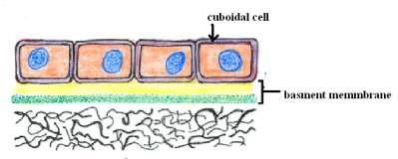

Epithelial tissues consist of two types:-
A- Covering or lining epithelial tissues
B- Glandular epithelial tissues
Classify Covering epithelial tissues covers the outer layers or lining of the organs, ---
according to the number of cells layers classified to:-
Simple epithelial tissue
Stratified epithelial tissue
**Simple epithelial tissue :-composed of only one layer based on basement membrane
1- Simple cuboidal epithelial tissue:-
Location: secretory ducts of small glands, kidney tubules
Function: allows secretion and absorption

Slide 4

2- Simple squamous epithelial tissue:-
Location: blood and lymphatic vessels being called endothelium
Lining the abdominal and plural cavities called mesothelium.
Function: secrets lubricating substance, allows diffusion and filtration
3- Simple columnar epithelial tissue :-
Location: bronchi, uterine tubes, uterus called ciliated columnar ; and cover digestive tract, called non ciliated columnar epithelium
Function: allows absorption, secretes mucous and enzymes

Slide 5
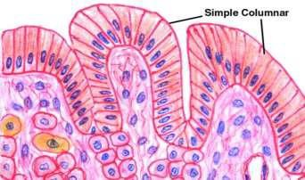

4 -Pseudostratified columnar epithelial tissue:- are tissues formed by a single layer of cells that give the appearance of being made from multiple layers, especially when seen in cross section. Several layers of nuclei suggest several layers of cells but in fact all cells are in contact with underlining extracellular matrix and show several layer of nuclei , composed of four types of cell.
Location: trachea and most of the upper respiratory tract (ciliated cells
Function: secretes mucus which is moved with cilia

Slide 6
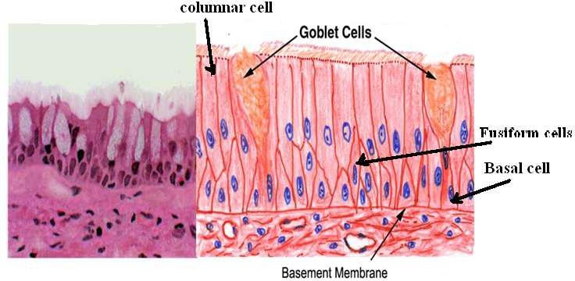
**Stratified epithelial tissue :- Composed of more than one layer based on basement membrane. classified to :-
1 - Stratified squamous epithelial tissue
There are two types of stratified squamous epithelial tissue:
***Non keratinized squamous epithelial tissue which is covering moist cavities such as mouth , esophagus , pharynx
***Keratinized squamous epithelial tissue found on exposed surface of the body such as the skin

Slide 7
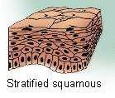

2- Stratified cuboidal epithelial tissue :- found in the large excretory ducts in the salivary glands and pancreas .
3 – Stratified columnar epithelial tissue
Is found in the fornix of conjunctiva ( قبو الملتحمة)while the ciliated Stratified columnar epithelial tissue is found in the larynx
2- Stratified cuboidal epithelial tissue :- found in the large excretory ducts in the salivary glands and pancreas .
3 – Stratified columnar epithelial tissue
Is found in the fornix of conjunctiva ( قبو الملتحمة)while the ciliated Stratified columnar epithelial tissue is found in the larynx

Slide 8
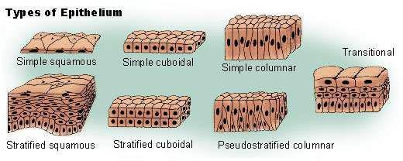
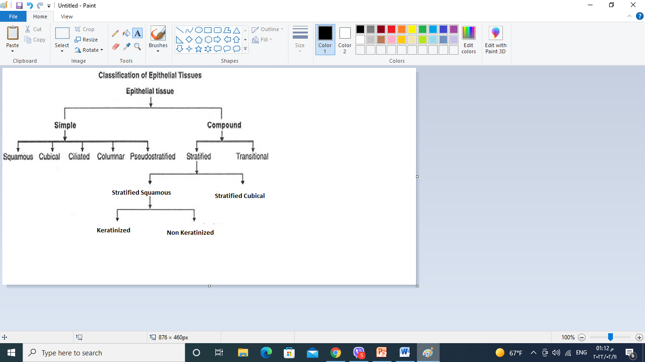
Stratified columnar
4 - Transitional epithelial tissue
Is found exclusively in the passages of the urinary system .

Slide 9
Glandular tissue :
Cells or parenchyma of the glands developed from epithelial tissue, according to the methods of secreted products of gland the glandular epithelial tissues classified to:
Exocrine glands(excrete their product into ducts )like skin
Endocrine glands(secret their products direct into circulatory system)
Mixed glands (like pancreas)

Slide 10
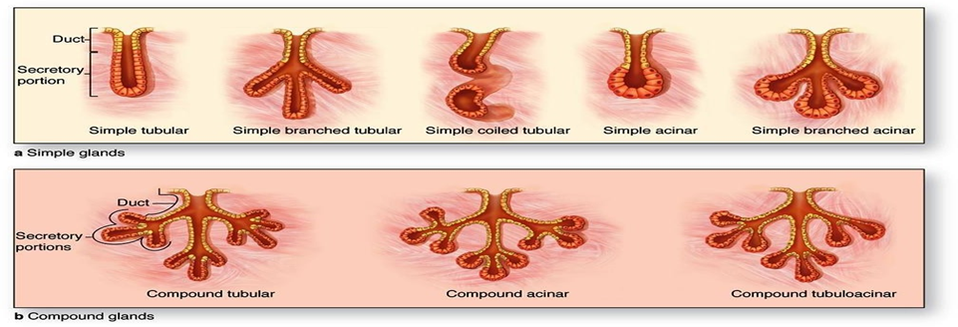
A- Exocrine gland: have a secretory portion, which contains the cells, specialized for secretion and ducts, which transport the secretion out of the gland.
According to the structure of the ducts
Simple (unbranched).
Compound (two or more branched).
According to the structure of secretory portion
Tubular (either short or long and coiled )
Acinar (round or globular).

Slide 11
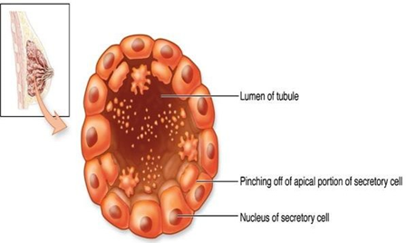
According to the way the secretory products leave the cell
Apocrine: the secretory products is typically a large lipid droplet and is discharged together with some of the apical cytoplasm.(السايتوبلازم القمي (
Example: Mammary glands

Slide 12
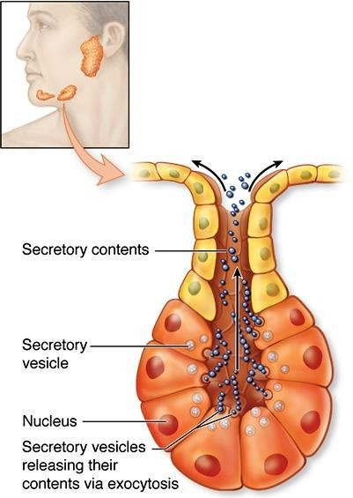
Merocrine ( Eccrine): secrete product usually containing proteins by means of exocytosis at the apical end of the secretory cells.
Example; (salivary glands)

Slide 13
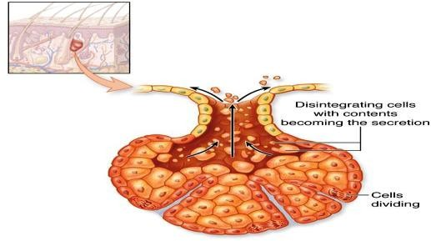
Holocrine: the cell filling with secretory product and then the whole cell being disrupted and shed .Example: Sebaceous glands of skin.

Slide 14
B. Endocrine Glands
Endocrine glands have not any ducts
Their specific products – hormones are released directly into the bloodstream.
The major endocrine glands include
Pituitary, Hypothalamus thyroid, Parathyroid, Adrenal, Pancreas,
Ovary (females), Testis (males)

