Slide 1


Department of Anesthesia Techniques
Title of the lecture:- Bacteria
Prof. Dr. Younis A. Alkhafaji
Younis.Abdulridha@mustaqbal-college.edu.iq
Microbiology is the study of microorganisms, a large and diverse group of microscopic organisms that exist as single cells or colony.
Microorganisms are group of microscopic life forms that include bacteria, viruses and unicellular eukaryotes like some fungi.
֍ Microorganisms are present in vast numbers everywhere on the bodies of animals and humans, on plant surfaces, in the air, food, water, dust, soil, and even inside the intestinal canal of all insects, birds, animals and human beings.
֍ Microorganisms are harmful include the agents of human infectious diseases: bacteria, fungi, protozoa, helminthes, and viruses. Others benefit by association with biological activity of the host.

Slide 2
Bacteria
Bacteria are a large group of microscopic organism, occur almost everywhere.
They have a simple internal structure, including capsule, cell wall, DNA, flagellum, pili, cytoplasm, and ribosomes.
• are unicellular
• have both DNA and RNA
• Prokaryotic cells
• 70s ribosomes
• No mitochondria
• Some have capsule
• Have cell wall
• Some are motile (flagellum, pili)
• Replicate by binary fission.
• Vary in sizes, measure approximately 0.1 to 10.0 μm.
• Some bacteria can cause diseases for human, animals and plants.
• Widely distributed. It can be found in soil, air, water, and living bodies.
• Some bacteria are harmless (i.e. live in human bodies as normal flora).

Slide 3
Department of Anesthesia Techniques
Title of the lecture:- Bacteria
Prof. Dr. Prof. Dr.Younis A. Alkhafaji
Prokaryotic cell structure
Shape
  Cocci – round
  Bacilli – rods
  Spirochetes – spiral shaped
  Pleomorphic – bacteria that have many different shapes (like jello – spreads out in different shapes)
  The shape is determined by the rigidity of the cell wall

Slide 4
Arrangement
• Pairs – Diplo
• Chains – Strepto
• Grape cluster – Staphylo
• Arrangement is determined by degree of attachment at time of cell division. E.g. cocci, diplococci, streptococci, staphylococci .
Size
֍ Range from 0.2 ~ 5 µm.
֍ The smallest bacteria, Mycoplasma, are about the same size as the largest virus (Pox).
֍A largest bacterium is Bacillus anthracis .
Cell shape is generally characteristic of a given bacterial species, but can vary depending on growth conditions.

Slide 5
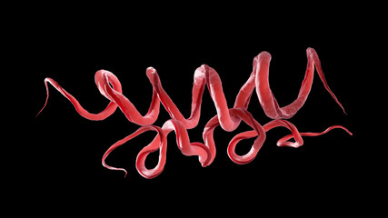
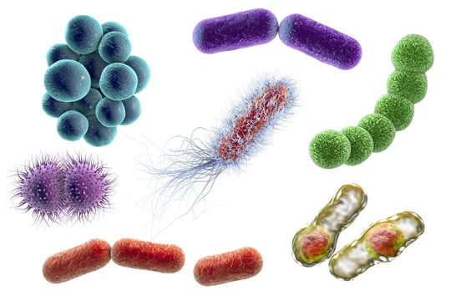
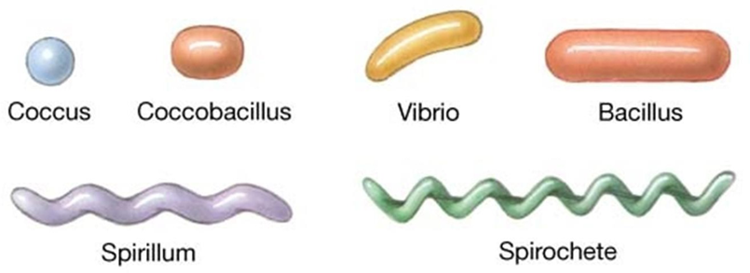
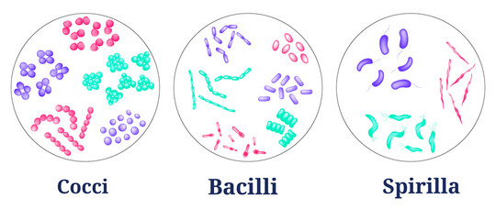

Slide 6
Department of Anesthesia Techniques
Title of the lecture:- Bacteria
Prof. Dr.Younis A. Alkhafaji
Structurally, a bacterial cell has three architectural regions:
Appendages (attachments to the cell surface) in the form of flagella and pili (or fimbriae).
Cell envelope consisting of a capsule, cell wall and plasma membrane.
Cytoplasmic region that contains the cell chromosome (DNA) and ribosomes and various sorts of inclusions.
Bacterial motility
The ability of an organism to move by itself is called motility. *
* Prokaryotes move by means of propeller-like flagella.
*Almost all spiral bacteria and about half of the bacilli are motile, whereas essentially none of the cocci are motile.

Slide 7
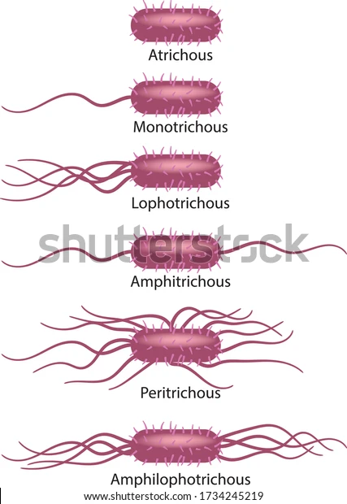
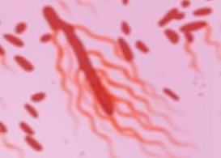
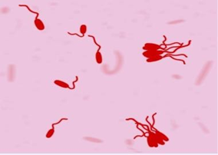
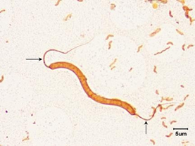
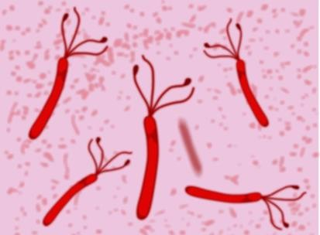
Site of flagella
1-Peritrichous 2- Monotrichous
3- Amphitrichous 4.Lophotrichous

Slide 8
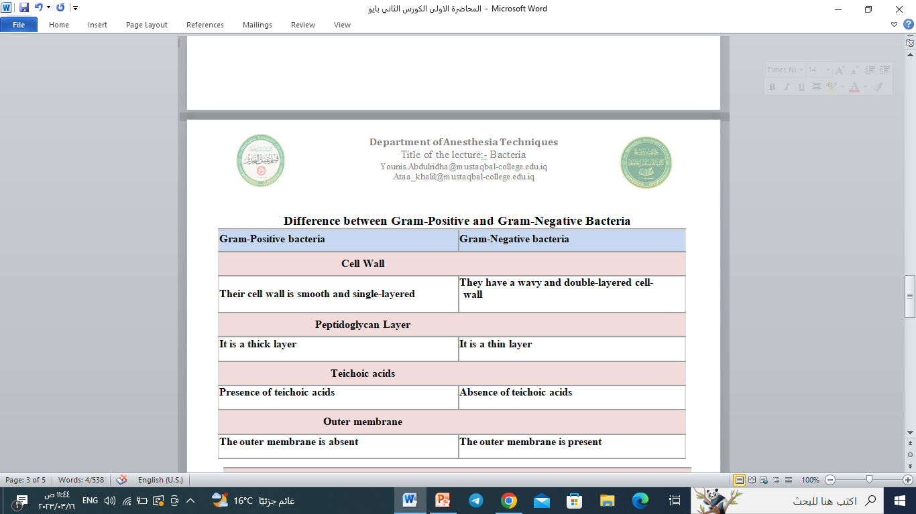
Difference between Gram-Positive and Gram-Negative Bacteria

Slide 9
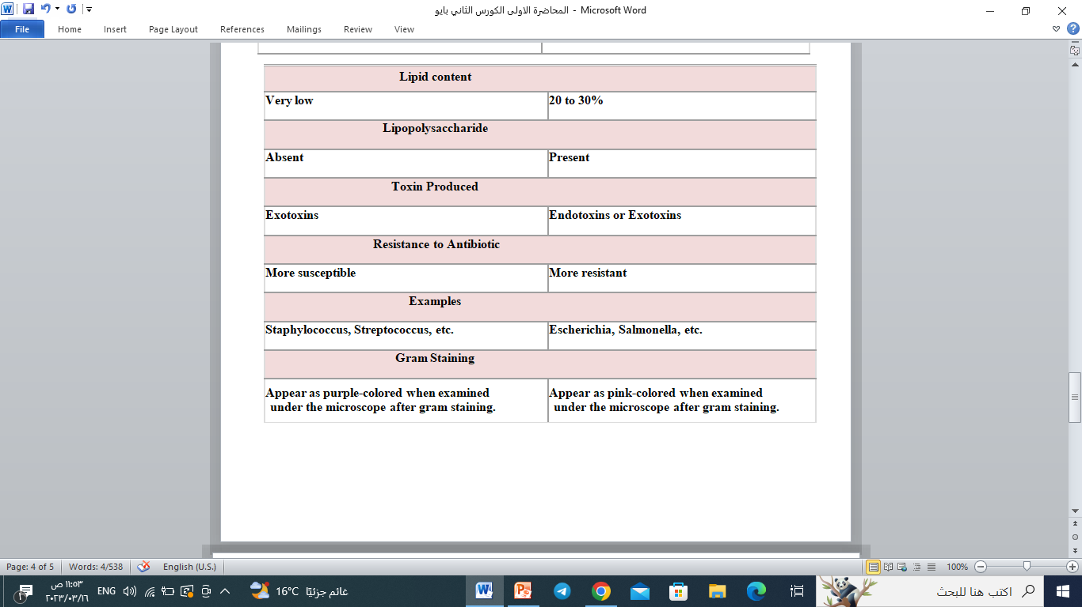
Ontain:

Slide 10
