Slide 1
The partograph is a record for monitoring maternal and foetal wellbeing during the active phase of labour, and a decision-making aid should be taken when abnormalities are detected. It is designed to be used at any level of care.
Its central feature is a graph used to record all observations made when the woman is in labor.
Partograph

Slide 2

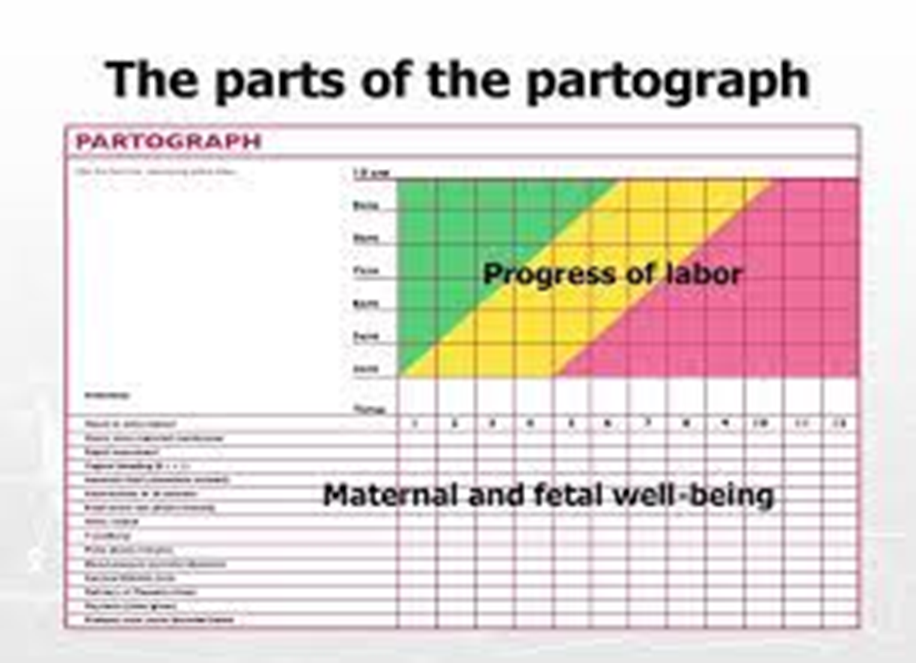

Slide 3
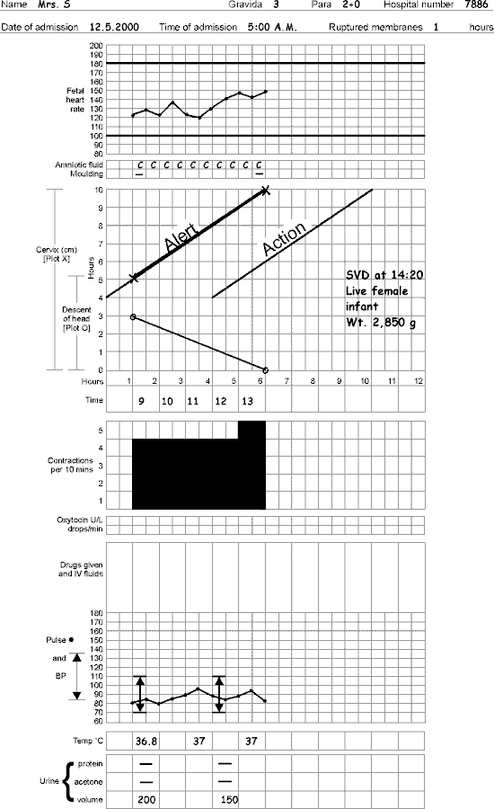

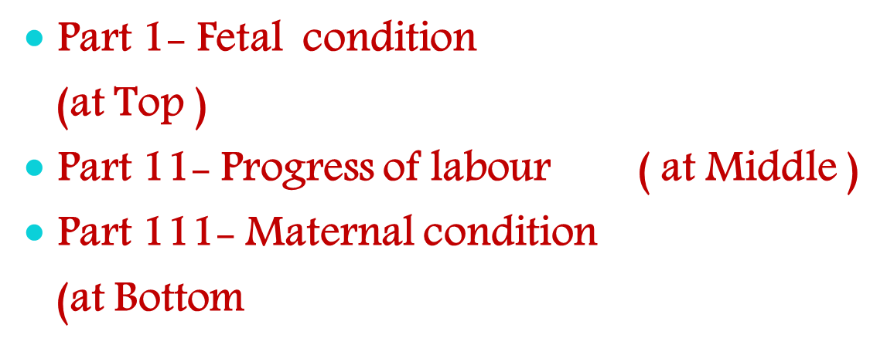

Slide 4

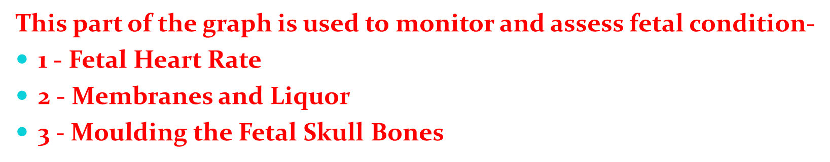
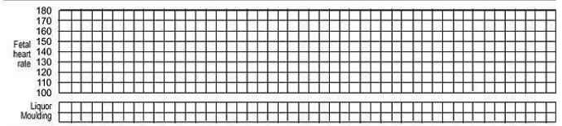

Slide 5

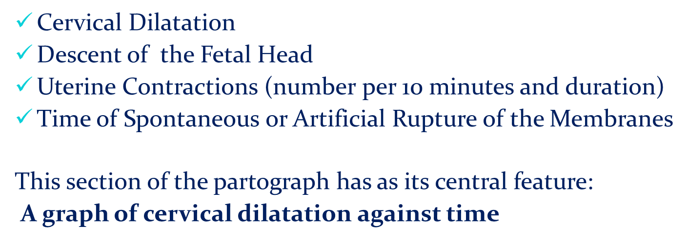

Slide 6

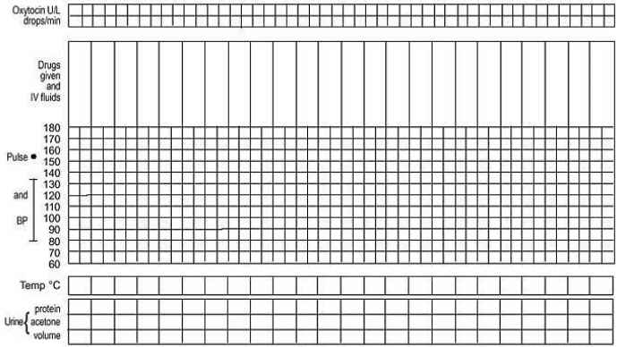
Assess maternal condition regularly by monitoring :
Drugs , IV fluids , and oxytocin , if labour is augmented
Pulse , blood pressure
Temperature
Urine volume , analysis for protein and acetone

Slide 7
Part 111: Maternal Condition (at the bottom) - Name, age, date, time of admission, and diagnosis (parity, Gravida). - Assess maternal condition regularly by monitoring:

Slide 8
Postpartum hemorrhage
is one of the leading causes of death among
postpartum patients.
PPH refers to a blood loss of more than 500 mL
after a vaginal birth and more than 1000 mL after
a C-section.
Postpartum hemorrhage is categorized
as early or late.
▪Early refers to a hemorrhage occurring within the
first 24 hours after birth
▪ Late refers to a hemorrhage occurring after 24
hours

Slide 9
Nursing interventions The nurse must report a PPH immediately and -prepare for the insertion of a large-bore intravenous catheter, if one is not already present, and the administration of intravenous fluids and oxygen. A large-bore intravenous catheter is inserted to allow possible administration of blood products. -The nurse should assess continually for bleeding, changes in vital signs, and oxygen saturation. -The patient’s legs may also be elevated. Patients and their families will need nursing support during a PPH, as it can be quite a disconcerting experience.

Slide 10
: Puerperium
The puerperium is the period of about 6 weeks, when we give special attention to the changes occurring in the mother’s body. These changes primarily include the return of the maternal organs to around pre-pregnant sizes and functions, endocrine changes as the placenta is lost, and the onset of lactation.

Slide 11
Routine Postpartum Care
The immediate postpartum period most often occurs in the hospital setting, where the majority of women remain for approximately 2 days after a vaginal delivery and 3-4 days after a cesarean delivery.
During this time, women are recovering from their delivery and are beginning to care for the newborn.
This period is used to make sure the mother is stable and to educate her in the care of her baby (especially the first-time mother).
While still in the hospital, the mother is monitored for blood loss,
signs of infection, abnormal blood pressure,
contraction of the uterus,
and ability to void.
There is also attention to Rh compatibility, maternal immunization statuses and breastfeeding.

Slide 12
Vaginal delivery
After a vaginal delivery, most women experience swelling of the perineum and consequent pain.
This is intensified if the woman has had an episiotomy or a laceration. Routine care of this area includes ice applied to the perineum to reduce the swelling and to help with pain relief.
. Pain medications are helpful both systemically as nonsteroidal anti-inflammatory drugs (NSAIDs) or narcotics and as local anesthetic spray to the perineum.
Hemorrhoids are another postpartum issue likely to affect women who have vaginal deliveries.
Symptomatic relief is the best treatment during this immediate postpartum period because hemorrhoids often resolve as the perineum recovers.
This can be achieved by the use of corticosteroid creams,

Slide 13
and local anesthetics in addition to a bowel regimen that avoids constipation.
This often takes longer for the woman who has had an episiotomy or a laceration than for one who has not.
The vagina and perineum should first be fully healed, which takes several weeks. .

Slide 14
Lochia removes waste
The puerperal uterine contractions also help in the expulsion of blood, membranes and vernix from the uterine cavity, in a vaginal discharge known as lochia.²
The red colored discharge (lochia rubra) typically lasts 3–5 days.
The discharge then becomes thinner and browner, as blood contributes less to it, (lochia serosa) and by around day 10
is followed by a yellow to white discharge, composed of leukocytes and mucus but possibly also fat and cholesterol (lochia alba).
The amount of lochia has been shown to be reduced in women who delivered smaller babies, had a cesarean section, and those who were not first time mothers.³
Green discolouration and malodorous lochia can be a sign of infection.

Slide 16
Care during puerperium :
Diet: lots of fluid, easy to digest diet (milk, green leafy vegetables, fresh fruits).
Care of breasts.
Care of bowel & bladder: encouraged to pass urine frequently, having more roughage, fluids in diet corrects constipation.
Care of perineum: kept clean, dry after every act of urination / defecation

Slide 17
Nursing interventions
The nurse must report a PPH immediately
prepare for the insertion of a large-bore intravenous
catheter, if one is not already present, and the
administration of intravenous fluids and oxygen.
A large-bore intravenous catheter is inserted to

Slide 18
allow possible administration of blood products.
The nurse should assess continually for bleeding,
changes in vital signs, and oxygen saturation.
The patient’s legs may also be elevated.
Patients and their families will need nursing support
during a PPH, as it can be quite a disconcerting experience

Slide 19

a surgical cut made at the opening of the vagina during childbirth, to aid a difficult delivery and prevent rupture of tissues
Episiotomy can be classified into four types:

Slide 20


Mediolateral: The incision is made to the right or left side from the midpoint of the fourchette
J-shaped:The incision begins in the center of the fourchette (a thin fold of skin at the back of the vulva) and is directed posteriorly along the midline

Slide 21
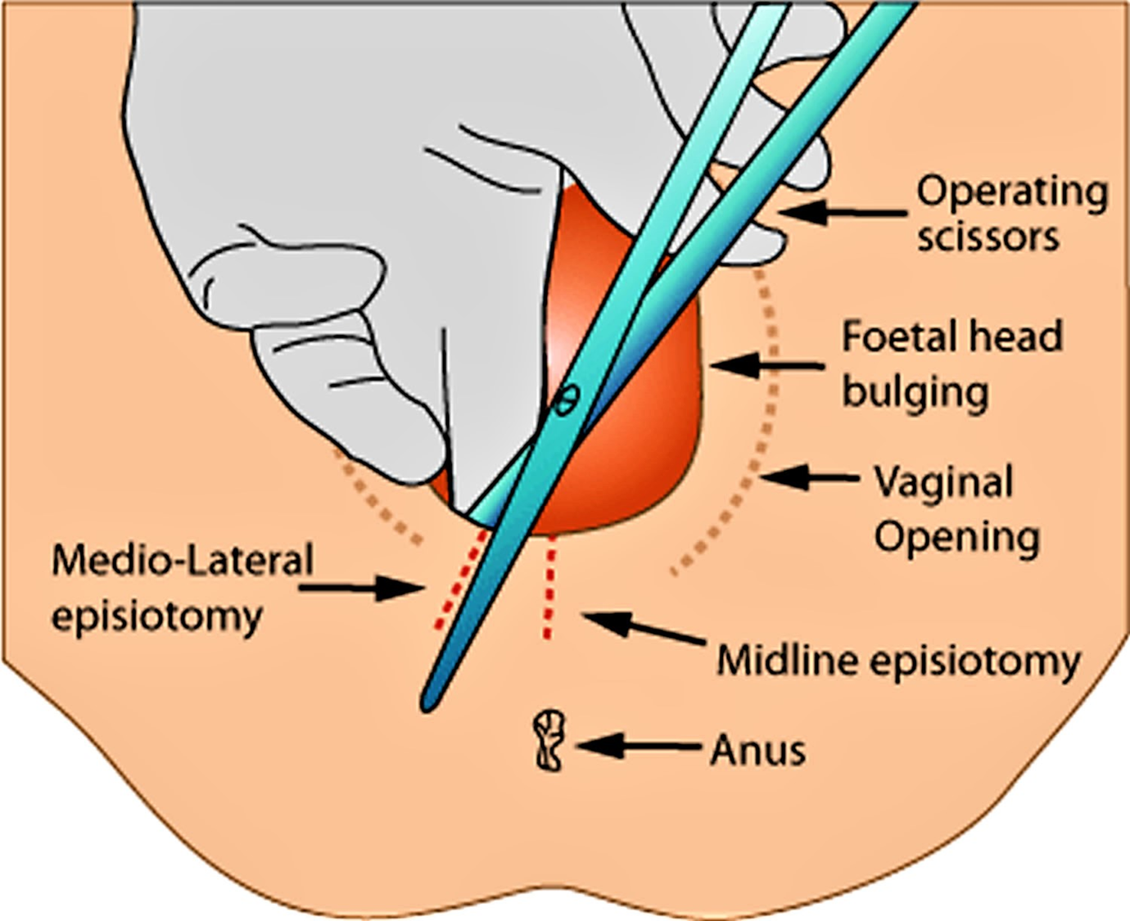

Slide 22
Tears of the perineum and vagina are classified as follows
First degree: involving the fourchette, perineal skin and vaginal mucous membrane, but not the underlying fascia and muscle;
Second degree: involving the perineal muscles and skin but not involving the anal sphincter;
Third degree: injury to the anal sphincter
Fourth degree: injury extends through the anal sphincter complex (external anal sphincter and internal anal sphincter) to ano-rectal epithelium epithelium

Slide 23
What is the management of episiotomy?
After an episiotomy, you may have pain at the incision site. An ice pack may help reduce swelling and pain. Warm or cold shallow baths may ease speed healing. Medicated creams or local numbing sprays may also be helpful. may take a pain reliever as recommended by doctor
. Most episiotomies heal in 3 weeks.

Slide 24
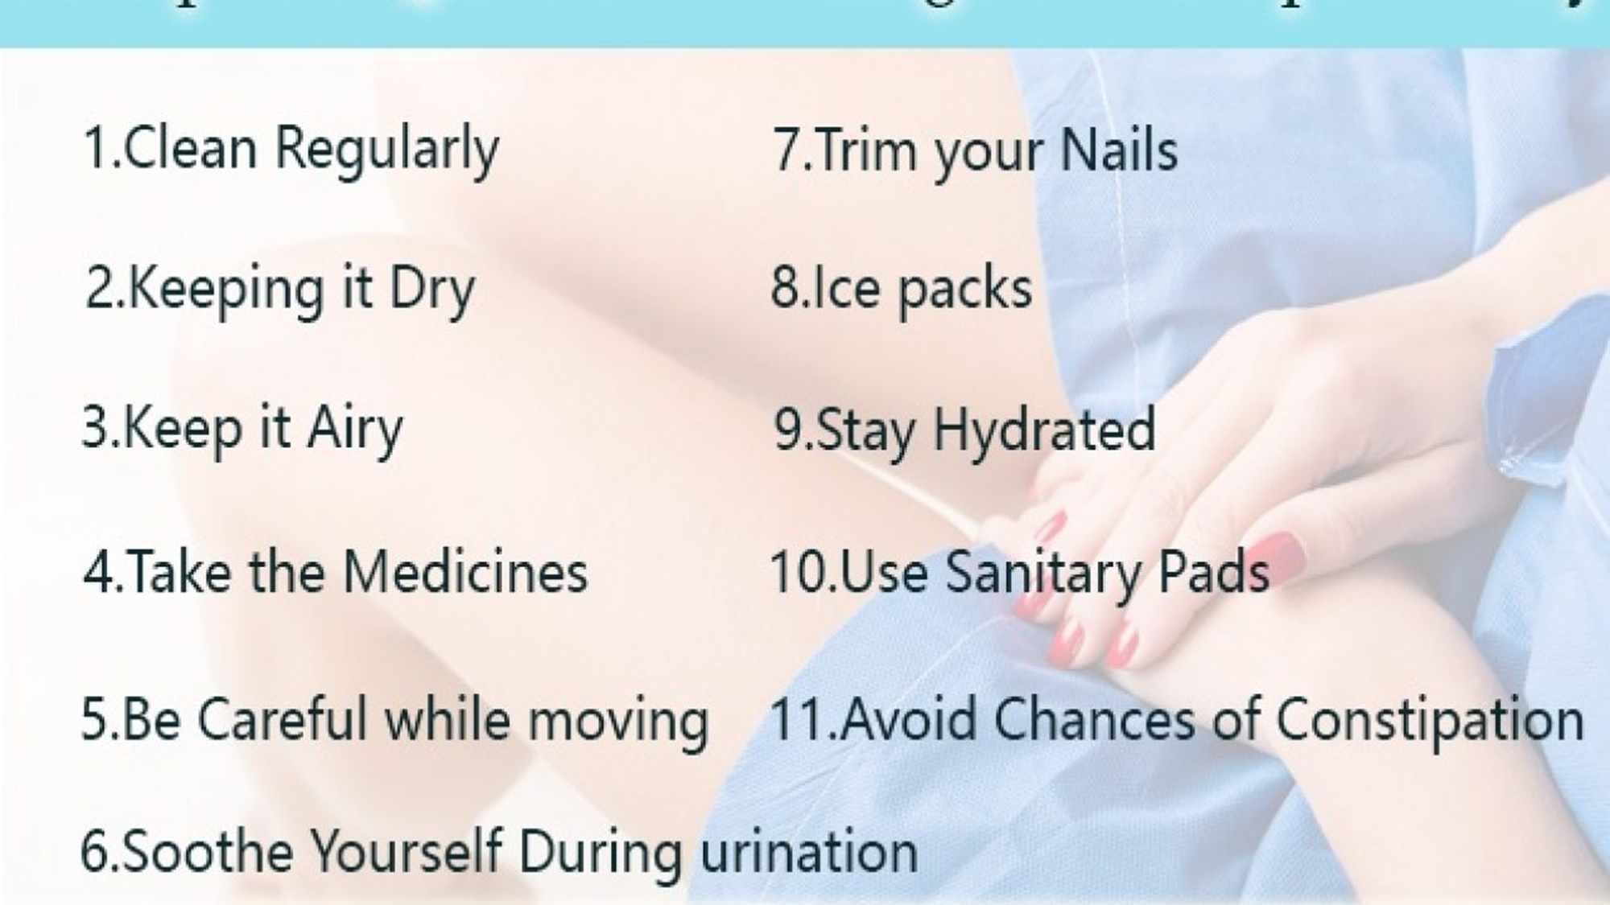

Slide 25
Induction and Augmentation of labor
What is the difference between induction and augmentation of labor?
. Labor induction is the process of starting labor before it begins on its own. Augmentation of labor is when labor is already in progress, but needs a little help to move along.

Slide 26
Augmentation of labor
Definition- Stimulating the uterus during labour to increase the frequency, duration and strength of contractions.
Note- A good labour pattern is established when there are three contractions in 10 minutes, each lasting more than 40 seconds.
oxytocin infusion and amniotomy
The difference between induction and augmentation is that with augmentation, labor has already begun and is being stimulated, while induction is used to start labor.

Slide 27
How is Labor Augmentation
rupturing the membranes if the amniotic sac is still intact
oxytocin, commonly known as the brand name Pitocin, may be used
. The goal is to provide just enough oxytocin to cause about three to five contractions every 10 minutes

Slide 28
Bishop Score Calculator
The Bishop Score (also known as Pelvic Score) is the most commonly used method to rate the readiness of the cervix for induction of labor
The Bishop Score gives points to 5 measurements
effacement of the cervix
station of the fetus
consistency of the cervix
position of the cervix

Slide 29
  Nursing Care with Augmentation of Labor-
Client education and ongoing support
Noninvasive methods such as emptying the bladder, ambulation and position changes, relaxation measures, nourishment and hydration, and hydrotherapy should be attempted before initiating invasive interventions (e.g: oxytocin and aminiotomy)
Initial and ongoing monitoring of maternal and fetal response to oxytocin
  Maternal vital signs
  Maternal comfort level/coping status
  Assessment of uterine contractions
Assessment of fetal heart rate
Preparation and administration of oxytocin
Interventions to promote comfort and progress in labor

