Slide 1
Prenatal Care

Slide 2
Goals of prenatal care • • Promote the health of the mother, fetus, newborn, and family. • • Ensure a safe birth for mother and child by promoting good health habits and reducing risk factors. • • Teach health habits that may be continued after pregnancy.(diet,hygein) • Provide physical care. • • Encourage breast feeding • Prepare parents for the responsibilities of parenthood

Slide 3
● Chief Concern  Get information to confirm pregnancy: date of the last menstrual period,  had a pregnancy test.  Find the expected date of delivery as follows: • 1st day of LMP + 7 days – 3 months + 1 year. • (4,------12month)  1st day of LMP +7 days 1st day of LMP + 7 days +9months + same year (1,2,3,month)

Slide 4
Prenatal care:
The initial routine prenatal visit should occur between 6 and 8 weeks gestation.
Follow-up visits should occur at
About 4-week intervals until 28 weeks
2-week intervals from 28 to 36 weeks
Weekly thereafter until delivery
Prenatal visits may be scheduled more frequently if risk of a poor pregnancy outcome is high or less frequently if risk is very low.
Prenatal care includes
Screening for disorders
Taking measures to reduce fetal and maternal risks
Counseling

Slide 5
information about signs of early pregnancy such as nausea, vomiting, breast changes or fatigue.  Ask about danger signs of pregnancy such as bleeding, continuous headache, visual disturbances, or swelling of the hands and face.  Ask if the pregnancy was planned.

Slide 6
CLINICAL CALCULATOR:
Pregnancy Gestation by LMP and Ultrasound Biometry
History
During the initial visit, clinicians should obtain a full medical history, including
Previous and current disorders
Drug use (therapeutic, social, and illicit)
Risk factors for complications of pregnancy .
Obstetric history, with the outcome of all previous pregnancies, including maternal and fetal complications (eg, gestational diabetes, preeclampsia, congenital malformations, stillbirth)
Family history should include all chronic disorders in family members to identify possible hereditary disorders .

Slide 7
3- History of the Past Illness • Ask about diseases that can pose potential difficulty during pregnancy such as kidney diseases, heart diseases, rheumatic fever, sexually transmitted disease, diabetes, or asthma. • Ask about any allergies,  Ask bout any past surgical procedure

Slide 8
Gravidity and parity
Gravidity is the number of confirmed pregnancies; a pregnant woman is a gravida.
Parity is the number of deliveries after 20 weeks.
Multifetal pregnancy is counted as one in terms of gravidity and parity.
Abortus is the number of pregnancy losses (abortions) before 20 weeks regardless of cause (eg, spontaneous, therapeutic, or elective abortion; ectopic pregnancy). Sum of parity and abortus equals gravidity.

Slide 9
Parity is often recorded as 4 numbers:
Number of term deliveries (after 37 weeks)
Number of premature deliveries (> 20 and < 37 weeks)
Number of abortions
Number of living children
Thus, a woman who is pregnant and has had one term delivery, one set of twins born at 32 weeks, and 2 abortions is gravida 5, para 1-1-2-3

Slide 10
4- History of Family Illness  Ask about illness that occur frequently in the family and cause potential problems in the pregnant woman or in the infant after birth, like any inherited diseases or congenital anomalies

Slide 11
7- Obstetric History  Review the previous pregnancy briefly.  previous miscarriages or abortion  blood type Rh negative, ask if she received Rh immune globulin (RhIG) after abortions or previous births.

Slide 12
Ask if she has ever had a blood transfusion.  Determine number of times she has been pregnant, including the present pregnancy (Gravida).  Determine number of children above the age of viability she has previously borne (Para).

Slide 13
● Examples: A woman who had two previous pregnancies, has given birth to two term children and is again pregnant: She is gravida 3, para 2

Slide 14
● Examples: A woman who had two previous pregnancies, has given birth to two term children and is again pregnant: She is gravida 3, para 2

Slide 15
● (GTPAL or GTPALM) provide greater detail on a woman’s history.  By this system the gravida classification remains the same, but para is broken down as follows:  G: Gravida  T: the number of full-term infants born (born at 37 weeks or after).  P: the number of preterm infants born(borne before 37 weeks).  A: the number of spontaneous or induced abortions.  L: The number of living children.  M: Multiple pregnancies

Slide 16
Examples:  A woman who had two previous pregnancies, has given birth to two term children and is again pregnant:  gravida 3 para 2002 (GTPAL) or 320020 (GTPALM)

Slide 17
● A woman who has had two abortions at 12 weeks (under age of viability) and is again pregnant. Gravida 3 para 0020 (GTPAL) or 300200 (GTPALM)  A woman who had term twins, then one preterm infant, and is now pregnant again. Gravida 3, para 21031 (A multigestation pregnancy is considered as one para)

Slide 18
. A pregnant woman who had the following past history: a boy born at 39 week’s gestation, now alive and well; a girl born at 40 week’s gestation, now alive and well; a girl born at 33 week’s gestation, now alive and well. 421030 (GTPALM)

Slide 19
Physical Examination
A full general examination, including blood pressure (BP), height, and weight, is done first. Body mass index (BMI) should be calculated and recorded. BP and weight should be measured at each prenatal visit.
In the initial obstetric examination, speculum and bimanual pelvic examination is done for the following reasons:
To check for lesions or discharge
To note the color and consistency of the cervix
To obtain cervical samples for testing
Also, fetal heart rate and, in patients presenting later in pregnancy, lie of the fetus are assessed .

Slide 20
Pelvic capacity can be estimated clinically by evaluating various measurements with the middle finger during bimanual examination.
If the distance from the underside of the pubic symphysis to the sacral promontory is > 11.5 cm, the pelvic inlet is almost certainly adequate.
Normally, distance between the ischial spines is ≥ 9 cm, length of the sacrospinous ligaments is 4 to ≥ 5 cm, and the subpubic arch is ≥ 90°.
During subsequent visits, BP and weight assessment is important.

Slide 21
*Obstetric examination focuses on uterine size, fundal height (in cm above the symphysis pubis),
fetal heart rate and activity,
and maternal diet, weight gain,
and overall well-being.
Speculum and bimanual examination is usually not needed unless vaginal discharge or bleeding, leakage of fluid, or pain is present.

Slide 22
● Important note: if a woman voids for clean-catch urine before the exam, this can: • Reduce bladder size and make the pelvic examination more comfortable. • Provide a urine specimen for laboratory testing.

Slide 23
1- Baseline Height/ weight and vital sign Measurement • Overweight (More than 20 kg above the weight-height baseline) leads to an increased risk of gestational diabetes, pregnancy-induced hypertension and thrombo-embolic disorders.

Slide 24
• Underweight (less than 20kg below the weightheight baseline) also puts the pregnant woman at a great risk. • Vital signs including blood pressure, respiratory rate, and pulse rate, are measured.

Slide 25
Assessment of the Systems  General Appearance and Mental Status  Head and Scalp.  Face  Eyes.  Nose.  The increase level of estrogen may cause nasal congestion or the appearance of swollen nasal membranes  Ears..
As
Mouth, teeth, and throat..  Neck. Observe for enlarged thyroid gland and scars of previous operations

Slide 26
Breasts. They should gently palpate to feel any lump.  The nipples should be drawn forward to see they are protractile.  The breasts should be observed for pregnancy changes.  Heart. Heart rate ranges from 70 to 80 beats per minute.  Many women notice occasional palpitations during pregnancy.  Teach them to rest or sleep on their side (left side is best) to help avoid this problem.

Slide 27
Lungs. Vital capacity of the lungs is not reduced.  However, late in pregnancy, the diaphragm movement is lessened because the diaphragm can not descend fully as usual due to distended uterus.  Back. The lumbar curve in many pregnant women is increased on standing to maintain body posture.  This response may cause backache.

Slide 28
Rectum. Assess it closely for hemorrhoid tissue, which commonly occurs from uterine pressure on pelvic veins preventing venous return

Slide 29
Extremities and skin. Assess the lower extremities carefully for varicosities which could be predisposing to deep vein thrombosis. Legs should be noted for edema.  Any edema more than ankle swelling may be a danger sign of pregnancy.  The calf must be observed for reddened areas which may be caused by phlebitis and white areas which could be caused by deep vein thrombosis.  Ask the women to report tenderness during examination.

Slide 30
3- Abdominal Examination  A. Inspection: the nurse should look at the following:  Skin changes such as linea nigra, striae gravidarum and scars of previous operations.

Slide 31
● The shape of the abdomen is inspected for:  Fetal lie and position.  The abdomen looks longer if the fetal lie is longitudinal as occurs in 99.5% of cases.  The abdomen looks lower and broad if the fetal lie is transverse

Slide 32
● Contour of the abdominal wall is observed for pendulous abdomen, lightening, protrusion of the umbilicus  Fetal movements are inspected as evidence of fetal life and position.  The abdomen also inspected for edema.

Slide 33
B. Palpation:  Abdominal palpation includes: • Measuring the fundal height to estimate the period of gestation: - After 12th week’s gestation, the uterus is palpable over the symphysis pubis as a firm globular sphere.  It reaches the umbilicus at 20 to 22 weeks and the xiphoid at 36 weeks, and then returns to about 4 cm. below the xiphoid due to lightening at 40 weeks

Slide 34
● The fundal height may be higher than the expected due to  Large size fetus, multiple pregnancy, polyhydrammnios, or mistaken date of last menstrual period.  - The fundal height may be lower than the expected due to a small size uterus, intrauterine growth retardation, oligohydramnios or mistaken date of last menstrual period.

Slide 35
Diagnosing the fetal lie and presentation to determine whether the fetus in a vertex or breach presentation.  Determining whether the head engagement has occurred or it is still floating.

Slide 36
C. Auscultation  Fetal heart sound is heard by sonicaid (Doppler technique) as early as 10th -12th week of Pregnancy.  Fetal heart sound is heard by Pinard’s stethoscope  The normal heart rate is 120-160 beats/ minute.  Any deviation is considered one of fetal distress signs

Slide 37
- Pelvic Examination  A pelvic examination reveals information on the health of both internal and external reproductive organs. • External Genitalia. Any signs of inflammation, irritation, or infection, such as redness, ulcerations, or vaginal discharge are noted

Slide 38
Internal Genitalia. This includes:  Cervix inspection. To view the cervix, the vagina must be opened with a speculum. The cervix can be inspected for:  Position. Normally it is centered on the vagina; a retroverted uterus has a cervix positioned anteriorly, and an anteverted uterus has its cervix positioned posteriorly.  Color. A nonpregnant cervix is light pink; in pregnancy it changes to almost purple.

Slide 39
Appearance. In the nulligravida, the cervical os is round and small, while in paras’ women, the cervical os has a slit( star)like appearance.  Abnormal appearance. Carcinoma of the cervix appears as an irregular, granular growth at the os.

Slide 40
Pap Smear is taken for early detection of cervical cancer and diagnosis of precancerous conditions; it also reveals inflammatory and infectious diseases.

Slide 41
5- Estimating Pelvic Size  This estimation is performed if the pregnant woman has never given birth vaginally before.  Estimation may be made by a combination of pelvic pelvimetry and fetal sonography.  It gives the actual diameters of the inlet 12cm and outlet through which the fetus must pass.

Slide 42
- Laboratory Assessment  Blood studies:  complete blood picture (Hb has to be repeated at the 36 weeks of pregnancy, and every 4 weeks if Hb is > 9g/dl).  Screening for sickle cell anemia and thalassemia.  A serologic test for syphilis (VDRL)  Blood typing including Rh factor every visit

Slide 43
● An indirect Coombs’ test for determination if Rh antibodies are present in an Rh negative woman
Urinalysis: It is performed to test for protienuria, glycosuria,.  All can be done by strips and microscopic examination of the urine

Slide 44
Ultrasonography: It is performed when the last menstrual period is unknown, and to assess the fetal growth and wellbeing.( uss end of pregnancy 3 rd )  End of 16th Week Sex can be determined by ultrasound  End 12 Week Sex is distinguishable by outward appearance.

Slide 45
Review danger signs of pregnancy:  Vaginal bleeding.  Persistent vomiting.  Chills and fever.  Sudden escape of clear fluid from the vagina.  Abdominal or chest pain( embolism)

Slide 46
sings of pregnancy-induced hypertension (PIH). * Rapid weight gain * Swelling of the face or fingers * Flashes of light or dots before the eyes. * Dimness or blurring of vision. * Severe, continuous headache * Decreased urine output. * Increase or decrease in fetal movement.

Slide 47
B- Physical Examination • Blood pressure (every visit) • Clean-catch urine for glucose, protein, and leukocytes (every visit) • Blood serum level for alpha-fetoprotien ) (16 weeks) • VDRL test for syphilis if possibility of new exposure. • Glucose screen (28 weeks) • Glucose challenge (24 to 28 weeks) if warranted • Anti-Rh titer (28 weeks)

Slide 48
2. Fetal Health • Fetal heart rate • Fundal height • Quickening or fetal movement • Ultrasound dating of pregnancy
Promoting health during pregnancy which include: self-care are required: • Bathing. • During pregnancy, sweating tends to increase because a woman excretes waste products for herself and a fetus. • She also has an increase in vaginal discharge. For these reasons,

Slide 49
* Breast care.  - A pregnant woman has to wear a firm, supportive bra with wide straps to spread weight across the shoulders.
● - At about 16th week of pregnancy, colostrums secretion begins in the breasts.  Instruct her to wash her breasts with clear tap water (no soap, because that could be drying) daily to remove the colostrums and reduce the risk of infection.  Afterward, she should dry her nipples well by patting them.  Otherwise, constant moisture can cause nipple, pain, and fissuring.

Slide 50
* Dressing. A woman should avoid garters, extremely firm gridles with panty legs, and knee-high stockings because these may impede lower-extremity circulation.  Suggest wearing sheos with moderate to low heel to minimize ..

Slide 51
Nutrition . Severe caloric restriction during pregnancy is c ontraindicated because it is a potential hazard to the mother and fetus, especially during organogenesis.
4. Weight reduction should never be started as a regimen during pregnancy.
5. Restriction of sodium and administration of di uretics are potentially dangerous to mother an d fetus during pregnancy; They may limit interstitial fluid reserve, which m ay be needed if the blood volume decreases

Slide 52
Exercise. - Exercise during pregnancy is important to prevent circulatory stasis in the lower extremities. - It also can offer a general feeling of well-being. - The average, well-nourished pregnant women should exercise every day for 30 consecutive minutes.

Slide 53
e. Increased minerals with supplement of iron to prevent anemia. f. Iodized salt to provide needed sodium and iodine. g. Increased calcium from milk. The pregnant woman should drink 8 to 10 glass es of fluid each day vitamin D intake
b. Average weight gain should be 14.4 to 16 kg, or 25 to 35 Ib, but is individual according to needs; underweight women should gain more, overweight women should gain les s; women carrying more than one fetus should gain more than the recommended weight

Slide 54
A calorie increase of about 300 cal/day in the second trimester and more cal/day in the third trimester
9. Dietary assessment and counseling should be an important part of prenatal care for every pregnant woman; consider cultural, economic, and psycho logic needs adequate weight gain is about 4 Ib every month after an initial 3 to 4 lb gain in the first trimest er

Slide 55
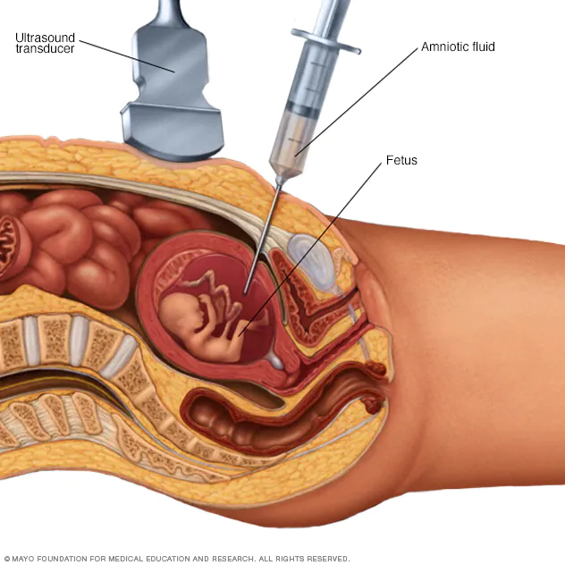
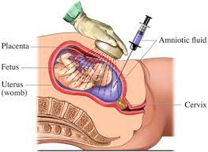
9. Chorionic villi or amniocentesis for women at high risk or 35 years or older to determine chr omosomal or other abnormalities.

Slide 56
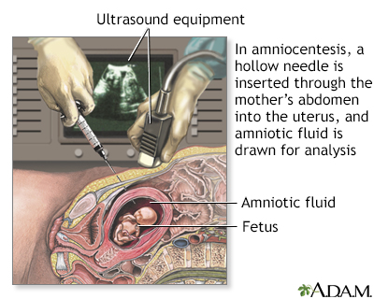
Amniocentesis
Culture - amniotic fluid; Culture - amniotic cells; Alpha-fetoprotein - amniocentesis
Amniocentesis is a test that can be done during pregnancy to look for certain problems in the developing baby. These problems include:
Birth defects
Genetic problems
Infection
Lung development

Slide 57
7. Weight monitored and compared with prepregnant levels 8. Routine sonogram scheduled to confirm gesta tional age, assess placenta, fetus, and amniotic fluid at 18 to 20 weeks.
Walking is the best exercise during pregnancy, and women should be encouraged to take a walk daily.
Sleep. - The optimal condition for body growth occurs during sleeping when growth hormone secretion is at its highest level

Slide 58
- Late in pregnancy a woman may have difficulty falling asleep due to activity of her fetus, she may also awaken with pyrosis or dyspnea if she has been lying flat (supine position). This position can cause supine hypotension syndrome (faintness, diaphoresis, and hypotension from the pressure of the expanding uterus on the inferior vena cava)

Slide 59
foramen ovale
shunt that directly connects the right and left atria and helps divert oxygenated blood from the fetal pulmonary circuit
lanugo
silk-like hairs that coat the fetus; shed later in fetal development
meconium
fetal wastes consisting of ingested amniotic fluid, cellular debris, mucus, and bile
quickening
fetal movements that are strong enough to be felt by the mother
shunt
circulatory shortcut that diverts the flow of blood from one region to another
vernix caseosa
waxy, cheese-like substance that protects the delicate fetal skin until birth

Slide 60
ductus arteriosus
shunt in the pulmonary trunk that diverts oxygenated blood back to the aorta
ductus venosus
shunt that causes oxygenated blood to bypass the fetal liver on its way to the inferior vena cava

