Slide 1

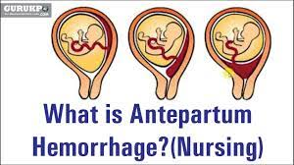
Antepartum haemorrhage

Slide 2
ETIOLOGY:
Risk factors are :
(b) advancing age of the mother
(c) poor socio-economic condition
(d) Malnutrition
(e) Smoking (vasospasm).
(f) Hypertension in pregnancy is the most important predisposing factor. Preeclampsia,
gestational hypertension and essential hypertension, all are associated with placental
abruption.
(g) Trauma:
(h) Sudden uterine decompression This may occur following— (a) delivery of the first
baby of twins (b) sudden escape of liquor amnii in hydramnios and (c) premature
rupture of membranes.
(i) Short cord
(l) Prior abruption: Risk of recurrence for a woman with previous abruption varies
between 5% and 17%

Slide 3
Antepartum haemorrhage
This is defined as vaginal bleeding from 24 weeks to delivery of the baby. The causes are
placental or local. Or is any bleeding occurring in the antenatal period after 20 weeks
gestation. It complicates 2–5 per cent of pregnancies. Most cases involve relatively small
quantities of blood loss, but they often signify that the pregnancy is at increased risk of
subsequent complications, including postpartum haemorrhage

Slide 4

Placenta previa
placenta is implanted partially or completely over the lower uterine segment (over and
adjacent to the internal os) it is called placenta previa
. The incidence in the UK
is approximately 5 per 1000
  Risk factors for placenta praevia
• Multiple gestation
• Previous Caesarean section
• Uterine structural anomaly
• Assisted conception
• The incidence is increased beyond the age of 35 years
• Smoking — causes placental hypertrophy to compensate carbon
monoxide induced hypoxemia
• Prior curettage

Slide 5
Classification of placenta previa
There are four types of placenta previa depending upon the degree of extension of placenta to
the lower segment
Type—I (Low-lying): The major part of the placenta is attached to the upper segment and
only the lower margin encroaches onto the lower segment but not up to the os.
Type—II (Marginal): The placenta reaches the margin of the internal os but does not cover
it.
Type—III (Incomplete or partial central): The placenta covers the internal os partially
(covers the internal os when closed but does not entirely do so when fully dilated).
Type—IV (Central or total): The placenta completely covers the internal os even after it is
fully dilated.

Slide 6
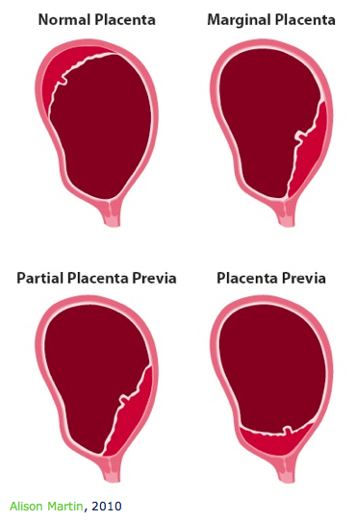

Slide 7
CAUSE OF BLEEDING: As the placental growth slows down in later months and the lower
segment progressively dilates, the inelastic placenta is sheared off the wall of the lower
segment. This leads to opening up of uteroplacental vessels and leads to an episode of
bleeding.

Slide 8
CAUSE OF BLEEDING: As the placental growth slows down in later months and the lower
segment progressively dilates, the inelastic placenta is sheared off the wall of the lower
segment. This leads to opening up of uteroplacental vessels and leads to an episode of
bleeding.

Slide 9
Clinical features
SYMPTOMS: The only symptom of placenta previa is vaginal bleeding character of
bleeding includes:
(i) sudden onset
(ii) painless
(iii) apparently causeless
(iv) recurrent
(v) unrelated to activity and often occurs during sleep
(vi) The bleeding is unassociated with pain unless labor starts simultaneously
SIGNS: General condition and anemia are proportionate to the visible blood loss

Slide 10
Abdominal examination:
1) The size of the uterus is proportionate to the period of gestation.
2) The uterus feels relaxed, soft and elastic without any localized area of tenderness.
3) Persistence of malpresentation like breech or transverse or unstable lie is more
frequent. There is also increased frequency of twin pregnancy.
4) The head is floating in contrast to the period of gestation. Persistent displacement of
the fetal head is very suggestive. The head cannot be pushed down into the pelvis.
5) Fetal heart sound is usually present, unless there is major separation of the placenta
with the patient in exsanguinated condition

Slide 11
Vaginal examination must not be done outside the operation theater in the hospital
Conformation of diagnosis
Complications of placenta previa
MATERNAL: During pregnancy—
1. Antepartum hemorrhage with varying degrees of shock
2. Malpresentation
3. Premature labor
4. Death due to massive hemorrhage during the antepartum, intrapartum or postpartum
period. Operative hazards, infection or embolism may also cause death.

Slide 12
FETAL COMPLICATIONS IN PLACENTA PREVIA - Low birth weight babies are quite common (15%)
• Asphyxia is common and it may be the effect of — (a) early separation of placenta
(b) compression of the placenta or (c) compression of the cord.
• Intrauterine death is more related to severe degree of separation of placenta, with
maternal hypovolemia and shock. Deaths are also due to cord accidents .
• Birth injuries are more common due to increased operative interference.
• Congenital malformation is three times more common in placenta previa
• Maternal and fetal morbidity and mortality from placenta previa are significantly
high.

Slide 13
What is the nursing care plan for placenta previa?
Placenta Previa Nursing Care Plans - Nurseslabs
The nursing care plan for patients with placenta previa includes close monitoring of maternal vital signs, uterine activity, and vaginal bleeding. Strict bed rest is often recommended to reduce the risk of bleeding episodes

Slide 14
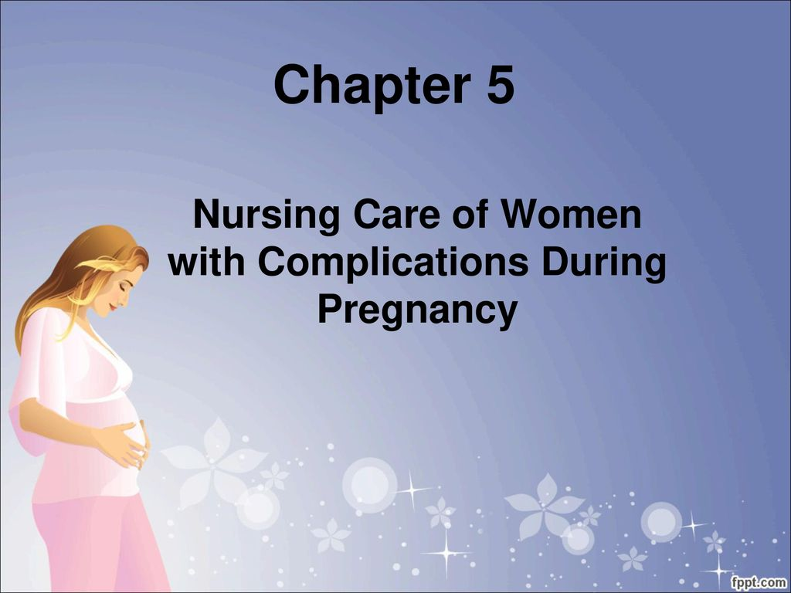

Slide 15
MANAGEMENT
ADMISSION TO HOSPITAL: All cases of APH, even if the bleeding is slight or absent by
the time the patient reaches the hospital, should be admitted. The reasons are:
(1) All the cases of APH should be regarded as due to placenta previa unless proved
otherwise.
(2) The bleeding may recur sooner or later and none can predict when it recurs and how
much she will bleed.

Slide 16
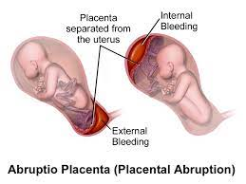
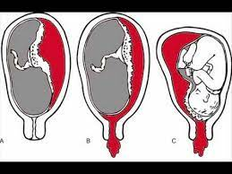
Abruption placentae
DEFINITION: It is one form of antepartum hemorrhage where the bleeding occurs due to
premature separation of normally situated placenta after 24 weeks of gestation.
Incidence and significance. The overall incidence is about 1 in 200 deliveries perinatal
mortality (15–20%) and maternal mortality (2–5%)

Slide 18
DIAGNOSIS: Mainly clinical. Ultrasonography or MRI may be helpful.
(6) Puerperal sepsis
COMPLICATIONS OF ABRUPTIO PLACENTAE
MATERNAL: In revealed type—maternal risk is proportionate to the visible blood loss and
maternal death is rare.
In concealed variety
(1) Hemorrhage
(2) Shock may be out of proportion to the blood loss.

Slide 19
(3) Blood coagulation disorders
(4) Oliguria and anuria due to—(a) hypovolemia (b) serotonin liberated from the
damaged uterine muscle producing renal ischemia and (c) acute tubular necrosis.
However, a severe case may lead to (d) cortical necrosis and renal failure.
(5) Postpartum hemorrhage due to — (a) atony of the uterus
(6) Puerperal sepsis

Slide 20
The complicating factors that are responsible for increased maternal death varies from 2% to
8%. Some cases who manage to survive may develop features of ischemic pituitary necrosis.
There is failure of lactation (Sheehan’s syndrome) later on
The major complications of placental abruption are: (a) hemorrhagic shock. (b) DIC. (c)
renal failure (see p. 706) and (d) uterine atony and postpartum hemorrhage.

Slide 21
What is the nursing care plan for placenta abruption?
Placental Abruption Nursing Care Plans - Nurseslabs
The nursing care plan and management for patients with placental abruption focus on timely recognition, assessment, and intervention. This includes monitoring vital signs, uterine contractions, and fetal heart rate, as well as assessing for signs of maternal and fetal distress

