Slide 1
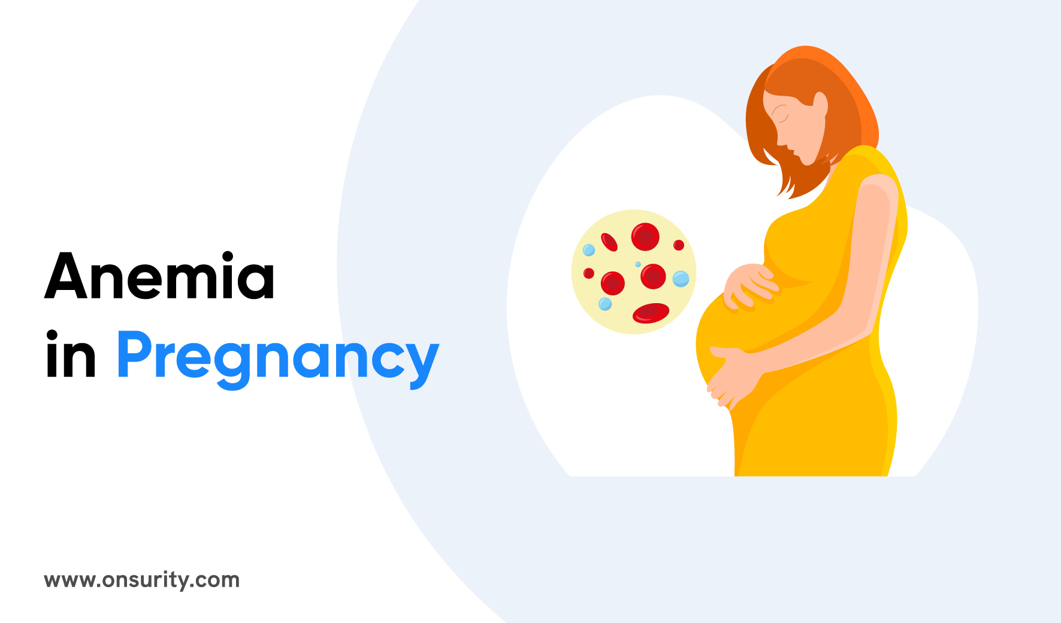

Slide 2
Who defined anaemia?
Anaemia is a condition in which the number of red blood cells or the haemoglobin concentration within them is lower than normal.
Its minimum normal value is 11 grams per deciliter in the first and third trimester of the pregnancy and 10.5 grams per deciliter in the second trimester.

Slide 3
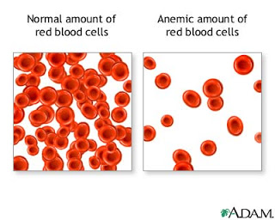
Description
Hemoglobin value of less than 11 mg/dL or hematocrit value less than 33% during the second and third trimesters
Mild anemia (hemoglobin value of 11 mg/dL) poses no threat but is an indication of a less than optimal nutritional state.
Iron deficiency anemia is the most common anemia of pregnancy, affecting 15% to 50% of pregnant women. It is identified as physiologic anemia of pregnancy

Slide 4
Types of Anemia During Pregnancy
Several types of anemia can develop during pregnancy. These include:
Iron-deficiency anemia
Folate-deficiency anemia
Vitamin B12 deficiency
Iron-deficiency anemia. This type of anemia occurs when the body doesn't have enough iron to produce adequate amounts of hemoglobin
Iron deficiency is the most common cause of anemia in pregnancy.

Slide 5
Folate-deficiency anemia. Folate is the vitamin found naturally in certain foods like green leafy vegetables A type of B vitamin, the body needs folate to produce new cells, including healthy red blood cells.
Man made supplements of folate are called folic acid.
Vitamin B12 deficiency. The body needs vitamin B12 to form healthy red blood cells. When a pregnant woman doesn't get enough vitamin B12 from their diet, their body can't produce enough healthy red blood cells. Women who don't eat meat, poultry, dairy products, and eggs have a greater risk of developing vitamin B12 deficiency, which may contribute to birth defects, such as neural tube abnormalities, and could lead to preterm labor.
Blood loss during and after delivery can also cause anemia

Slide 6
Symptoms of Anemia During Pregnancy
The most common symptoms of anemia during pregnancy are:
Pale skin, lips, and nails
Feeling tired or weak
Dizziness
Shortness of breath
Rapid heartbeat
Trouble concentrating

Slide 7
During your first prenatal appointment, you'll get a blood test so your doctor can check whether you have anemia. Blood tests typically include:
Hemoglobin test. It measures the amount of hemoglobin -- an iron-rich protein in red blood cells that carries oxygen from the lungs to tissues in the body.
Hematocrit test. It measures the percentage of red blood cells in a sample of blood.
If you have lower than normal levels of hemoglobin or hematocrit, you may have iron-deficiency anemia. Your doctor may check other blood tests to determine if you have iron deficiency or another cause for your anemia.
Even if you don't have anemia at the beginning of your pregnancy, your doctor will most likely recommend that you get another blood test to check for anemia in your second or third trimester.

Slide 8
Risk Factors for Anemia in Pregnancy
All pregnant women are at risk for becoming anemic. That's because they need more iron and folic acid than usual. But the risk is higher if you:
Are pregnant with multiples (more than one child)
Have had two pregnancies close together
Vomit a lot because of morning sickness
Are a pregnant teenager
Don't eat enough foods that are rich in iron
Had anemia before you became pregnant

Slide 9
Severe or untreated iron-deficiency anemia during pregnancy can increase your risk of having:
A preterm or low-birth-weight baby
A blood transfusion (if you lose a significant amount of blood during delivery)
Postpartum depression
A baby with anemia
A child with developmental delays

Slide 10
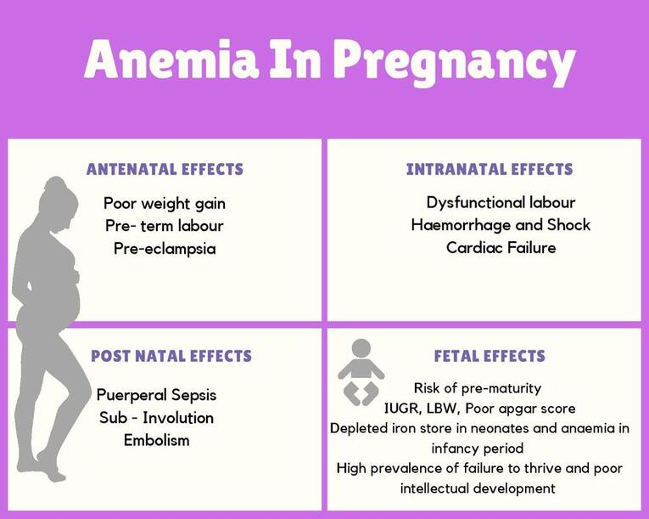

Slide 11
Untreated folate deficiency can increase your risk of having a:
Preterm or low-birth-weight baby
Baby with a serious birth defect of the spine or brain (neural tube defects)
Untreated vitamin B12 deficiency can also raise your risk of having a baby with neural tube defects.

Slide 12
Treatment for Anemia
If you are anemic during your pregnancy, you may need to start taking an iron supplement and/or folic acid supplement in addition to your prenatal vitamins. Your doctor may also suggest that you add more foods that are high in iron and folic acid to your diet.
In addition, you'll be asked to return for another blood test after a specific period of time so your doctor can check that your hemoglobin and hematocrit levels are improving.
To treat vitamin B12 deficiency, your doctor may recommend that you take a vitamin B12 supplement.
The doctor may also recommend that you include more animal foods in your diet, such as:
meat
eggs

Slide 13
Guidelines for Iron Intake ​for Pregnant Women | Iron Per Day ​(2nd and 3rd Trimesters) | Folic Acid Per Day
World Health Organisation (WHO) | 60 mg | 400 mcg

Slide 14
Prevention
Many types of anemia can't be prevented. But you can avoid iron deficiency anemia and vitamin deficiency anemias by eating a diet that includes a variety of vitamins and minerals, including:
Iron. Iron-rich foods include beef and other meats, beans,,, dark green leafy vegetables and dried fruit.
Folate. This nutrient, and its synthetic form folic acid, can be found in fruits and fruit juices, dark green leafy vegetables, green peas, kidney beans,, grain products,الحنطهsuch as bread, cereal, pasta and rice.
Vitamin B-12. Foods rich in vitamin B-12 include meat, dairy products and soy products.
Vitamin C. Foods rich in vitamin C include citrus fruitsالحمضيات and juices, peppers, broccoli, tomatoes, melons الطيج and strawberries. These also help increase iron absorptio

Slide 15
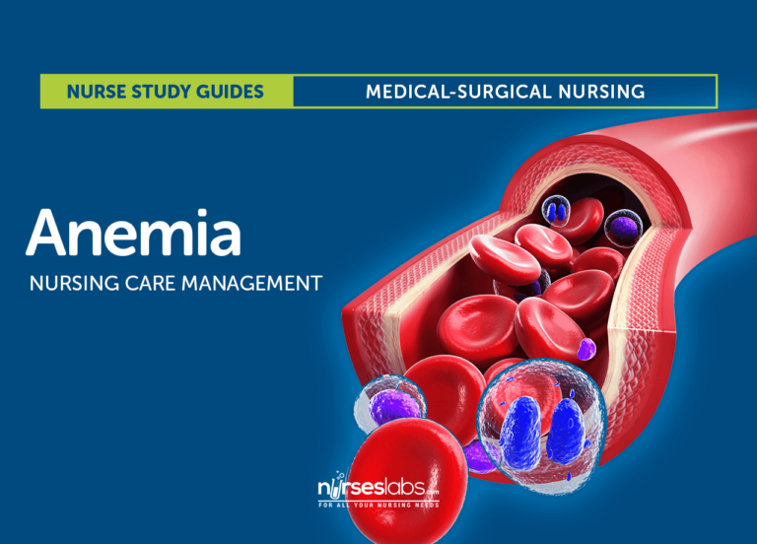

Slide 16

*
Tips for a Healthier Pregnancy*
 | ​Eat smaller, more frequent meals throughout the day Drink plenty of water, get adequate sleep and exercise. Include iron-rich foods like green leafy vegetables,,, chicken, or fish.​ * Follow doctor's advice as per your individual needs.
*

Slide 17
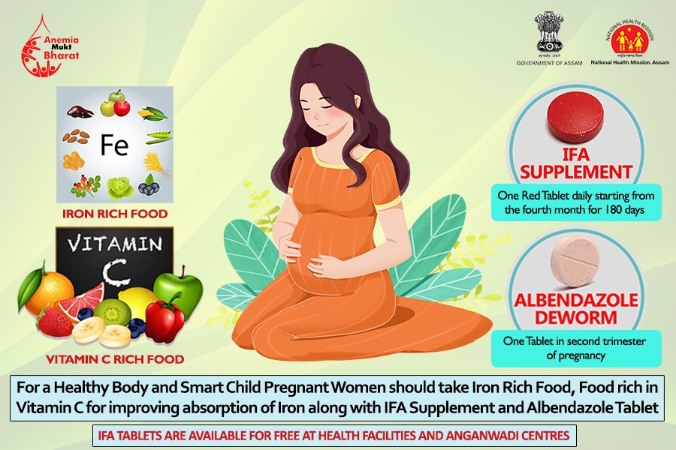

Slide 18
Foods that are high in vitamin C can help your body absorb more iron. These include:
citrus fruits and juices
strawberries
tomatoes
bell peppers
Try eating those foods at the same time that you eat iron-rich foods. For example, you could drink a glass of orange juice and eat an iron-fortified cereal for breakfast.
Also, choose foods that are high in folate to help prevent folate deficiency. These include:
leafy green vegetables
citrus fruits and juices
dried beans
breads and cereals fortified with folic acid

Slide 19
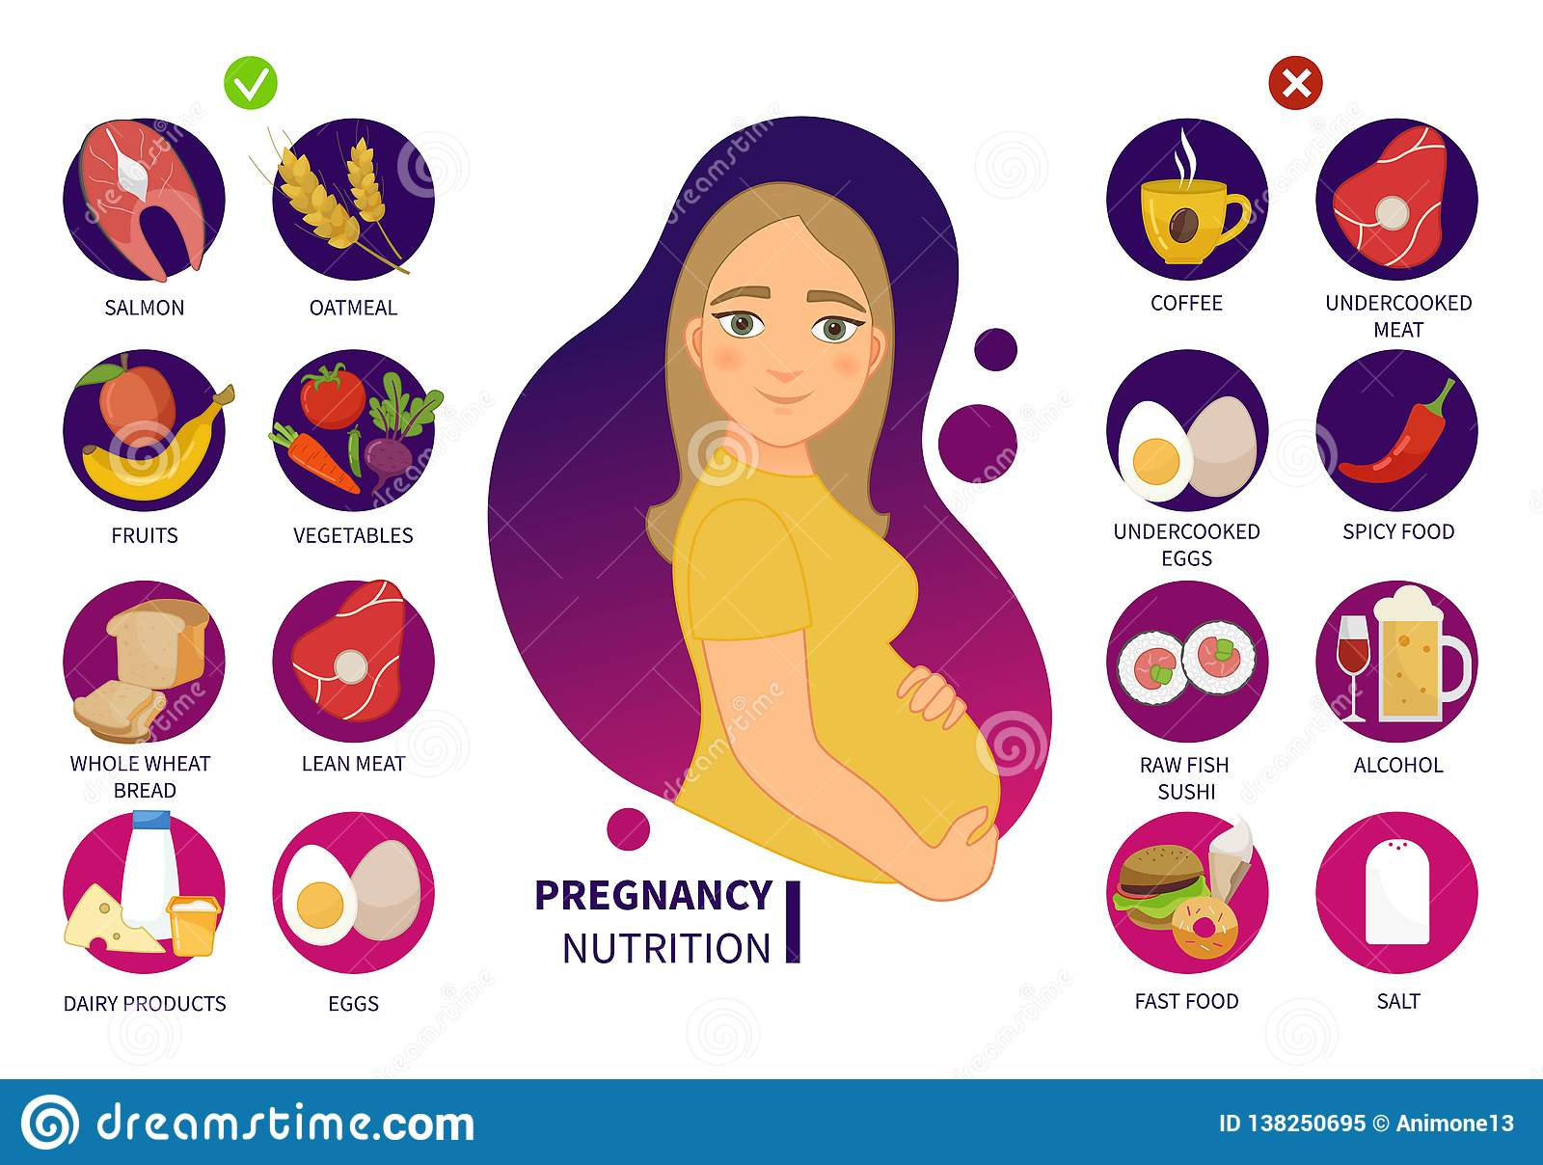

Slide 20
Anemia in Pregnancy Nursing Management
How do you care for a patient with anemia?
Be sure to drink plenty of fluids, and include fruits, vegetables, and fibre in your diet each day. Iron pills often make your bowel movements dark or green. If you forget to take an iron pill, do not take a double dose of iron the next time you take a pill. Keep iron pills out of the reach of small children.
Nursing Management
Provide client and family teaching. Discuss using iron supplements and increasing dietary sources of iron as indicated.
Prepare for blood-typing and crossmatching, and for administering packed PBCs during labor if the client has severe anemia.

Slide 21
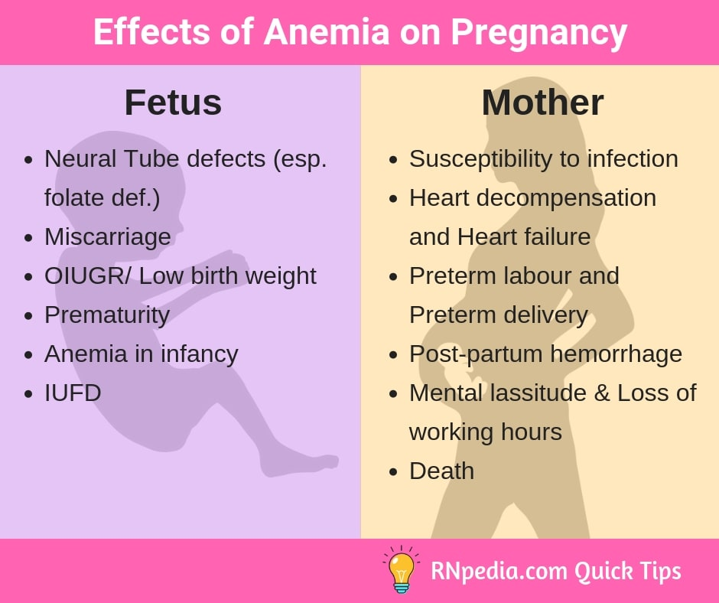

Slide 22
Thanks

