Slide 1
colloids
A colloid, or disperse phase, is a dispersion of small particles
of one material in another that does not settle out under gravity. In this context, ‘small’ means that one dimension at least
is smaller than about 500 nm (about the wavelength of visible
light). Many colloids are suspensions of nanoparticles (particles of diameter up to about 100 nm). In general, colloidal
particles are aggregates of numerous atoms or molecules, but
are commonly but not universally too small to be seen with an
ordinary optical microscope.

Slide 2
Classification and preparation
The name given to the colloid depends on the two phases involved:
• A sol is a dispersion of a solid in a liquid (such as clusters
of gold atoms in water) or of a solid in a solid (such as ruby glass, which is a gold-in-glass sol, and achieves its
color by light scattering).
• An aerosol is a dispersion of a liquid in a gas (like fog and
many sprays) or a solid in a gas (such as smoke): the particles are often large enough to be seen with a microscope.
• An emulsion is a dispersion of a liquid in a liquid (such
as milk).
• A foam is a dispersion of a gas in a liquid.

Slide 3
A further classification of colloids is as lyophilic, or solvent
attracting, and lyophobic, solvent repelling. If the solvent is
water, the terms hydrophilic and hydrophobic, respectively,
are used instead. Lyophobic colloids include the metal sols.
Lyophilic colloids generally have some chemical similarity to
the solvent, such as –OH groups able to form hydrogen bonds.
A gel is a semi-rigid mass of a lyophilic sol.

Slide 4
Emulsions are normally prepared by shaking the two components together vigorously, although some kind of emulsifying agent usually has to be added to stabilize the product. This emulsifying agent may be a soap (the salt of a long-chain carboxylic acid) or other surfactant (surface active) species, or a lyophilic sol that forms a protective film around the dispersed phase. In milk, which is an emulsion of fats in water, the emulsifying agent is casein, a protein containing phosphate groups.
It is clear from the formation of cream on the surface of milk that casein is not completely successful in stabilizing milk: the dispersed fats coalesce into oily droplets which float to the surface. This coagulation may be prevented by ensuring that
the emulsion is dispersed very finely initially: intense agitation with ultrasonics brings this dispersion about, the product being ‘homogenized’ milk.

Slide 5
Ex: Determining the isoelectric point of a protein
The velocity with which the protein bovine serum albumin
(BSA) moves through water under the influence of an electric
field was monitored at several values of pH, and the data are
listed below. What is the isoelectric point of the protein?
pH 4.20 4.56 5.20 5.65 6.30 7.00
Velocity/(µm s-1) 0.50 0.18 -0.25 -0.65 -0.90 -1.25
Collect your thoughts Plot velocity against pH, then use interpolation to find the pH at which the velocity is zero, which is the pH at which the molecule has zero net charge.
The solution The data are plotted in Fig.14E.3. The velocity passes through zero at pH = 4.8; hence pH = 4.8 is the isoelectric point.

Slide 6
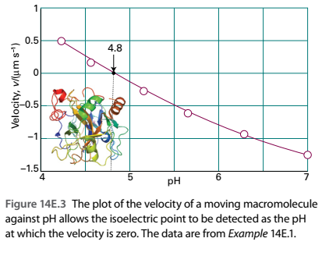

Slide 7
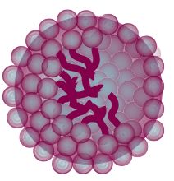
(a) The hydrophobic interaction
Consider a long-chained alcohol, such as pentan-1-ol
(CH3CH2CH2CH2CH2OH). The hydrocarbon chain is hydrophobic and the –OH group is hydrophilic. A species with both hydrophobic and hydrophilic regions is called amphipathic.
Amphipathic substances do dissolve slightly in water, and an understanding of the process gives insight into the formationof micelles and biological structures in general.

