Slide 1
Introduction :
• Surface tension is the elastic tendency of a fluid surface
which makes it acquire the least surface area possible.
Surface tension allows insects (e.g. water striders), usually
denser than water, to float and stride on a water surface.
• At liquid–air interfaces, surface tension results from the
greater attraction of liquid molecules to each other (due
to cohesion) than to the molecules in the air (due
to adhesion)

Slide 2
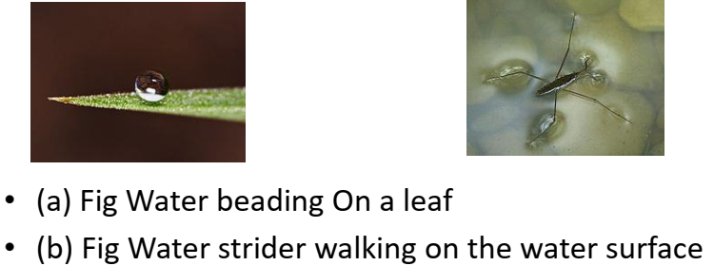
Surface tension has the dimension of force per unit length,
or of energy per unit area. The two are equivalent, but
when referring to energy per unit of area, it is common to
use the term surface energy, which is a more general term
in the sense that it applies also to solids.
• In materials science, surface tension is used for
either surface stress or surface free energy.

Slide 3
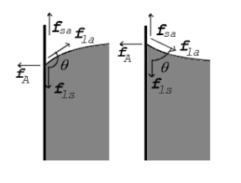
• Surface Tension:
• Free surface of a liquid has tendency to contract in
surface area is called surface tension.
• SI unit of Surface tension: N/m. or (J/m²).
• Its Dimension is [M⁰L¹T ²̄ ].
• Angle of Contact : The angle measured from the side of
the liquid, between the tangent to the solid surface
inside the liquid and tangent to the free liquid surface
at the point of contact between solid and liquid
surfaces

Slide 4
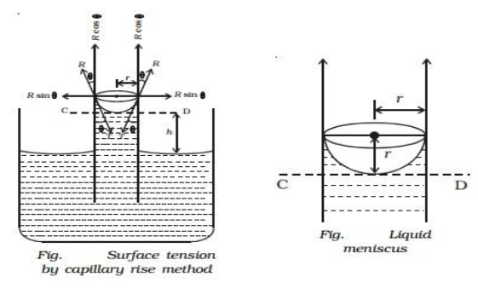
Capillary Rise Method:
• Total upward force = R cos θ circumference of the tube
• (i.e) F = 2πr R cos θ or F = 2πr T cos θ This upward force
is responsible for the capillary rise. As the water
column is in equilibrium, this force acting upwards is
equal to weight of the water column acting
downwards.
• F = w.
• T = hgrρ/2cosӨ
• h = 2TCosӨ/ρgr

Slide 5
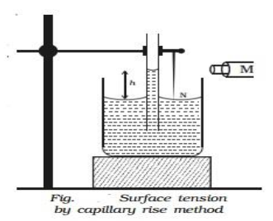
• The radius of the capillary tube is determined using the
travelling microscope. If ρ is the density of water then
the surface tension of water is given by
• T = hrρg /2cosӨ , Ө = 0◦ , cos 0 = 1.
• T = hrρg /2
• where g is the acceleration due to gravity.
• The radius of the capillary tube is determined using the
travelling microscope. If ρ is the density of water then
the surface tension of water is given by
• T = hrρg /2cosӨ , Ө = 0◦ , cos 0 = 1.
• T = hrρg /2
• where g is the acceleration due to gravity.

Slide 6
• Application of surface tension:
• Surface tension of soap solution is less, it can
spread over large areas and wash clothes more
effectively, since the dirt particles stick to the soap
molecules.
• In soldering, addition of flux reduces the surface
tension of molten tin. Hence, it spreads.
• Antiseptics like dettol have low surface tension, so
that they spread faster.
• Surface tension prevents water from passing
through the pores of an umbrella.
• A duck is able to float on water as its feathers
secrete oil that lowers the surface tension of water.

