Slide 1
Engineering Drawing
Lecture 4
Geometric Construction

Slide 2
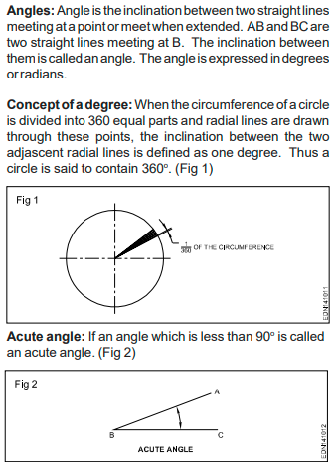
Geometrical Figures types of angles

Slide 4
Triangles

Slide 6
Geometrical Figures
Square, Rectangle, rhombus, Parallelogram and Circle

