Slide 1

الرسـم الهندسـي
Engineering Drawing

Slide 2
مـقـدمـة Introduction
الرسم الهندسي هو احد انواع الرسم التقني، يستخدم لتعريف الاجزاء الهندسية بشكل كامل وواضح، وعادة ينفذ وفق مواصفات متفق عليها بالنسبة للمخططات، التسميات، التفسير، الحجم الظاهر،.....الخ.
هدفه هو اظهار الخاصية الهندسية للمنتج او الاجزاء بشكل واضح ودقيق.
الهدف الاخير للرسم الهندسي هو نقل كل المعلومات المطلوبة التي تسمح للمصنع من تقديم هذه الاجزاء.

Slide 3
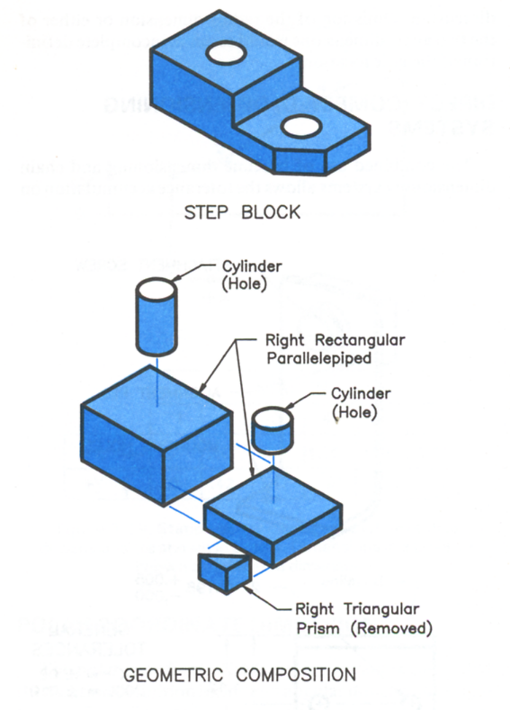
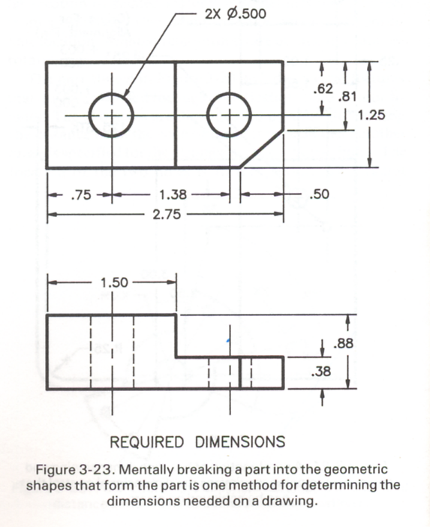
الهدف من الرسم الهندسي
Purpose of an Engineering Drawing
الرسم الهندسي هو ليس تصوير.
هو اعطاء مواصفات الحجم والشكل للجزء او الاجزاء المجمعة.
المعلومات المهمة في الرسم هي الابعاد والسماحات لجميع خواص الرسم.

Slide 4
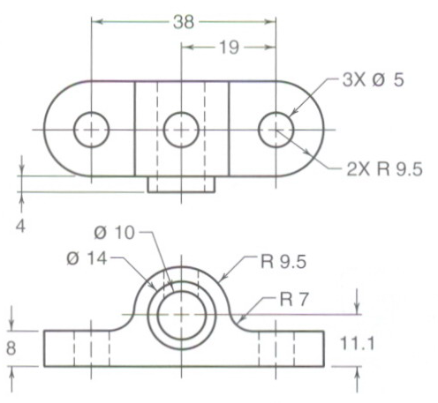
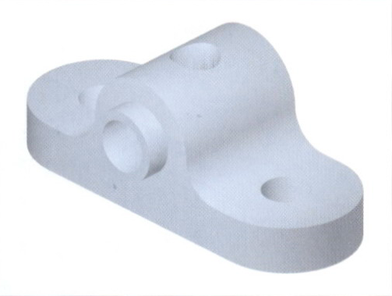
عناصـر الرســـم الهندســــي
Elements of Engineering Drawing
الرسم الهندسي يتكون من لغة الرسم ولغة الكتابة
لغة
الرسم
توصف الشكل
لغة
الكتابة
توصف الحجم، الموقع وخواص الجسم

Slide 5
المفاهيم الاسـاسـية للرســـم
Basic Knowledge for Drafting
لغــة
الرســم
لغــة
الكتابــة
انواع
الخطوط
طرق
الاسقاط
البنية
الانشائية
الكتابة

Slide 6

Traditional Drawing Tools

Slide 7
Instruments
Drawing board/table.
Drawing sheet/paper.
Drafting tape.
Pencils.
Eraser.
Sharpener.
T-square.
Set-squares/triangles.
Scales.
Compass and divider.

Slide 8
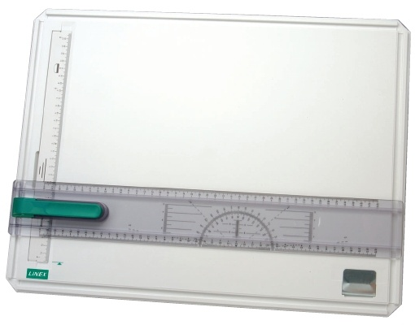
Drawing board

Slide 9
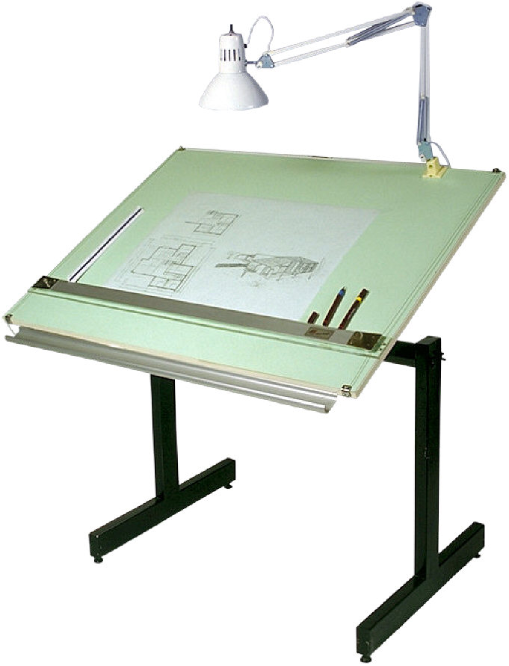
Drawing table

Slide 10
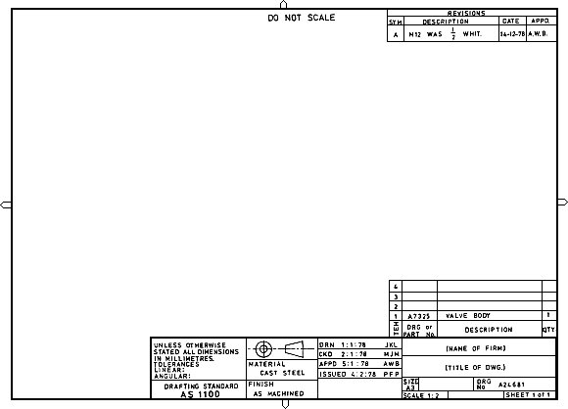

Drawing sheet/paper
216 X 280 mm
280 X 382 mm
382 X 560 mm
585 X 726 mm

Slide 11
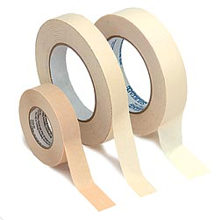
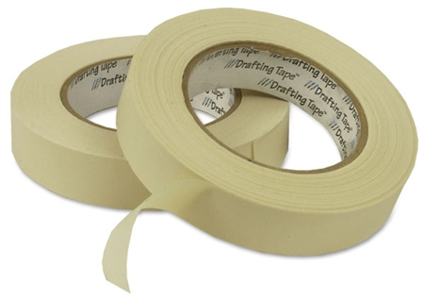
Drafting tape

Slide 12
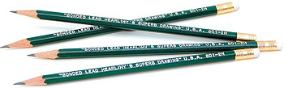

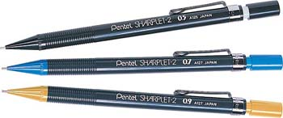
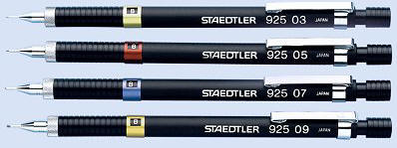
Pencils
Wood pencils: H, 2H, 3H, 4H, 5H, 6H, 7H, 8H, 9H, B, HB, 2B, 3B, 4B, 5B, 6B.
Semiautomatic Pencils (lead holder) are more convenient then ordinary wood pencils.

Slide 13
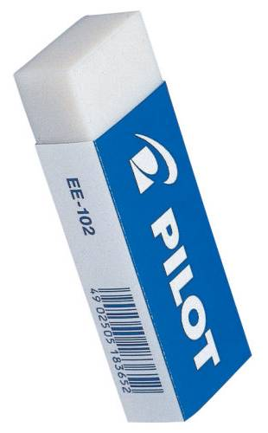

Eraser

Slide 14
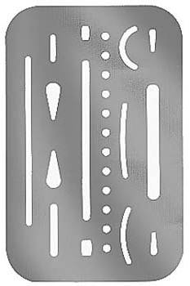
Erasing Shield

Slide 15

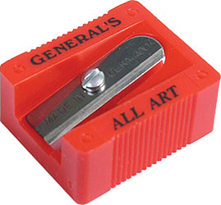
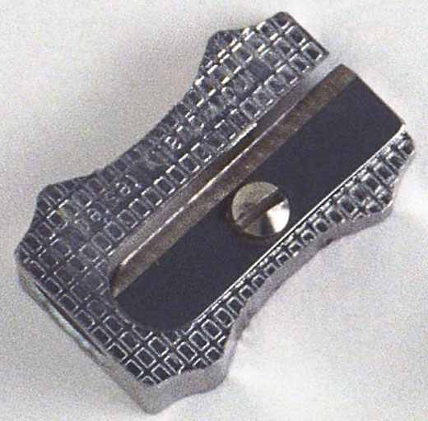
Sharpener

Slide 16
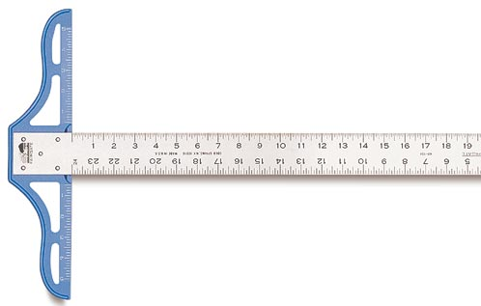
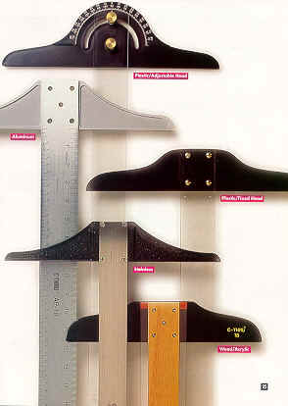
T-square

Slide 17
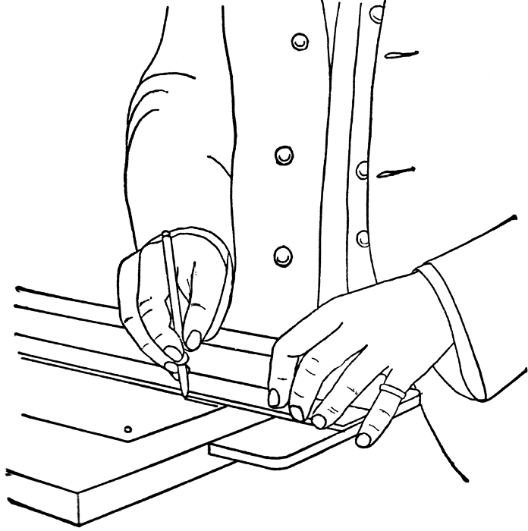

Slide 18
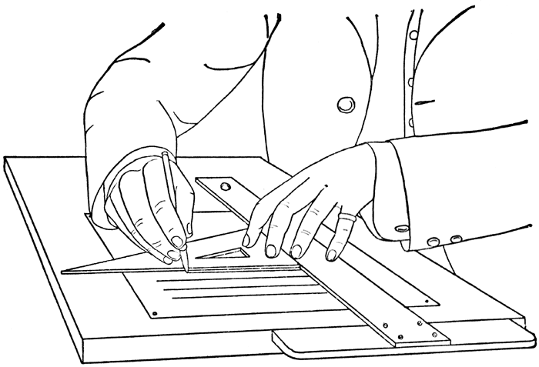

Slide 19
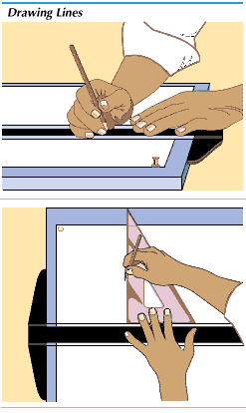

Slide 20
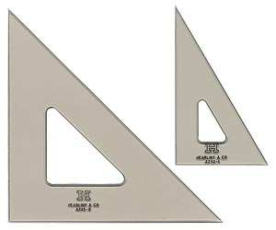
Set-squares/triangles

Slide 21
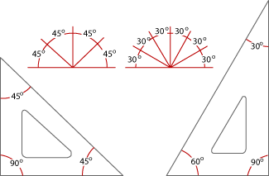

Slide 22
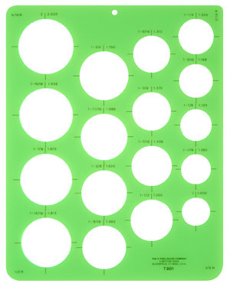
Circle Template

Slide 23
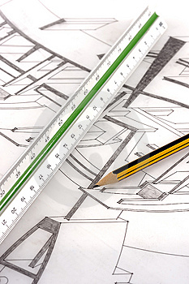
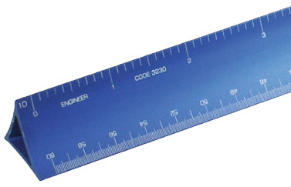
Scales

Slide 24


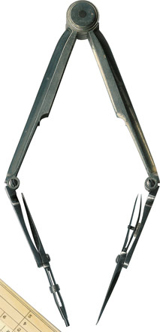
Compass and divider

Slide 25

Sandpaper

Slide 26

Tissue paper

Slide 27

Clean paper

Slide 28



Drawing Standard

Slide 29
Introduction
Standards are set of rules that govern how technical
drawings are represented.
Drawing standards are used so that drawings convey
the same meaning to everyone who reads them.

Slide 30
Standard Code
Country
Code
Full name
Thailand
มอก.
สำนักงานมาตรฐานผลิตภัณฑ์อุตสาหกรรม
USA
ANSI
American National Standard Institute
Japan
JIS
Japanese Industrial Standard
UK
BS
British Standard
Australia
AS
Australian Standard
Germany
DIN
Deutsches Institut für Normung
ISO
International Standards Organization

Slide 31
Partial List of Drawing Standards
Code number
Contents
JIS Z 8311 Sizes and Format of Drawings
JIS Z 8312 Line Conventions
JIS Z 8313 Lettering
JIS Z 8314 Scales
JIS Z 8315 Projection methods
JIS Z 8316 Presentation of Views and Sections
JIS Z 8317 Dimensioning

Slide 32
Drawing Sheet
Trimmed paper of
a size A0 ~ A4.
A4
A3
Standard sheet size (JIS)
A4 210 x 297
A3 297 x 420
A2 420 x 594
A1 594 x 841
A0 841 x 1189
A2
A1
(Dimensions in millimeters)
A0

Slide 33
Orientation of drawing sheet
1. Type X (A0~A4)
2. Type Y (A4 only)
c
d
d
c
Drawing
space
Border
lines
Drawing space
Title block
Title block
c
Sheet size c (min) d (min)
A4 10 25
A3 10 25
A2 10 25
A1 20 25
A0 20 25

Slide 34
216 X 280 mm
280 X 382 mm
382 X 560 mm
585 X 726 mm

Slide 35
Title Block of drawing sheet
الاسم: الجامعة: رقم اللوحة:
المرحلة : الكلية: مقياس الرسم:
المجموعة : االقسم : التاريخ:

Slide 36
Drawing Scales
Length, size
Scale is the ratio of the linear dimension of an element
of an object shown in the drawing to the real linear
dimension of the same element of the object.
Size in drawing
Actual size
:

Slide 37
Drawing Scales
Designation of a scale consists of the word “SCALE”
followed by the indication of its ratio, as follow
SCALE 1:1 for full size
SCALE X:1 for enlargement scales (X > 1)
SCALE 1:X for reduction scales (X > 1)
Dimension numbers shown in the drawing are correspond
to “true size” of the object and they are independent of
the scale used in creating that drawing.

Slide 38
Basic Line Types
Name according
to application
Types of Lines
Appearance
Continuous thick line HB
Visible line
Continuous thin line 2H
Dimension line
Extension line
Leader line
Dash thick line HB
Hidden line
Chain thin line 2H
Center line
NOTE : We will learn other types of line in later chapters.

Slide 39
Meaning of Lines
Visible lines represent features that can be seen in the
current view
Hidden lines represent features that can not be seen in
the current view
Center line represents symmetry, path of motion, centers
of circles, axis of axisymmetrical parts
Dimension and Extension lines indicate the sizes and
location of features on a drawing

Slide 40
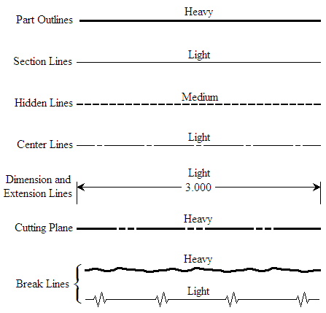
Types of Line

Slide 41
Line Conventions
Visible Lines – solid thick lines that represent visible edges or contours
Hidden Lines – short evenly spaced dashes that depict hidden features
Section Lines – solid thin lines that indicate cut surfaces
Center Lines – alternating long and short dashes
Dimensioning
  Dimension Lines - solid thin lines showing dimension extent/direction
  Extension Lines - solid thin lines showing point or line to which dimension applies
  Leaders – direct notes, dimensions, symbols, part numbers, etc. to features on drawing
Cutting-Plane and Viewing-Plane Lines – indicate location of cutting planes for sectional views and the viewing position for removed partial views
Break Lines – indicate only portion of object is drawn. May be random “squiggled” line or thin dashes joined by zigzags.
Phantom Lines – long thin dashes separated by pairs of short dashes indicate alternate positions of moving parts, adjacent position of related parts and repeated detail
Chain Line – Lines or surfaces with special requirements

Slide 42
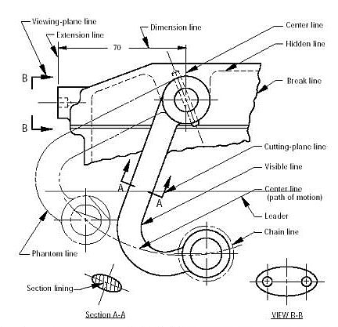
Viewing-plane line
1
Dimension Line
4
3
Center Line
Extension line
2
Hidden Line
5
6
Break Line
Cutting-plane Line
7
8
Visible Line
9
10
Center Line (of motion)
Leader
Phantom Line
14
13
Section Line
11
12
VIEW B-B
SECTION A-A

Slide 43
ABCDEFGHIJKLMNOPQRSTUVWXYZABCDEFGHIJKLMNOPQRSTUVWXYZABCDEF
Lettering
ABCDEFGHIJKLMNOPQRSTUVWXYZABCDEFGHIJKLMNOPQRSTUVWXYZABCD

Slide 44
Text on Drawings
Text on engineering drawing is used :
To communicate nongraphic information.
As a substitute for graphic information, in those instance where text can communicate the needed information more clearly and quickly.
Thus, it must be written with
Legibility
- shape
- space between letters and words
Uniformity
- size
- line thickness

Slide 45
Lettering Standard
ANSI Standard
This course
Use a Gothic text style,
either inclined or vertical.
Use only a vertical Gothic
text style.
Use all capital letters.
Use both capital and
lower-case letters.
Use 3 mm for most
text height.
Same. For letters in title block it is recommend to use 5~8 mm text height
Space between lines
of text is at least 1/3
of text height.
N/A.
Follows ANSI rule.

Slide 46
Basic Strokes
Straight
Slanted
Horizontal
Curved
Examples : Application of basic stroke
4
5
“I” letter
1
“A” letter
1
2
“B” letter
1
3
6
3
2

Slide 47
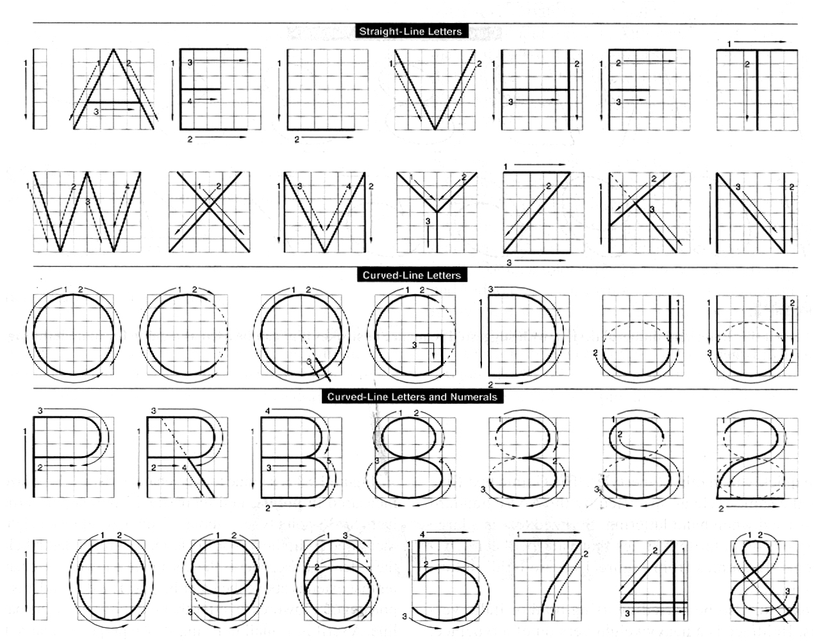
Suggested Strokes Sequence
Upper-case letters & Numerals
Straight line
letters
Curved line
letters
Curved line
letters &
Numerals

Slide 48
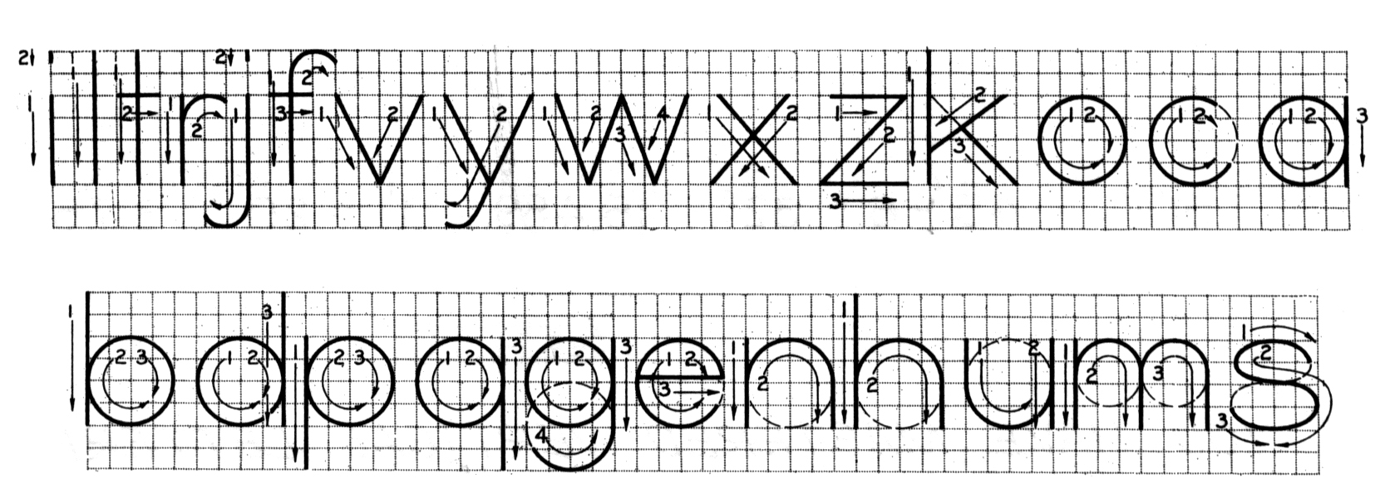
Suggested Strokes Sequence
Lower-case letters
The text’ s body height is about 2/3 the height of a capital
letter.

Slide 49
Stroke Sequence
I
L
T
F
E
H

Slide 50
Stroke Sequence
V
X
W

Slide 51
Stroke Sequence
N
M
K
Z
Y
A
4

Slide 52
Stroke Sequence
O
Q
C
G

Slide 53
Stroke Sequence
D
U
P
B
R
J
1
2

Slide 54
Stroke Sequence
5
7

Slide 55
Stroke Sequence
S
0
3
6
8
9

Slide 56
Stroke Sequence
l
i

Slide 57
Stroke Sequence
v
w
x
k
z

Slide 58
Stroke Sequence
j
y
f
t
r

Slide 59
Stroke Sequence
c
o
a
b
d
p
q
e

Slide 60
Stroke Sequence
g
n
m
h
u
s

Slide 61
Word Composition
Look at the same word having different spacing between letters.
A) Non-uniform spacing
JIRAPONG
B) Uniform spacing
J
I
R
A
P
O
N
G
Which one is easier to read ?

Slide 62
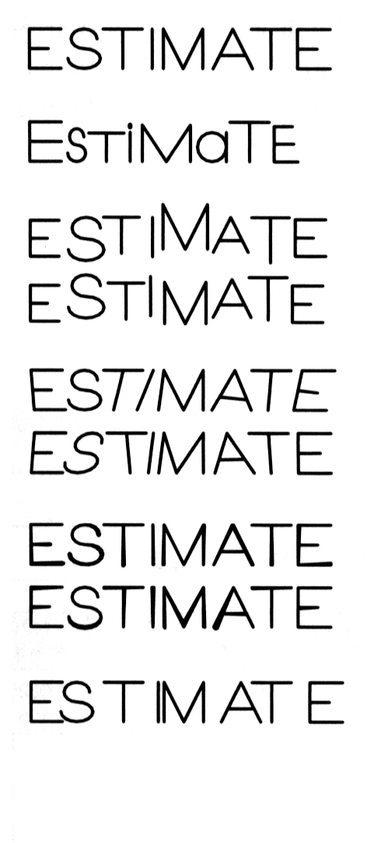

Example : Good and Poor Lettering
GOOD
Not uniform in style.
Not uniform in height.
Not uniformly vertical or inclined.
Not uniform in thickness of stroke.
Area between letters not uniform.
Area between words not uniform.

Slide 63
Sentence Composition
Leave the space between words equal to the space
requires for writing a letter “O”.
Example
ALL
O
DIMENSIONS
O
ARE
O
IN
MILLIMETERS
O
UNLESS
OTHERWISE
O
SPECIFIED.

