Slide 1
Unit # 06
Pin Out of 8086 Microprocessor
Pin Out of 8086 Microprocessor
By
Dr. Feryal Althefery
Feryal Althefery
Feryal.Ibrahim@uomus.edu.iq

Slide 2
Unit # 06
Outlines of the lecture
1. Pin Out Description.
2. Logic Devices for Interfacing.
Feryal Althefery
Feryal.Ibrahim@uomus.edu.iq
1

Slide 3
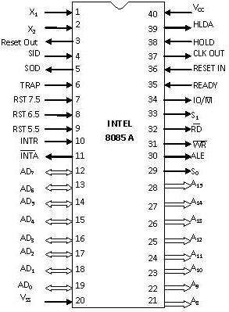
Unit # 06
Pin Out Description
X1 & X2
Pin 1 and Pin 2 (Input)
These are also called Crystal Input Pins.
A 8085 microprocessor need oscillator to
generate clock signal.
The frequency of oscillator is twice of
microprocessor frequency.
H/W / solve the question 18 of reference book in
p.p. 1-51 (frequency only)
Feryal Althefery
Feryal.Ibrahim@uomus.edu.iq
q
2

Slide 4
Unit # 06
Pin Out Description
RESET IN and RESET OUT
Pin 36 (Input) and Pin 3 (Output)
RESET IN:
It is used to reset the microprocessor.
It is active low signal.
When the signal on this pin is low for at least
3 clock cycles, it forces the microprocessor
to reset itself which means:
Clearing the PC and IR.
Disabling all interrupts (except TRAP).
Disabling the SOD pin.
All the buses (data, address, control) are
tristated( what is meaning that?).
Gives HIGH output to RESET OUT pin.
Feryal Althefery
Feryal.Ibrahim@uomus.edu.iq
3

Slide 5
Unit # 06
Pin Out Description
RESET IN and RESET OUT
Pin 36 (Input) and Pin 3 (Output)
RESET OUT:
It is used to reset the peripheral devices and
other ICs on the circuit.
It is an output signal.
It is an active high signal.
The output on this pin goes high whenever
RESET IN is given low signal.
Feryal Althefery
Feryal.Ibrahim@uomus.edu.iq
4

Slide 6
Unit # 06
Pin Out Description
SID and SOD
Pin 4 (Input) and Pin 5 (Output)
SID (Serial Input Data):
It takes 1 bit input from serial port of 8086.
Stores the bit at the 8th position (MSB) of the
Accumulator.
RIM (Read Interrupt Mask) instruction is
used to transfer the bit.
Feryal Althefery
Feryal.Ibrahim@uomus.edu.iq
5

Slide 7
Unit # 06
Pin Out Description
SID and SOD
Pin 4 (Input) and Pin 5 (Output)
SOD (Serial Output Data):
It takes 1 bit from Accumulator to serial
port of 8085.
Takes the bit from the 8th position (MSB) of
the Accumulator.
SIM (Set Interrupt Mask) instruction is used
to transfer the bit.
Feryal Althefery
Feryal.Ibrahim@uomus.edu.iq
6

Slide 8
Unit # 06
Pin Out Description
TRAP
Pin 6 (Input)
It is an non-mask able interrupt.
It has the highest priority.
It cannot be disabled.
It is both edge and level triggered.
It means TRAP signal must go from low to high.
And must remain high for a certain period of
time.
TRAP is usually used for power failure and
emergency shutoff.
Feryal Althefery
Feryal.Ibrahim@uomus.edu.iq
7

Slide 9
Unit # 06
Pin Out Description
RST 7.5
Pin 7 (Input)
It is a mask able interrupt.
It has the second highest priority.
It is positive edge triggered only.
The internal flip-flop is triggered by the rising
edge.
The flip-flop remains high until it is cleared
by RESET IN.
Feryal Althefery
Feryal.Ibrahim@uomus.edu.iq
8

Slide 10
Unit # 06
Pin Out Description
RST 6.5
Pin 8 (Input)
It is a mask able interrupt.
It has the third highest priority.
It is triggered edge only.
The pin has to be held high for a specific period
of time.
RST 6.5 can be enabled by EI instruction.
It can be disabled by DI instruction.
Feryal Althefery
Feryal.Ibrahim@uomus.edu.iq
9

Slide 11
Unit # 06
Pin Out Description
RST 5.5
Pin 9 (Input)
It is a mask able interrupt.
It has the fourth highest priority.
It is also triggered edge only.
The pin has to be held high for a specific period
of time.
This interrupt is very similar to RST 6.5.
Feryal Althefery
Feryal.Ibrahim@uomus.edu.iq
10

Slide 12
Unit # 06
Pin Out Description
INTA
Pin 11 (Input)
It stands for interrupt acknowledge.
It is an out going signal.
It is an active low signal.
Low output on this pin indicates that
microprocessor has acknowledged the INTR
request.
Dr. Feryal Althefery
Feryal.Ibrahim@uomus.edu.iq
11

Slide 13
Unit # 06
Pin Out Description
Address and Data Pins
Address Bus:
• The address bus is used to send
address to memory or IO devices.
• It selects one of the many locations in
memory or one of I/O devices.
• Its length 16-bit.
Data Bus:
• It is used to transfer data between
microprocessor and memory or IO devices.
• Its length 8-bit.
Dr. Feryal Althefery
Feryal. Ibrahim @uomus.edu.iq
12

Slide 14
Unit # 06
Pin Out Description
AD0 – AD7
Pin 19-12 (Bidirectional)
These pins serve the dual purpose of
transmitting lower order address and data byte.
During 1st clock cycle, these pins operate as lower
half of address.
In remaining clock cycles, these pins operate as
data bus.
The separation of lower order address
and data is done using address latch circuit.
H/W / solve the question 23 of reference book in p.p. 1-51
Dr. Feryal Althefery
Feryal.Ibrahim@uomus.edu.iq
13

Slide 15
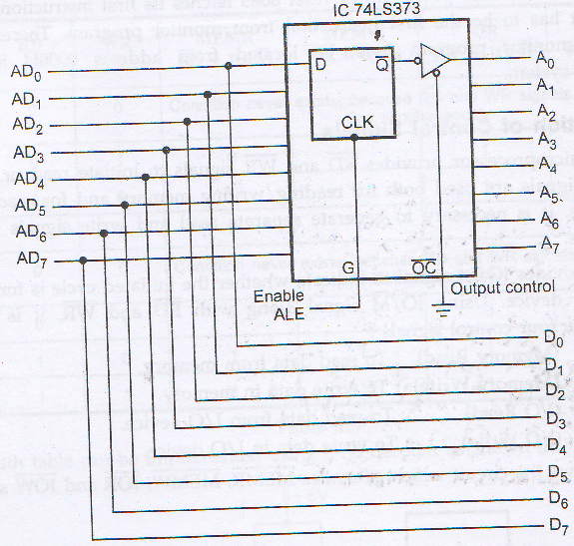
Unit # 06
Pin Out Description
AD0 – AD7
Pin 19-12 (Bidirectional)
This latch circuit used to latch the status
of lower order address bus
During 1st clock cycle, ALE is activated.
Dr. Feryal Althefery
Feryal.Ibrahim@uomus.edu.iq
14

Slide 16
Unit # 06
Pin Out Description
A8 – A15
Pin 21-28 (Unidirectional)
These pins carry the higher order of address
bus.
The address is sent from microprocessor to
memory or I/O devices.
These 8 pins are switched to high impedance
state during HOLD and RESET mode.
Dr. Feryal Althefery
Feryal.Ibrahim@uomus.edu.iq
15

Slide 17
Unit # 06
Pin Out Description
ALE
Pin 30 (Output)
It is used to enable Address Latch.
It indicates whether bus functions as
address bus or data bus.
If ALE = 1 then
Bus functions as address bus.
If ALE = 0 then
◦ Bus functions as data bus.
Dr. Feryal Althefery
Feryal.Ibrahim@uomus.edu.iq
16

Slide 18
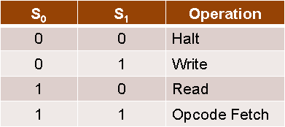
Unit # 06
Pin Out Description
S0 and S1
Pin 29 (Output) and Pin 33 (Output)
S0 and S1 are called Status Pins.
They tell the current operation which is in
progress in 8085.
Dr. Feryal Althefery
Feryal.Ibrahim@uomus.edu.iq
17

Slide 19
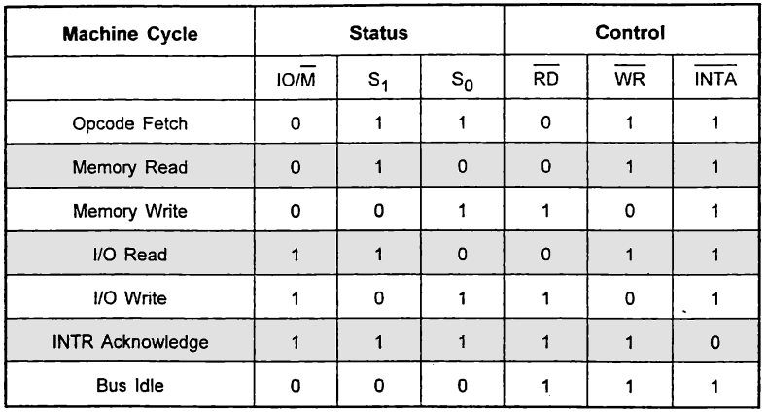
Unit # 06
Pin Out Description
IO/M
Pin 34 (Output)
This pin tells whether I/O or memory operation
is being performed.
If IO/M = 1 then
◦ I/O operation is being performed.
If IO/M = 0 then
◦ Memory operation is being performed.
Dr. Feryal Althefery
Feryal.Ibrahim@uomus.edu.iq
18

Slide 20
Unit # 06
Pin Out Description
RD
Pin 32 (Output)
RD stands for Read.
It is an active low signal.
It is a control signal used for Read operation
either from memory or from Input device.
A low signal indicates that data on the data
bus must be placed either from selected
memory location or from input device.
Dr. Feryal Althefery
Feryal.Ibrahim@uomus.edu.iq
19

Slide 21
Unit # 06
Pin Out Description
WR
Pin 31 (Output)
WR stands for Write.
It is also active low signal.
It is a control signal used for Write operation
either into memory or into output device.
A low signal indicates that data on the data
bus must be written into selected memory
location or into output device.
Dr. Feryal Althefery
Feryal.Ibrahim@uomus.edu.iq
20

Slide 22
Unit # 06
Pin Out Description
READY
Pin 35 (Input)
This pin is used to synchronize slower
peripheral devices with fast microprocessor.
A low value causes the microprocessor to enter
into wait state.
The microprocessor remains in wait state
until the input at this pin goes high.
Dr. Feryal Althefery
Feryal.Ibrahim@uomus.edu.iq
21

Slide 23
Unit # 06
Pin Out Description
HOLD
Pin 38 (Input)
HOLD pin is used to request the microprocessor
for DMA (Direct Memory Accesses) transfer.
A high signal on this pin is a request to
microprocessor to relinquish the hold on buses.
This request is sent by DMA controller.
Intel 8257 and Intel 8237 are two DMA
controllers.
Dr. Feryal Althefery
Feryal.Ibrahim@uomus.edu.iq
22

Slide 24
Unit # 06
Pin Out Description
HLDA
Pin 39 (Output)
HLDA stands for Hold Acknowledge.
The microprocessor uses this pin to
acknowledge the receipt of HOLD signal.
When HLDA signal goes high, address bus, data
bus, RD, WR, IO/M pins are tri-stated. This
means they are cut-off from external
environment.
The control of these buses goes to DMA controller.
Control remains at DMA Controller until
HOLD is held high.
When HOLD goes low, HLDA also goes low and
the microprocessor takes control of the buses.
Dr. Feryal Althefery
Feryal.Ibrahim@uomus.edu.iq
23

Slide 25
Unit # 06
Pin Out Description
VSS and VCC
Pin 20 (Input) and Pin 40 (Input)
+5V power supply is connected to VCC.
Ground signal is connected to VSS.
H/W / solve the question 21 of
reference book in p.p. 1-51
Dr. Feryal Althefery
Feryal.Ibrahim@uomus.edu.iq
24

Slide 26
Unit # 06
Logic Devices for Interfacing:
1. Multiplexing AD7 - AD0
It is explained previously.
Dr. Feryal Althefery
Feryal.Ibrahim@uomus.edu.iq
25

Slide 27
Unit # 06
Logic Devices for Interfacing:
2. Generation of control signals:
The important control signals are RD, WR and IO/M signals which organize the data
follow between microprocessor and memory location or IO devices.
Table below shows the logic state to execute these three control signals.
IO/M | RD | WR | MEMR RD + IO/M | MEMW WR + IO/M | IOR RD + IO/M | IOW WR+ IO/M
0 | 0 | 0 | Condition never exists, because RD and WR signals doesn’t go low simultaneously
0 | 0 | 1 | 0 | 1 | 1 | 1
0 | 1 | 0 | 1 | 0 | 1 | 1
0 | 1 | 1 | 1 | 1 | 1 | 1
1 | 0 | 0 | Condition never exists, because RD and WR signals doesn’t go low simultaneously
1 | 0 | 1 | 1 | 1 | 0 | 1
1 | 1 | 0 | 1 | 1 | 1 | 0
1 | 1 | 1 | 1 | 1 | 1 | 1
Dr. Feryal Althefery
Feryal.Ibrahim@uomus.edu.iq
26

Slide 28
Unit # 06
Logic Devices for Interfacing:
2. Generation of control signals:
Figure below shows the circuit which generates the truth table shown in previous slide
IO/M | RD | WR | MEMR RD + IO/M | MEMW WR + IO/M | IOR RD + IO/M | IOW WR+ IO/M
0 | 0 | 0 | Condition never exists, because RD and WR signals doesn’t go low simultaneously
0 | 0 | 1 | 0 | 1 | 1 | 1
0 | 1 | 0 | 1 | 0 | 1 | 1
0 | 1 | 1 | 1 | 1 | 1 | 1
1 | 0 | 0 | Condition never exists, because RD and WR signals doesn’t go low simultaneously
1 | 0 | 1 | 1 | 1 | 0 | 1
1 | 1 | 0 | 1 | 1 | 1 | 0
1 | 1 | 1 | 1 | 1 | 1 | 1
Dr. Feryal Althefery
Feryal.Ibrahim@uomus.edu.iq
27

Slide 29
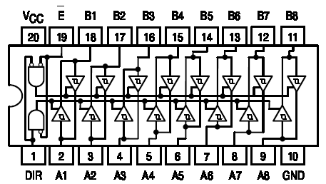
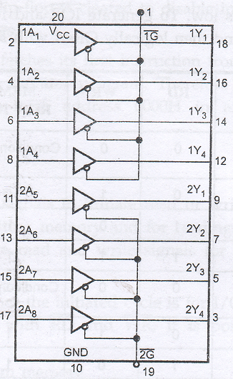
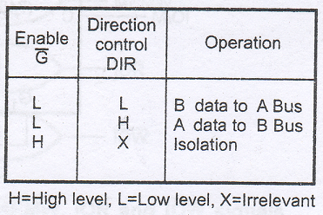
Unit # 06
Logic Devices for Interfacing:
3. Bus Drivers :
Typically, the 8085 buses can source 400 μA and sink 2 mA of current, i.e. it can drive
only one TTL load.
One of solutions of this problem is using buffer which increase capacity of buses for
more than one TTL as in figures below.
Dr. Feryal Althefery
Feryal.Ibrahim@uomus.edu.iq
28

