Slide 1
Antibiotics sensitivity test
BY :
Dr. Noor Ali Jabbar

Slide 2
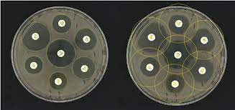
Antibiotic sensitivity testing or antibiotic susceptibility testing ; is the measurement of the susceptibility of bacteria to antibiotics. It is used because bacteria may have resistance to some antibiotics. Sensitivity testing results can allow a clinician to change the choice of antibiotics from empiric therapy, which is when an antibiotic is selected based on clinical suspicion about the site of an infection and common causative bacteria, to directed therapy, in which the choice of antibiotic is based on knowledge of the organism and its sensitivities

Slide 3
Why do I need an antibiotic sensitivity test?
You may need this test if you have an infection that has been shown to have antibiotic resistance or is otherwise hard to treat. These include tuberculosis, MRSA, and C. diff . You may also need this test if you have a bacterial or fungal infection that is not responding to standard treatments.

Slide 4
Testing for antibiotic sensitivity
1- Diffusion methods
2- Dilution methods for minimum inhibitory concentration determination ( MIC )

Slide 5
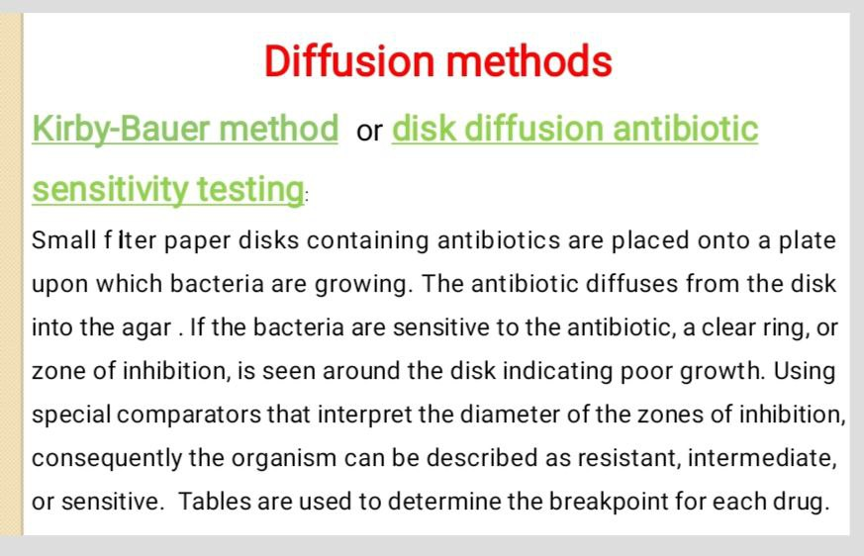

Slide 6
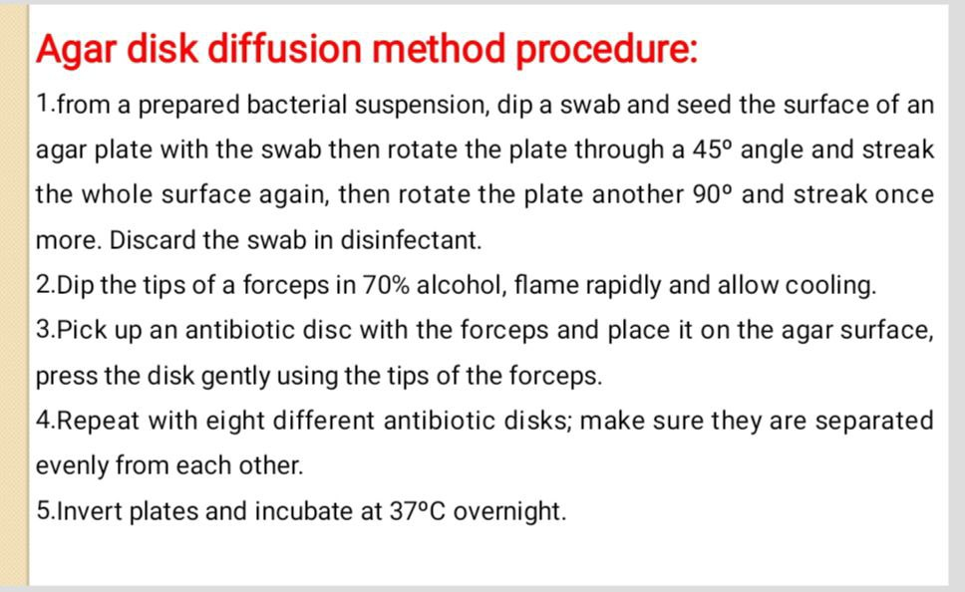

Slide 7
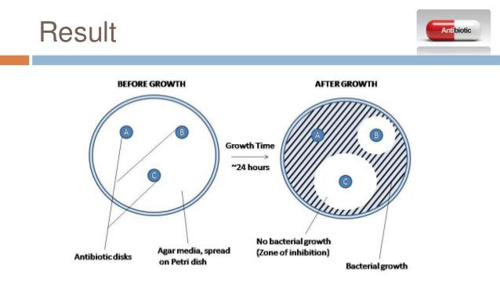

Slide 8
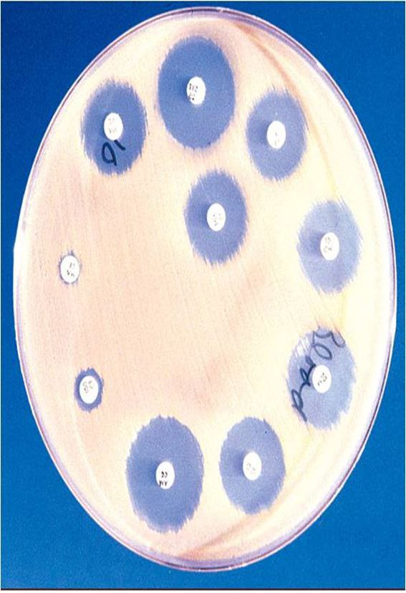

Slide 9
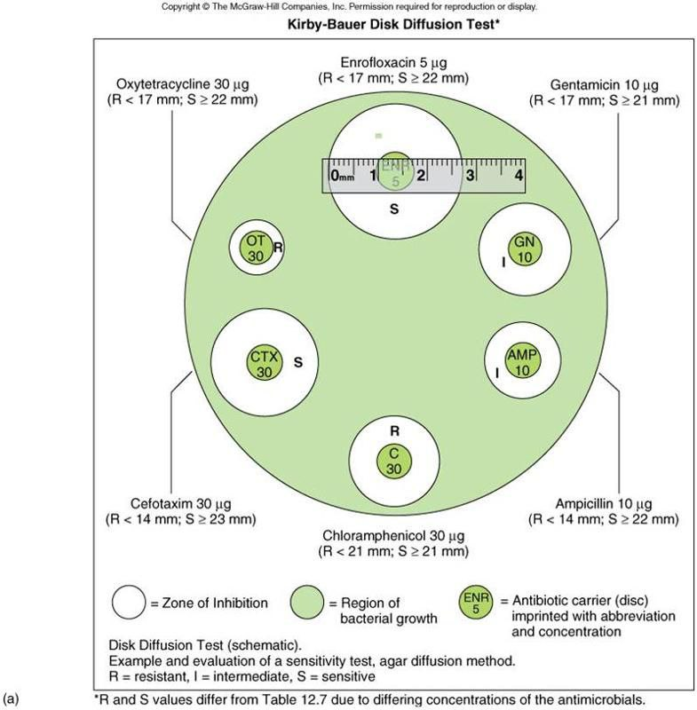

Slide 10
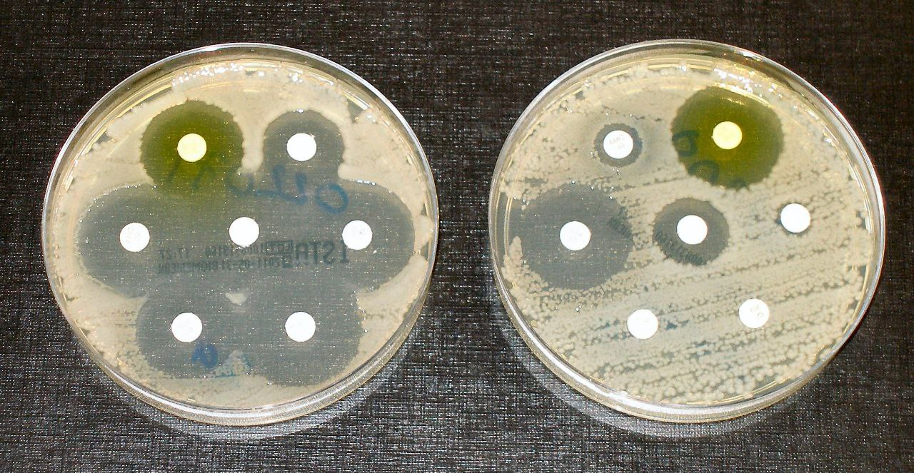
Example
Bacteria are streaked on dishes with white disks, with a different antibiotic. Clear rings, such as those on the left, show that bacteria have not grown—indicating that these bacteria are not resistant. The bacteria on the right are fully resistant to all but two of the seven antibiotics are sensitive

