Slide 1


Department of Anesthesia Techniques
Prof . Dr. Younis A. Alkhafaji
Practical Biology -3-
Microscope
Microscope : is the means by which to enlarge the small things that cannot be seen with the naked eye .
Types of microscopes
1- Compound light microscope
2- Phase contrast microscope
3- Dark field microscope
4- Fluorescence microscope
5- Dissecting microscope
6- Ultraviolet microscope
7- Polarization microscope
8- Electron microscope:
a) Transmission electron microscope (TEM)
b) Scanning electron microscope (SEM)

Slide 2
The Optical (light) Microscope
Light Microscope:
Parts & Function
1-Eypiece(Ocular lenses): It one or two lenses use to look through the
microscope and it has 5 or 20 times of the magnification but X10 it generally
used.
2-Optical tube: It connect the eye piece with objective lenses. Standard length
16 cm
3- Revolving Nose piece : It hold four objectives lenses .It can be rotation left
and right to change magnification power.
4- Objectives lenses: It four lenses on the Revolving Nosepiece.it has differs
with length and magnification power. Then the shorter one it the lower mag.
a-Low power(L.P) :It magnify about 4 times(X4)
b-Low power ( L.P) :It magnify about 10 time(X10)
c-High power objective (H.P):It magnify about 40 times (X40)
d-Oil immersion objective: It magnify about 100 time(X100)and use special oil
on the slide.

Slide 3
5- specimen Stage :It hold the specimen .
6- Clips: it used for slide fixing on the stage
7-Condencer: It located under the stage and can moved it up and down to adjust
the light band on the object(sample).
8-Iris Diaphragm : It used for regulation the illumination of the object(sample)
to examined.
9-Illumination: (Tungsten-halogen light bulb) for all microscope types except
(u.v or carbon) for Fluorescent microscope.
10-Coarse adjustment knob: Used for stage movement up and down to adjust
the distance between objectives lenses and the slide.
11-Fine adjustment knob: Used for clarity of the vision .
12- Arm: Used for microscope hold
13- Foot Base: Used for standing and supporting of the microscope.

Slide 4
Microscope care
1. Always carry with two hands one holding the arm and the other hold the base of instrument.
2. Only use lenses paper for cleaning
3. Do not force the knobs and Focus smoothly; don't try to speed through the focusing process or force anything.
4. Always make sure the stage and lenses are clean before putting away the microscope.
5. Always store covered.
6. Turn the instrument off when it is not in use.

Slide 5
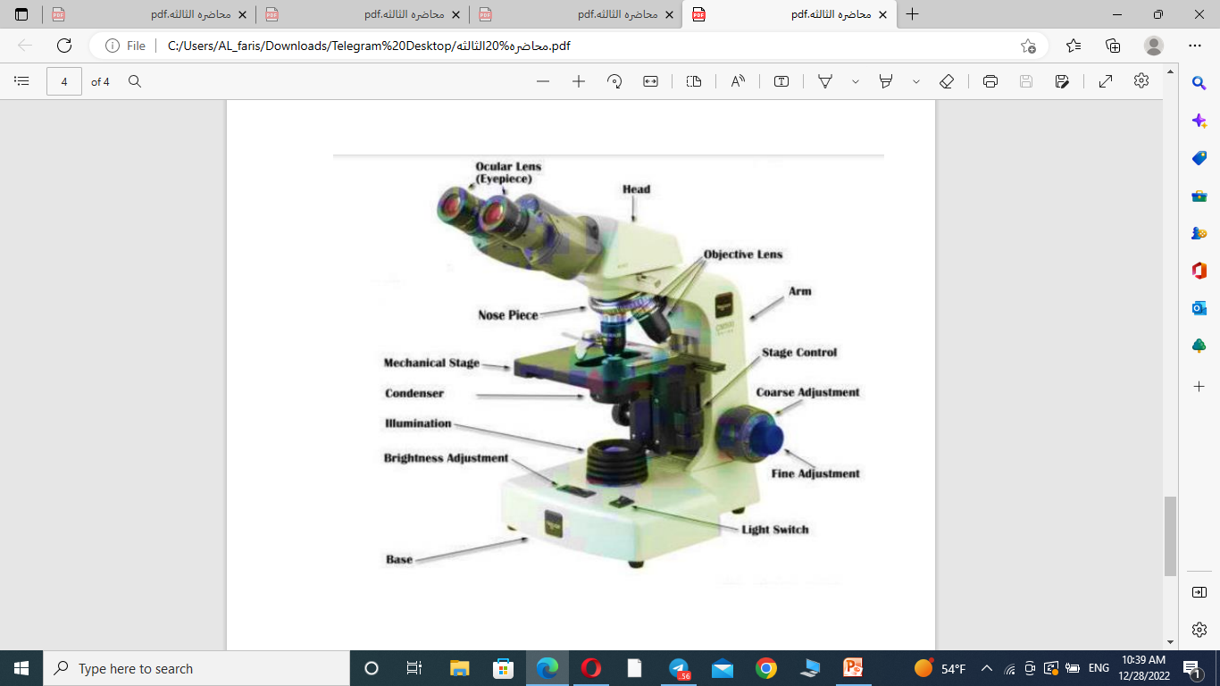

Slide 6
