Slide 1


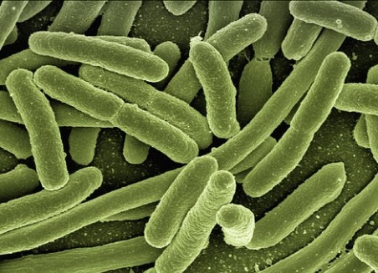
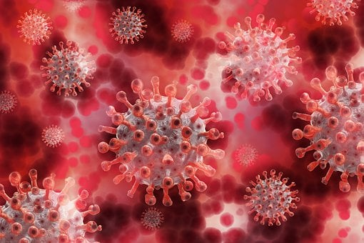
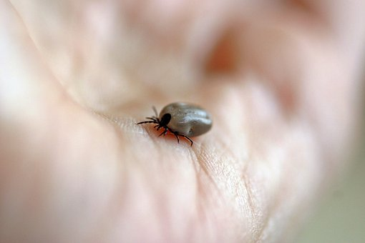
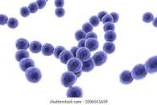
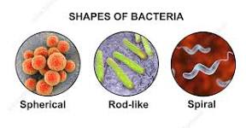
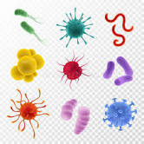
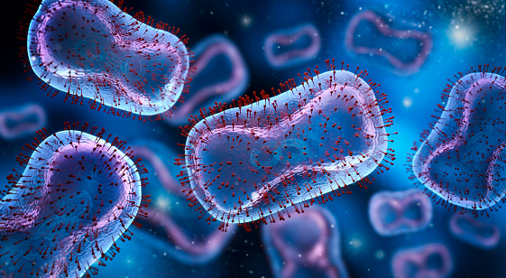
Department of Anesthesia Techniques
Prof . Dr. Younis A. Alkhafaji younis.abdulridha@uomus.edu.iq
Practical Biology -2
Biological Agents
Biological agents include bacteria, viruses, fungi, other microorganisms and their associated toxins. They have the ability to adversely affect human health in a variety of ways, ranging from relatively mild, allergic reactions to serious medical conditions—even death

Slide 2
The Main Routes of Infection can Enter the Body are:
Body fluids – A body fluid e.g. blood, urine, pus, saliva e.g. syphilis, HIV etc.
Through saliva_(e.g. glandular fever).
Through the air – e.g. common cold, respiratory viruses.
Through touch – Those caught by directly touching the skin/skin to skin contact such as chickenpox.
Through ingestion – contaminated food causes food poisoning e.g. cholera
Through bites from other creatures – e.g. infections from dog and cat bites or by blood sucking parasites e.g. malaria.

Slide 3
control measure in biology
Control measures are systems and actions used to reduce the risks of exposure to biological agents and hazards.
إجراءات التحكم في علم الأحياء تدابير التحكم هي الأنظمة والإجراءات المستخدمة لتقليل مخاطر
التعرض للعوامل والمخاطر البيولوجية.
What are Control Measures? ما هي إجراءات التحكم؟
Eliminate the hazard. تخلص من الخطر.
Substitute the hazard with a lesser risk. استبدل الخطر بمخاطر أقل.
Isolate the hazard. اعزل الخطر.
Use engineering controls. استخدم الضوابط الهندسية.
Use administrative controls. استخدم الضوابط الإدارية.
Use personal protective equipment. استخدم معدات الحماية الشخصية.

Slide 4
Hierarchy of Control Measures
1-Eliminate
Least
Preferred
2- Substitute
Most
Preferred
3- Isolate
4-Engineering Control
5- Administrative Control
6- Personal Protective Equipment's

Slide 5
Hazard group classification system
The aim of this guide is to help you understand the different categories of hazards, so you can confidently identify them in your workplace.
Biological Hazards. For example, mould, blood and other bodily fluids, harmful plants, sewage, dust and vermin.
Chemical Hazards such as skin irritation, respiratory system irritation, blindness, corrosion and explosions.
Physical Hazards. including heights, noise, radiation and pressure.
Safety Hazards. For example, exposed wires or a damaged carpet might result in a tripping hazard. These are sometimes included under the category of physical hazards.
Ergonomic Hazards. For example, a poor workstation setup in an office, poor posture and manual handling. المخاطر المريحة. على سبيل المثال ، إعداد ضعيف لمحطة العمل في المكتب وضعف الموقف والتعامل اليدوي.
Psychosocial Hazards. Psychosocial hazards include sexual harassment, victimisation, stress and workplace violence.

Slide 6
Biological safety cabinets (BSCs)
Biosafety Cabinets (BSCs) are enclosed workspaces with a ventilated hood that is designed to contain pathogenic microorganisms during microbiological processes.
Biosafety cabinets are classified into three classes:
1-Class I and II Biosafety cabinets are used for Biosafety levels I and II but, when used correctly in conjunction with useful microbiological techniques
2-Class III BSCs are most suitable for work with hazardous agents that require Biosafety Level 3 or 4.

Slide 7
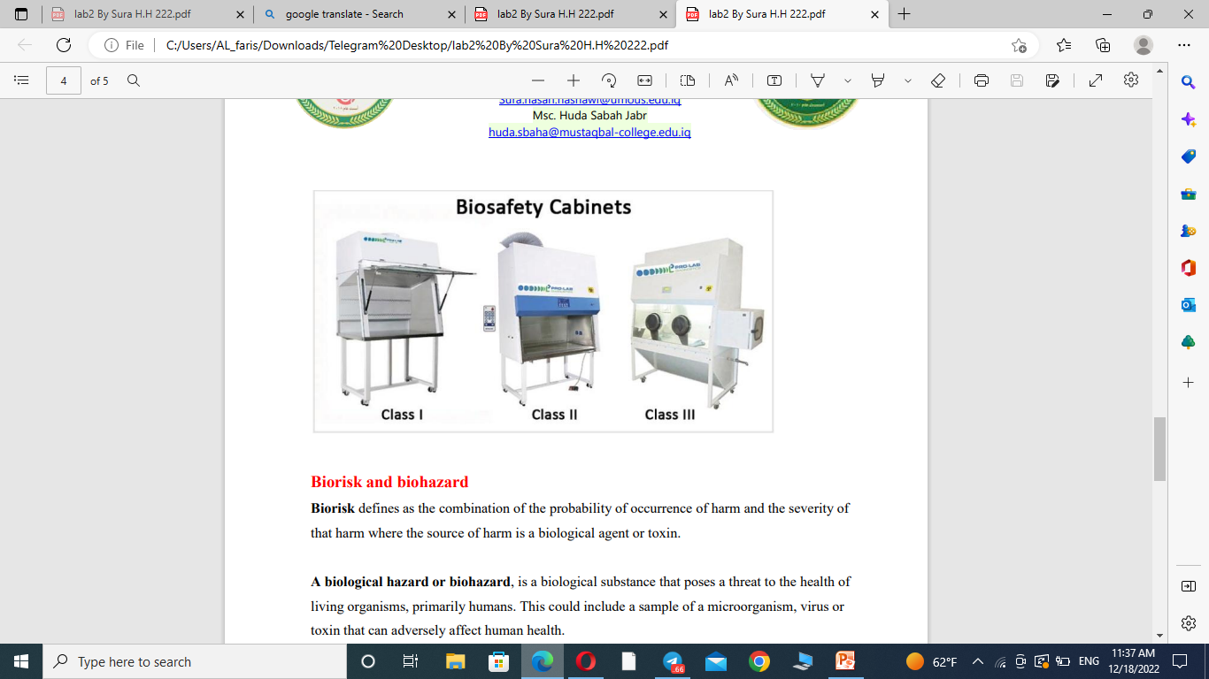

Slide 8



Biorisk and biohazard
Biorisk defines as the combination of the probability occurrence of harm and the severity of that harm where the source of harm is a biological agent or toxin. كمزيج من احتمالية حدوث الضرر وخطورة ذلك الضرر حيث يكون مصدر الضرر عاملًا بيولوجيًا أو سمًا
A biological hazard or biohazard, is a biological substance that poses a threat to the health of living organisms, primarily humans. This could include a sample of a microorganism, virus or
toxin that can adversely affect human health. الخطر البيولوجي هو مادة بيولوجية تشكل تهديدًا لصحة الكائنات الحية ، وبشكل أساسي البشر. يمكن أن يشمل ذلك
عينة من الكائنات الحية الدقيقة أو الفيروسات أو
السم الذي يمكن أن يؤثر سلبًا على صحة الإنسان.

Slide 9
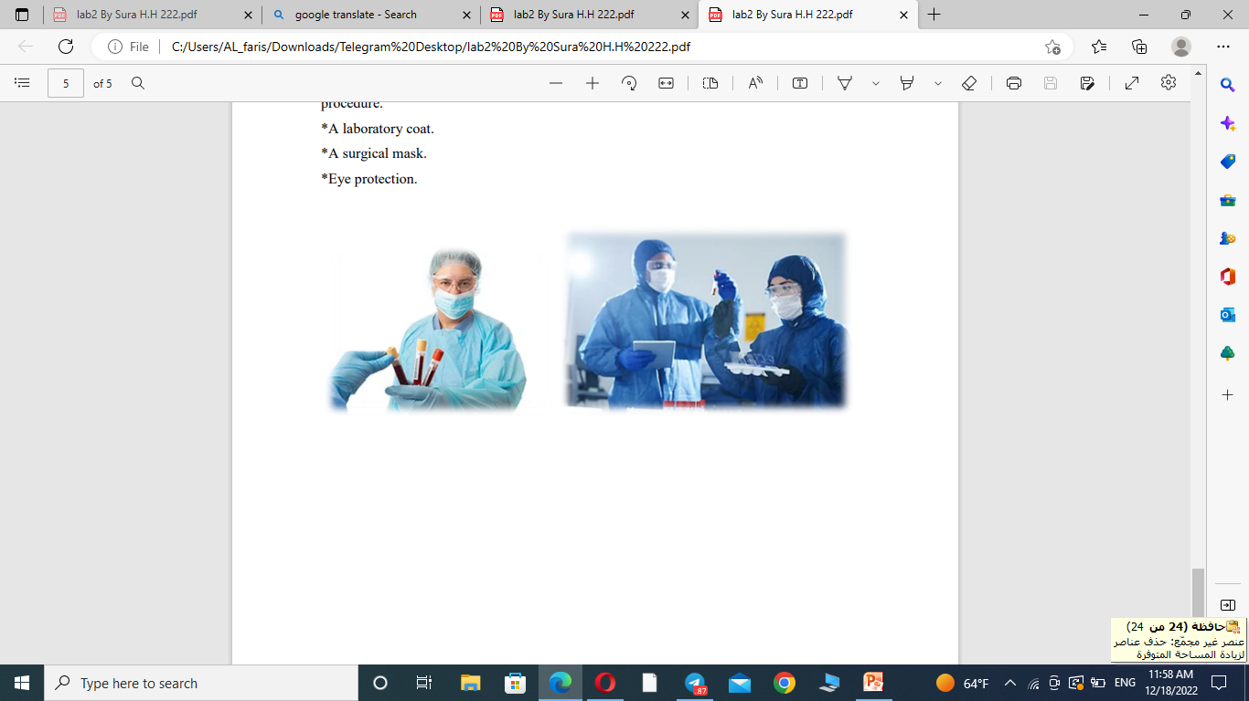
Assessing risk for work with human blood and tissues hazards تقييم مخاطر العمل مع الدم البشري ومخاطر الأنسجة
A risk assessment focuses on hazard identification at each step or task level, and can provide essential information for enhancing safety practices.
For example People working with blood samples must:
*Wear two pairs of disposable gloves, with the outside disposed of and replaced after each procedure.
*A laboratory coat.
*A surgical mask.
*Eye protection

Slide 10

T
H
A
N
K
S

