Slide 1
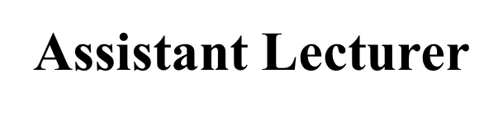
Neck & Cervical Assessment
Alaa Hamza
Lecture -6-

Slide 2
Inspect neck for the following:
Appearance: Normal :Symmetrical, centered head position
Movement: Smooth, controlled movements; range of motion (ROM) from:
Flexion = 45 degree
Extension = 55 degree
Lateral abduction = 40 degree
Rotation = 70 degree

Slide 3
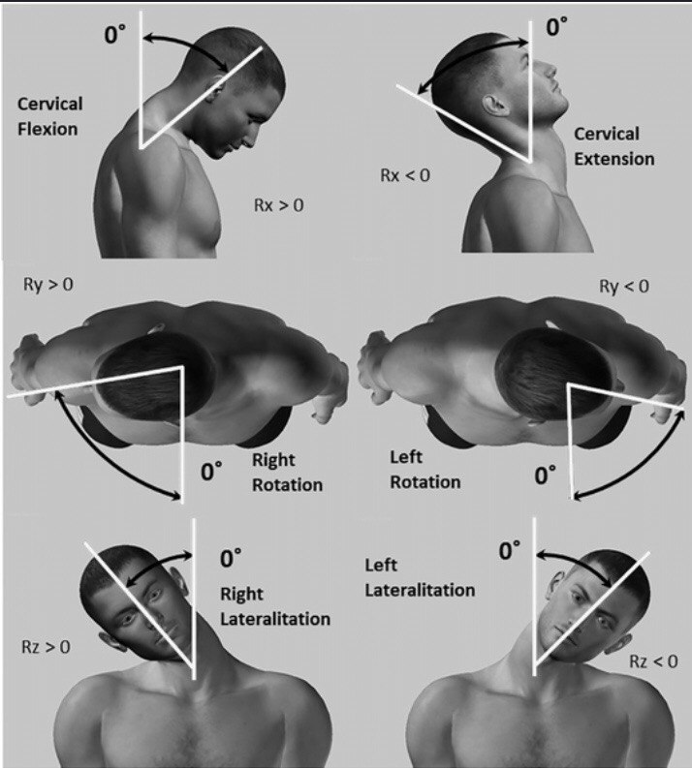

Slide 4
Abnormal : Asymmetrical , mass benign or malignant ,client may complains pain with flexion or rotation ,pain associated muscle spasm cause by meningitis , generalized discomfort may related to trauma, inflammation of muscle or vertebral disease

Slide 5
Palpation
Palpate trachea for position
(tracheal rings, cricoid & thyroid cartilage).
Midline position; symmetrical
Palpate thyroid for the following:
Position
Characteristics, landmarks
Midline ,Smooth, firm, no tender
Ask the client to drink sips of water normally thyroid move upward . The movement not visible. in males the thyroid cartilage large or Adam’s apple is more prominent than in females

Slide 6
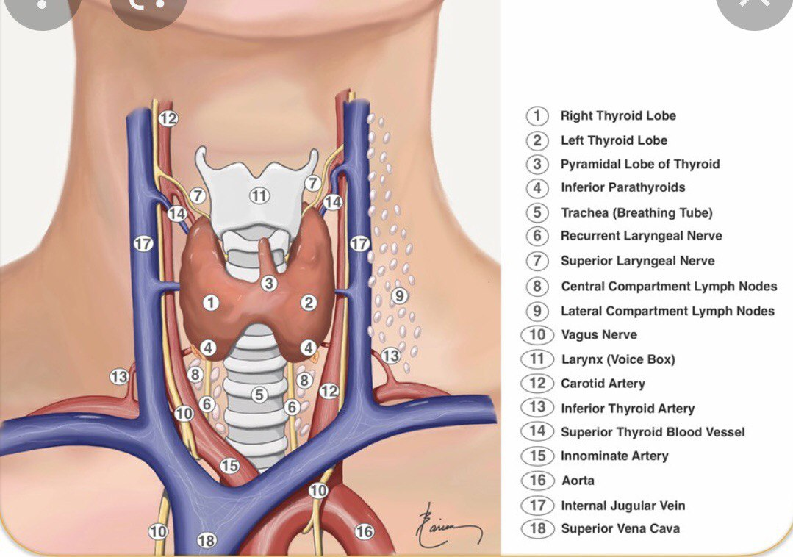

Slide 7
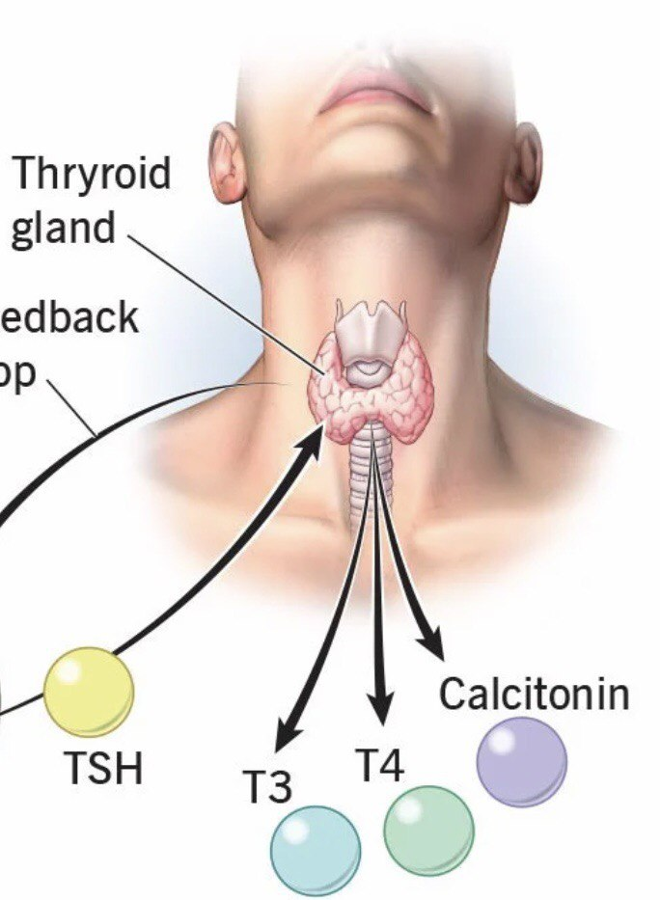

Slide 8
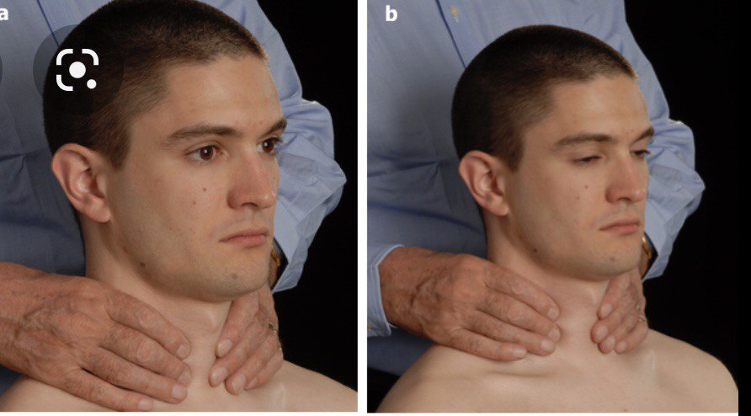
Palpating Thyroid Gland:

Slide 9
Palpate cervical lymph nodes for the following:
Size & shape:
Delineation:
:Mobility
:Consistency
:Tenderness
Cervical lymph nodes are usually not palpable. If palpable, they
should be lcm or less & round.
Discrete
Mobile
Soft
No tender

Slide 10
Lymph Nodes
1- Preaurical
2- Postaurical
3- Occipital
4- Tonsillar
5- Submandibular
6- Submental
7-Anterior cervical chain (deep cervical)
8- Posterior cervical chain
9- Supraclavical

Slide 11
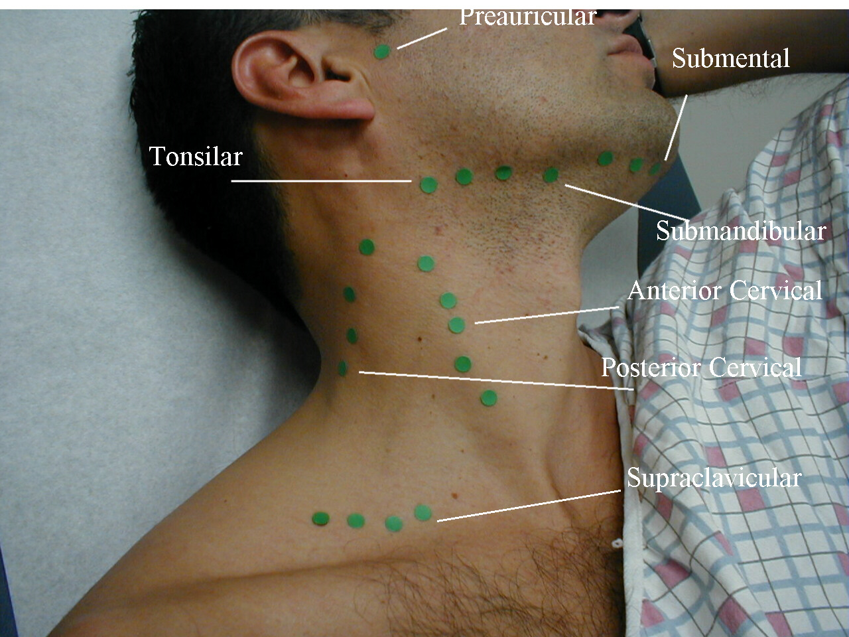

Slide 12
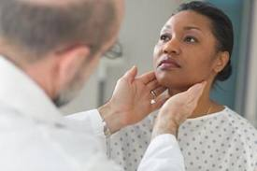
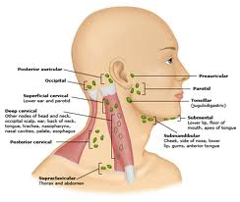

Slide 13

Auscultation
Use bell to assess bruit sound

